Slide 1
Chapter 9: Soil Sampling

Slide 2

Secondary/
Micronutrients
Nitrogen
P & K
Soil pH
Soil Test

Slide 3
What is soil sampling
Process of which a field unit is sampled in order to provide an estimation of current nutrient availability for a crop, as well as provide a basis for fertility management.
  Critical part of Soil Fertility
For a producer, this is where a nutrient management plan starts
Errors in soil sampling can cause errors for the rest of the season, and can impact multiple seasons after

Slide 4
Steps to soil sampling
Sampling Scheme
Sampling Tools
Sampling Technique

Slide 5

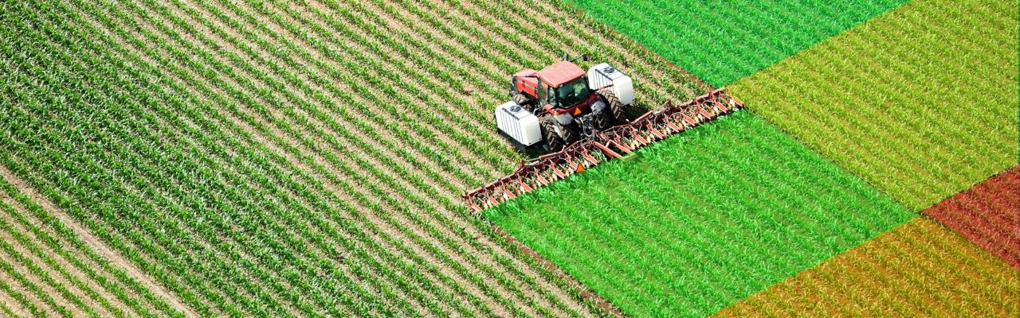
Sampling Scheme- Things to consider?
Budget/Value
Time
  Acres to cover
  Equipment limitations
Management
  Ability to vary inputs

Slide 6
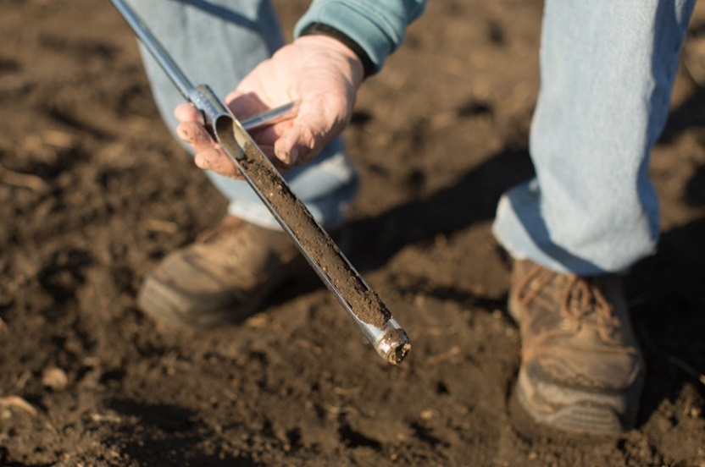
Sampling Scheme
Composite/Random Sampling
  Taking a sample consisting of subsamples from one field
Grid Sampling
  Splitting Field into grids, sampling each grid
Zone Sampling
  Splitting fields into zones

Slide 7
Composite/Random Sampling
Randomly and Independently sampling entire field, producing 1 sample for size of field

Slide 8
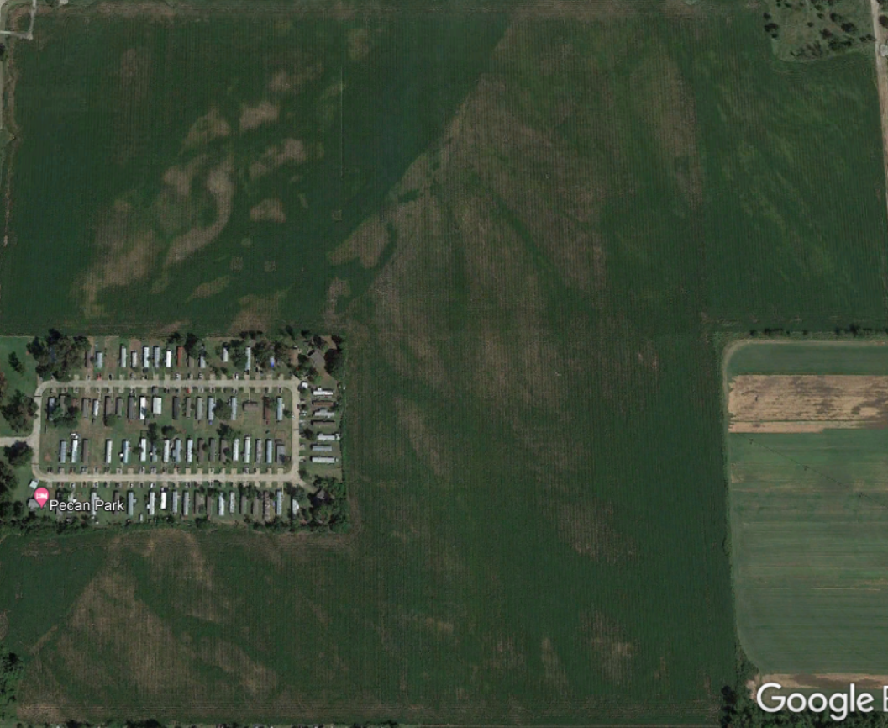
150 acres

Slide 9
150 acres
pH: 6.0
P: 12.0 lb/ac
K: 91 lb/ac
CEC: 7.7

Slide 10
Composite/Random Sampling
Randomly and Independently sampling entire field, producing 1 sample for size of field
Advantages
  Cost effective
  Time Efficient
  Can be used on all size fields
Disadvantages
  Single value for entire field
  Doesn’t give idea of variability

Slide 11
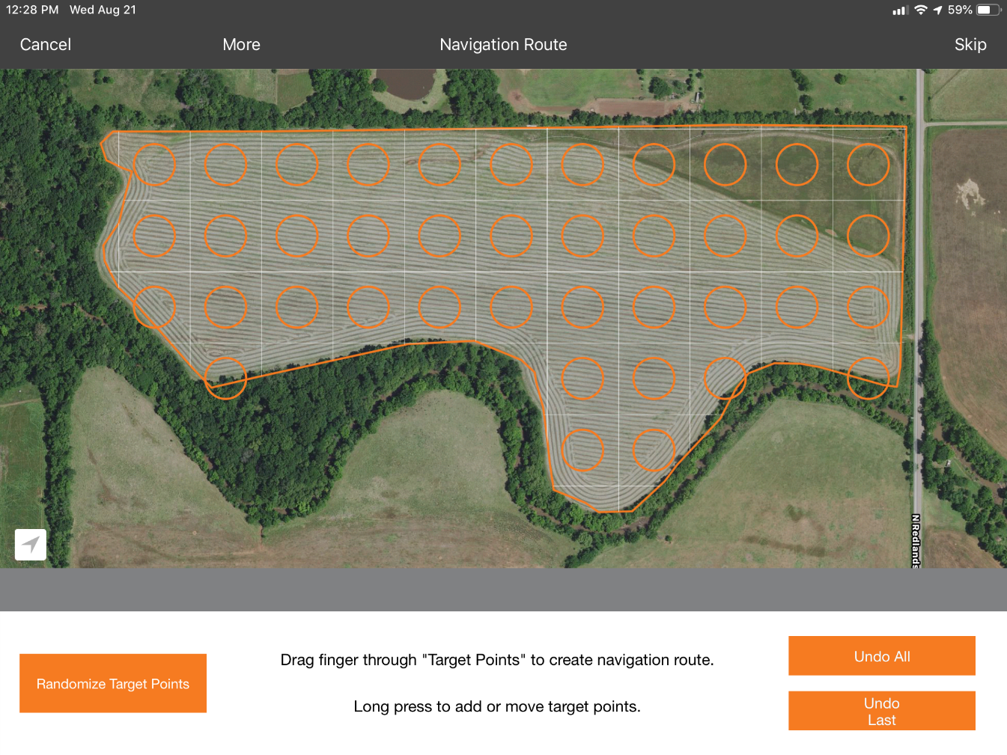
Grid sampling
Geo-referenced fixed points and each grid is sampled and treated independently
Grid size based on user-preference
  Field size
  Field Variability
  Access to variable rate equipment

Slide 12
1x1 (60-acre cell)

Slide 13
6x4 (2.5 acre/cell)

Slide 14
12x8 (0.625 acre/cell)

Slide 15
25x16 (0.15 acre/cell)

Slide 16
50x32 (0.0375 acre/cell)

Slide 17
100x64 (45 yd²/cell)

Slide 18
200x127 (11 yd²/cell)

Slide 19
472x300 (2 yd²/cell)

Slide 21
150 acres

Slide 22
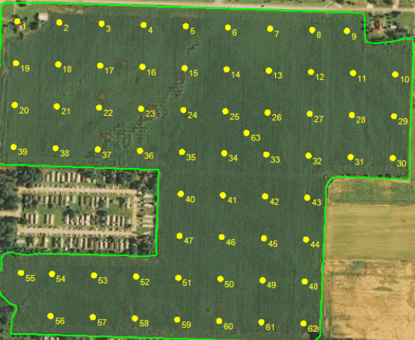
150 acres
2.5 acre grid

Slide 23
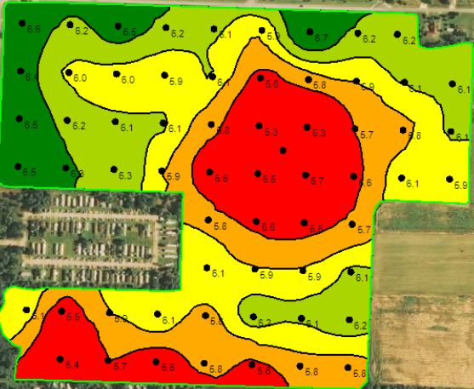
150 acres
pH

Slide 24
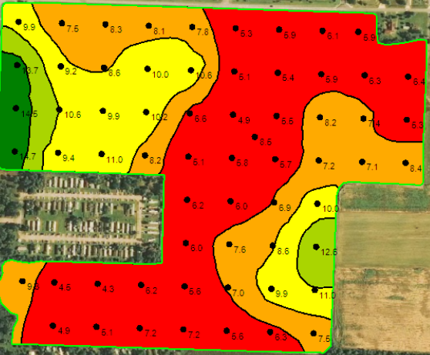
150 acres
CEC

Slide 25
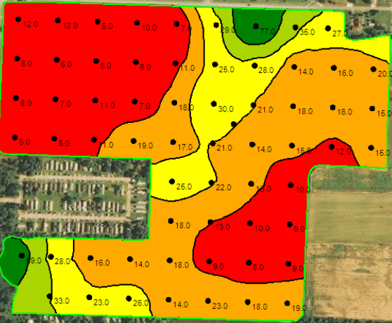
150 acres
Bray 1 P

Slide 26
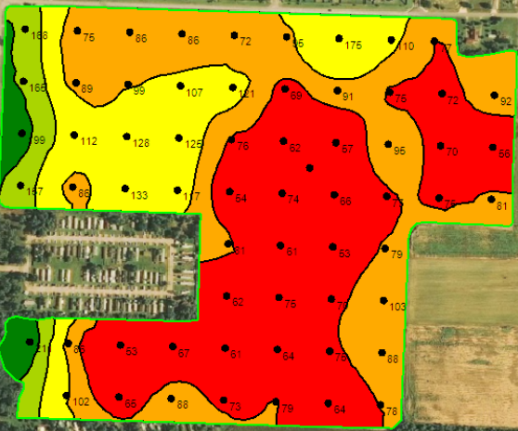
150 acres
K

Slide 27
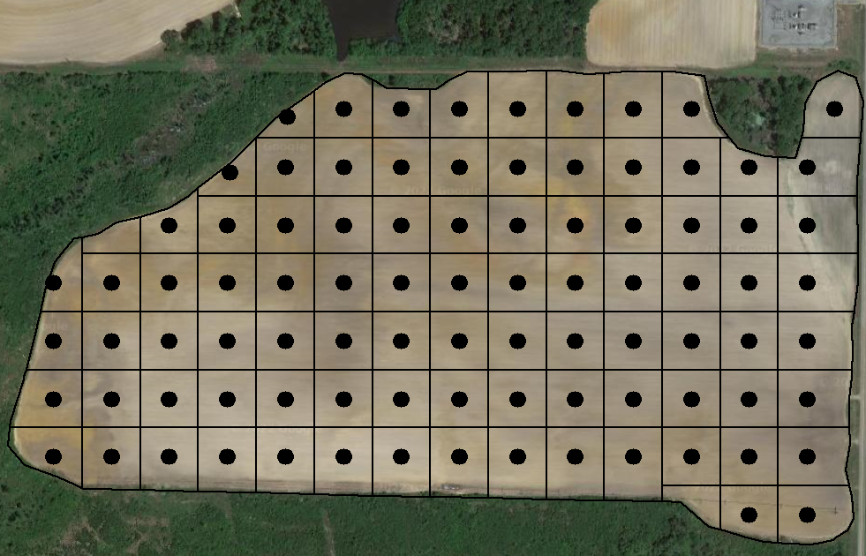
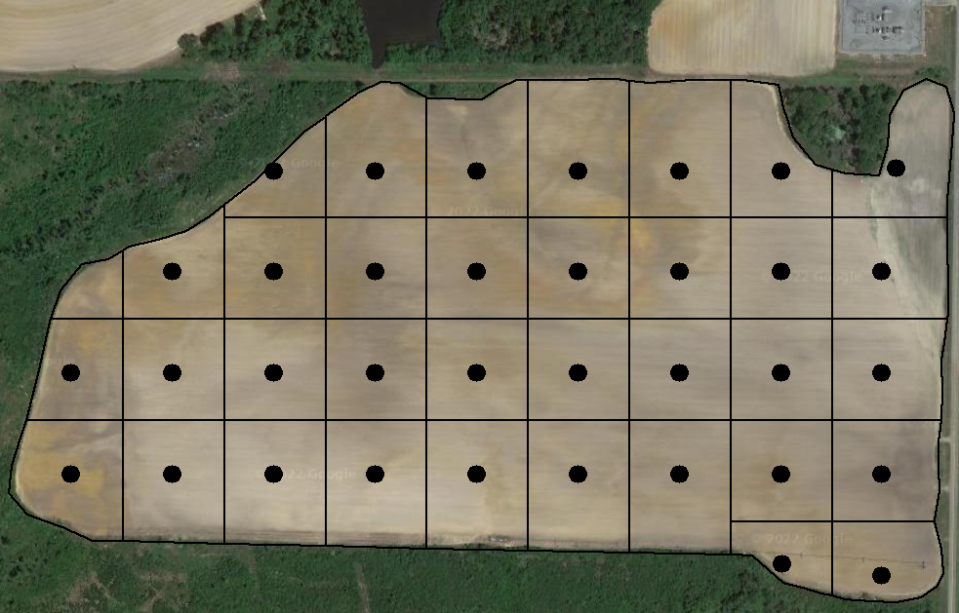
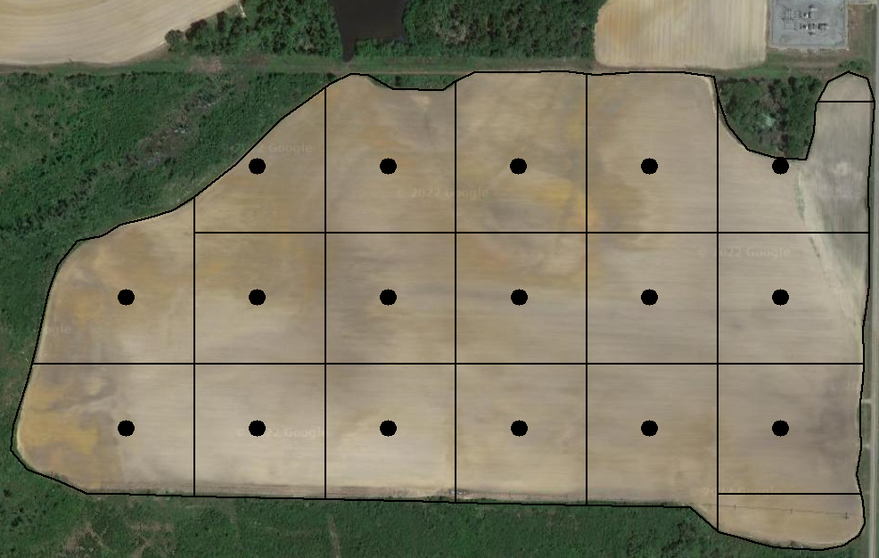



Is there an optimal grid size for precision soil sampling?
Grid Size (ac) | #samples | Soil Sampling/ Labor Costs ($) | Sample Analysis Costs ($) | Total Cost ($)
1.0 | 92 | 460 | 552 | 1012
2.5 | 35 | 414 | 210 | 624
5.0 | 17 | 368 | 102 | 470
7.5 | 13 | 368 | 78 | 446
10.0 | 8 | 368 | 48 | 416
1.0 ac
2.5 ac
5.0 ac
7.5 ac
10.0 ac

Slide 28
Investigating accuracy and economics of different grid sizes
(2022 – 9 fields across Georgia)
1.0 ac
2.5 ac
5.0 ac
7.5 ac
10.0 ac

Slide 29
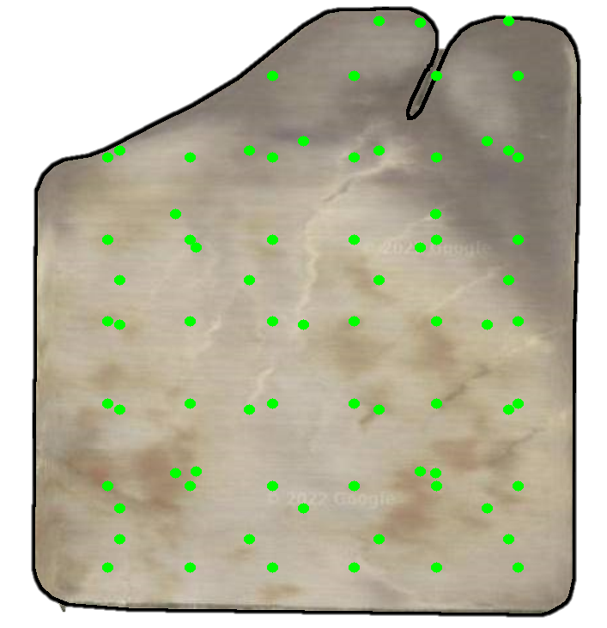
Actual Nutrient Variability
Soil sampling points from all grid sizes (1.0, 2.5, 5.0, 7.5 and 10.0 ac) were combined plus additional soil samples taken as required.
This high-density sampling map
(2-4 samples/ac) was assumed to represent actual nutrient variability.

Slide 30

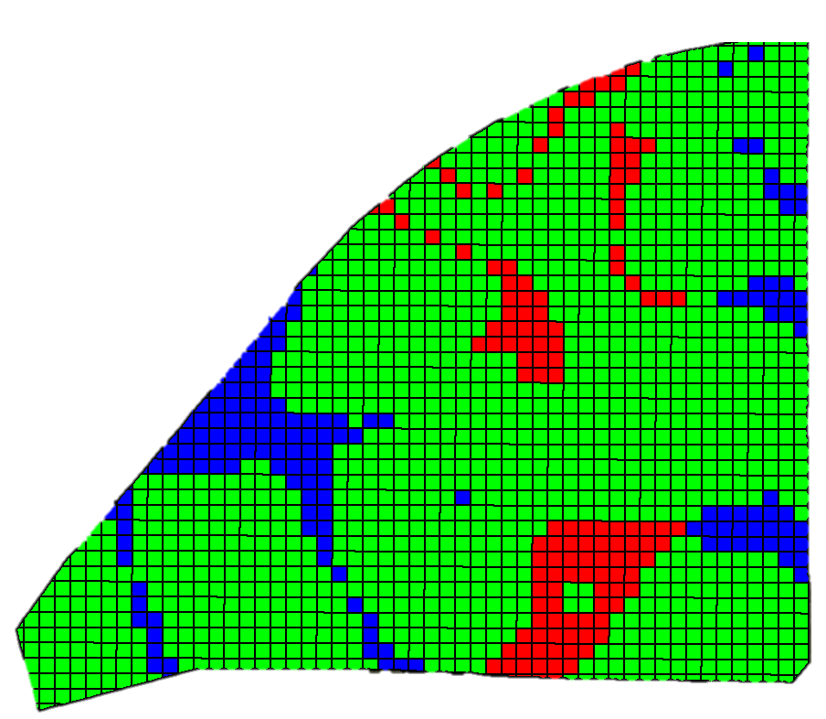
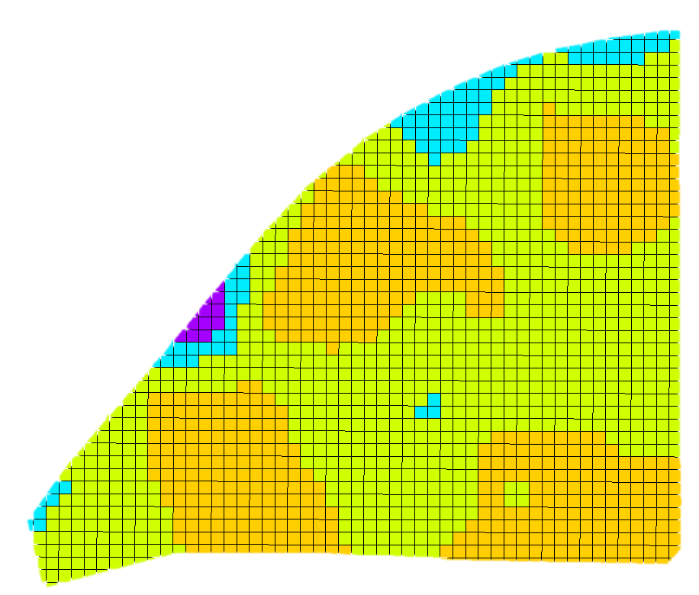
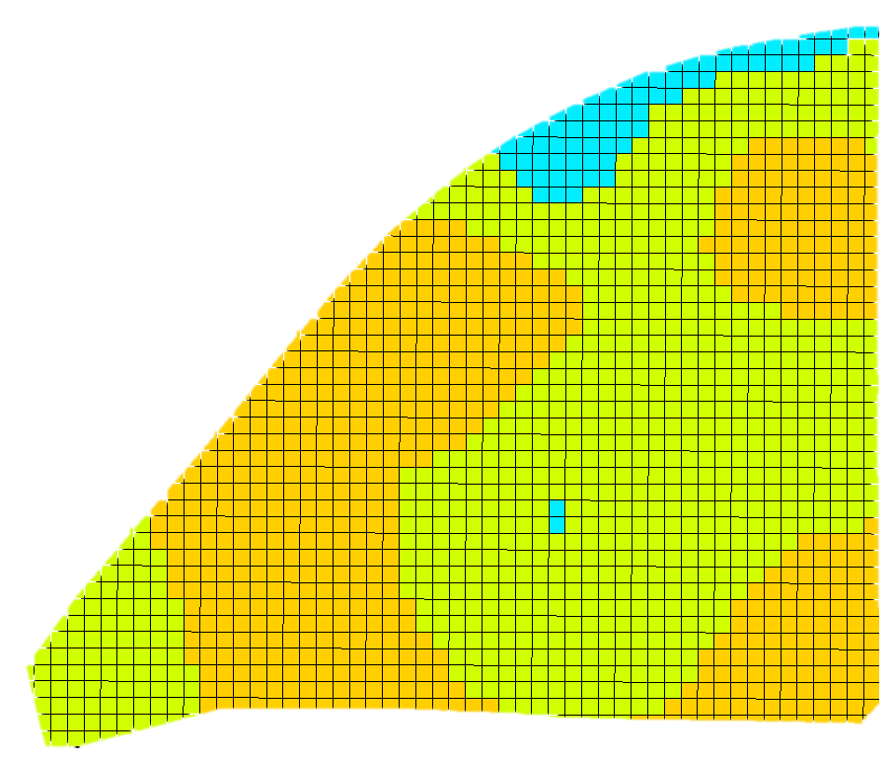
Spatial Application Accuracy
On-Target
K Prescription Map
(All points representing actual nutrient variability)
K Prescription Map (2.5 ac grid sampling)
Map showing on-target, under- and over-application areas
Under Applied
Over Applied

Slide 31
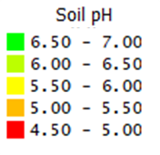
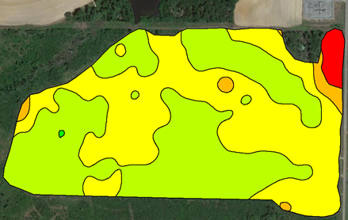
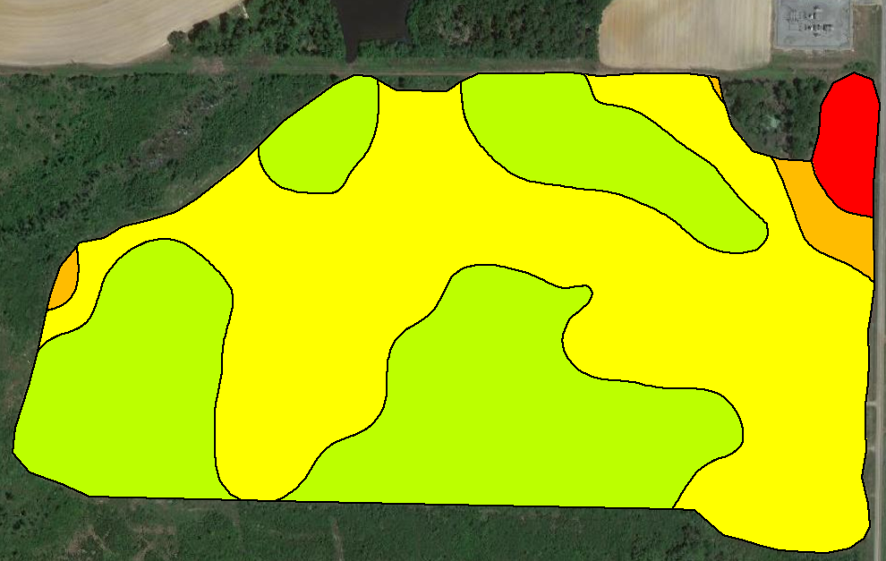
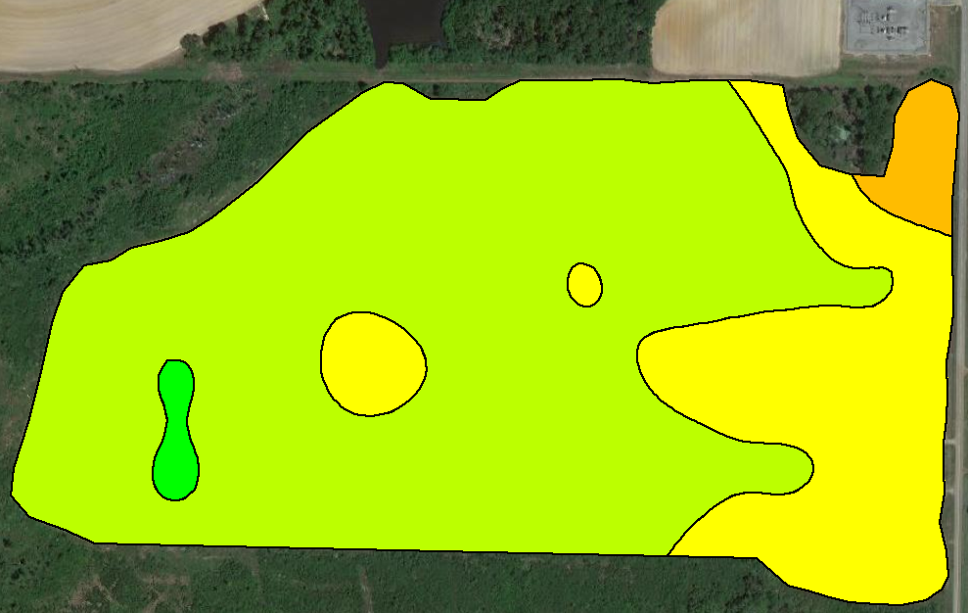
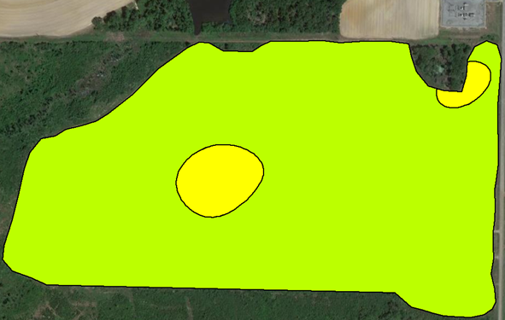
1 ac
(92 samples)
Actual Soil pH Variability
(163 Samples)
2.5 ac
(35 samples)
5 ac
(17 samples)

Slide 32
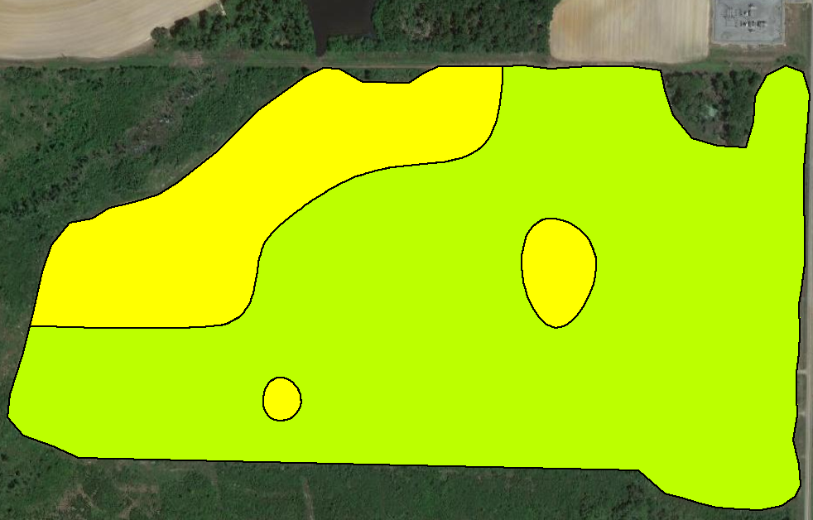
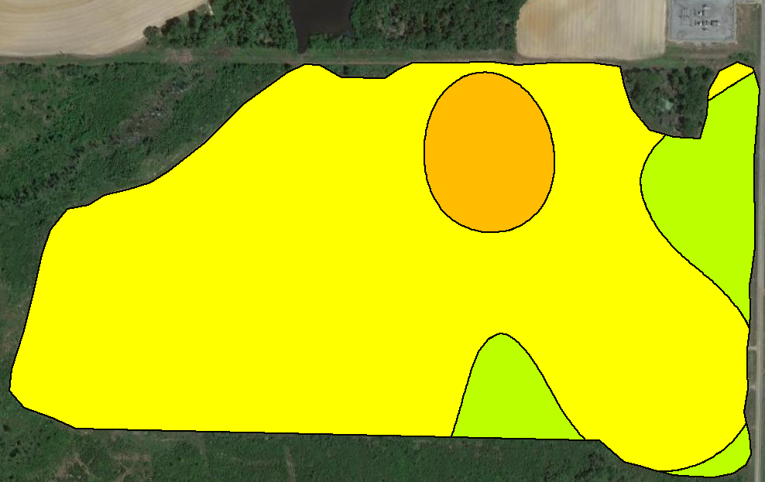
Actual Soil pH Variability
(163 Samples)
7.5 ac
(13 samples)
10 ac
(8 samples)

Slide 33
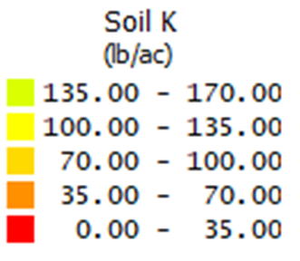
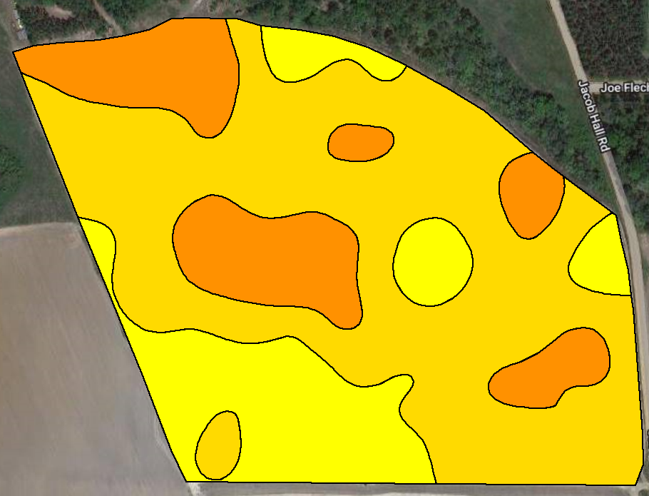
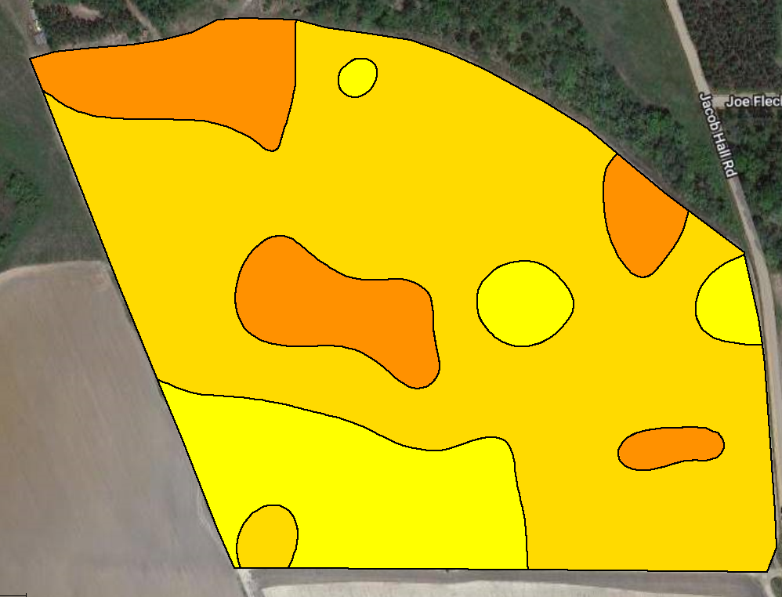
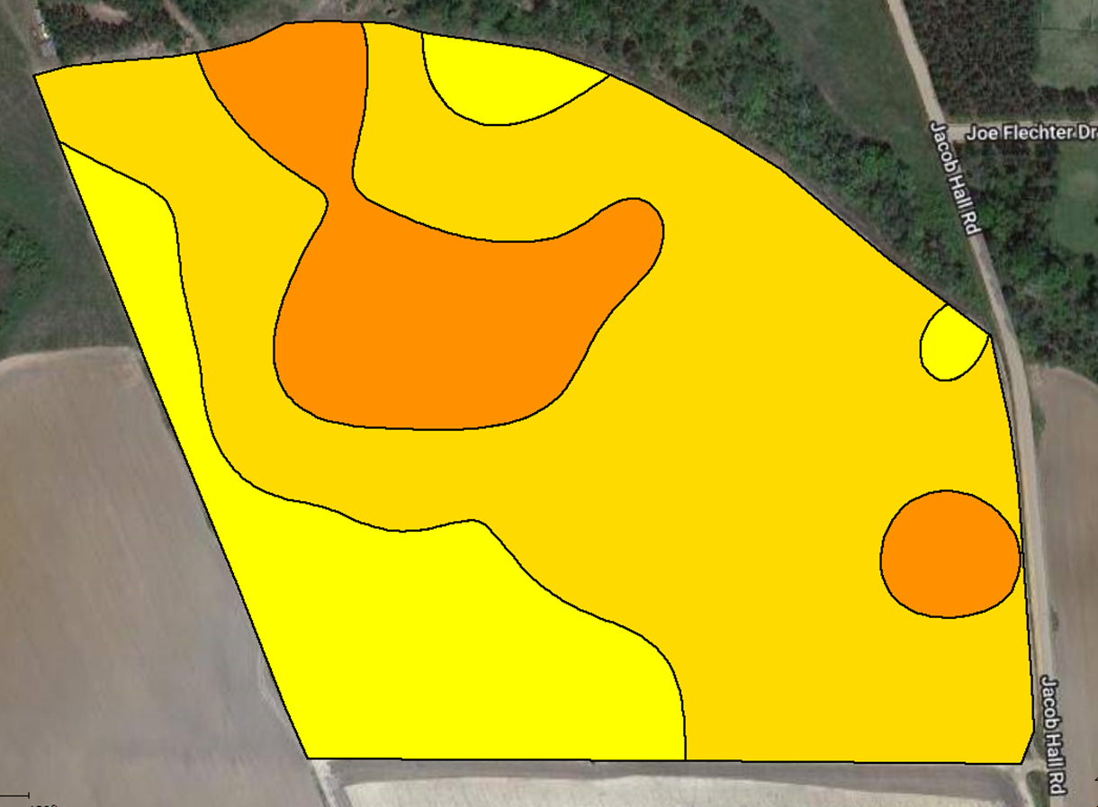
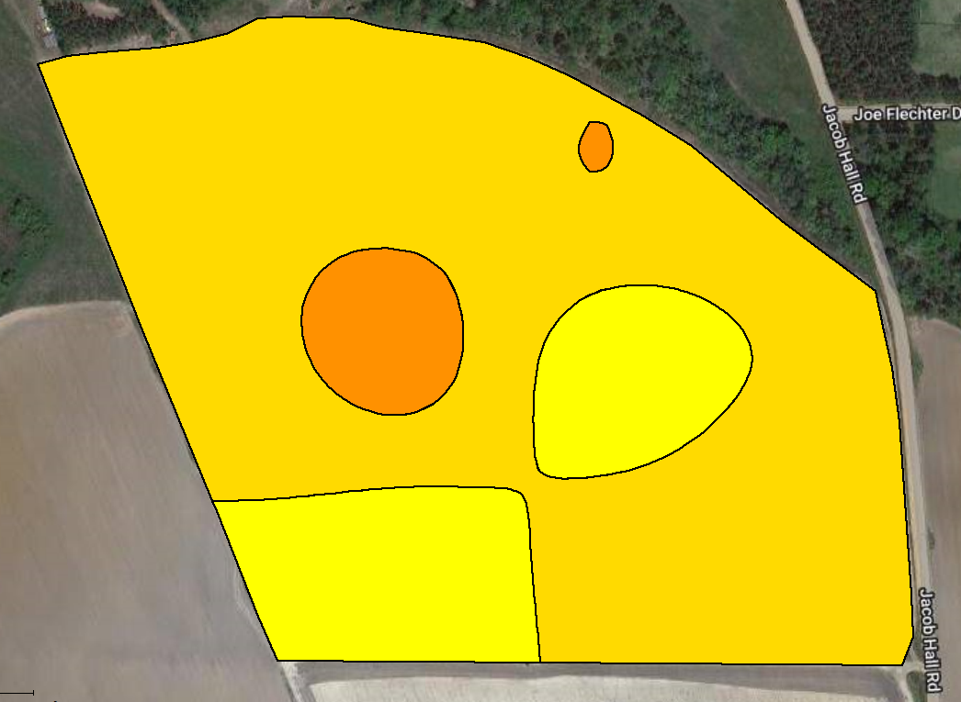
1 ac
(53 samples)
Actual Soil K Variability
(100 samples)
5 ac
(10 samples)
2.5 ac
(23 samples)

Slide 34
Economic Analysis
Consultant/Soil Lab Fees:
Soil sampling/Labor = $4-6/ac
Sample analysis = $6/sample
Variable-Rate Prescription Maps:
Cotton Lint Yield Goal = 1200 lb/ac
2023 UGA Cotton Enterprise Budget:
Lime = $50/ton
Phosphorus = $0.67/lb
Potassium = $0.68/lb
Total Cost ($/ac)
Grid Size | Samples | Sampling Cost | Analysis Cost | Fertilizer Cost | Total Cost
(ha) | (#) | ($/ac) | ($/ac) | ($/ac) | ($/ac)
1.0 | 90 | 6 | 6 | 33 | 45
2.5 | 35 | 5 | 2 | 29 | 36
5.0 | 17 | 4 | 1 | 26 | 31
7.5 | 13 | 4 | 1 | 28 | 33
10.0 | 8 | 4 | 1 | 37 | 41
=
Soil Sampling Cost ($/ac)
+
Soil Analysis Cost ($/ac)
+
Fertilizer Cost ($/ac)

Slide 35
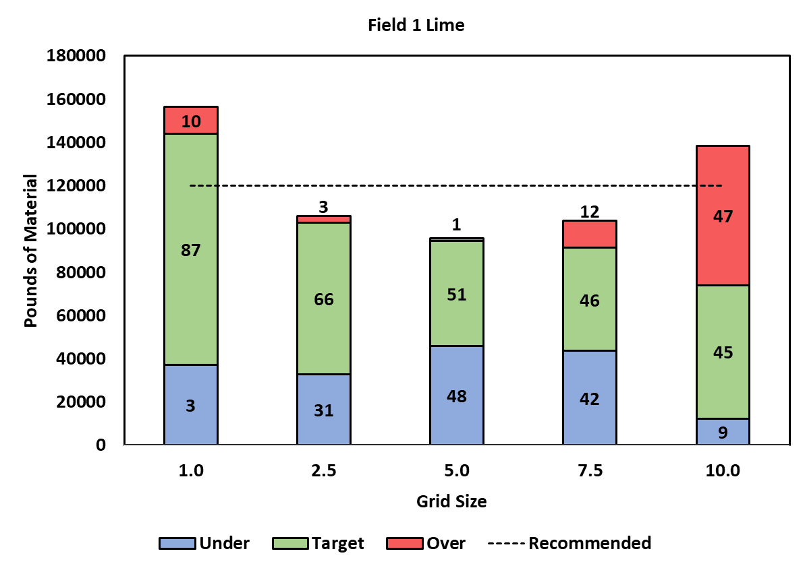
Application Accuracy and Cost
Field 1 - Lime
Grid Size | Analysis Cost | Lime Cost | Total Cost
(ac) | ($/ac) | ($/ac) | ($/ac)
1.0 | 10 | 33 | 43
2.5 | 6 | 29 | 35
5.0 | 5 | 26 | 31
7.5 | 5 | 28 | 33
10.0 | 5 | 37 | 41
*Sampling cost ($4-6/ac) was constant among all grid sizes.

Slide 36
Grid Size – Effectiveness vs Cost
Lime, Potassium and Phosphorus
Application Accuracy (%)
Grid Size | F1 | F2 | F3 | F4 | F5 | F6 | F7 | F8 | F9
1.0 | 87 | 89 | 95 | 90 | 95 | 75 | 91 | 90 | 91
2.5 | 66 | 85 | 92 | 78 | 93 | 82 | 41 | 70 | 13
5.0 | 51 | 75 | 75 | 81 | 87 | 80 | 68 | 65 | 77
7.5 | 46 | 66 | 94 | 11 | 92 | 75 | 41 | 70 | 81
10.0 | 45 | 34 | 65 | 54 | 30 | 75 | 41 | 48 | 76
Application Costs ($/ac)
Grid Size | F1 | F2 | F3 | F4 | F5 | F6 | F7 | F8 | F9
1.0 | 43 | 20 | 34 | 33 | 34 | 43 | 40 | 38 | 56
2.5 | 35 | 14 | 28 | 27 | 30 | 41 | 31 | 33 | 64
5.0 | 31 | 15 | 23 | 26 | 32 | 41 | 35 | 36 | 55
7.5 | 33 | 20 | 30 | 5 | 30 | 42 | 30 | 31 | 51
10.0 | 41 | 17 | 22 | 18 | 39 | 42 | 30 | 22 | 55

Slide 37
Field 1
Lime
P
K
Grid Size | Accuracy (%) | Cost ($/ac)
1.0 | 89 | 20
2.5 | 85 | 14
5.0 | 75 | 15
7.5 | 66 | 20
10.0 | 34 | 17
Grid Size | Accuracy (%) | Cost ($/ac)
1.0 | 92 | 16
2.5 | 82 | 15
5.0 | 70 | 13
7.5 | 74 | 14
10.0 | 77 | 10
Grid Size | Accuracy (%) | Cost ($/ac)
1.0 | 88 | 89
2.5 | 72 | 85
5.0 | 66 | 82
7.5 | 49 | 86
10.0 | 44 | 86
How do we make a grid size decision here?

Slide 38
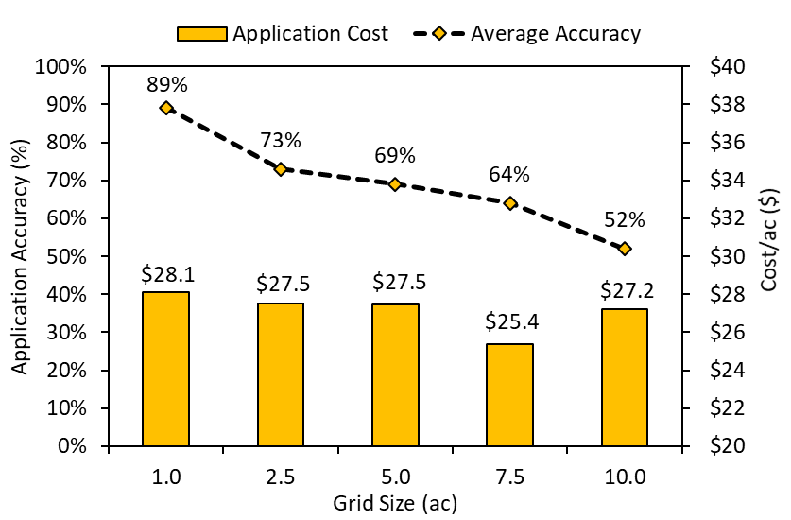
Lime

Slide 39
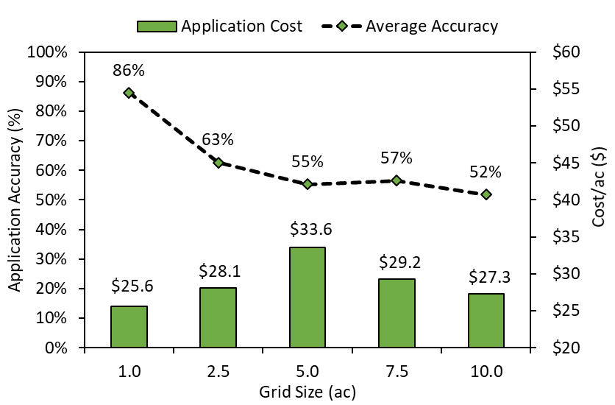
Phosphorus

Slide 40
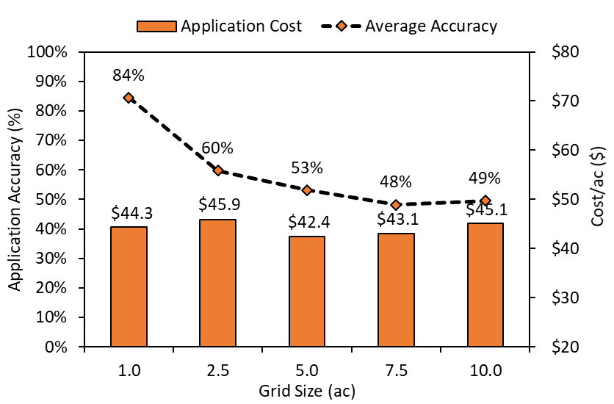
Potassium

Slide 41
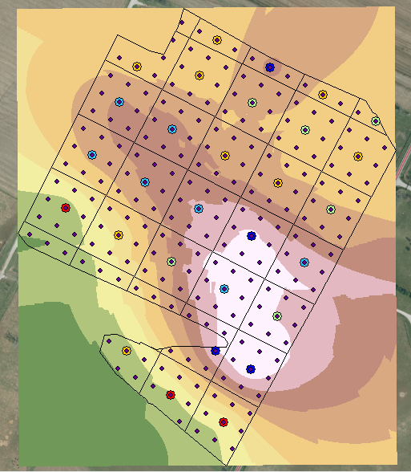

Accuracy of Grid sampling/Interpolation?
Actual: 157 lb K/ac
Predicted: 214.4 lb K/ac
Actual: 187 lb K/ac
Predicted: 233.6 lb K/ac
Actual: 267 lb K/ac
Predicted: 261.7 lb K/ac

Slide 42
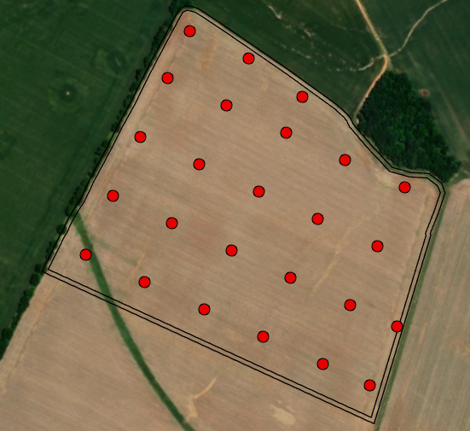
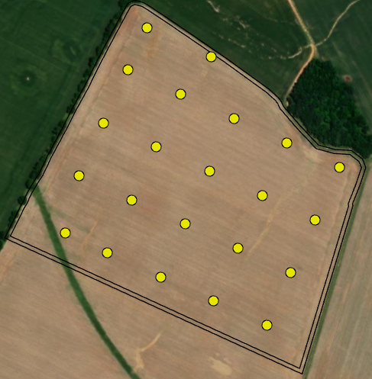
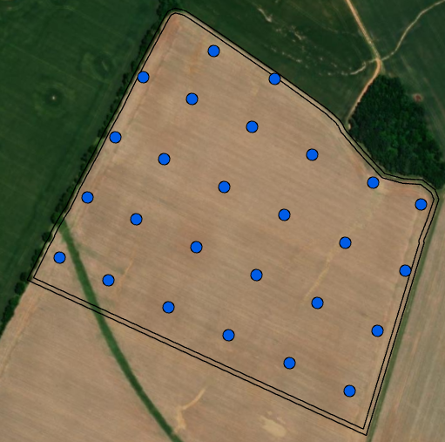
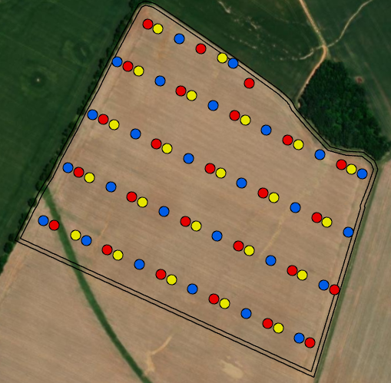
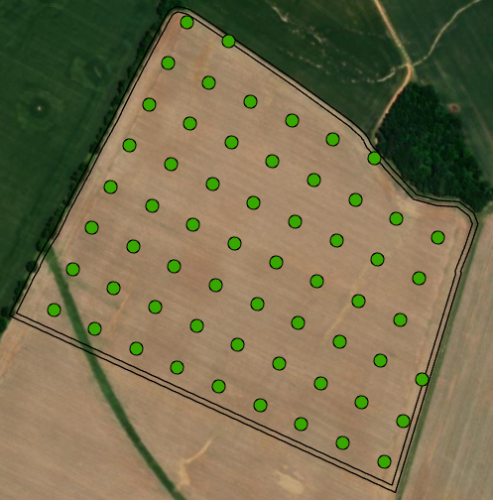
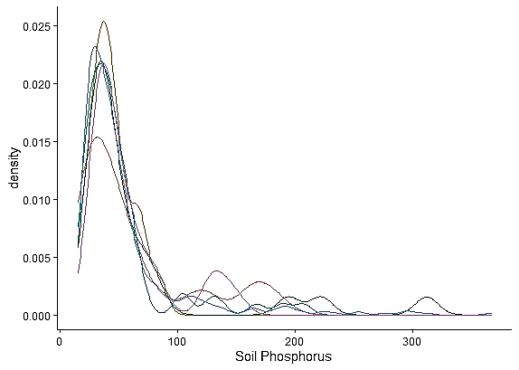
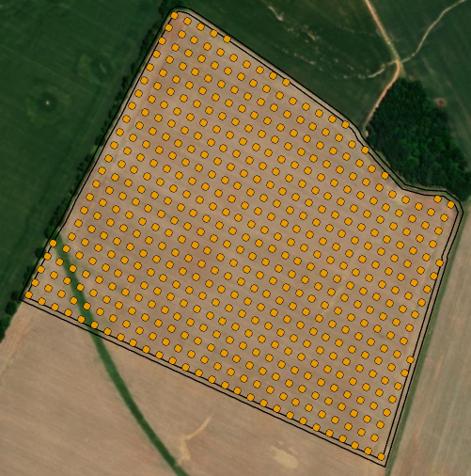
1 ha grid
1 ha grid
1 ha grid
n=25
n=22
n=26
4000 sq m grid
400 sq m grid
n=59
n=529

Slide 43
Grid Sampling Comparisons – Phosphorus
Grid Type | Mean, mg kg⁻¹ | Std dev, mg kg⁻¹ | Minimum, mg kg⁻¹ | Maximum, mg kg⁻¹ | CV, %
4000 m² | 26 | 20 | 9 | 103 | 76.9
1 ha(1) | 30 | 25 | 8 | 92 | 81.6
1 ha (2) | 22 | 9 | 9 | 42 | 39.5
1 ha (3) | 33 | 35 | 11 | 156 | 105.2
400 m² | 26 | 23 | 7 | 184 | 86.8

Slide 44


Grid sampling
Advantages
  Accuracy across grid
  Allows for variable rate inputs
  Can increase profits
Disadvantages
  Time
  Cost
    ~$8 sample, 2.5 acre grid, 150 acres, 63 samples
    $504
Bottom Line:
  Do what you can afford to do

Slide 45
Zone Sampling
Split field into zones that would impact soil characteristics
  Historical information
    Yield
    Soil Test
    Management
    Bad areas in the field
  Soil Type

Slide 46
2021

Slide 47
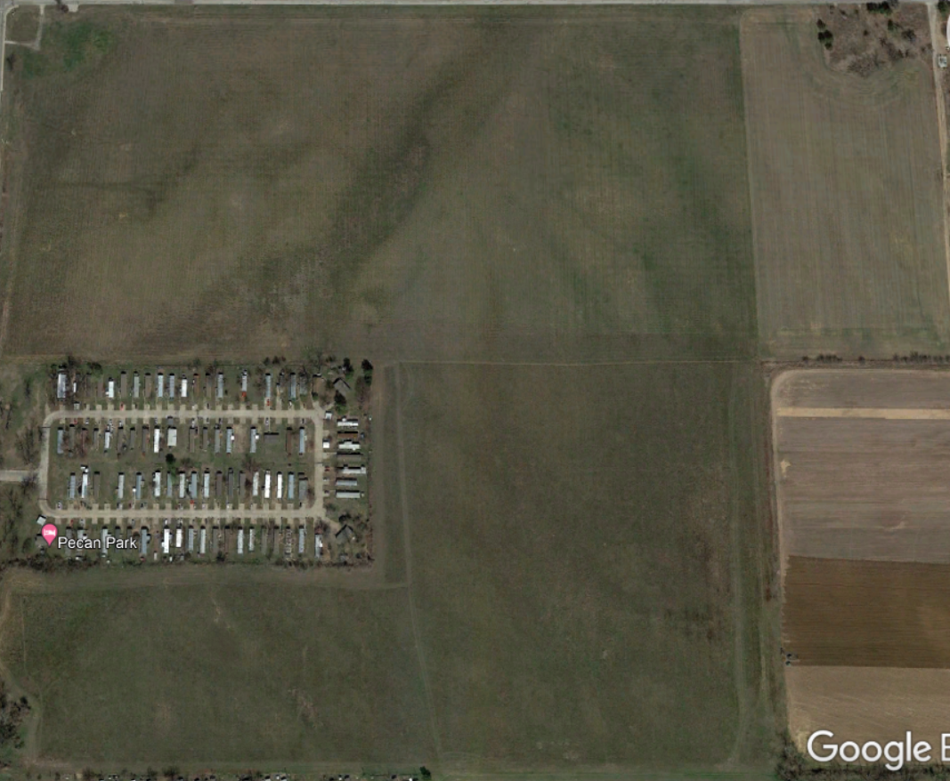
2019

Slide 48
Corn
Soy
2019
Cattle

Slide 49
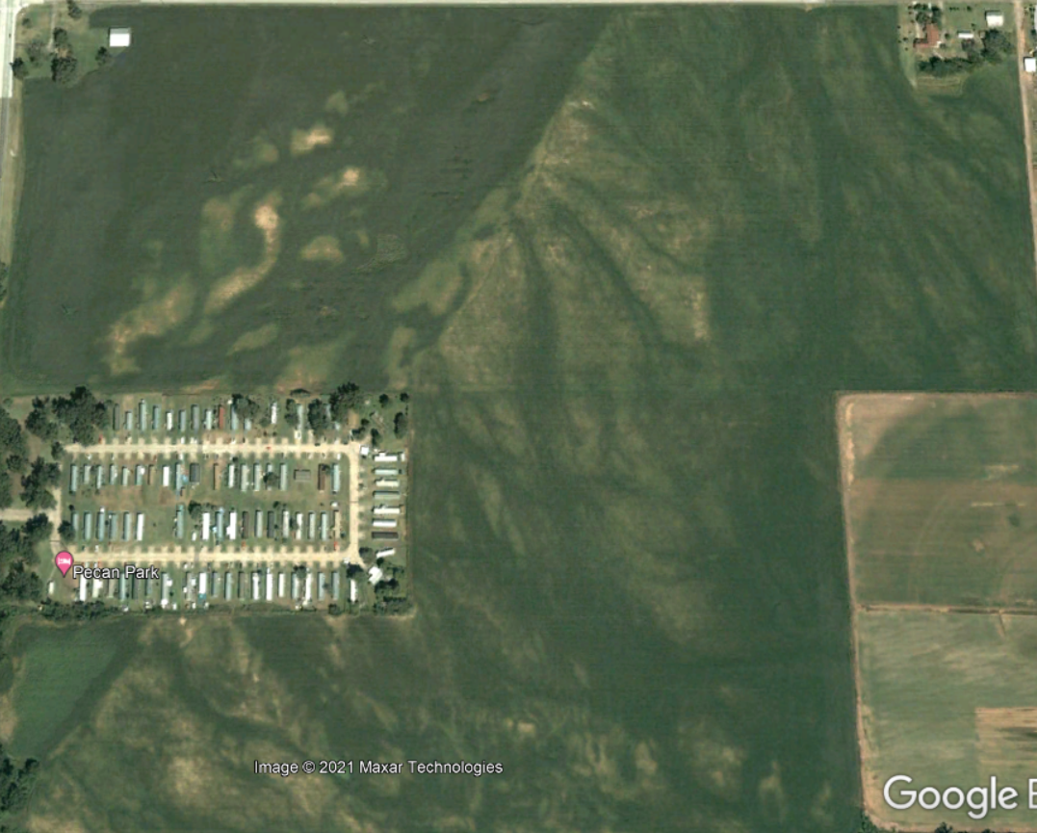
2012

Slide 50
2021

Slide 51
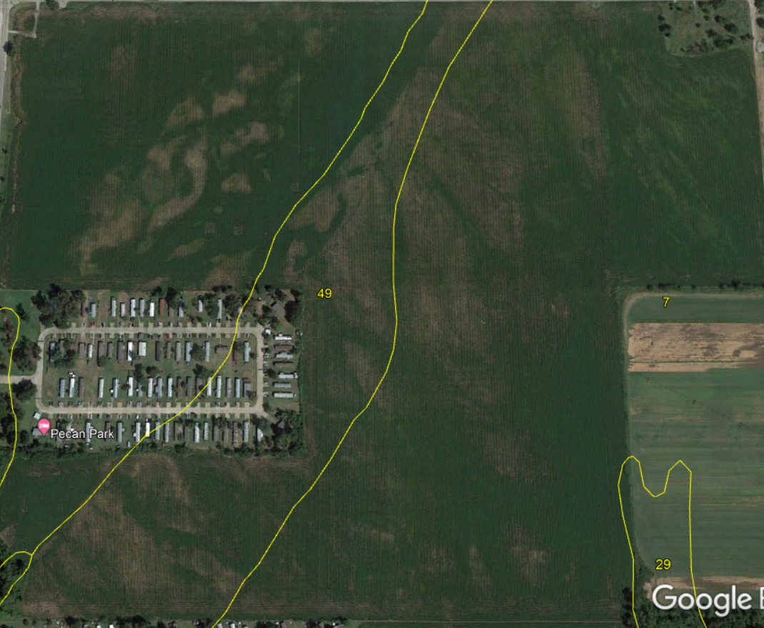
2021

Slide 52
Silt Loam
0-1% slope
Silt Loam
0-1% slope
2021
Sandy Loam
1-3% slope

Slide 53
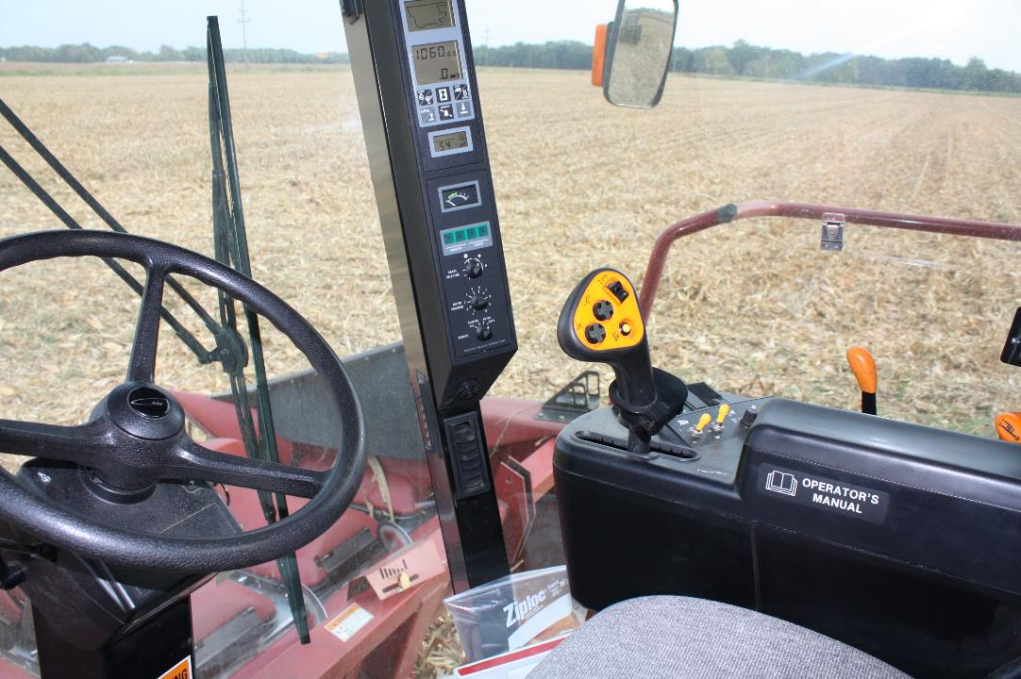
Zone Sampling
Split field into zones that would impact soil characteristics
  Historical information
    Yield
    Soil Test
    Management
    Bad areas in the field
  Soil Type
Allows more control for producer
Can be used in a hybrid soil sampling model

Slide 54
150 acres
Zone 1
Bray 1 P
Zone 2

Slide 55


Zone Sampling
Advantages
  Could be time/cost efficient
  Producer Input
Disadvantages
  Takes more planning
  Requires more information of field history

Slide 56
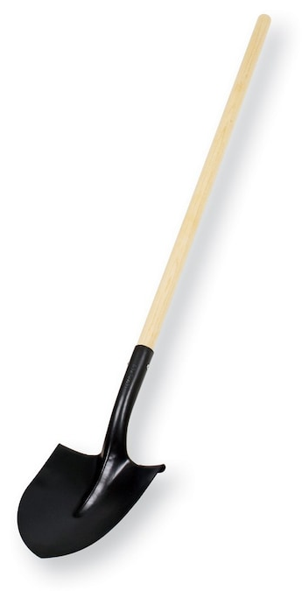
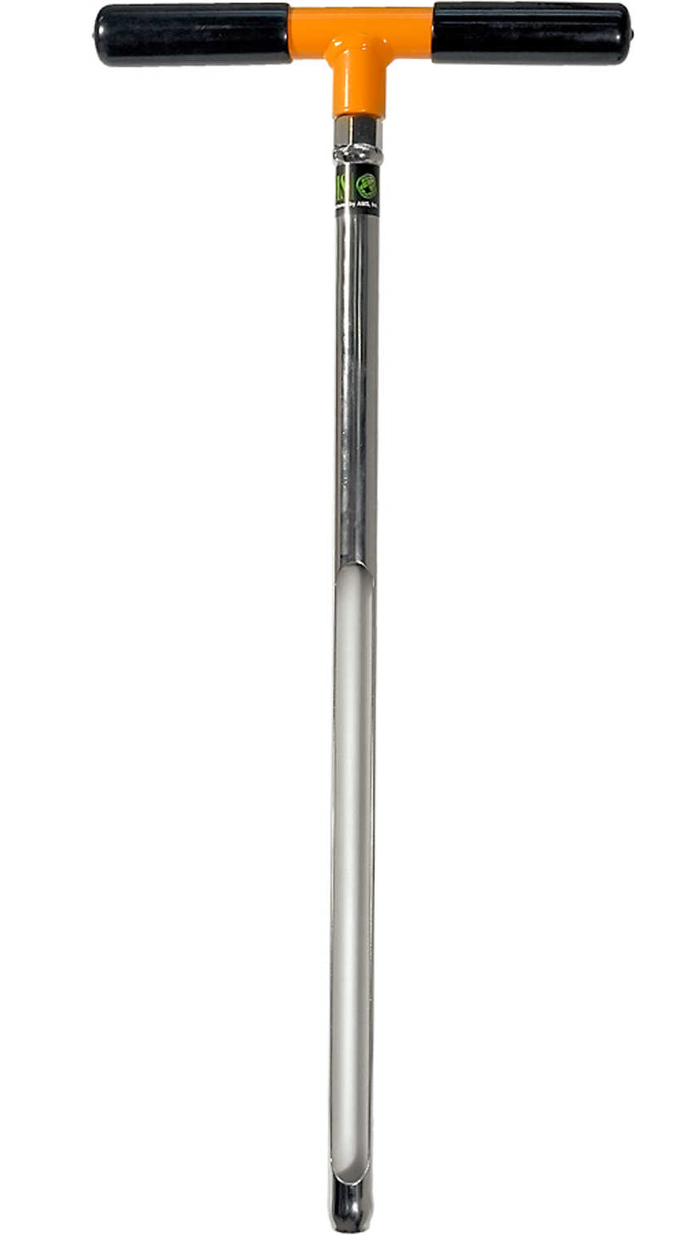
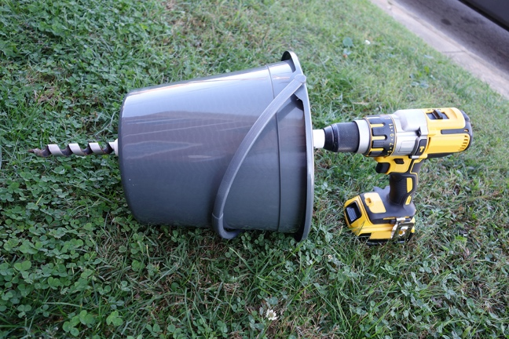
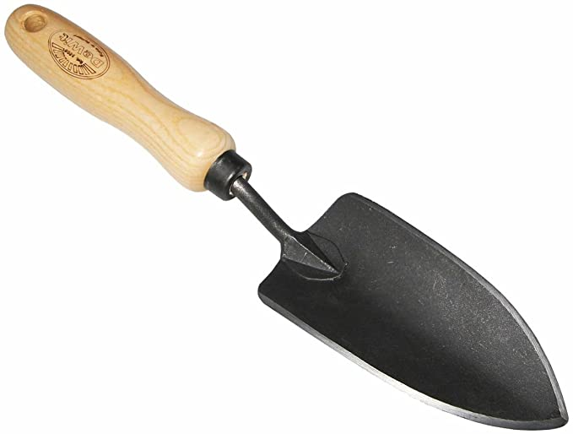
Tools for Sampling
Shovel/Trowel/Probe
  Clean, dirt/rust free
  Non-galvanized, non-reactive
  Capable of consistent depth

Slide 57
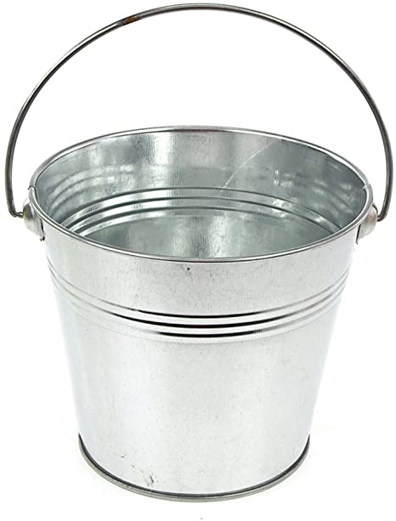
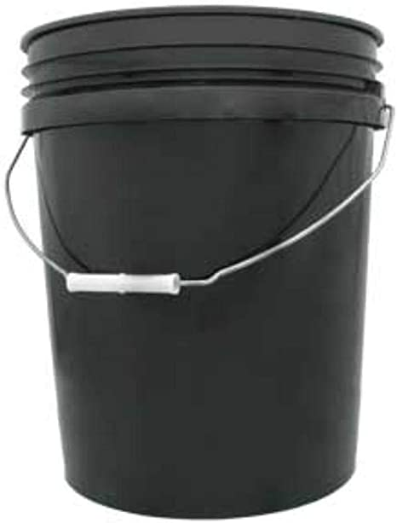
Tools for Sampling
Shovel/Trowel/Probe
  Clean, dirt/rust free
  Non-galvanized, preferably chrome
  Capable of consistent depth
Bucket
  Clean
  PLASTIC, not metal

Slide 58


Tools for Sampling
Shovel/Trowel/Probe
  Clean, dirt/rust free
  Non-galvanized, preferably chrome
  Capable of consistent depth
Bucket
  Clean
  PLASTIC, not metal
Container for sample
  Clean
  1 pt of soil is generally adequate

Slide 59


If you are into big toys…

Slide 60

Sampling Technique
Area of Interest
Sampling Depth
Sampling Timing
Sampling Frequency

Slide 61

Area of Interest
There is more variability in soil in 1’x1’ square then across a 100 acre field!

Slide 62


Area of Interest
Representative of the AOI
  Avoid problem areas
  Remove excessive residue
  1 composite sample should represent no more than 20 acres
Subsamples
  At least 15-20
  30+ if the field has been limed/fertilized by broadcast in the past 2 years
Pattern?
  Zig-Zag

Slide 63


Area of Interest
Banded Fertilizer
  If you know location
    Avoid completely
  Don’t know location
    Completely Random
    Paired Sampling

Slide 64

Area of Interest
Banded Fertilizer
  If you know location
    Avoid completely
  Don’t know location
    Completely Random
    Paired Sampling
Ridge Tillage
  Take samples in equal proportions between top and shoulders of ridge to 6” depth

Slide 65

Sampling Depth
Depth can drastically impact reported nutrient availability

Slide 66
Sampling Depth
Depth can drastically impact reported nutrient availability
Fertilizer Recommendations are based on 6” sampling depth (tillage depth)
Recommended depth could change based on:
  Tillage
  Nutrient/Analysis

Slide 67
Sampling Depth – Tillage
No-Till
  Stratified soil characteristics

Slide 68

Sampling Depth – Management
No-Till
  Stratified soil characteristics
  Impact Nutrient Recommendations
0-2”
200 STP
0 P₂O₅ lb/ac
0-6”
110 STP
0 lb P₂O₅ ac
2-6”
40 STP
80 P₂O₅ lb/ac

Slide 69

Sampling Depth – Management
Chlorsulfuron
No-Till
  Stratified soil characteristics
  Impact Nutrient Recommendations
  Herbicide Stability – pH
Soil pH 7.5
Half-life ≈ 10 weeks
Soil ph 5.6
Half-life ≈ 2 weeks

Slide 70

Sampling Depth – Management
No-Till
  Stratified soil characteristics
  Impact Nutrient Recommendations
  Herbicide Stability – pH
  0-2” for pH
  0-4” for nutrient recommendations
Conventional Till
  Depth of Tillage implement, 6”

Slide 71

Sampling Depth - Nutrient/Analysis
pH
  0-2”, especially in no-till systems
Mobile Nutrients (N and S)
  Consider Subsurface sampling (6-18”, 0-18”)
  For deeper rooting crops, go deeper (0-2’, 0-3’, 0-4’)
Immobile Nutrients (P and K)
  Standard sampling depth

Slide 72

Sampling Timing
Nutrient Fluctuations
Application Timing
  Lime
    Sample and apply lime in Fall
  Fertility
    Fall soil sampling for Spring planted crops
    Summer soil sampling for Fall planted crops
Processing Time
  Allow for 1-3 weeks for report
Best timing is whenever you can get it done

Slide 73


Slide 74
Sampling Timing
Nutrient Fluctuations
Application Timing
  Lime
    Sample and apply lime in Fall
  Fertility
    Fall soil sampling for Spring planted crops
    Summer soil sampling for Fall planted crops
Processing Time
  Allow for 1-3 weeks for report
Best timing is whenever you can get it done

Slide 75


Sample Frequency
Value of Crop
  High value crop/high nutrient removal, more often
Problem soils
  Salinity/Sodicity
  pH?
    Lime takes up to 4 years to take full effect
    Sampling yearly will not give accurate representation
Every 3 years, or once per crops rotation
Regardless of frequency, sample same time as last sample

Slide 76
Recap
Sampling Scheme
  Composite/Random Sampling
  Grid Sampling
  Zone Sampling
Sampling Tools
  Tool
  Bucket
  Container
Sampling Technique
  Area of Interest
  Depth
  Timing
  Frequency

Slide 77


Slide 78


