Slide 1
Chapter 8 – Secondary and Micro-Nutrients

Slide 2
Secondary and Micro-Nutrients
Secondary Nutrients
Sulfur
Calcium
Magnesium
Micronutrients
Iron
Zinc
Manganese
Copper
Chloride
Boron
Molybdenum

Slide 3
Sulfur

Slide 4
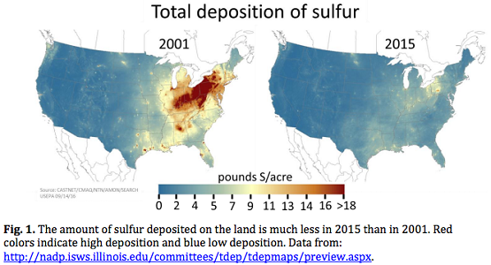
Sulfur
Total S in soil may range from 100 to several thousand lb S/ac
Metal sulfides (FeS, pyrite)
Gypsum, CaSO₄ . 2H₂O
Elemental S
Atmosphere, SO₂
Contributes about 5 lb/S/year, but has decreased over time due to cleaner emissions
Most (70%) is from natural causes (volcanoes)
Ocean
2700 ppm SO₄ = 0.27%
Freshwater
0.5-50 ppm S, can go much higher with saline waters

Slide 5
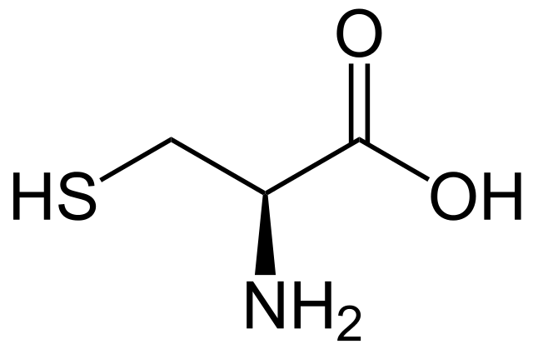
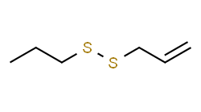
Forms and Functions of S
Cysteine
Allylpropyl disulfide
Plants generally range from 0.2-0.5% ppm S
Sulfur in plant is generally reduced from SO₄²⁻ to –S– (multiple S can exist) or –SH forms, though some SO₄²⁻ exists in plant tissues and sap
Almost Exclusively taken up as SO₄²⁻ in plants
Very small amount S₂O₃⁻² and SO₂
Can be inhibited by chromate and selenate, but not from Nitrate or Phosphate
Functions
Synthesis of Amino Acids
-S—S- bond for folding proteins (important as a catalyst)
Transported to roots via diffusion/mass flow

Slide 6

Sulfur Deficiency
Generally immobile in plant, so will see in newer leaves first
Chlorosis along midveins

Slide 7
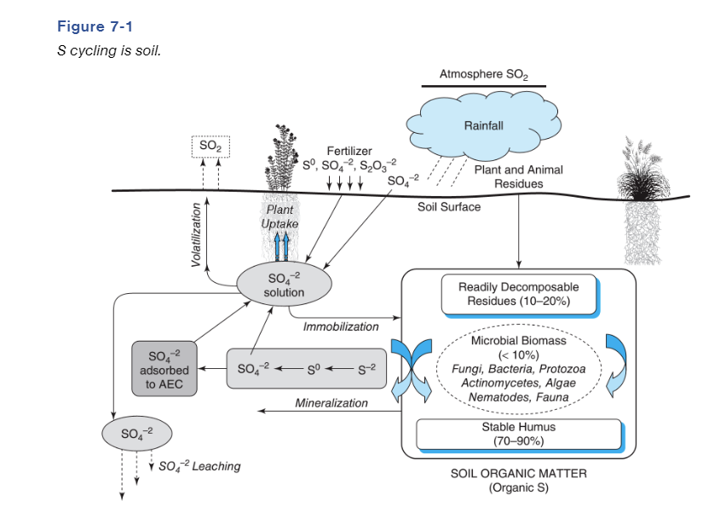

Slide 8
Forms of Sulfur in soil
Solution SO₄²⁻
Ranges 1-100 ppm in most soils
Fluctuates rapidly depending upon uptake and leaching (moves with water)
3-5 ppm SO₄²⁻ in solution is generally adequate for sufficient growth, except with high sulfur crops (canola, alfalfa, broccoli)
In Equilibrium with solid forms, like gypsum (CaSO₄ • 2H₂O)
Exchangeable SO₄²⁻
Require soils that are highly weathered, with significant anion exchange capacity (+)
Also, lightly bound to positive charges on clay particles (think similar to P from the last chapter)

Slide 9
Forms of Sulfur in Soil
Organic S
In non-calcareous soils, S behaves in soils like N, and organic matter accounts for >90% of total soil sulfur
C, N, S, are closely reatled in soil organic matter, with a common ration of about 84:7:1, and N:S of 7:1
For every 7 lb N mineralized, there will be 1 lb S mineralized
Mineralization and Immobilization of S is similar to that for N as far as factors affecting the processes, the end product, and effect of the processes relative to plant available S.
<200:1, Net Mineralization
>400:1, Net Immobilization

Slide 10
Forms of Sulfur in Soil
Precipitated Sulfate Compounds
In calcareous soils, SO₄²⁻ precipitates as sparingly soluble gypsum and epsomite (MgSO₄ . 7H₂O).
Equilibrium solution SO₄²⁻ concentration far exceeds that required to meet plant requirement
Subsoils, even in humid climates, usually are much higher in SO₄ concentration than surface soil, especially if there is an accumulation of clay in the B horizon
Extracts may attempt to measure this fraction, but is not readily available in season, so may over-estimate plant available S

Slide 11
Sulfur Oxidation-Reduction Reactions
H₂S
Anaerobic environments can lead to an accumulation of H₂S (rotten egg smell) (think rice paddy’s), from the decomposition of organic matter
Presence of Iron (Fe) in soil will lead to the formation of FeS from H₂S, which will later reduce further to FeS₂
If Fe is not available, it can volatilize
Generally happens more in soils with greater OM

Slide 12
Measuring Plant available Sulfur
Usually we measure water soluble and easily exchangeable SO₄²⁻
Saturated Calcium Phosphate
Ammonium Acetate
Only of importance in humid regions, even then soil test is questionable
Think about soil test with N, rarely do we use it, because of how variable it is
Generally, we will offer blanket S fertilization on sandy, low OM soils
Starting to suggest S fertilizer recommendations on higher S removal crops (corn becoming one of these)

Slide 13
Fertilizer Recommendations for Sulfur
Soil Test for S?
Total S
Extractable S
~10:1 ratio of Nitrogen
100 lbs N applied, 10 lbs S
Lots of UAN found around the state already has S in it

Slide 14
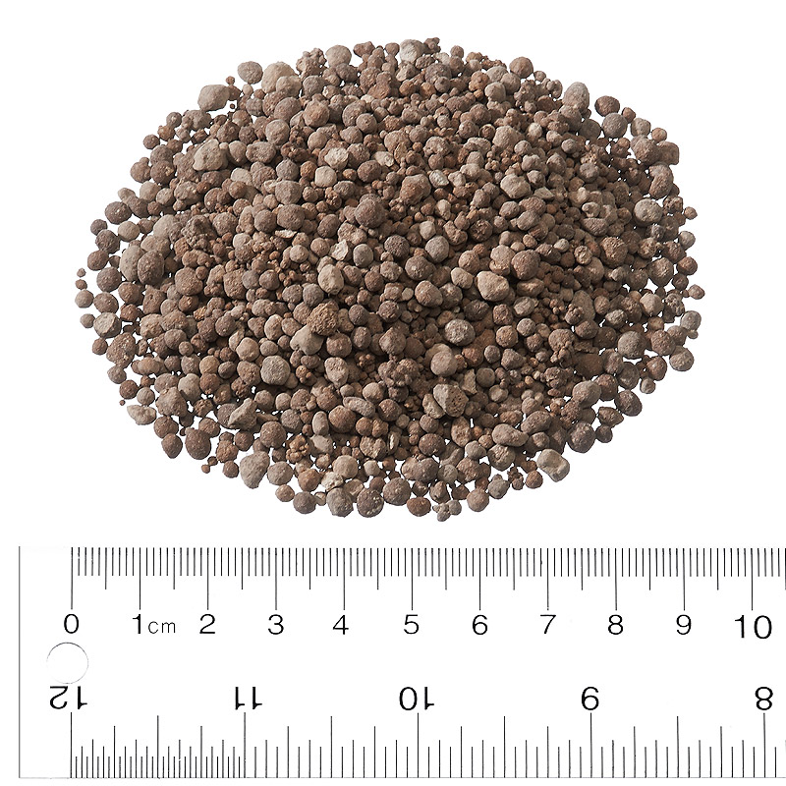
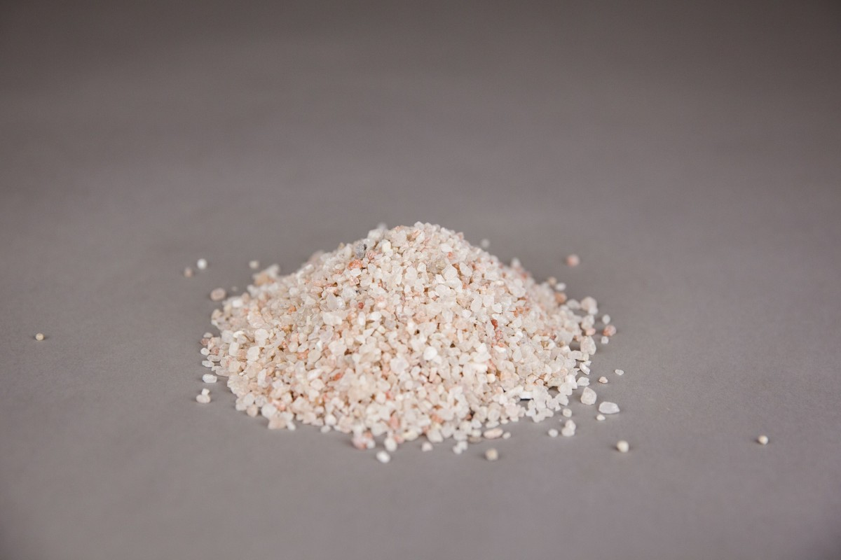
S Fertilizer Sources
Gypsum (CaSO₄) 0-0-0-17-23Ca
Great slow release source, very cheap, especially if you are looking for a sole S source
Getting more difficult to find
K-Mag (K₂SO₄, MgSO₄) 0-0-22-22S-11Mg
Ammonium Sulfate (AMS) 21-0-0-24
Animal Waste 0.2-0.5% S
S-coated urea (25% S)
Elemental S (90% S)
Most often used as an acidifier, though can be used as a S source

Slide 15
Calcium and Magnesium

Slide 16
Calcium
Content depends upon mineralogy, rainfall, and CEC to a greater degree than for K and Mg
Ca bearing minerals, except for carbonates and sulfates, are too slowly weathered to supply crop needs as a sole source, however this is seldom a circumstance
High rainfall leaches Ca out of soil over geologic time, however, plant growth and the consequent recycling (most plants contain relatively high amounts of Ca, 0.5%) continually replenishes the surface where Ca is held on CEC
In Neutral to basic soil pH’s, Ca dominates CEC, so plenty will be available

Slide 17
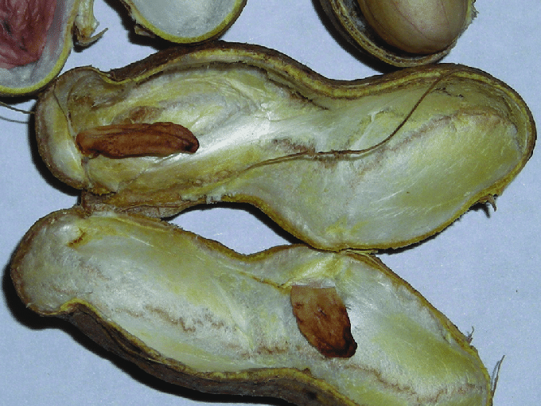
Forms and Functions
Absorb Ca²⁺ via mass flow and root interception
Vital for cell membranes, cell metabolism, cation uptake, translocation of carbohydrates and nutrients
Important for translocation, but immobile in plants
Any other nutrient deficiency that might limit root growth can in turn cause lack of Ca uptake

Slide 18
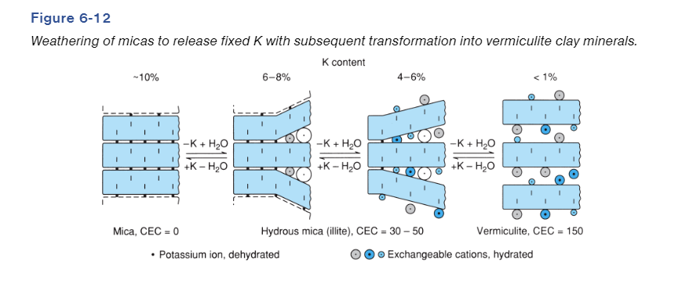
Soil Calcium
Earth’s crust is 3.5% in total Ca
Soil Solution
Contains 30-300 ppm. For corn, 15 ppm Ca in soil solution is related to max yield
Primary/Secondary/Exchangeable Minerals
Very similar to K

Slide 19
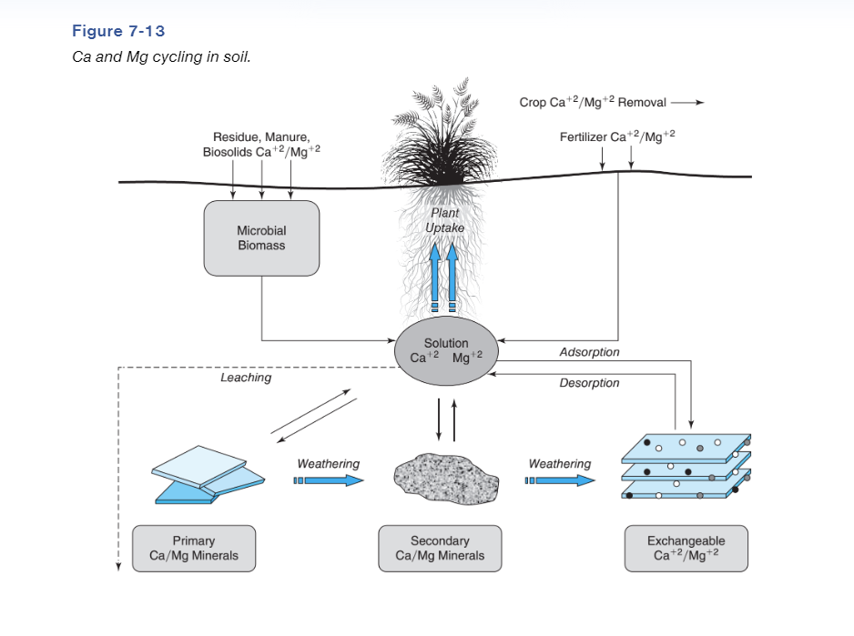

Slide 20
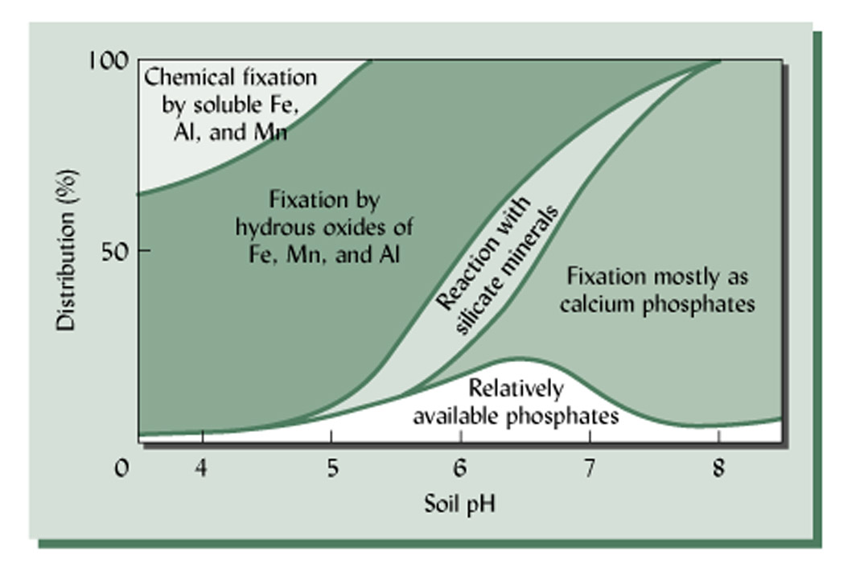
Calcium Deficiencies and Fertilizer
Deficiencies are very rare, and hard to see, except for peanuts
Deficiencies are generally associated with very acidic soil, where Ca is being held more tightly
More likely to occur on coarser textured soils (sands), where CEC isn’t high enough to hold Ca
Soil Test by determining exchangeable Ca, similar to that of K
Fertilizer sources
Lime (fixes two issues)
Gypsum

Slide 21
Magnesium
Constitutes 2% of Earth’s crust
Content varies with parent material and climate (rainfall) under which soil developed
Ranges from a few thousand ppm to a percent or more
Acid, highly leached soils are lowest and most likely to be deficient
Behavior in soils is VERY similar to calcium. But generally, Mg compounds are slightly more soluble than Ca, and less tightly held on CEC

Slide 22
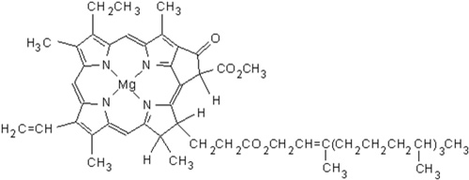
Magnesium Form and Function
Taken up as its cation form, Mg²⁺, predominately through mass flow, less through root interception
Magnesium is used as a primary constituent of chlorophyll, and enzyme metabolism
Same pools as Calcium
Exchangeable Mg is most important available form
In most soils, 4-20% of CEC is exchangeable Mg

Slide 24

Magnesium Deficiencies
Deficiency is more common than Ca
May be a results of low CEC, high rainfall, and abundant Ca (takes place on CEC binding sites, much more of it)
Interveinal Chlorosis in lower leaves (Mobile in plant)
Soil test Mg is determined same as Ca and K
Grass tetany (hypomagnesemia) is a disease or malady of livestock that have low Mg blood levels relative to K and Ca
Alleviation in cattle is application of “mineral block”

Slide 25
Magnesium Fertilizers
Fertilizer Mg
K-Mag (11% Mg)
Ag lime (has some percentage of Mg in it)
Dolomitic lime (contains large quantities of Mg)

Slide 26
Micronutrients

Slide 27
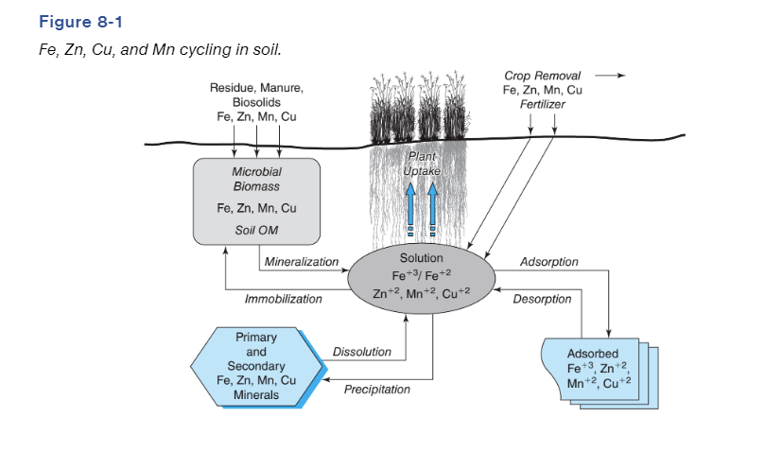
Micronutrients
Fe, Zn, Mn, Cu
All absorbed by plants as the metal cation
All are immobile in soils
All form relatively strong chelates, both naturally and synthetically
Strength of formation: Cu > Fe > Zn Mn

Slide 28
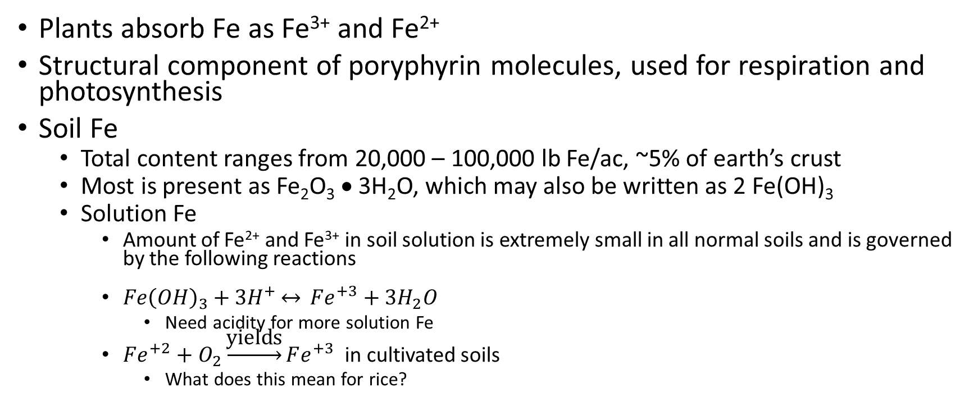
Iron Fe
Plants absorb Fe as Fe³⁺ and Fe²⁺
Structural component of poryphyrin molecules, used for respiration and photosynthesis
Soil Fe
Total content ranges from 20,000 – 100,000 lb Fe/ac, ~5% of earth’s crust
Most is present as Fe₂O₃ • 3H₂O, which may also be written as 2 Fe(OH)₃
Solution Fe
Amount of Fe²⁺ and Fe³⁺ in soil solution is extremely small in all normal soils and is governed by the following reactions
$Fe{\left(OH\right)}_{3}+3H^{+}\underset{↔}{} Fe^{+3}+3H_{2}O$
Need acidity for more solution Fe
$Fe^{+2}+O_{2}\underset{→}{\text{yields}}Fe^{+3}$ in cultivated soils
What does this mean for rice?

Slide 29
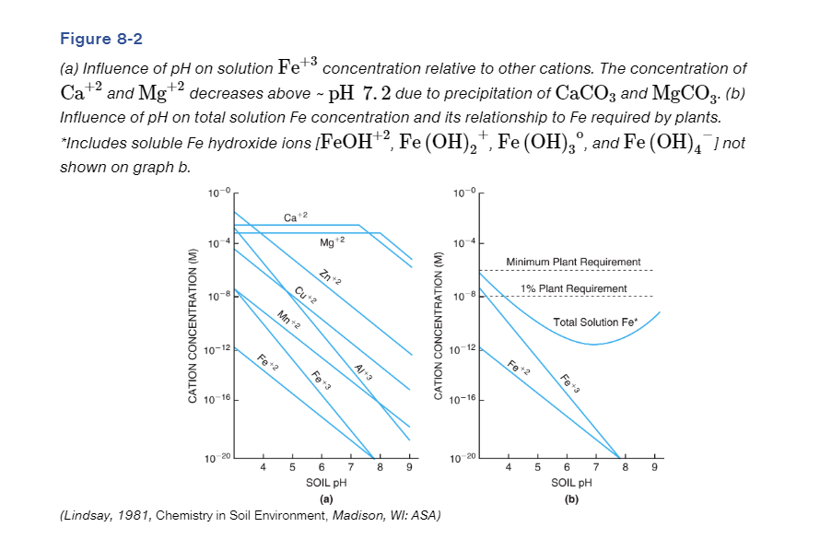

Slide 30
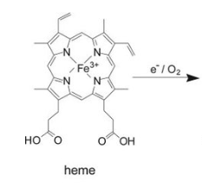
Iron Fe
Total solution Fe at normal/neutral pH ranges are not sufficient enough for Fe requirements, so we have to get Fe in other ways
Chelates
Comes from the Greek word for “Claw”
Tightly bound metal ions (including Fe in heme, Mg in chlorophyll)

Slide 31
Iron Fe
Iron Chelates
Chelates improve the mobility of metal ions because the metal-chelate complex is water soluble
Chelates are naturally occurring in soils (fulvic and humic acids)
Synthetic chelates are sometimes used as fertilizer
Chelates acts like conveyor belt between Fe(OH)₃ and plant root surface

Slide 32
Iron Chelate Conveyor

Slide 33
Iron Fe
Many plants are capable of producing exudates that cause Fe to become more available if they experience a deficiency. This is most common in dicots (soybean, cotton), triggered by Fe deficiency
Increased production of organic acids
Increased production of chelates
Fe Soil Test
Most common extraction of micronutrients in soil using a synthetic chelate, DTPA
Critical level for most crops is 4.5 ppm

Slide 34
Iron Deficiency and Fertilizer
Crop deficiencies are going to be crop specific most of the time, but generally happen on high pH soils (>7.5)
Sorghums and sorghum-sudan are most sensitive
Fertilizer
Increase natural chelation by adding organic matter to soil (feedlot manure, rotten hay, etc.) is most effective long-term remedy
Soil applied compounds quickly become unavailable if they are soluble inorganics (FeSO₄) or are too expensive if they are synthetic chelates
Chelates may be economical for high value crops (horticulture)
Foliar application is temporarily effective

Slide 35
Zinc
In soil, ranges 10-33 ppm of total Zn, with 2-70 ppb in solution, and is moved via diffusion into the plant
Most solution Zn is complexed with OM, many times chelated similar to that of Fe
Plant roots absorb Zn as Zn²⁺
Generally involved with a lot of enzymatic activities
Ranges from 25-150 ppm in plant tissue

Slide 36
Zinc
Zn Deficiencies are uncommon
Often result of high pH, and/or low OM
Corn is most sensitive cultivated crop
Soil test is DTPA
Critical level depends on crop
Corn 0.8 ppm
Fertilizer source most often is ZnSO₄, 2-6 lb Zn/ac, or Zn chelates (more expensive)

Slide 37
Copper
Plants absorb Cu²⁺, mainly via diffusion of organic bound chelated Cu
Plant tissue ranges 5-20 ppm, solution Cu is extremely low
Copper will strongly bind to organic substances, to the point that it will be less available with too much OM
Deficiencies are rare, mostly on high OM soils, or very basic soils
Soil test is DTPA
Fertilizer source is generally a CuSO₄, or CuO, or chelated Cu

Slide 38
Manganese
Mn is used as an electron transfer in photosynthesis
Absorbed as Mn²⁺ , Concentration ranges 20-500 ppm in plants
Mineral bound Mn is largest pool (1000 ppm), solution Mn ranging 0.01-1.0 ppm
Mn toxicity is more common than deficiency
Low pH soils (<4.5)
Frequently flooded conditions
DTPA Soil Test
Fertilize using MnSO₄, organic sources

Slide 39
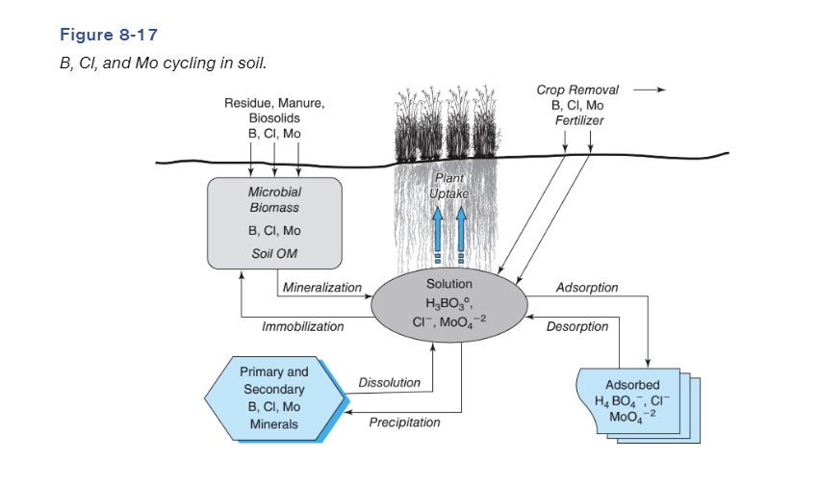
Boron, Chloride, and Molybdenum

Slide 40
Boron
Absorbed predominantly as undissociated Boric acid (H₃BO₃), but can also take up other forms (H₂BO₃, HBO₃, BO₃, B₂O₇)
Mobile in soil, immobile in plant
Important for structural integrity of plant cell walls
0.1 ppm required for adequate plant growth, becomes less available at pH > 6.5
Shallow rooted crops are most sensitive to deficiency (peanuts)
Toxicity can happen, when irrigation water is high in B
Soil test is hot-water soil extraction
Fertilizer sources are sodium and calcium borate (Borax – soap)

Slide 41
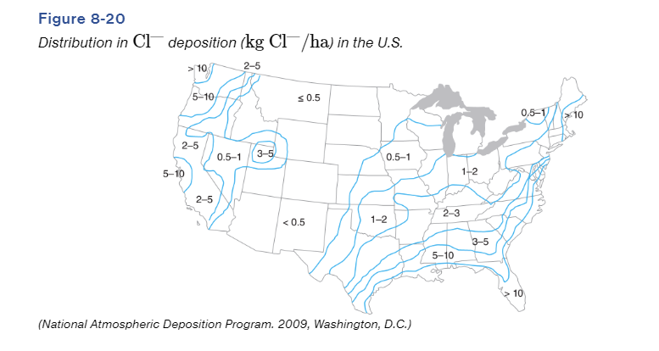
Chloride
Absorbed as Cl⁻, ranging from 0.2-2.0%, usually exceeding requirements within plants
Functions in osmotic and ion charge balance
Nearly all Cl in soil is in solution, which is mobile.
Most Cl required naturally comes from rainfall
Deficiencies can occur in areas with very little rainfall, or loose textured soil, so Cl moves much easier through the profile (mass flow)
Soil test is hot water extraction, critical level is ~40 lb/ac 2 feet deep
Fertilizer source is 0-0-60 KCl

Slide 42
Molybdenum
Absorbed as weak acid molybdate (MoO₄²⁻) that can complex with other anions
Availability in soil is heavily linked to soil pH
Deficiencies mainly occur in acidic soils
Deficiencies are so rare that a reliable soil test has not been developed
Fertilization requirement is extremely small, liming most often will correct any deficiencies
Large seeded legumes need the most Mo
Generally receive adequate supply for the season from seed, assuming seed was grown without deficiency
Seed coating of ammonium molybdate is “fertilizer source”

Slide 43
Nickel
Supplied to plants as Ni²⁺, required in very low amounts
Required for the urease reaction, and beneficial of N metabolism in legumes
Will cause urea accumulation in leaf tips if deficient
NiSO₄ and organic matter are sources of Ni

Slide 44
Summary of Managing Micronutrient Fertility
Make sure your pH is correct, and most micronutrient issues will go away.
Organic Fertilizer sources will provide enough micronutrients in average application amounts
Foliar application of micronutrients are a viable option (not a ton is needed)

Slide 45
