Slide 1
Chapter 7 – Potassium

Slide 2
Soil Potassium
Total K in soils averages ~40,000 lbs/ac
Most of K is held as part of primary minerals
Easily exchangeable K levels is often very small (40-600 ppm)
Only small amount is readily available and in solution (1-10 ppm)
K removal is very high, equal with N

Slide 3
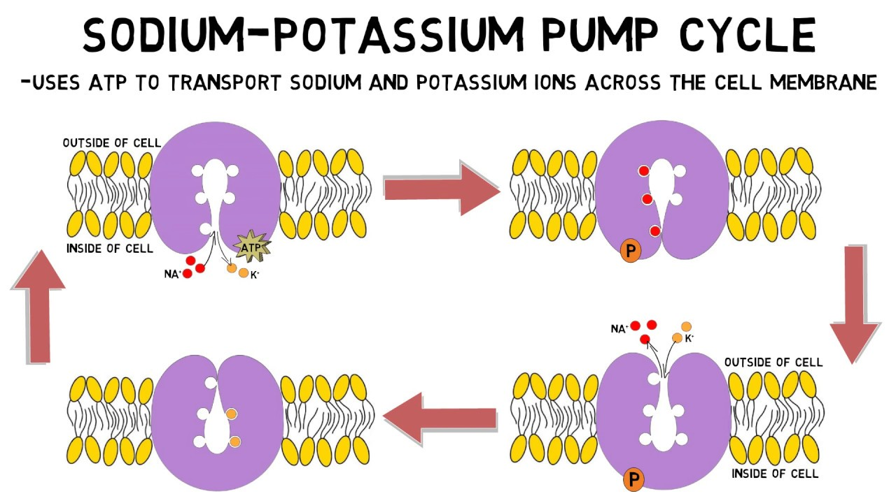
Forms and Function of K
Forms
  Adsorbed as K⁺
  Tissue ranges from 1-5%
Functions
  Not a component of biochemical compounds
  Exists in solution or bound to negative charges in the plant
  Activator in dozens of enzymatic reactions
  Responsible
    Energy metabolism
    Starch synthesis
    Nitrate Reduction
    Sugar Degradation

Slide 4
Forms and Function of K
Essential
  Photosynthesis
  Protein Synthesis
  Starch Formation
  Sugar Translocation
Increases resistance
  Lodging and diseases due to excess N
  Delays maturity, working against the ripening action of P

Slide 5
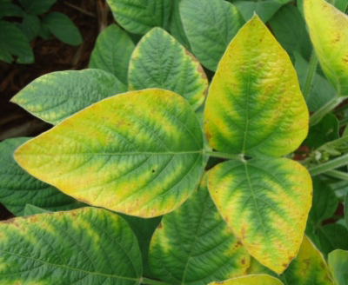
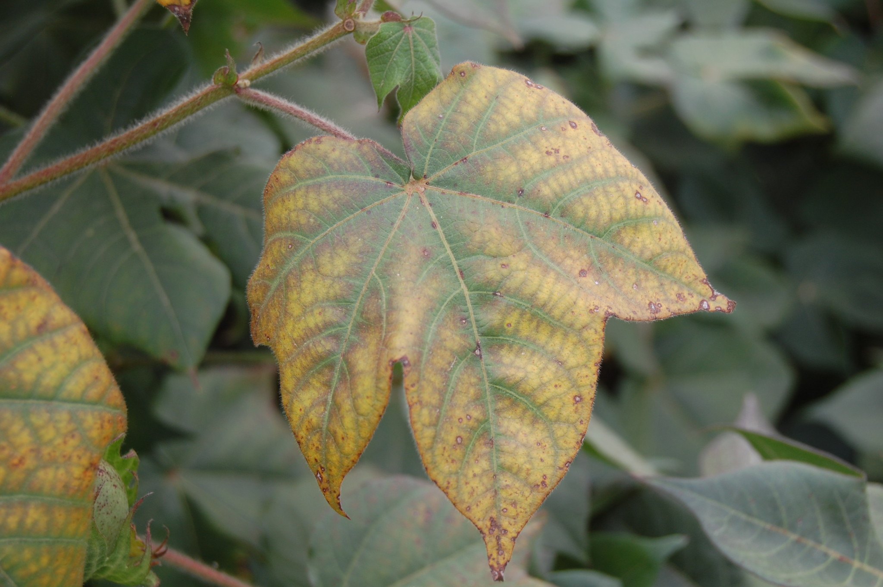
K Deficiency in Plants
Mobile in Plant
  Will see in lower leaves first
Visual symptoms
  Chlorosis along the margins
  Weak stems/lodging
Severe deficiency indicated by necrosis of lower leaves
May appear in upper/younger leaves of high yielding/fast maturing crops

Slide 6
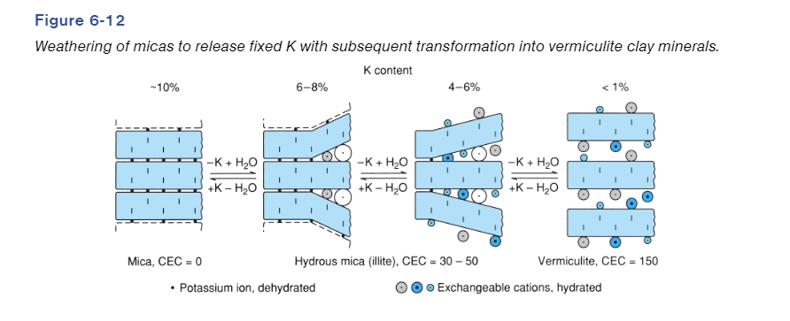
Soil Potassium
K is found in 4 forms in soil
  Occluded (98% of total K)
  Fixed (1% of total K)
  Exchangeable (1% of total K)
  Solution (0.1% of total K)
K⁺
Occluded
Fixed
Exchangeable
Solution

Slide 7
Soil Potassium
Occluded Potassium (98% of soil K)
  Held by soil minerals, such as micas and feldspars
  Can weather and break down over time to become more available
Fixed Potassium (1%)
  Soil minerals have broken down over time, but tripped within lattice of clay minerals, so still tightly bound. More likely to become exchangeable than Occluded
K⁺
Occluded
Fixed
Exchangeable
Solution

Slide 8
Soil Potassium
  Exchangeable K (1%)
    Attached to the same colloids as Fixed, but on the outside of the lattice, meaning more available than fixed
    Attached on 1:1 and 2:1 clay types
    Held by charges
  Solution K (0.1%)
    Free floating in solution
    Very small amount
K⁺
Occluded
Fixed
Exchangeable
Solution

Slide 9
Available Soil K
Plant uptake is dictated by diffusion (90%) and mass flow (10%)
  K is relatively immobile in soil
  Scale 1-100, NO₃⁻ being 99, K⁺ being 33, HPO₄²⁻ being 1
Factors affecting K availability
  Clay Minerals and CEC
  Exchangeable K
  Environment

Slide 10
Factors affecting K availability
Clay minerals and CEC
  Clay mineral K content will determine how much K will be available when broken down
    Vermiculite, montmorillinite, mica have higher K content
    Kaolinite tend to have lower K content
  Higher CEC soils will have a greater concentration of exchangeable K
    Having low CEC doesn’t mean more will be in solution, due to losses
Exchangeable K
  The more exchangeable K in the soil, the greater available K there will be

Slide 11
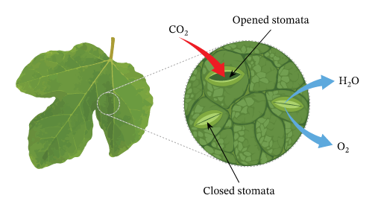
Factors affecting K availability – Environment
Soil Moisture and Temperature
  At low moisture, water films are too small for K to diffuse to roots
  Also, plants require more K in drought stress conditions, due to CO₂ fixation
    K is needed for both photosynthesis and stomatal closure
  This is why K deficiency may show up even if plenty of K is available
Temperature and diffusion are also correlated
Root function is also dependent on adequate O₂ being available in the soil, Aeration

Slide 12
Factors affecting K availability – Environment
  Lyotropic series
    Al³⁺ ≅ H⁺ > Ca²⁺ ≅ Mg²⁺ > K⁺ ≅ NH₄⁺ > Na⁺
Soil pH
3 K+ cannot compete effectively for the more tightly held Al3+ and H+
3 K+ can compete more effectively for Ca2+ than the more tightly held Al3+ and H+. It is easier to increase exchangeable K by fertilizing a Ca saturated soil than Al3+ and H+ saturated exchange complex.

Slide 13
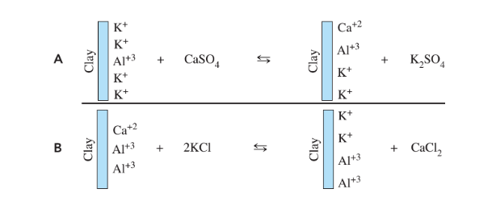
Potassium Losses
Leaching
  Occurs more often in looser textured soils
  No binding sites (either due to low CEC or high concentration of stronger bases)
Removal via harvest

Slide 14
Soil Testing for Potassium
Solution and Exchangeable K is generally what will supply the plant throughout the season, with a little coming from Fixed K.
Our soil tests aim to measure the Solution and Extractable K, to give an estimate on the plant available K.
Extractant isn’t nearly as dependent as extraction for P
Most of the time the extractant used for P will be used for K and other nutrients as well
Just need a moderate acid to remove K from binding sites

Slide 15
Soil Testing for Potassium
Moist Soil Test for K
  Had some following back in the 80’s, then went away, because handling non-dry samples was not fun for labs
By drying soil samples, you are removing water, and subsequently making the soil particles condense together, making some bound K⁺ less available for extraction
Moist soil test K has been shown to be more accurate at estimating plant available K than dry soil testing

Slide 16
Fertilizer Recommendations for Potassium
Immobile, so based upon sufficiency index
In high yielding forage crops, where forage is removed completely, when soil is sandy, K management will be more similar to N, because of how many losses (leaching, removal)
Correlation/Calibration

Slide 17
Potassium Fertilizer

Slide 18
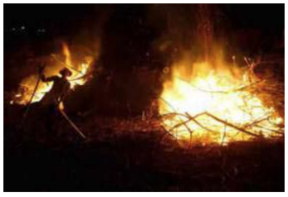
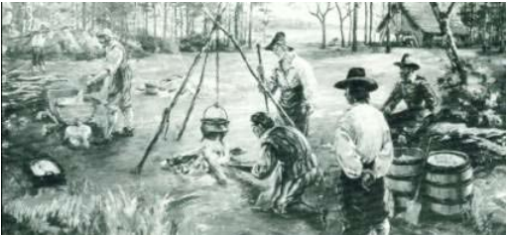
History of Potash
First sources of potash (K Fertilizer) came from boiling wood ash to recover nutrients
Take ashes of fire wood from stoves, boil it with water, and collect the salts leftover
“pot-ash”
Non sustainable or efficient

Slide 19
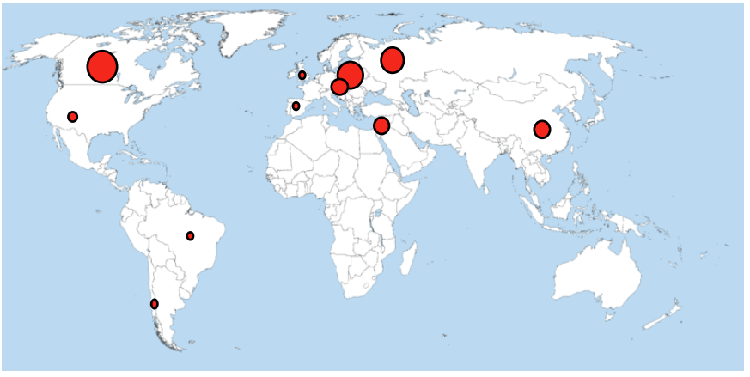
Sources of K fertilizer
Mainly come from deposits of soluble K salts found well below Earth’s surface
  Many are high purity, and lend to mining of K salts and potash

Slide 20
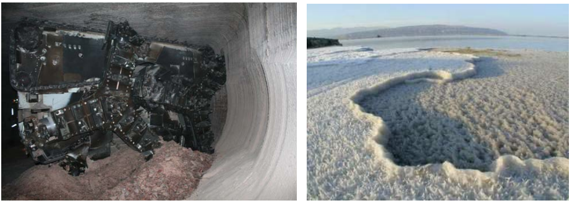
Sources of K Fertilizer
Come from marine sources
  Ancient Seas that are now buried and dried
  Salt water brines (KCl, not just NaCl)

Slide 21
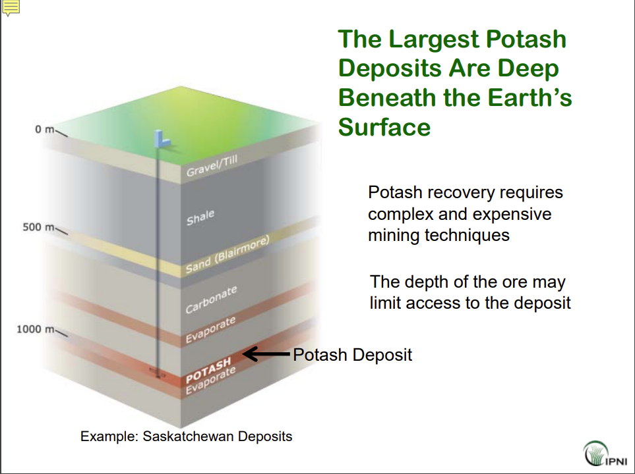

Slide 22
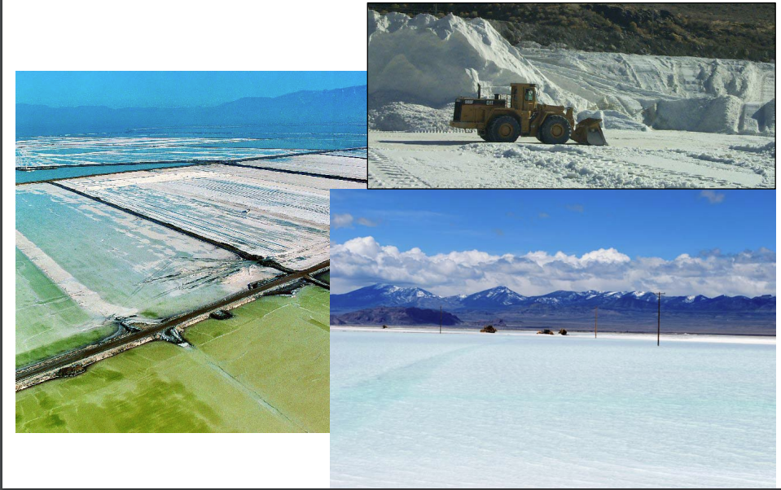
Sources of K Fertilizer
Can also come from natural salt brines (water evaporates and leaves behind salts)
Dead Sea
Great Salt Lake

Slide 23
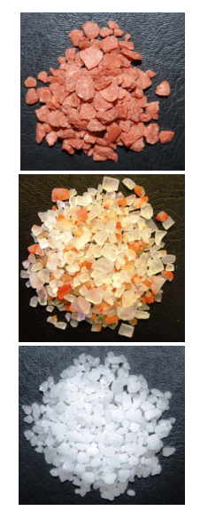
Potassium Fertilizer Sources
Muriate of Potash (0-0-60, MOP)
  Primarily mined as mineral containing KCl and NaCl, which is then milled and separated
  Colors and sizes differ depending on the source
  Iron oxide within gives our MOP that reddish tinge
Source for other K fertilizers
Readily water soluble
Cheapest form of K Fertilizer

Slide 24
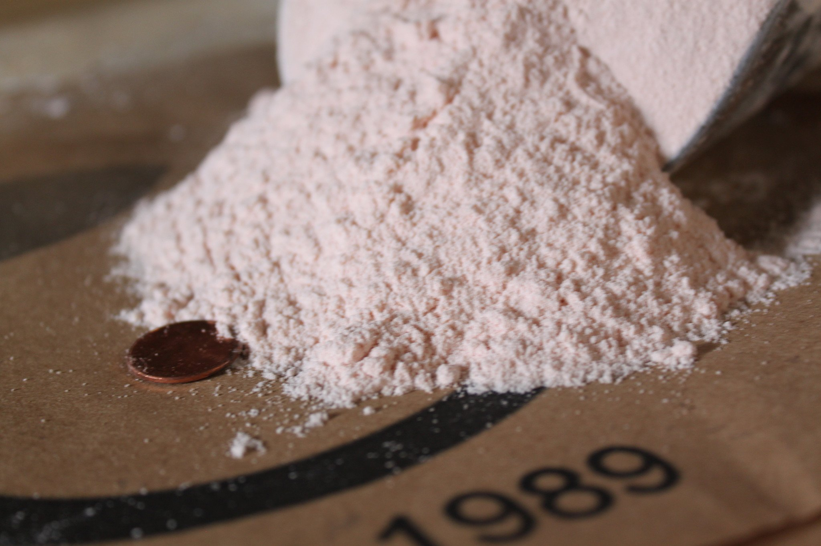
Potassium Fertilizer Sources
Potassium Sulfate
  0-0-53-17
  Commonly used in Cl⁻ sensitive crops
    Potatoes
    Tree Fruits
    Vegetables
    Tobacco

Slide 25
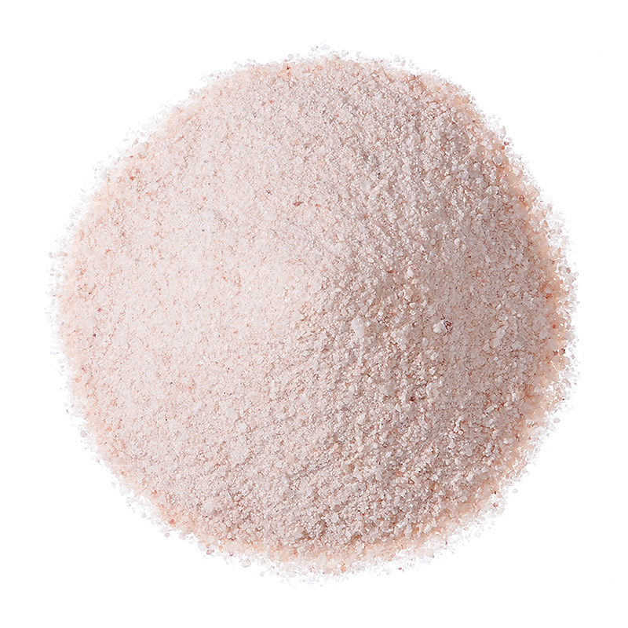
Potassium Fertilizer Sources
Potassium Magnesium Sulfate (0-0-22-22-11Mg)
  (K₂SO_{4,} MgSO₄)
  Also known as K-Mag
  Used when you need more S and Mg

Slide 26
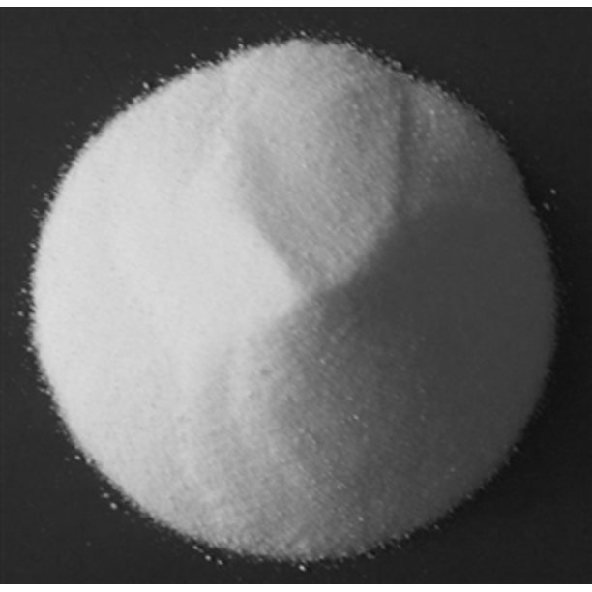
Potassium Fertilizer Sources
Potassium Nitrate (KNO₃), (13-0-44)
  Good source of N and K
  Used mainly for trees, cotton, vegetables
High production costs limit use

Slide 27
Potassium Fertilizer Sources
Potassium Phosphates (K₄P₂O₇, KH₂PO₄, K₂HPO₄)
  Assorted K concentration
    K – 20-50%
    P – 30-60%
  Advantages
    High analysis
    Low salt index
    Useful in liquid fertilizers high in K
  Commonly used in Cl⁻ sensitive crops

Slide 28
Potassium Fertilizer Sources
Potassium Thiosulfate (K₂S₂O₃ ,KTS, 0-0-25-17S)
Potassium Polysulfide (KS_{x}, 0-0-36-42S)
Liquid K fertilizers
Advantages
  High analysis
  Low salt index
  Useful in liquid fertilizers high in K
Commonly used on Cl⁻ sensitive crops

Slide 29
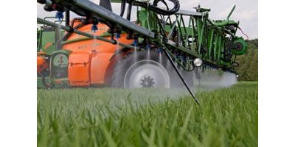
Potassium Fertilizer Sources
Potassium Hydroxide (KOH)
Potassium Bicarbonate (KHCO₃)
Potassium Carbonate (K₂CO₃)
Potassium Acetate (CH₃COOK)
  All generally foliar fertilizer K sources
  Compatible with other liquid fertilizers
Can cause tissue burn, especially on HOT DRY days

Slide 30
Potassium Fertilizer Sources – Organic
In organic manures, occurs predominately as soluble as K⁺
Average K content is 0.2-2% K, on par with N and P
Most organic fertilizer sources are applied to account for N or P concentration, so whatever that rate is will generally supply sufficient quantities, depending on the rate applied

Slide 31
Considerations for K fertilizer application
Applications of K are better done frequently rather than heavily due to luxury consumption problems, and leaching
Banding?
  Doesn’t necessarily help against fixation
  Banding (near the surface) will have beneficial effects in colder environments, where K diffusion is slowed due to temperature
  Higher concentration of K = higher chance of diffusion even if its cold
Foliar K application is a mixed bag
  Watch for salt burns

