Slide 1
Chapter 6 – Phosphorus

Slide 2
Phosphorus in Soil
Elemental P does not exist in nature
EXTREMELY reactive at room temperature, and must be stored underwater, reacts violently with O₂
In nature, P never exists as a cation, but as an anion (-)
Exists as an oxidized compound (PO₄³⁻), and bonds with many other ions
Mixed with DI water, will form H₃PO₄, phosphoric acid, which is moderately strong
In soil, PO ₄⁻³ will react with whatever cations have the highest charge and are present in the highest concentration.

Slide 3
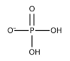
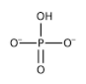
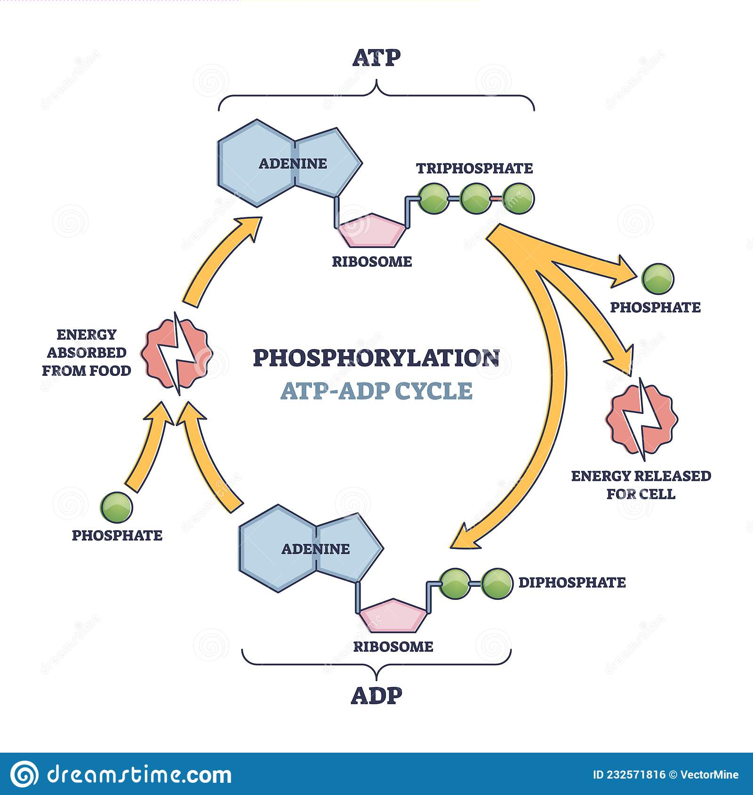
Forms and Function of P in soils
Absorbed as orthophosphates
H₂PO₄⁻ and HPO₄⁻²
0.1-0.5% in tissue
Component of ADP and ATP, which are used as “energy currency”
Component of DNA and RNA
Other functions and qualities
Photosynthesis
N Fixation
Crop Maturation
Root development
Strength of straw in cereal crops
Improvement of crop quality (especially in forages and vegetables)

Slide 4
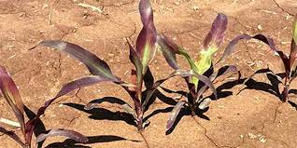
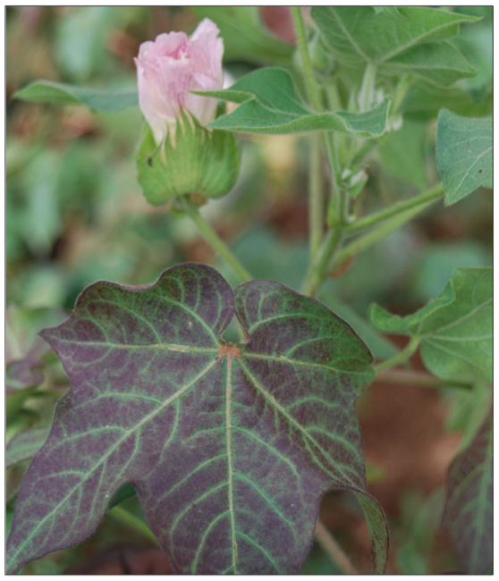
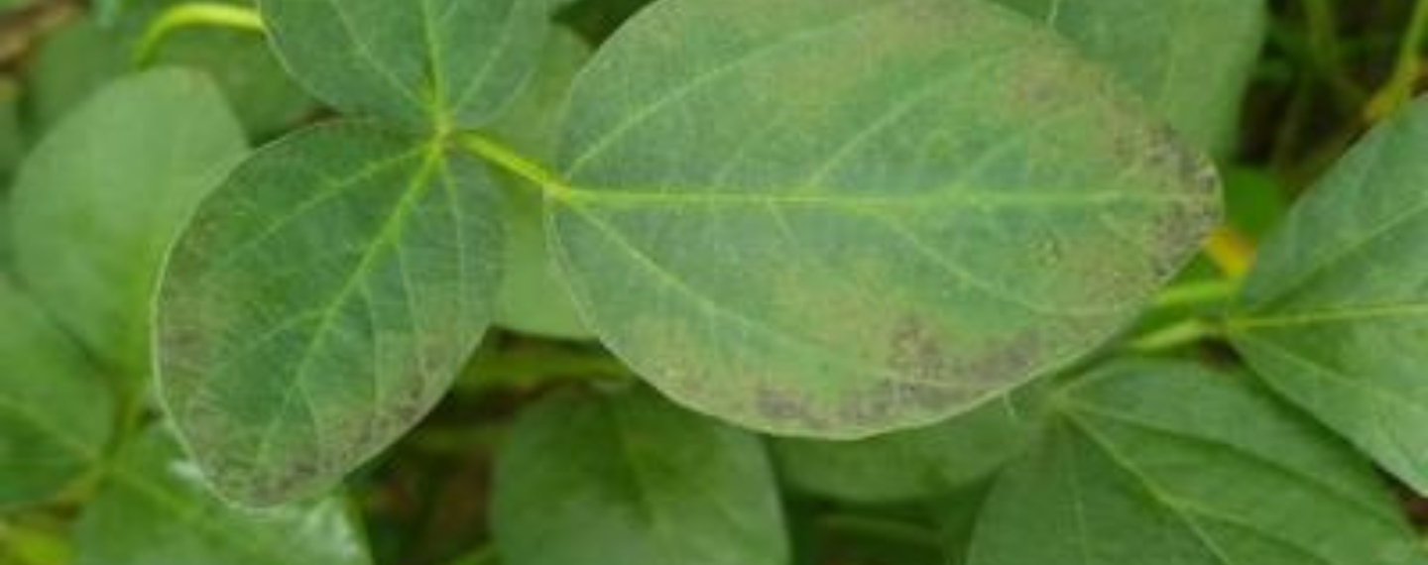
Phosphorus Deficiency
Visual Symptoms
Dark green leaves change to grayish green, then to purple with metallic luster
Stunted growth
Mobile in plants, so visual deficiency will first be seen in lower leaves
Common in cool, wet conditions

Slide 5
Phosphorus Forms in Soil
Total P content in soil ranges from 0.03-0.3% P
Not well related to plant available P because much of the total P is found in very insoluble primary minerals and precipitated secondary minerals
Available P levels generally very low
Seldom greater than 0.01% of the total P
Must be supplemented with chemical fertilizers
Added P can be converted to less available mineral forms
Released very slowly
Useful to plants only over a number of years

Slide 6
Phosphorus Forms in Soil
Distribution of soil-P between solid and solution
Connector representing dissolution/precipitation
These two forms are sometimes referred to as the intensity factor (solution concentration/solution) and the capacity factor (solid concentration) for characterizing P supply for crop production
Solid forms of soil-P may be differentiated further by considering those forms that may be readily available (labile-P) move into solution, from those that will not (non-labile, or fixed, P)

Slide 7
Phosphorus Forms in Soil
Solution P – Smallest pool of P
Mostly inorganic (H₂PO₄⁻ and HPO₄⁻²), with rarely some organic forms
Solution concentration of 0.05 ppm is believed to characterize soils with adequate P for plant growth and development
Weak concentration only supplies about 1% of the total P required for plants by mass flow transport
Most P reaches the root surface by diffusion and root interception, and that the amount of P removed from the solution by a growing plant may be replenished 2-3 times each day during the growing season, as solid forms dissolve
0.05 ppm = .1 lbs P/ac
Plants need ~0.4 lbs P/ac/day

Slide 8
Phosphorus Forms in Soil – Solution P
When solid forms of P dissolve in the soil solution, or when fertilizer P is added, the ionic form of P present in the soil solution is pH dependent
Stepwise Dissociation of phosphoric acid (H₃PO₄) and the appropriate equilibrium or dissociation constants

Slide 9
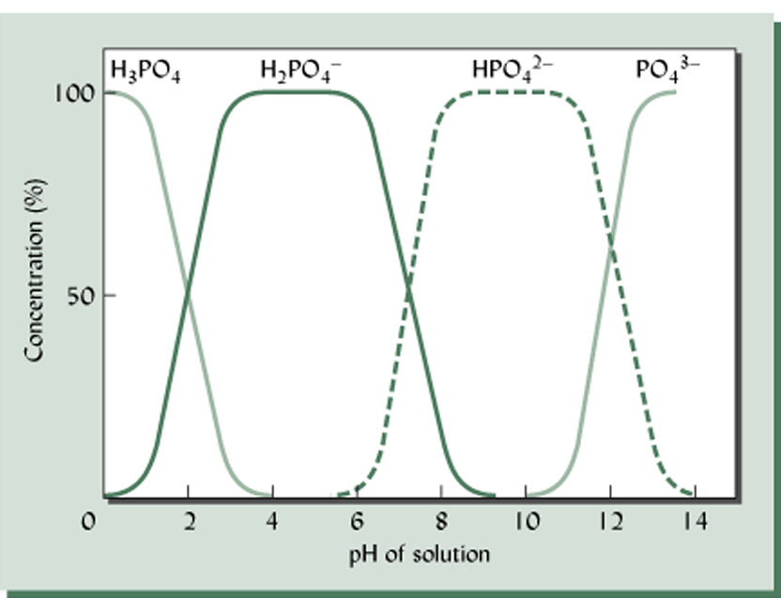
Phosphorus Forms in Soil – Solution P
Ionic forms of P taken up by plants (HPO₄²⁻, H₂PO₄⁻)
H₂PO₄⁻ is dominant at pH < 7.2
HPO₄⁻² is dominant at pH > 7.2
PO₄⁻³ is NOT prevalent in solution, its bound in one form or another
Plants do not have a preference of one form over another, so little justification for trying to lime a soil to a pH where P is most available

Slide 10
Phosphorus Forms in Soil – Labile/Nonlabile P
Since the phosphate ion may exist in the trivalent form (PO₄³⁻), it is capable of forming highly insoluble compounds with divalent and trivalent cations, if such cations are present in soil solution
The relationship of soil pH and percentage base saturation, and the lyotropic series, characteristics of all soils, will dictate that PO₄³⁻ will react with Fe³⁺ and/or Al³⁺ in soils where they are free in solution for bonding (acidic soils) and Ca²⁺ in near neutral and basic soils.

Slide 11
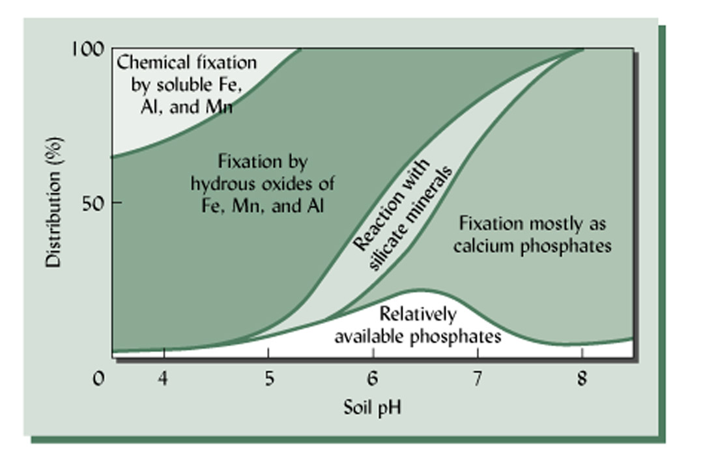
Phosphorus Forms in Soil – Labile/Nonlabile P
pH<5.5, Al(OH)₃ and Fe(OH)₃ will dissolve (discussed earlier), and free Al³⁺ and Fe³⁺ will react with with PO₄³⁻ and make it unavailable
pH>5.5, there is enough Ca²⁺ present to form calcium phosphates
pH 5-8, suitable for plant growth, small amounts of H₂PO₄⁻ and HPO₄²⁻ will be present, the ionic forms of P taken up by plants
As a result of these reactions, surface applied phosphate does not leach through soils, but is instead retained near the surface in these solid forms

Slide 12
Speciation Figure
The P species with the lowest solubility is the species that will predominate
SOLUBILITY
pH 4.5 Event Precipitate Formed
1. add fertilizer soluble P added -
2. 1 - 2 soluble P decreases DCP
3. 2-3 DCP dissolves FA
4. 3-4 FA dissolves Variscite

Slide 13
Phosphorus Forms in Soil – Labile/Nonlabile P
Since Phosphate precipitates from solution to form solid Fe/Al/Ca phosphates, it follows that the concentration of plant-available inorganic P is governed by the solubility of these compounds
In acidic soils, Al and Fe produces
As reactants increase/decrease on one side of the reaction above, the equilibrium shifts to accommodate

Slide 14
Phosphorus Forms in Soil – Labile/Nonlabile P
Calcium Phosphates – in more neutral to basic pH’s
Most soluble: Monocalcium phosphate, will revert to most insoluble, apatite, with time, until that pool fills.
Gradual transition, slow enough that concentrations of available phosphate (H₂PO₄⁻ and HPO₄²⁻) in the soil will be sufficiency high throughout the season to benefit the crop
Usually a year after fertilization, the transition to highly insoluble forms is almost complete, and there is little residual effect on past year’s application
* Times in italics are the approximate time required for monocalcium phosphate to revert to the indicated, less soluble, forms.

Slide 15
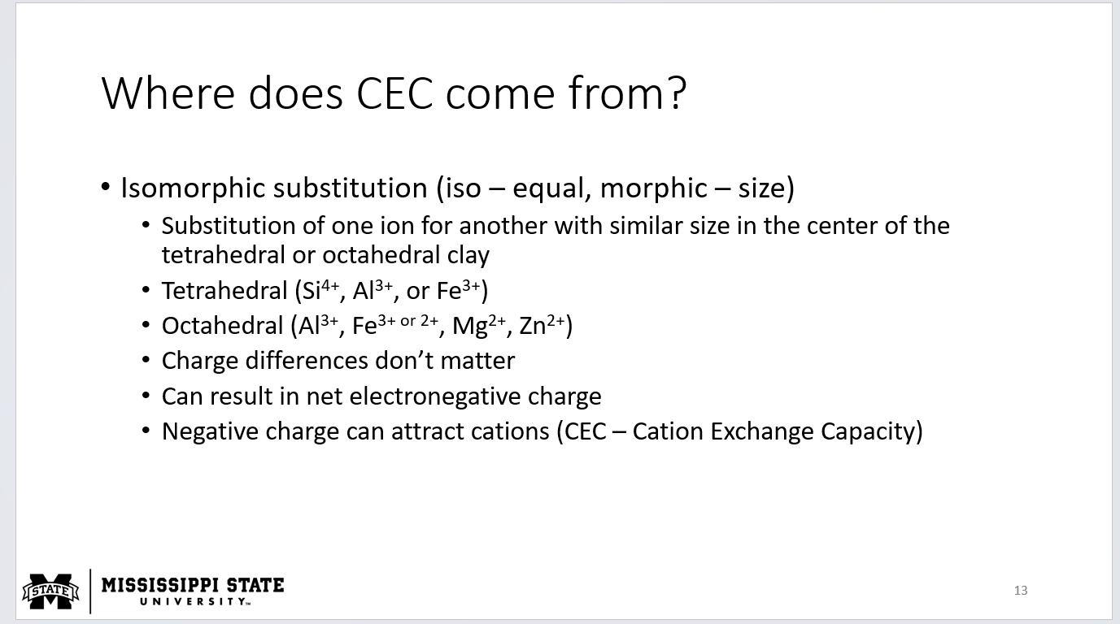
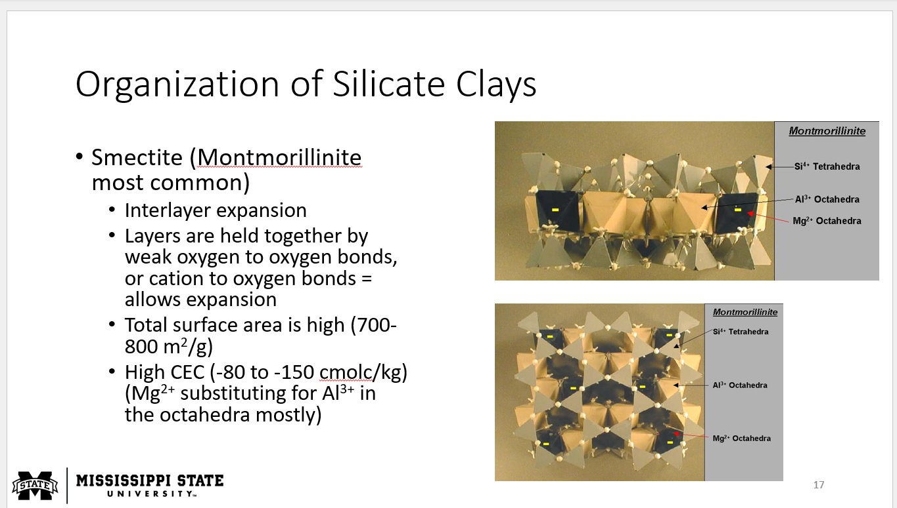
Phosphorus Forms in Soil – Labile/Nonlabile P
Just as phosphates are able to form highly insoluble compounds with Fe and Al, it is believed that phosphates can react with exposed Al at the broken edges of clay minerals and colloidal amorphous Fe and Al oxides
Because these reactions occur at the surface of solids, the extent at which they occur is related strongly to the surface area, and thus, clay content.
Initial adsorption is a result of a single bond forming between the Al and H₂PO₄-. Phosphates weakly held are sometimes categorized as labile phosphate, which could be relatively easily dissociated and move back into the soil solution for plant use.
With time, labile phosphate becomes geometrically positioned to allow a second bond to form, which leads to more strongly bond, or fixed, phosphate
This form is not believed to be readily available for plant use. Labile-P may be considered an intermediate phase in the transition of available to unavailable soil-P.

Slide 16
Phosphorus Forms in Soil – Labile/Nonlabile P
Just as phosphates are able to form highly insoluble compounds with Fe and Al, it is believed that phosphates can react with exposed Al at the broken edges of clay minerals and colloidal amorphous Fe and Al oxides
Because these reactions occur at the surface of solids, the extent at which they occur is related strongly to the surface area, and thus, clay content.
Initial adsorption is a result of a single bond forming between the Al and H₂PO₄-. Phosphates weakly held are sometimes categorized as labile phosphate, which could be relatively easily dissociated and move back into the soil solution for plant use.
With time, labile phosphate becomes geometrically positioned to allow a second bond to form, which leads to more strongly bond, or fixed, phosphate
This form is not believed to be readily available for plant use. Labile-P may be considered an intermediate phase in the transition of available to unavailable soil-P.

Slide 17
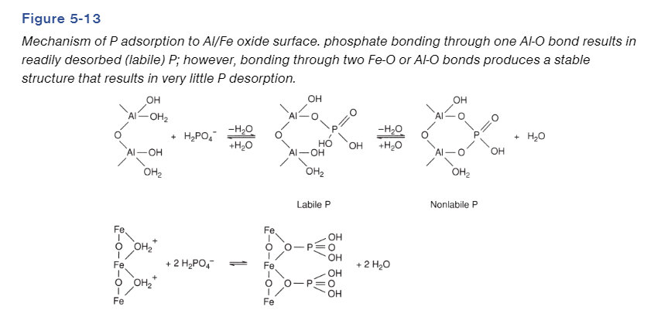
Phosphorus Forms in Soil – Labile/Nonlabile P

Slide 18
Phosphorus Forms in Soil

Slide 19
Factors influencing P retention
Soil pH
Peak available P occurs around 6.5
Soil Colloids/minerals
Soils with high Al/Fe/Ca content can tend to fix P more
1:1 clay types offer more reaction sites than 2:1 types
1:1 clay types have higher amounts of Al/Fe oxides
1:1 clay types will also develop pH dependent charges (+), which can also adsorb P
More clay content can increase bonding sites for both Al/Fe oxides, as well as bonding sites for PO₄⁻³
Acid soils (pH < 5.5), high clay content, and dominance of 1:1 clays over 2:1 clays, will ALL increase the retention and fixation of phosphates
Where would we expect increased P fixation? What type of environments?

Slide 20
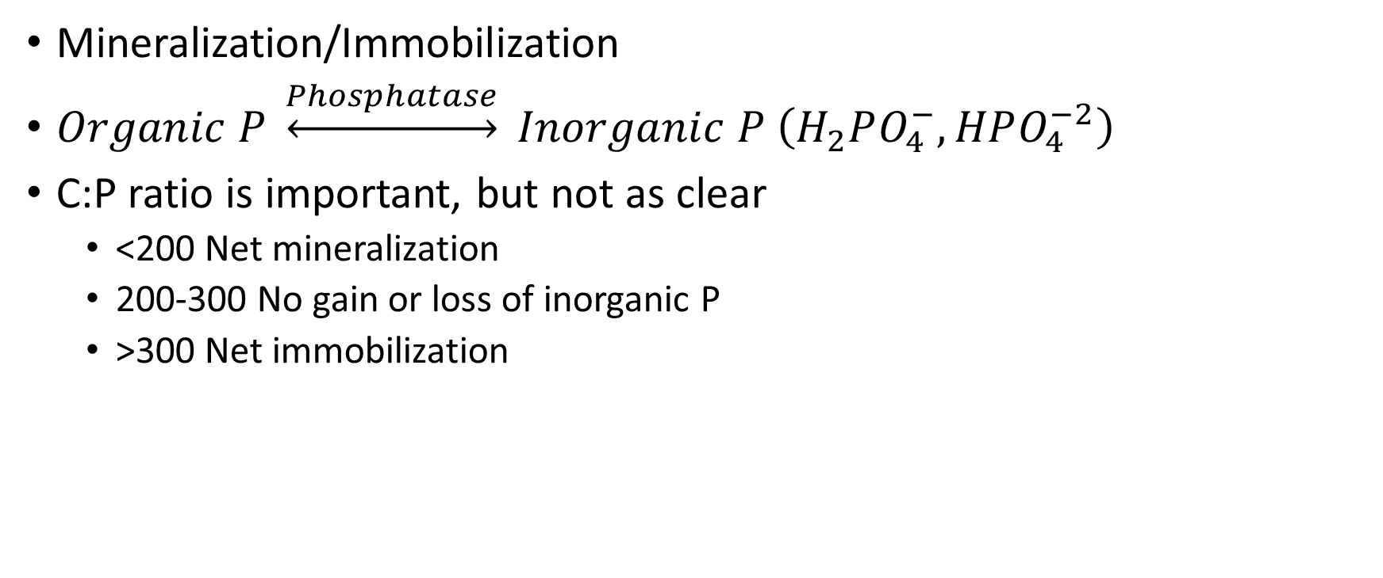
Phosphorus Cycling
Mineralization/Immobilization
$Organic P \underset{↔}{Phosphatase} Inorganic P \left(H_{2}PO_{4}^{−}, HPO_{4}^{−2}\right)$
C:P ratio is important, but not as clear
<200 Net mineralization
200-300 No gain or loss of inorganic P
>300 Net immobilization

Slide 21
Organic Soil P
Comprises >50% of TOTAL soil P
Inositol phosphate (greatest amount)
Phosphate ester of sugar-like compound
Most abundant known organic P compound
Created from biological degradation of organic matter
Nucleic acid
DNA & RNA
Phospholipids (least amount)
Fat-like compounds of microbial origin

Slide 22
Organic Soil P
In native grounds, natural ecosystems will cycle P in enough amounts that deficiencies won’t occur. Newly cultivated soils are usually fertile
Mineralization of organic-P is an important source of plant available-P for several years as virgin soils are brought under cultivation

Slide 23
Phosphorus Cycling
Reaction time and the extent to which past reactions have satisfied the capacity of the soil to fix P are both important to P fertilization considerations
With continued addition of fertilizer-P to the soil, the envisioned capacity of the soil for fixing P becomes somewhat satisfied and there is less fixation of each additional P addition
Because the concentration of reactants (Ca²⁺ and Al³⁺) to form insoluble phosphates in the soil is quite low, a relatively long time is required for the least soluble P-fixing compounds to be formed
This allows significant time for plants to utilize P in solution at relatively high concentrations following fertilization.

Slide 24
Phosphorus Losses
Crop Removal
Greatest amount of loss from native systems, with yearly removal of P
Runoff
Occurs with high irrigation shortly after fertilization, or with high amounts of liquid fertilizer (effluent)
Leaching
When additional P is added, but not fixed or adsorbed one way or another
Generally an issue with high over-fertilization

Slide 25
Soil Testing for Phosphorus
Key to managing soil and fertilizer P: knowledge of whether or not the level of soil solution P is adequate (about 0.05 ppm) to meet the needs for plant growth
When the level of solution P is not adequate, it is important to know how much P fertilizer should be added, and/or how much yield loss will occur if the P deficiency is not corrected. Soil tests are important to determine this information
Will solution P alone be enough to be an indicator of P in season?

Slide 26
Soil Testing for Phosphorus
Effective soil tests extract P that is immediately available (solution) and a representative portion of the P that will become available during the growing season (Labile/non-labile)
The latter fraction represents Al/Fe/Ca phosphates bound in soil, that could become available
There is no perfect way to determine, so we must develop a correlation between soil test extracts and plant extracts

Slide 27
Soil Testing for Phosphorus
In the early period of soil test development, many chemical solutions and extraction periods were used
Over time, similarities have been recognized that allow reliable extraction and analysis to be made using only one procedure, with consideration of soil pH

Slide 28
Orthophosphate Analysis
KCl extraction flushes H₂PO₄⁻ and HPO₄²⁻ out of the profile
Measures only solution P

Slide 29
Bray P1
Acid soils, developed by Bray at University of Illinois
The procedure is designed to dissolve Al-phosphates by precipitating Al with Fluoride (F).

Slide 30
Olsen
Developed by Olsen at Colorado State University, for neutral and basic soils with high Ca concentration
Dissolves Ca phosphates by precipitating Ca with carbonate

Slide 31
Mehlich 3
Adolph Mehlich at NC State
Acetic acid, ammonium nitrate, ammonium fluoride, EDTA
Extracts portions of plant available P from either acid or basic soils
This procedure is becoming more widely used and replacing regionally specific procedures

Slide 32
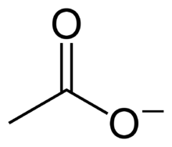
Mehlich 3
Acidic Soils
Acetic ion will compete with Phosphate on adsorption sites (AEC), releasing more P
Organic P

Slide 33
Mehlich 3
Basic Soils
Break apart Calcium Phosphates (HAP)

Slide 34
Lancaster/Mississippi Method
Developed here at State by JD Lancaster in the 70’s specifically to provide better correlation with blackland prairie soil types (high Ca)
Assortment of acids
Malic
Malonic
Acetic
AlF₃
Ammonium Acetate

Slide 35
Correlation/Calibration
For any P test to be beneficial, the extracted P must be related to crop response or growth and development
The relationship between P soil test value and growth is compared using correlation
When there is a good relationship between soil test extraction values and the percentage of maximum yield, then the procedure has promise as an effective tool to help manager fertilizer P inputs
Generalized correlation of soil test-P and crop response

Slide 36
Correlation/Calibration
Calibration is a process that involves determining what rates of P fertilizer will lead to low residual P places to no longer have deficiencies

Slide 37
Making P fertilizer Recommendations
Two main strategies
Sufficiency
Buildup/Maintenance

Slide 38
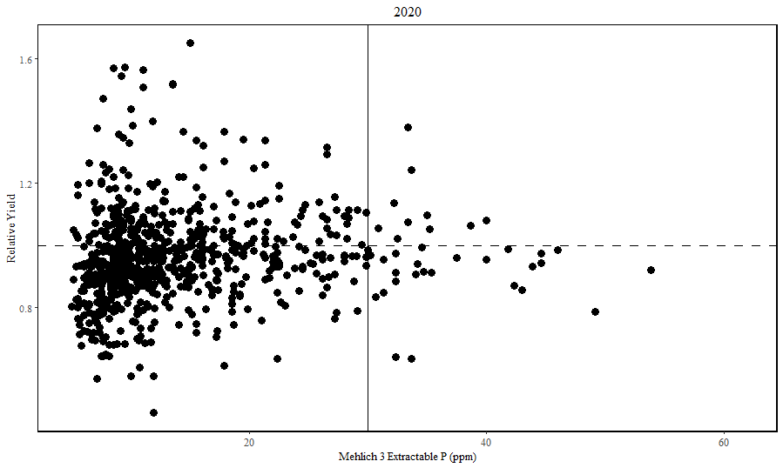
Sufficiency
Based directly from Bray’s Nutrient Mobility Concept
Pro’s
Does not apply any more than is needed
Solely for the crop
Con’s
If correlation/calibration studies aren’t accurate, may not be enough to maximize yield all years

Slide 39
Making recommendations
Sufficiency approach
When soil test level is below optimum, apply only enough nutrients to meet crop needs

Slide 40
P Buildup/Maintenance
Since soluble fertilizer forms of P react with soil to form less soluble compounds soon after they are added, Plant Uptake Efficiency is generally 15%
About 85% remains in soil as labile/non-labile P
Buildup suggests continued annual fertilizer application to build-up P in order to provide adequate P to meet crop yields
Can monitor via annual soil testing
On average, buildup is about 1 lb P ac for every 15 lb P₂O₅ fertilizer P added in excess of crop removal

Slide 41
P Buildup/Maintenance
Think about it in terms of the reservoir diagram
When fertilizer additions exceed crop removal the large reservoir “fills up” to the point where the soil test reaches 65 and fertilizer may be unnecessary for several years
Then, you just replace what is removed on a year to year basis

Slide 42
P Buildup/Maintenance
Pros
Will provide plenty of P whenever the crop needs it
Reduces risk of not applying enough P on a year to year basis
Cons
Cost prohibitive
Too much P can leach out the system
Takes time to buildup, can’t apply bulk immediately

Slide 43
Making recommendations
Crop | P₂O₅ | K₂O
lb/bu
Corn | 0.4 | 0.3
Soybean | 0.8 | 1.4
Wheat | 0.5 | 0.3
Sufficiency approach
When soil test level is below optimum, apply only enough nutrients to meet crop needs
Buildup and maintenance approach
Rapidly build low soil test concentrations to optimum level
Replace nutrients removed by crop at higher soil test levels where response is not expected

Slide 44
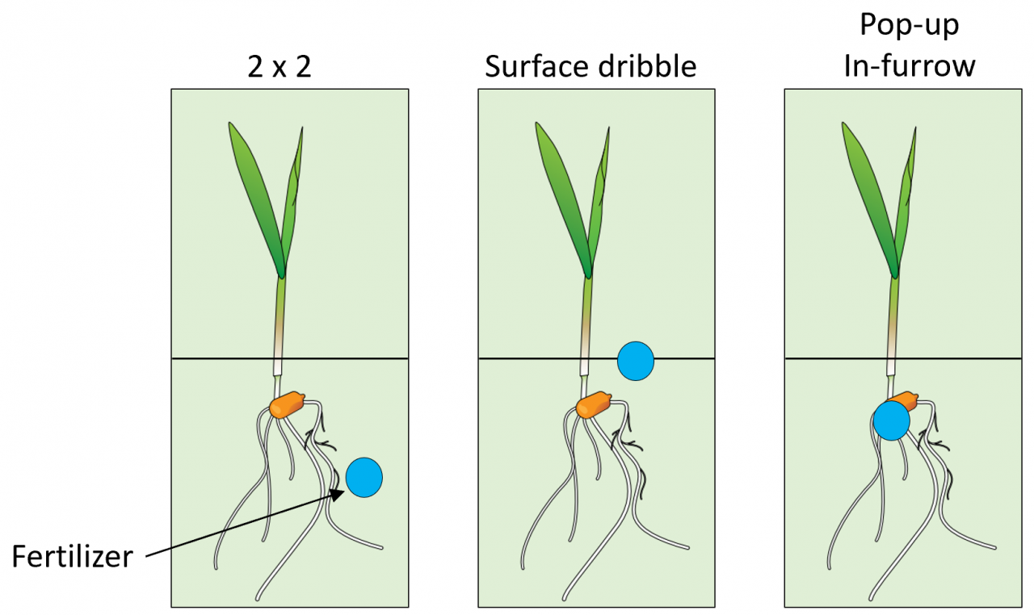
Methods of P fertilization
Most common: Broadcast dry fertilizer over soil surface, then incorporation with tillage
Little time consumption, move as fast as you can get a spreader in to apply and then till it in
Banding
Surface dribble
In-furrow
2x2, or two inches below and to the side of the seed furrow

Slide 45
Methods of P fertilization
Why banding?
Creating area of HIGH concentration that won’t all be converted/fixed
Banding leads to being able to use more than just diffusion and active transport, can have mass flow

Slide 46
Methods of P fertilization – Foliar Applied P
Foliar fertilizer is usually restricted to the correction of micronutrient plant deficiencies, or late N application, there is reason to believe foliar P fertilization could be effective in select situations
Only small amount of soil applied P will contribute to the crop (labile)
Foliar absorption COULD be in the range of 50-80% efficient, and could be effective if the plant can take it in via leaf
This approach has special appeal in countries where the soil has a high P-fixing capacity (lots of Al/Fe or Ca) and labor is inexpensive to allow hand spraying of small scale production systems
In intensive agriculture, NOT a replacement for soil applied fertilizer

Slide 47
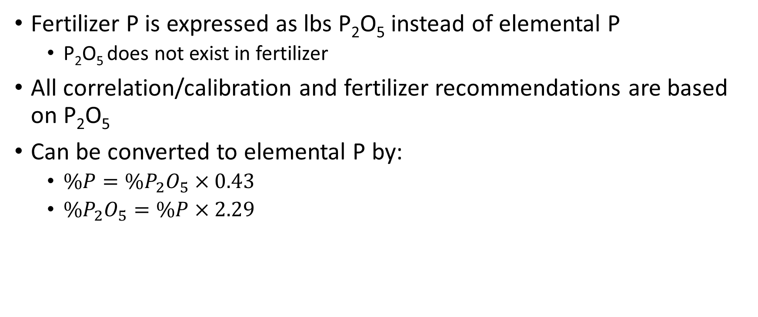
Fertilizer P nomenclature
Fertilizer P is expressed as lbs P₂O₅ instead of elemental P
P₂O₅ does not exist in fertilizer
All correlation/calibration and fertilizer recommendations are based on P₂O₅
Can be converted to elemental P by:
$\%P=\%P_{2}O_{5}×0.43$
$\%P_{2}O_{5}=\%P×2.29$

Slide 48
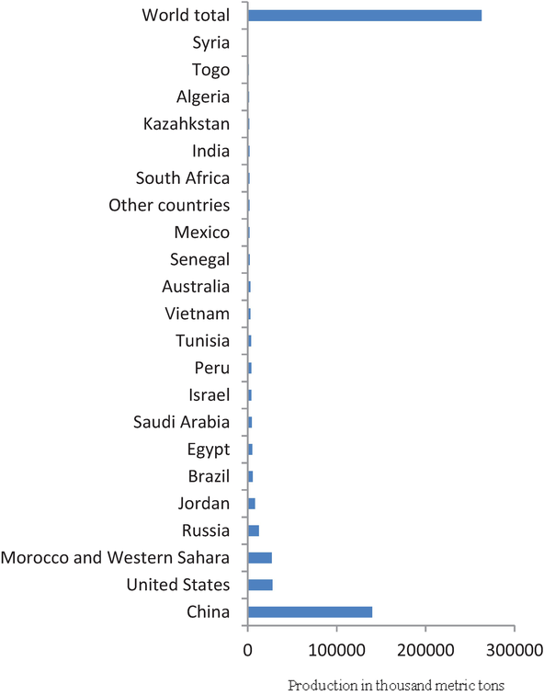
Phosphorus Sources
Currently, no way to synthetically make phosphorus fertilizer
Mined as rock phosphate, then turned into other forms

Slide 49
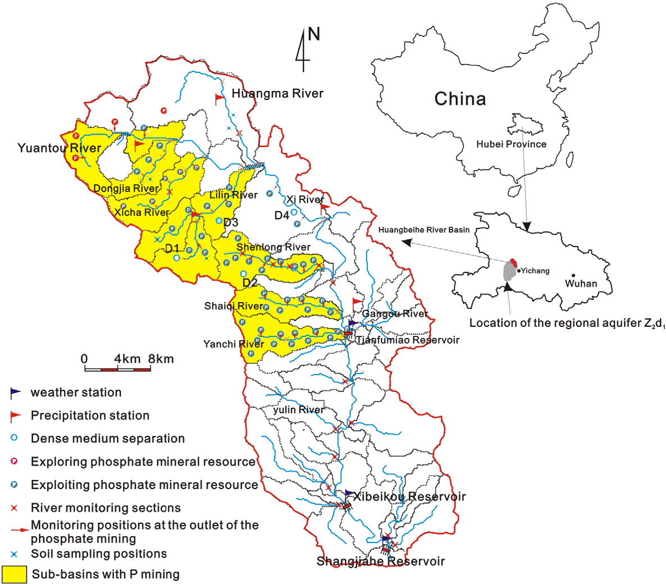
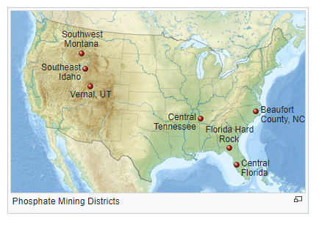
Phosphorus Mining Sources
https://goo.gl/maps/wuwfxX1uSoRGVamM8

Slide 50
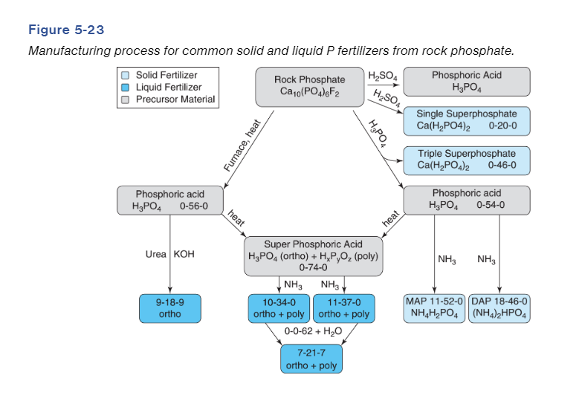
Sources of P fertilizers

Slide 51
Inorganic P Fertilizers
Rock Phosphate (0-20-0)
Finely ground rock phosphate
Low solubility, only becomes soluble in low pH’s
Can be an important source of P on soils that have high P fixing capacity (slowly becomes available, meaning it may have time to be used before completely fixed)
Can be used to correct a severe soil deficiency in a small area (slow to become available, will increase over time)
What about in acidic soils?

Slide 52
Inorganic P Fertilizers
Ordinary Super Phosphate (0-20-0)
Occurs with the reacting of rock phosphate with sulfuric acid to form more soluble monocalcium phosphate plus gypsum
One of the first processed P fertilizers, common in early use
Still important in developing countries and also supplies sulfur

Slide 53
Inorganic P Fertilizers
Concentrated Super Phosphate, or Triple Super Phosphate (0-46-0, TSP)
Reacting Rock Phosphate with phosphoric acid results in a higher concentration of P fertilizer, no gypsum is produced
Highly soluble P product

Slide 54
Inorganic P Fertilizers
With time, cultivated soils become increasingly deficient in N, and the fertilizer industry recognized the added value of a mixed fertilizer product
Mono-Ammonium Phosphate (11-52-0, MAP)
Di-Ammonium Phosphate (18-46-0, DAP)
Reacting phosphoric acid with ammonia to create ammonium phosphates
Both are solid granular materials that can be easily blended with other solid fertilizers

Slide 55
Inorganic P Fertilizers
Ammonium PolyPhosphate (10-34-0, APP)
Liquid, considerably more expensive on a P lb/ac basis, but popular because liquid is easier to apply and store
Just as effective as dry sources on lb/lb basis, selection should be based on availability, convenience, and cost

Slide 56
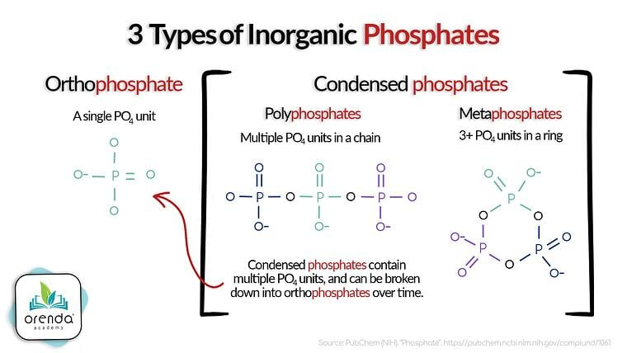
Inorganic P Fertilizers – Poly vs Ortho
In general, P in dry fertilizers such as DAP and MAP are present as orthophosphate
In contrast, P in liquid fertilizers are present as BOTH poly and ortho phosphates
~2/3 poly, 1/3 ortho
9-18-9 is a liquid that is ALL ortho

Slide 57
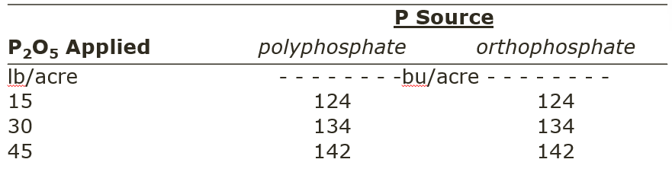
Inorganic P Fertilizers – Poly vs Ortho
Effect of both forms of P on crop production has been evaluated in various field trials throughout the corn belt
Corn in Nebraska

Slide 58
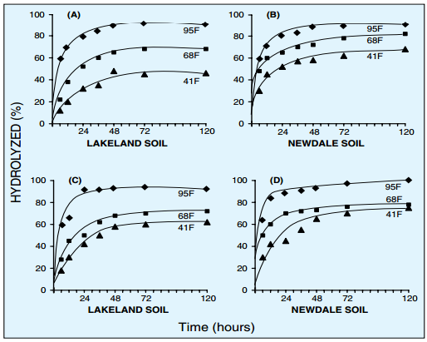
Inorganic P Fertilizers – Poly vs Ortho
Applied as a liquid source (~60% poly, 40% ortho)
A is a sodium pyrophosphate (smaller chain)
B is a tripolyphosphate (larger chain)
Texture and temperature impact the conversion from poly to ortho
Lakeland is a sandy texture
Newdale is a coarse-silty texture, silt loam

Slide 59
Inorganic P Fertilizers – Poly vs Ortho
P in polyphosphate form should be hydrolyzed to orthophosphate within a week after application
The availability of P in liquid forms should be equal, regardless of ortho vs. poly
Use of liquid and dry fertilizers are equivalent as long as equal P is being applied. Results from multiple trials have shown this
You should not base choice of fertilizers on orthophosphate or polyphosphate claims

Slide 60
Organic P Sources
Animal waste is a great source of P by analysis
Generally, animal waste is 1:1:1 ratio of NPK
Plants generally use N:P in 10:1 ratio
Biggest considerations for animal waste as P fertilizer comes down to two things
Over application due to high supply
Over application of P due to applying to meet N needs
Most P from animal waste is not used by the crop, accumulates, and leads to excess P in runoff

