Slide 1
Chapter 5 - Nitrogen
Spring 2026

Slide 3
Introduction
Most frequently deficient nutrient in non-legumes
Legumes can fix enough for their growth
Generally need to meet plant needs with N additions
Inorganic – Immediately available or slow release
Organic – Must Mineralize before available
Globally, N use has increased over last 50 years
US use has remained fairly steady
N Use has lead to environmental problems
Have to understand N cycle to manage for yield and environment

Slide 4
Form and Function of N
Plants are about 1%-6% N by weight
Forms absorbed (predominately)
NO₃⁻
NH₄⁺
Both move to plant by mass flow and diffusion
Urea and amino acids, less so, and still have to be converted to be used
When absorbing any nutrient, plant must also exude an equal charge
Important in the soil rhizosphere

Slide 5
Form and Function of N
NO₃⁻ Uptake
Exudes OH⁻, HCO₃⁻, other anions (creates a slightly basic area around rhizosphere)
Must be reduced to NH₃ before converted to amino acids and proteins
Energy requiring process, so NH₄⁺ is preferable
Could impact carbohydrate and protein levels at the molecular level, but not significant enough to impact yield
NH₄⁺ uptake
Reduces Ca²⁺, Mg²⁺, and K⁺ uptake, as it uses the same pathway (charge)
Exudes H⁺ for uptake (creates a slightly acidic area around rhizosphere)

Slide 6
Form and Function of N
Plant preference varies, while energy consumption says NH₄⁺ is preferable
Most plants have evolved to uptake a lot of NO₃⁻
NH₄⁺ conversion to NO₃⁻ rapid in moist, aerated soils

Slide 7
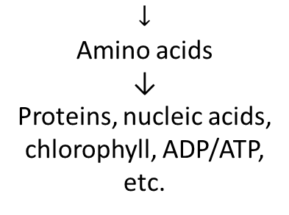
Form and Function in Plants
NO₃⁻ must be reduced to NH₃ before use in the plant
Adequate supply of N needed for high photosynthetic activity
Excess can delay maturity, increase insect/disease pressure
Step 1 NO₃⁻ → NO₂⁻ Nitrate Reductase Cytoplasm
Step 2 NO₂⁻ → NH₃ Nitrite Reductase Chloroplast
Occur in series so toxic NO₂⁻ does not accumulate
$$↓$$
Amino acids
↓
Proteins, nucleic acids, chlorophyll, ADP/ATP, etc.

Slide 8
Nitrogen Pools

Slide 9
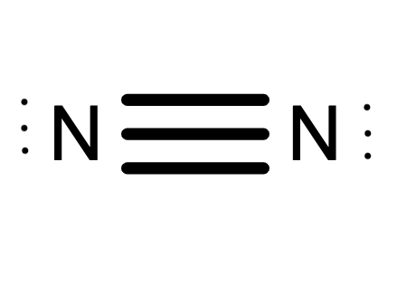
Nitrogen Pools – Atmosphere
Greatest source of N is N₂ in the Atmosphere
Atmosphere is 78% N
~36,000 ton/ac
It is in an unusable form for plant consumption
As N₂ is very chemical stable, it takes a considerable amount of energy to transform it into a form that plants and animals can use
It exists throughout all the environment, in one form or another

Slide 10
Nitrogen Pools – Soil N
Microbial/Plant Sink
Actively living plants that uptake N in one form or another
Soil Pools
NO₃⁻
NH₄⁺
But these pools alone are not capable of supplying our crops N with all their needs, so we must transform these pools into another form

Slide 11
Nitrogen Pools – Soil N
Organic N (95% of soil N) – Central Component of N in soil
Amino Acids, organically bound NH₄⁺ – Majority of Mineralized N during growing season
Acid insoluble organics, amino sugars are others
Soils contain about 2,000 lbs of N/acre (12” deep) for each 1% of organic matter content
Inorganic N
NH₄⁺, NO₃⁻, NO₂⁻, N₂O, NO, NO₂, and N₂
NH₄⁺, NO₃⁻ are most important, and derived from aerobic decomposition of OM, or additions from fertilizer recommendations

Slide 12
Nitrogen Sources/Additions

Slide 13
Nitrogen Sources
Symbiotic Fixation
Non-Symbiotic Fixation
Soil Microorganisms
Atmospheric N
Greenhouse Gases
Industrial Fixation

Slide 14
Nitrogen Sources – Symbiotic Fixation
Legumes – Rhizobium
Mechanism
Bacteria invade root hairs and form nodules
Rhizobia absorbs N₂ from air, and convert to NH₄⁺ with enzyme Nitrogenase and energy
Specificity between the different rhizobium species and the host plant thye infect exist
Seeds can be inoculated with desired rhizobium species
As population increases, need for inoculation decreases.
Amount of N fixed is dependent on soil and climatic conditions
Soils with adequate water, nutrients, and pH are generally best
Rhizobia is drastically reduced in heavily acidic soils (<5.5)
High levels of available N tend to depress fixation
Legume N generally available to following crops
Mineralization of plant residue
Immobilization of N preventing loss

Slide 15
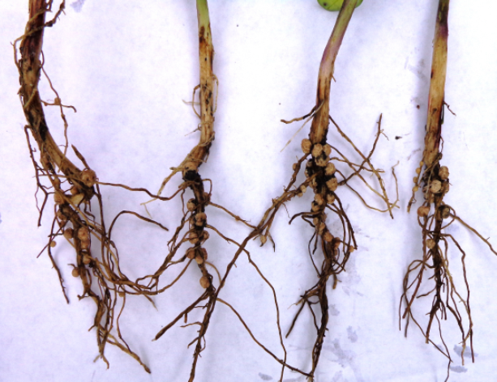
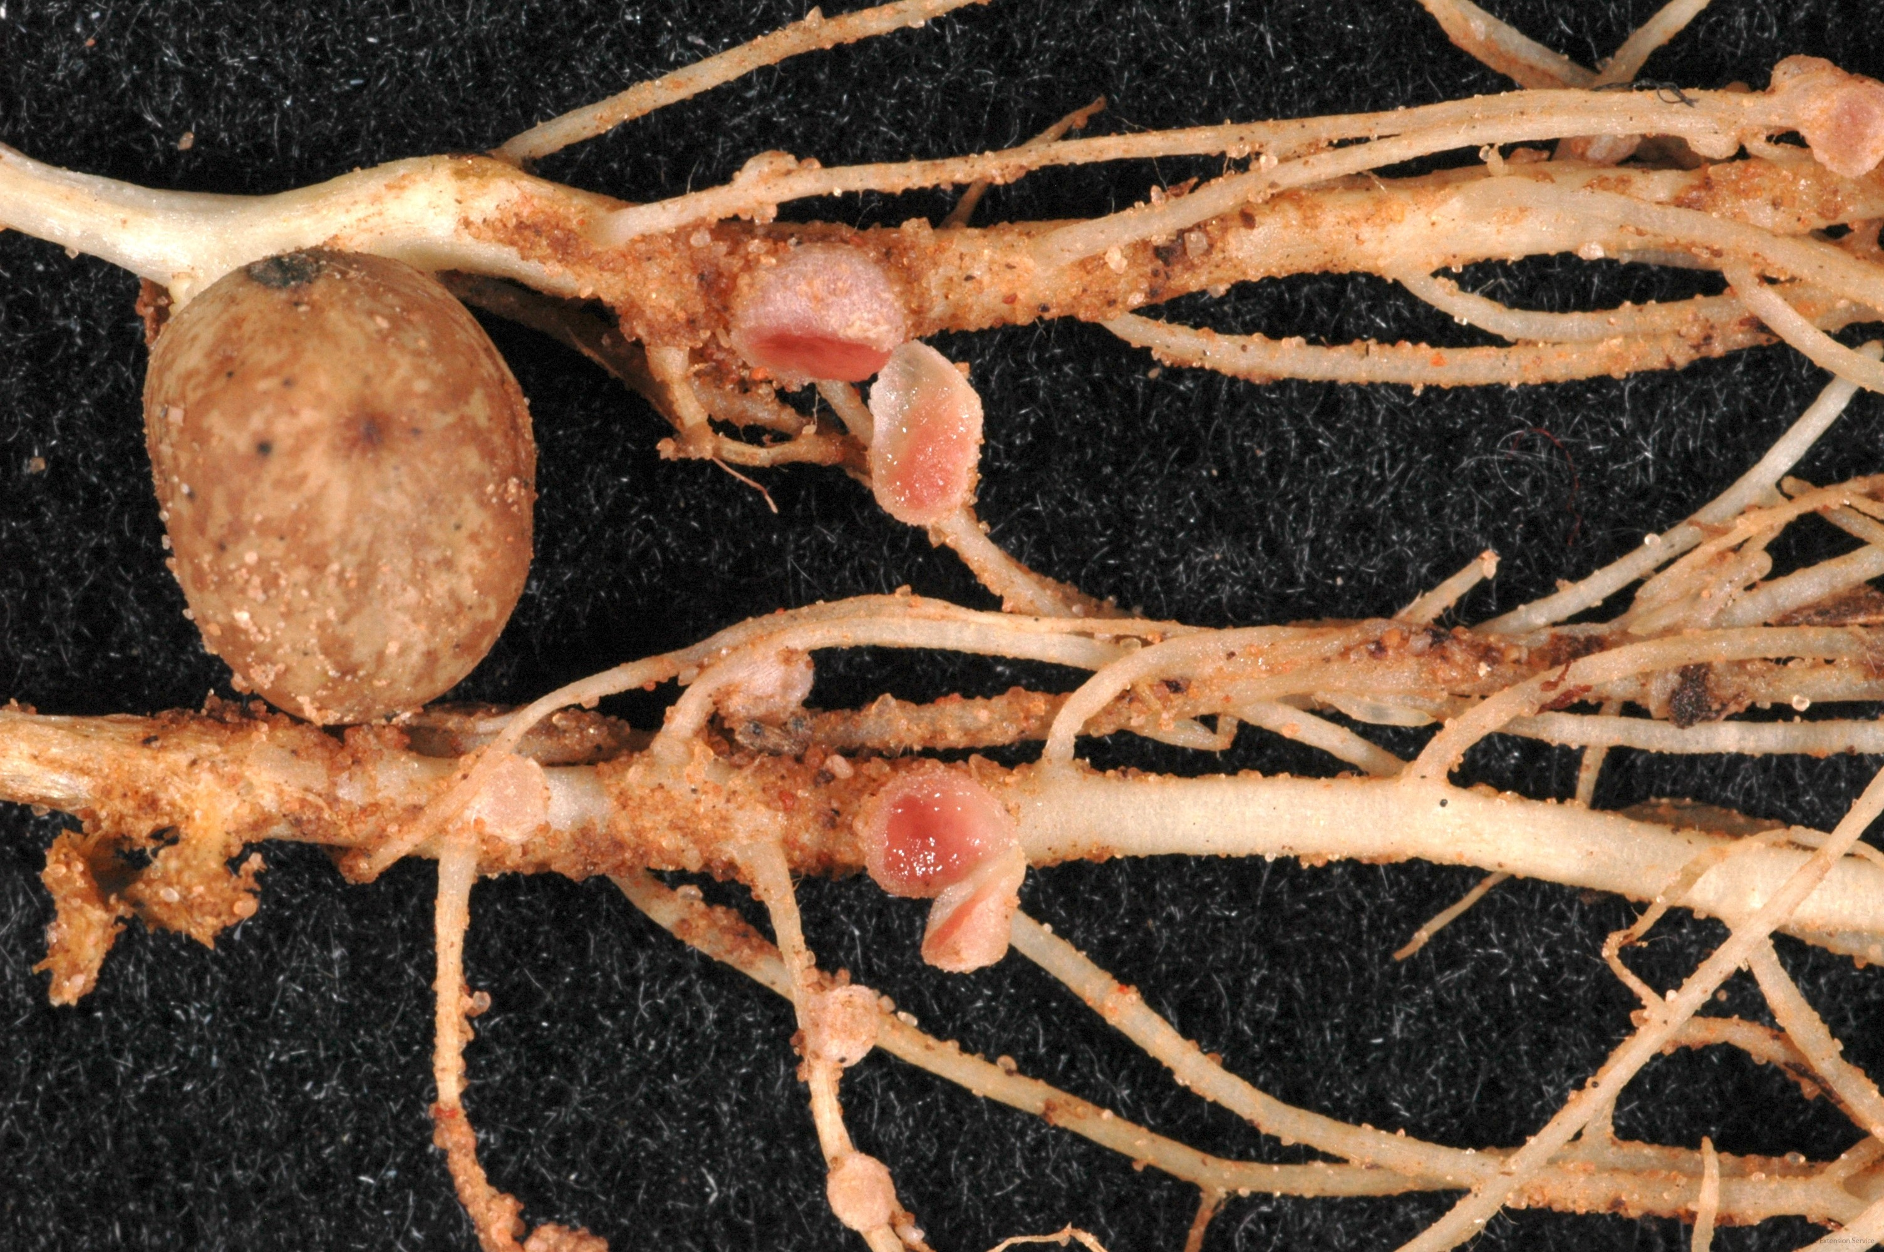
Rhizobia

Slide 16
Nitrogen Sources – Symbiotic Fixation
Rhizobium associated with N assimilation by legumes account for about 90,000,000 tons of N from N₂ to biological-N annually
By comparison, worldwide manufacture of N fertilizers is estimated to be about 90-100,000,000 tons annually
Other biological symbiotic fixation
160 species of non-legumes are known to develop nodules and accommodate symbiotic N fixation
Alder Tree/Bush
Accomplished with actinomycetes and compares with legume fixation

Slide 17
Nitrogen Sources – Non-Symbiotic Fixation
Generally occurs with certain strains of free-living bacteria
Microorganisms fix N for themselves, but the N becomes available when the microorganism dies and decomposes
Blue Green Algae, Azotobacter, Clostridium
Uncommon in agriculture, varies, and very unreliable, produce at most 5 lb N/ac

Slide 18

Nitrogen Sources – Non-Symbiotic Fixation
Natural Fixation
N₂ is oxidized via lightning (high energy)
Becomes NO₃⁻ or NO₂⁻, comes down as rainfall
~5-10 kg/ha (4-9 lb/ac)
Earliest plant life received their N this way
Relatively insignificant compared to seasonal N requirements

Slide 19
Nitrogen Sources – Non-Symbiotic Fixation
Greenhouse gases
Some manufacturing processes will create N₂O gas, which will move into the atmosphere, and then will come down with rainfall later
Industrial Fixation
Most important source of N to plants in the past 100 years
Based on Haber-Bosch Process

Slide 20
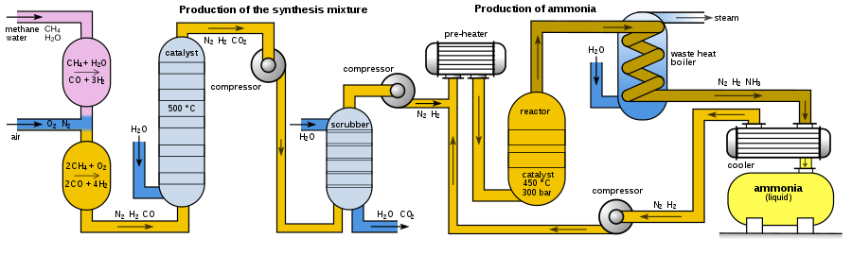

Haber-Bosch Process
1200° C, 500 atm, $3H_{2}+N2 →2 NH_{3}$

Slide 21
Nitrogen Transformations

Slide 22
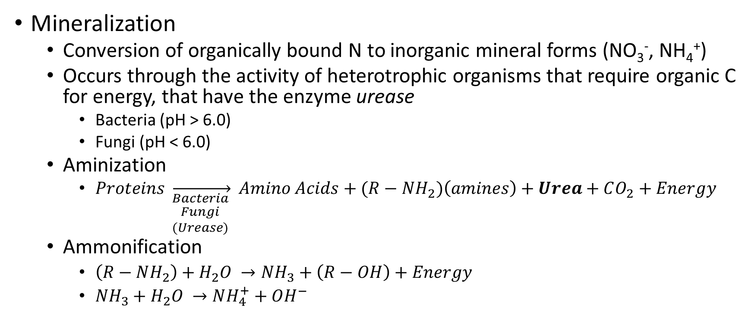
Mineralization and Immobilization
Mineralization
Conversion of organically bound N to inorganic mineral forms (NO₃⁻, NH₄⁺)
Occurs through the activity of heterotrophic organisms that require organic C for energy, that have the enzyme urease
Bacteria (pH > 6.0)
Fungi (pH < 6.0)
Aminization
$Proteins \overset{→}{\begin{aligned}Bacteria \\ Fungi \\ (Urease)\end{aligned} } Amino Acids+(R−NH_{2})\left(amines\right)+Urea+CO_{2}+Energy$
Ammonification
$\left(R−NH_{2}\right)+H_{2}O →NH_{3}+\left(R−OH\right)+Energy$
$NH_{3}+H_{2}O →NH_{4}^{+}+OH^{−}$

Slide 23
Mineralization and Immobilization
NH₄⁺ now has a few different fates
Converted to NO₃⁻ via Nitrification
Absorbed by plants
Utilized by Bacteria to decompose more residues
Fixed to clay particles (NH₄⁺ Fixation)
Converted to NH₃ and released to the atmosphere via Volatilization

Slide 24
Mineralization and Immobilization
Immobilization
Conversion of inorganic-N (NO₃⁻, NH₄⁺) into organic forms
Microorganisms absorb the inorganic-N and convert it to organic tissue
Dependent on C:N ratio
Microbes need 8:1, so they will regulate through either mineralization or immobilization
When conditions are favorable for immobilization, and non-legume crops are grown in the same soil, microbes will successfully compete for the available N

Slide 25
Mineralization and Immobilization
Based on C:N ratio of the material that is being decomposed
When organic matter has a C:N ratio > 30, NO₃⁻ initially present in the soil is consumed (immobilized) by microbes during the decay process.
As a product of the decay process (respiration) CO₂ content in the soil gradually increases
Because C is lost and N is conserved, the C:N ratio becomes narrower until it is finally <20, at which point NO₃⁻ begins to accumulate
Summary
Materials with higher N content (manure) will decompose and be mineralized
Materials with lower N content (wheat straw, grain residue) will immobilize

Slide 26
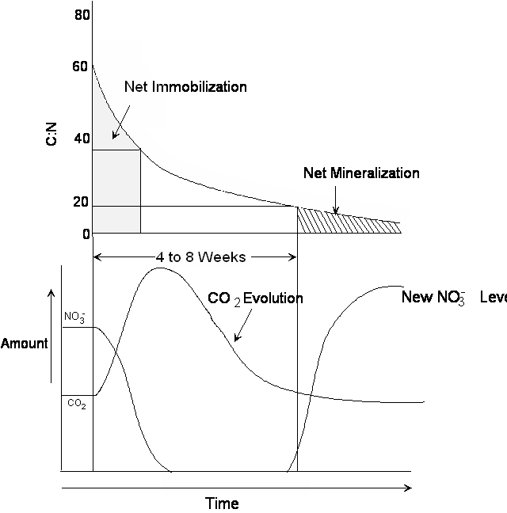

Slide 27
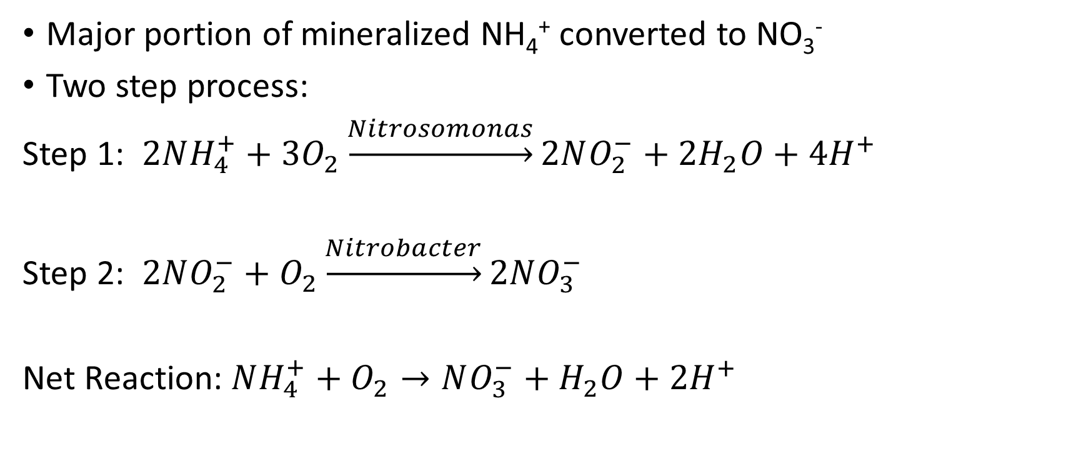
Nitrification
Major portion of mineralized NH₄⁺ converted to NO₃⁻
Two step process:
Step 1: $2NH_{4}^{+}+3O_{2}\underset{→}{Nitrosomonas}2NO_{2}^{−}+2H_{2}O+4H^{+}$
Step 2: $2NO_{2}^{−}+O_{2}\underset{→}{Nitrobacter}2NO_{3}^{−}$
Net Reaction:$NH_{4}^{+}+O_{2}→NO_{3}^{−}+H_{2}O+2H^{+}$

Slide 28
Nitrification
Nitrite (NO₂⁻) does not accumulate in well-aerated soils because the second step occurs at a faster rate than the first, so it is quickly transformed to NO₃⁻. Because NO₂⁻ is not normally found in soils, it is toxic
Factors affecting Nitrification
NH₄⁺ supply
Nitrifying Organisms – Nitrosomonas and Nitrobacter
Must have nitrifying organisms
Adequate environment
Moist
Anaerobic
Neutral pH
Optimum soil temp (25-35° C)

Slide 29
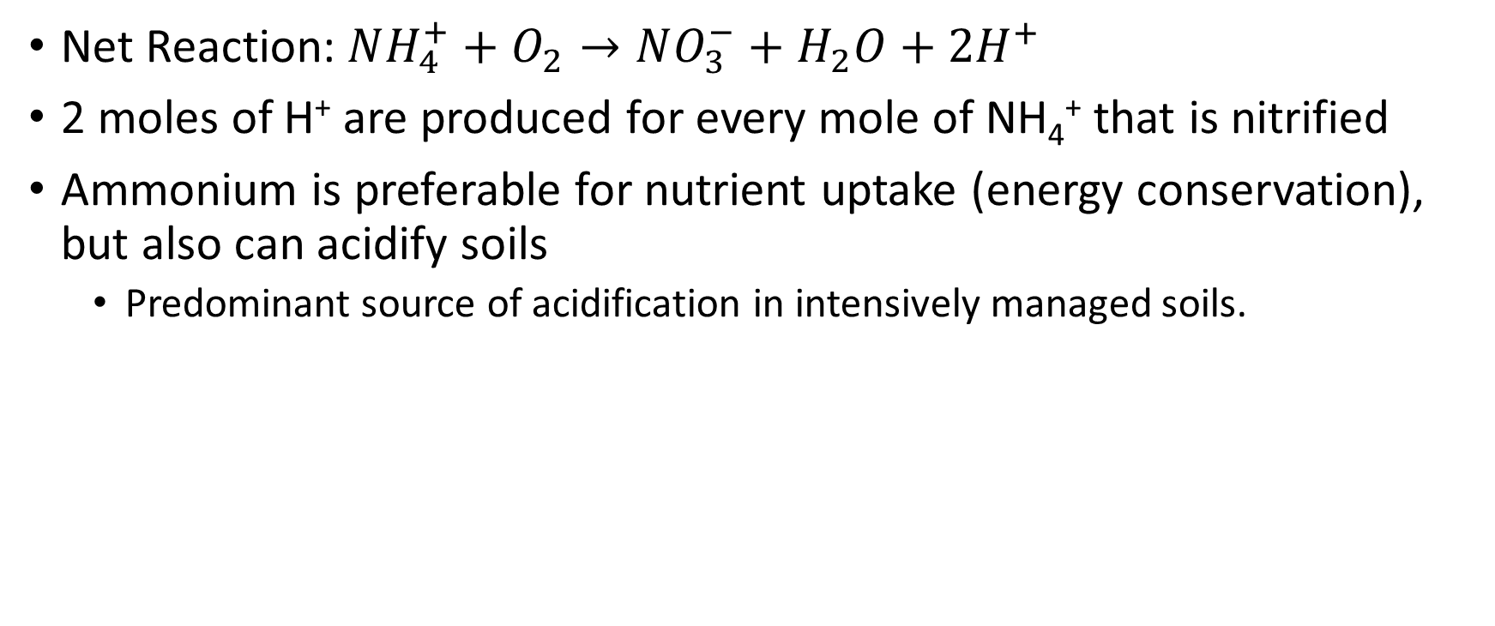
Nitrification
Net Reaction:$NH_{4}^{+}+O_{2}→NO_{3}^{−}+H_{2}O+2H^{+}$
2 moles of H⁺ are produced for every mole of NH₄⁺ that is nitrified
Ammonium is preferable for nutrient uptake (energy conservation), but also can acidify soils
Predominant source of acidification in intensively managed soils.

Slide 30
Lime required to neutralize the soil acidity produced by fertilizers if all ammonium-N is converted to nitrate-N.
Nitrogen source | Chemical Formula | Composition | Lime required (lb CaCO₃ / lb N)
Anhydrous ammonia | NH₃ | 82-0-0 | 1.8
Urea | (NH₂) ₂ CO | 46-0-0 | 1.8
Ammonium nitrate | NH₄ NO₃ | 34-0-0 | 1.8
Ammonium sulfate | (NH₄) ₂SO₄ | 21-0-0-24 | 5.4
Monoammonium phosphate | NH₄H₂PO₄ | 10-52-0 | 5.4
Diammonium phosphate | (NH₄) ₂HPO₄ | 18-46-0 | 3.6
Triple super phosphate | P₂O₅ | 0-46-0 | 0.0
Adapted from Havlin et al., 1999.

Slide 31
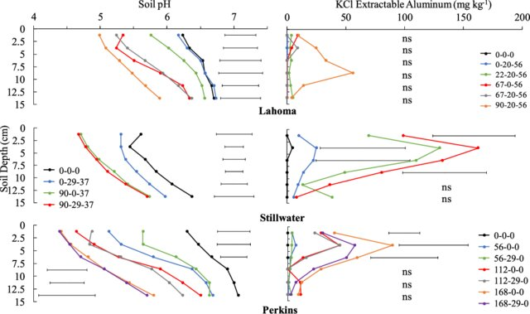
Nitrification

Slide 32
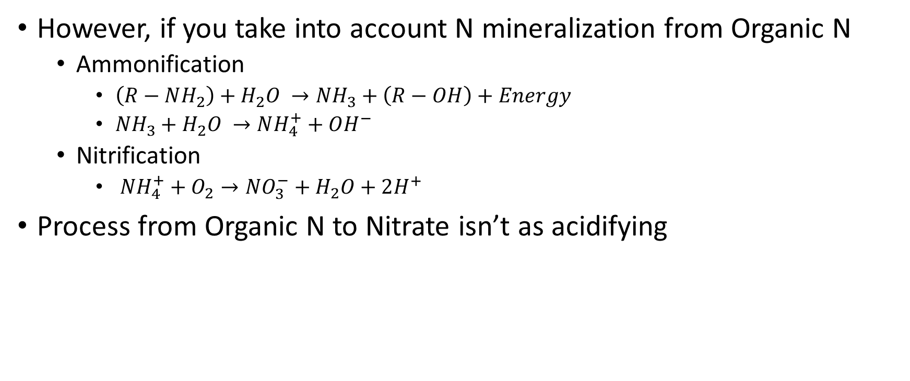
Nitrification
However, if you take into account N mineralization from Organic N
Ammonification
$\left(R−NH_{2}\right)+H_{2}O →NH_{3}+\left(R−OH\right)+Energy$
$NH_{3}+H_{2}O →NH_{4}^{+}+OH^{−}$
Nitrification
$NH_{4}^{+}+O_{2}→NO_{3}^{−}+H_{2}O+2H^{+}$
Process from Organic N to Nitrate isn’t as acidifying

Slide 33
Nitrification
When organic forms of N are the source of NO₃⁻ used by plants, only one mole of H⁺, or acidity, is produced from each mole of N taken up by the plants
As NO₃⁻ is metabolized and reduced to amino-N, the H⁺ is either neutralized or assimilated in the process and use of organic-N or amino-N by plants is not an acidifying process

Slide 34
Nitrification
How fast does this happen? Depends on pH

Slide 35
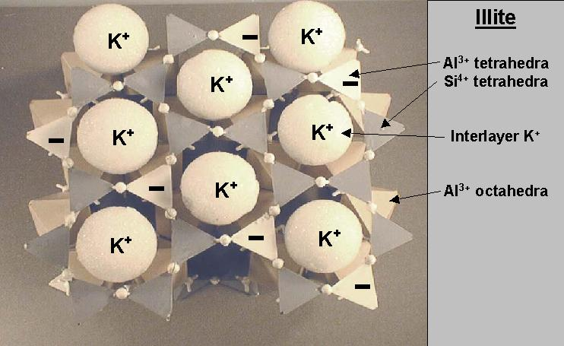
Ammonium Fixation
Occurs mainly on Vermiculate/Illite soils
Similar to K interlayer
As the concentration of NH₄⁺ increases, NH₄⁺ will successfully compete for exchange sites on clay and humus occupied by other cations
Cause for NH₄⁺ to be immobile in soil
Provides some degree of protection against other type of losses
Presence of K often restricts NH₄⁺ fixation, as it can fill the same fixation sites
K fertilization can reduce NH₄⁺ fixation

Slide 36
Ammonium Fixation
How much is actually fixed?
Varies greatly
Select soils (with great amounts of illite and vermiculite) can fix 1-30% of NH₄⁺
Certain soils will natively fix NH₄⁺ more greatly, not from overapplication.
Eastern Canada showed 14-60%
Intensively farmed areas generally can’t readily remove natively fixed ammonium
More recently fixed NH₄⁺ generally can be recovered by cropping

Slide 37
Nitrogen Losses

Slide 38
Nitrogen Losses
There are four major pathways for nitrogen losses
Leaching
Denitrification
Volatization
Immobilization and NH₄⁺ fixation isn’t considered a ‘loss’, because we aren’t losing it
It just becomes a form that isn’t plant available
NO₃
NH₄

Slide 39
Nitrogen Losses – Leaching
Nitrate is very soluble in water
Anion (negatively charged), so not adsorbed to soil colloids
Greatest loss pathway in high rainfall/irrigated systems
Magnitude of loss
Rate, time source, method of fertilization
Cropping intensity and crop N uptake
Soil porosity, texture, structure
Rainfall/irrigation timing, amount, pattern
General losses
Tile drained – 30-40%
Natural Drainage – 10-30%

Slide 40
Nitrogen Losses – Leaching
How do we mitigate losses?
Apply at peak NO₃⁻ uptake times
Avoid applying at high water movement periods
“Spoon feed” NO₃⁻ applications
Split N applications
Source
Apply NH₄⁺ sources
Use a NO₃⁻ source, or additive that limits leaching potential (talk about this in future section)

Slide 41
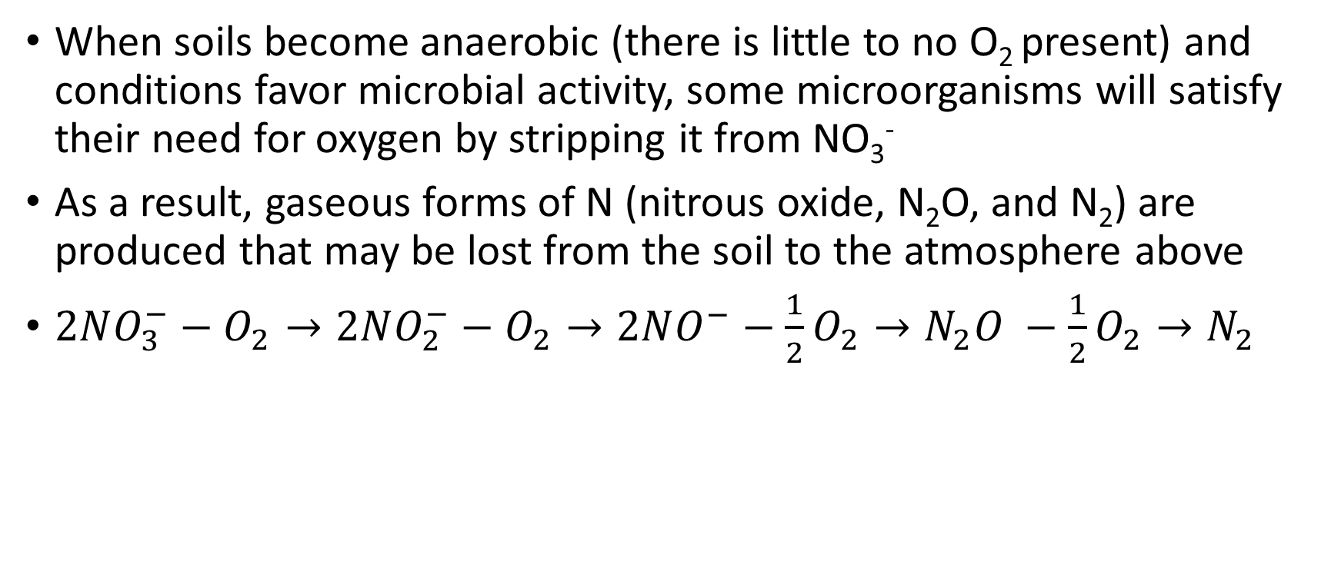
Nitrogen Losses – Denitrification
When soils become anaerobic (there is little to no O₂ present) and conditions favor microbial activity, some microorganisms will satisfy their need for oxygen by stripping it from NO₃⁻
As a result, gaseous forms of N (nitrous oxide, N₂O, and N₂) are produced that may be lost from the soil to the atmosphere above
$2NO_{3}^{−}−O_{2}→2NO_{2}^{−}−O_{2}→2NO^{−}−\frac{1}{2}O_{2}→N_{2}O −\frac{1}{2}O_{2}→N_{2}$

Slide 42
Nitrogen Losses – Denitrification
Two categories of denitrification losses
Rapid and extensive flushes (greatest losses)
Associated with heavy rains, irrigation, and snowmelt
Losses range from 2-25% of soil N in well drained soils
6-55% of soil N in poorly drained soils
Continuous small losses over extended periods
Denitrification in micro-, localized spots
How to mitigate losses?
Drainage
Low Organic matter?
Denitrification and Leaching are major issues in winter times
High rainfall (leaching and denitrification)

Slide 43
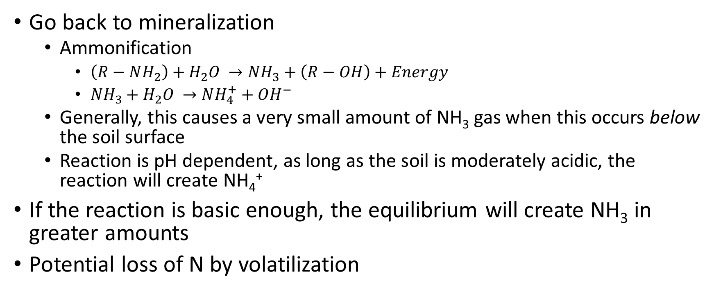
Nitrogen Losses – Volatilization
Go back to mineralization
Ammonification
$\left(R−NH_{2}\right)+H_{2}O →NH_{3}+\left(R−OH\right)+Energy$
$NH_{3}+H_{2}O →NH_{4}^{+}+OH^{−}$
Generally, this causes a very small amount of NH₃ gas when this occurs below the soil surface
Reaction is pH dependent, as long as the soil is moderately acidic, the reaction will create NH₄⁺
If the reaction is basic enough, the equilibrium will create NH₃ in greater amounts
Potential loss of N by volatilization

Slide 44
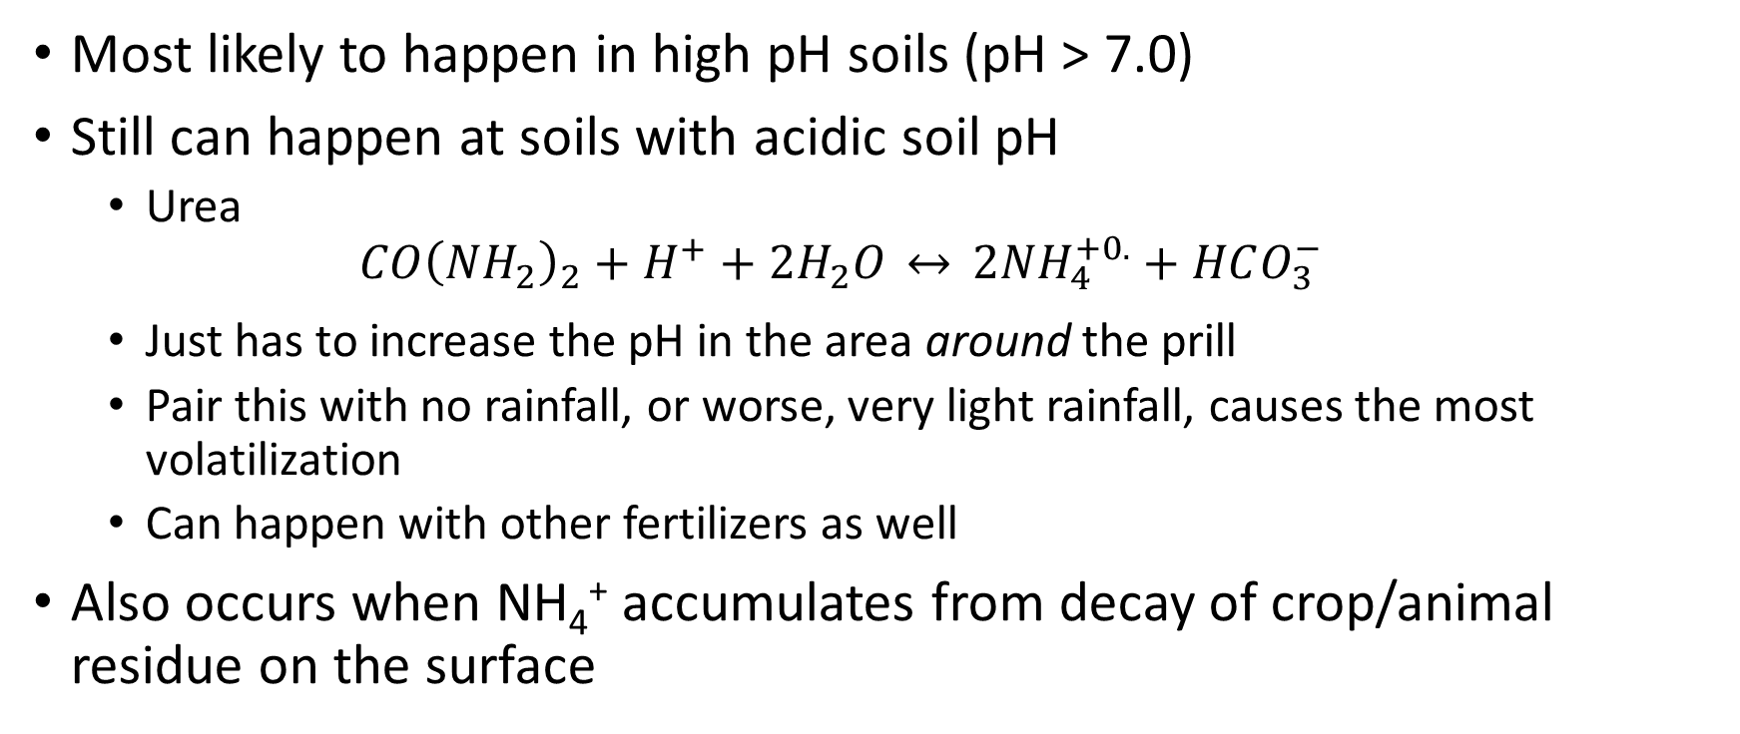
Nitrogen Losses – Volatilization
Most likely to happen in high pH soils (pH > 7.0)
Still can happen at soils with acidic soil pH
Urea $CO{\left(NH_{2}\right)}_{2}+H^{+}+2H_{2}O \overset{↔}{} 2NH_{4}^{+0.}+HCO_{3}^{−}$
Just has to increase the pH in the area around the prill
Pair this with no rainfall, or worse, very light rainfall, causes the most volatilization
Can happen with other fertilizers as well
Also occurs when NH₄⁺ accumulates from decay of crop/animal residue on the surface

Slide 45
Nitrogen Losses – Volatilization
Factors affecting Volatilization
Soil pH
Soil buffer capacity
Soil with higher buffer capacity will fix NH₄⁺
Environment
Won’t happen below 50° F, increases with temperature up to 113° F
Decreases in dry soil
But dry soil doesn’t stop it from ever happening, just doesn’t occur while dry
Max loss occurs when the soil surface is field capacity moist, and then it slowly drys
Evaporation of water encourages volatilization

Slide 46
Nitrogen Losses – Volatilization
Factors affecting Volatilization
Surface crop residue
Increased residue leads to holding more moisture at the surface, which over time, will evaporate
Nitrogen Source
Varies with source
NH₄⁺ containing fertilizers will have increased chances of volatilization
Urea
Manure, unless incorporated, can have losses up to 40%
Placement
Broadcast has the highest chance of volatization

Slide 47
Nitrogen Losses – Volatilization
Potential for maximum losses
Application of NH₄⁺ containing fertilizer on hot days, after rainfall/irrigation event, without incorporation
Control with
Incorporation
Banding
Sources
Additives
Urease inhibitor coating/additive to fertilizer sources

Slide 48
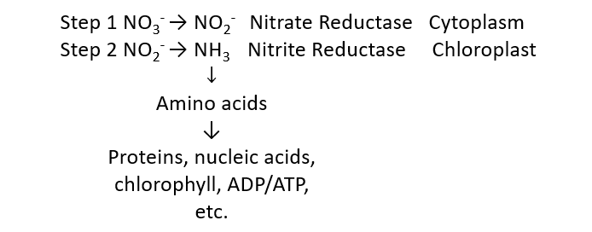
Nitrogen Losses – Plant Loss
Very little is known about the processes or the amounts
NO₃⁻ and NH₄⁺ converted to NH₃ in plant, and in stress environments (drought/pathogens) will gas NH₃ off

Slide 49
Nitrogen Pools, Transformations, and Losses interrelation
This is a cycle, the product of one reaction is a reactant for another
Its important to consider how change in the concentration of one component of the cycle can have a ripple effect throughout the rest of the cycle.
Incorporate N fertilizer so you don’t have volatilization occur, but now you have NH₄⁺ fixation
Add drainage so you have less likelihood of denitrification, but now you are leaching all your nitrate away too easily
Many N cycles try to illustrate the interrelationship of these processes, but its very difficult because everything is interconnected.

Slide 50
Nitrogen Cycle – To our advantage

Slide 51
Nitrogen Cycle
Important aspect of the N cycle is that it is natures way of conserving N
In nature, there is likely seldom more than a few (1-5 ppm) of N present in the form of either NH₄⁺ or NO₃⁻
Thus, although there are processes (leaching and volatilization) that can remove excess N from the natural system, these are not likely to be active except in extreme situations.

Slide 52
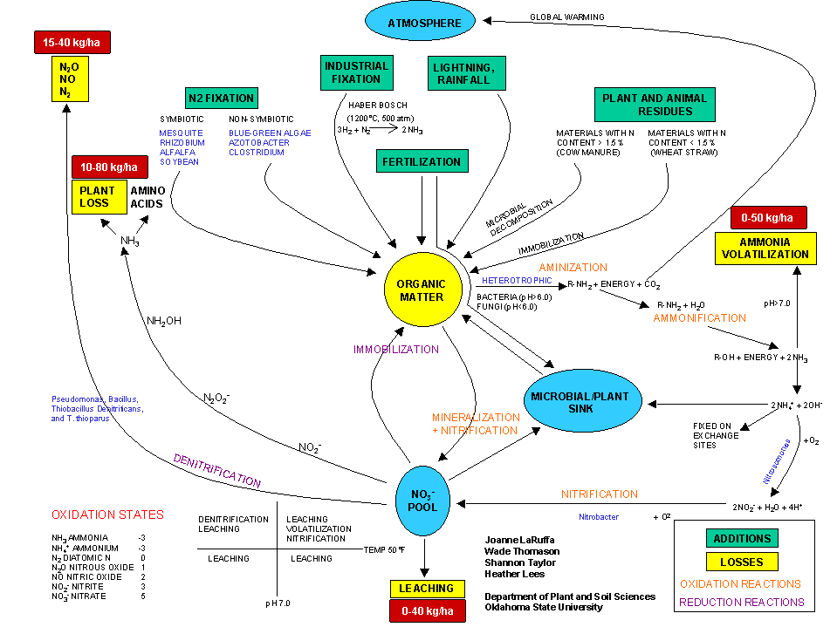

Slide 53
How does the N Cycle influence commercial plant production?
In a natural system, N is being cycled throughout the entire system
However, in intensive ag systems, turf, and horticulture, we are harvesting and removing N out of the system
Cultivation stimulates N mineralization and nitrification, resulting in gradual depletion of soil organic-N and soil organic matter
Many soils have lost from ¼ - ¾ of original organic matter as a consequence

Slide 54
Mineralization of N in legume residue
The use of legume crops in rotation with non-legumes and the N fertilizer industry grew out of a need to replace the depleted soil N.
Because legumes seldom lack N in their growth and development, their residue is rich in N (high protein)
C:N ratio is <20:1 and N mineralization will be favored.
When non-legumes, like corn, are rotated with a legume, such as soybeans, soybean residue may contribute 30-50 lbs N/ac to the next crop
Soybean-corn system, without N, yields about the same as the 40 lb N rate for the corn-corn system

Slide 55
How about long term legume residue?
Alfalfa – perennial legume (forage) usually been growing for 4-10 years
Accumulated residue, and existing growth when the alfalfa was destroyed by cultivation can provide a large amount of N-rich organic residue
Sufficient to meet N needs of the first year of corn production following alfalfa
Over time, that residual N will become less and less

Slide 56
What about inter-seeding legumes with non-legumes?
Will increase crude protein content of the mixture, but not directly due to legume producing N that the non-legume can immediately use
N-rich residue is created whenever non-legumes are grown in a N-rich environment as a result of fertilizer input at levels that exceed crop requirement
Because we have a legume with a non-legume, there will be excess N at the end of the season, which will accumulate in the residue
However, the response isn’t linear, as you would expect. Why?

Slide 57
What about inter-seeding legumes with non-legumes?
Think about the N cycle
Some of the fertilizer N is immobilized because the soil already has N available
Some of the mineral N is lost from the system because of mineral N enrichment
N cycle is effective at conserving N in a natural ecosystem
When we introduce excesses into the system, it no longer is as efficient
Efficient systems should be viewed as one that buffers against mineral N changes, and one that leaks when mineral N is present in excess
Most efficient N fertilization program would be one that most closely resembles the natural supply of N from the soil to the growing plants
This system would add minute amounts of mineral N to the soil at a location where the plant could absorb it each day. Is this feasible?

Slide 58
Nitrogen Fertilizer Recommendations

Slide 59
Nitrogen Use Efficiency
We must make strides to increase nitrogen use efficiency
Utliize the nitrogen cycle to our advantage
We must first know how to measure our efficiency before we can increase it
NUE of cereal grain production worldwide is 33%
$1 of N, lose $0.77

Slide 60
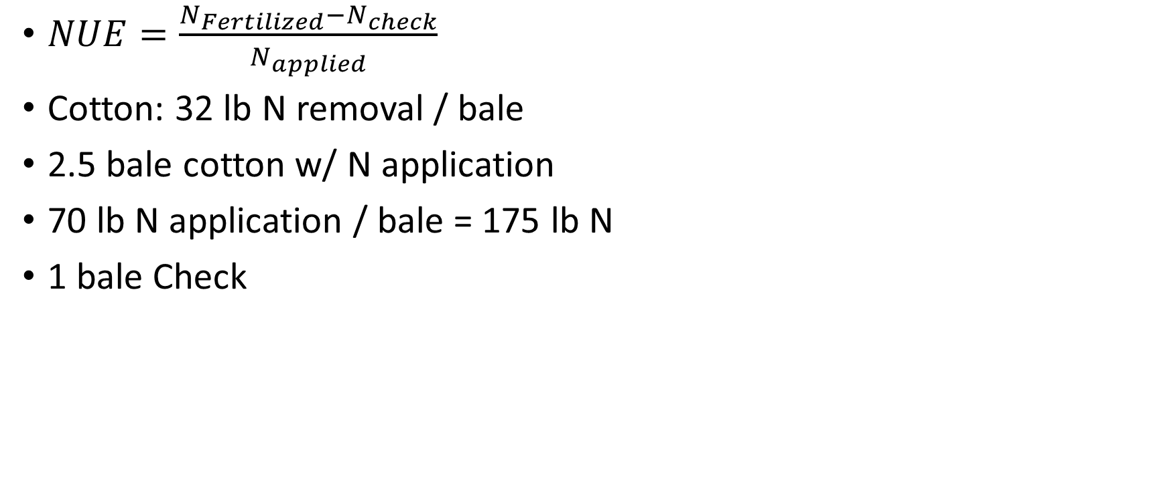
Nitrogen Use Efficiency (NUE)
$NUE=\frac{N_{Fertilized}−N_{check}}{N_{applied}}$
Cotton: 32 lb N removal / bale
2.5 bale cotton w/ N application
70 lb N application / bale = 175 lb N
1 bale Check
2.5 * 32 = 80 lbs N removed
1 * 32 = 32 lbs N removed
80-32 = 48 lbs N difference
48/175 = 27%

Slide 61
Nitrogen Use Efficiency (NUE)
NUE = 50% at the lowest input of fertilizer
Decreases to 35% or less at maximum yield
Low NUE is believed to result from increasingly large “excesses” of mineral N being present because all fertilizer was applied preplant, without knowledge of yield potential or supply of non-fertilizer N
In order to have better NUE, we need to know how much fertilizer we need.

Slide 62

Nitrogen Use Efficiency (NUE)
How to increase nutrient use efficiency
$$NUE=\frac{N_{Fertilized}−N_{check}}{N_{applied}}$$
N_{fertilized}
N_{check}
N_{Applied}

Slide 63
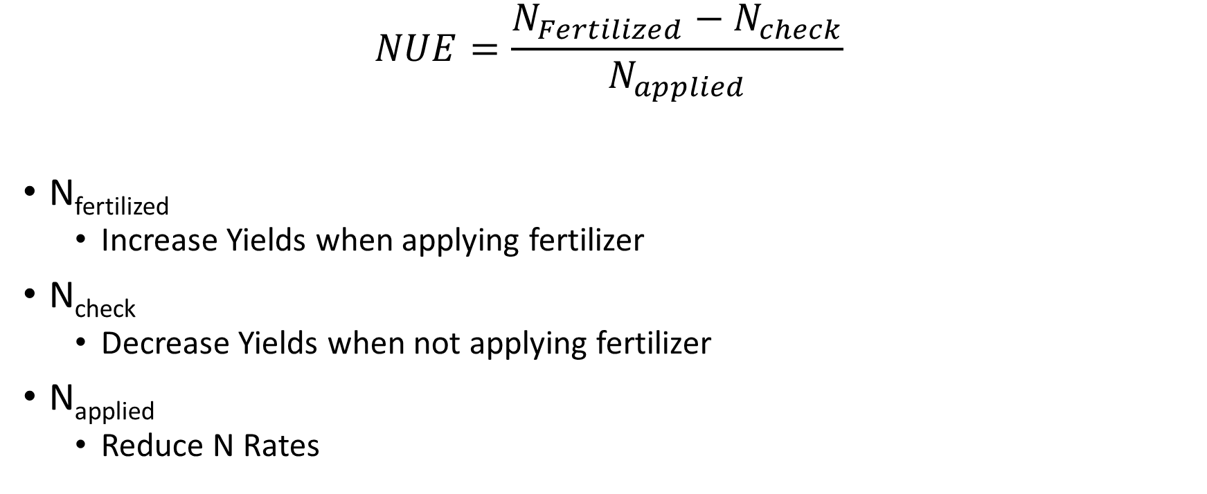
Nitrogen Use Efficiency (NUE)
$$NUE=\frac{N_{Fertilized}−N_{check}}{N_{applied}}$$
N_{fertilized}
Increase Yields when applying fertilizer
N_{check}
Decrease Yields when not applying fertilizer
N_{applied}
Reduce N Rates
All of this starts by knowing our YIELD

Slide 64
N_{fertilized}
Yields change yearly depending on weather conditions
Need for nutrients like N varies with plant growth
Should we apply the same amount of N each year?
Considerable year-to-year variability in how much N is supplied by the soil
Tendency for the unfertilized yield to decrease slightly over time, and that amount of non-fertilizer N available to the crop varies
Decrease in supply of non-fertilizer N with time
Continued crop production without fertilizer mines soil-organic N

Slide 67
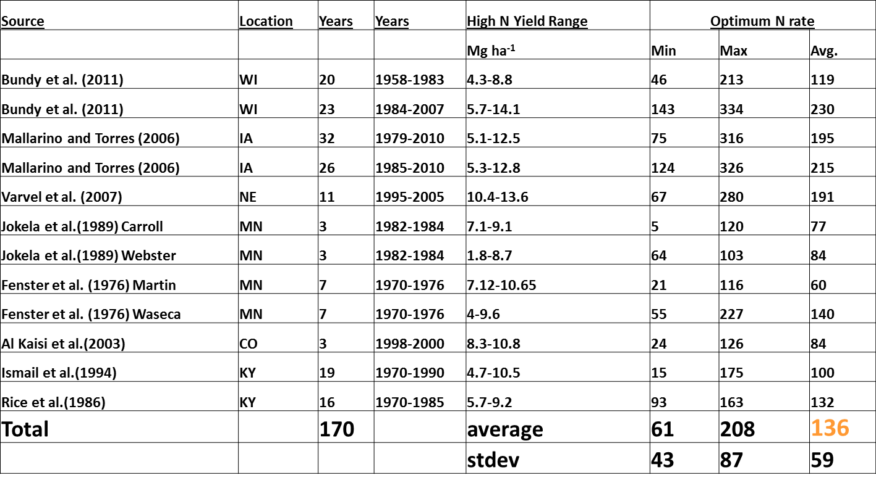
Corn
1 Mg/ha = 15 bpa, 5 Mg = 75 bpa, 10 Mg=150 bpa, 15 Mg= 225 bpa

Slide 68

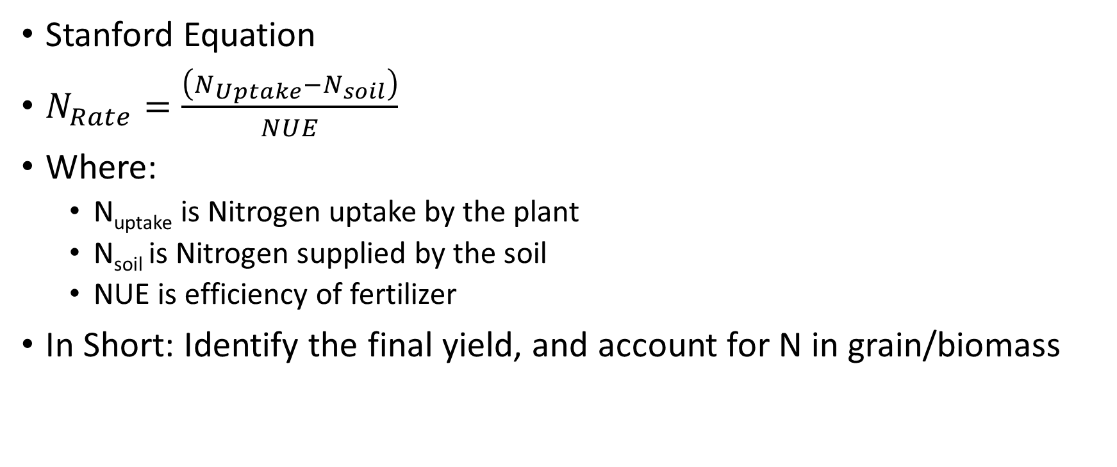
N fertilizer recommendations
Stanford Equation
$N_{Rate}=\frac{\left(N_{Uptake}−N_{soil}\right)}{NUE}$
Where:
N_{uptake} is Nitrogen uptake by the plant
N_{soil} is Nitrogen supplied by the soil
NUE is efficiency of fertilizer
In Short: Identify the final yield, and account for N in grain/biomass

Slide 69
N uptake: Yield Goal
Use of averages or soil capabilities
Lots of times, its undefined, even though every recommendation uses it
Realistic target yield that is achievable with favorable growing conditions (University of Maryland)
5 year average
5 year average + 5-10% (Nebraska)
Expected yield in 3-4 years of 5 under good management (NY)

Slide 70
N Uptake: Yield Goal
Proven Yield – South Dakota
Proven yield (5 year data minus outliers)
Proven Yield + 10%
Proven Yield Modified for Soil Moisture (±10-20%)
Modified County Averages
Avg Yield increase about 1.8 bu/ac/year annually (<2% per year and diminishing)
Aggressive
Yield goals should be sufficiently greater than long-term averages to insure N will not be a yield limiting factor.
Average yield + 20%

Slide 71
N Soil Estimations
NO₃⁻ and NH₄⁺ can be measured in lab setting
Weak acid can be used to strip NH₄⁺, and because NO₃⁻ is mobile, it will come with solution
Both react with different color reagents, which can be read with instrumentation
Total N can also be determined using combustion
Quickly burns it, turns all N (NO₃⁻, NH₄⁺, other forms) into N₂
However, very inaccurate, because it fluctuates greatly
NO₃⁻ is mobile in the soil
NH₄⁺ is quickly converted or fixed shortly
Total N can’t tell the difference between inorganic and organic N
Many labs won’t even offer N testing

Slide 72
Efficiency of Fertilizer
What percentage applied can be used?
N Cycle
Processes that convert one source to another
Source
Timing

Slide 73
How profitable is it to fertilizer to maximum yield?
Data courtesy Frank Coale
Notes:
This represents a typical nitrogen response using quadratic model. Pre-plant N on coastal plain of MD

Slide 74
Agronomic Optimum
Max: 174 bu/a
@230 lb-N
Data courtesy Frank Coale
Notes:
Using simple quadratic mode fitted to N response data from Maryland we see that the “Agronomic Optimum” is the point where the slope of the yield curve = 0, or the yield no longer increases with added N.

Slide 75
Agronomic ≠ Economic Optimum
EOY: 173 bu/a
EONR: 205 lb/a
Data courtesy Frank Coale
Notes:
The “Economic Optimum” is slightly below the agronomic optimum because this is a “diminishing return function.” As you add more N you get less grain per unit nitrogen. The economic optimum is the point where the slope of the curve is equal to the grain:fertilizer price ratio or the point beyond which additional nitrogen does not produce enough grain to cover N cost.

Slide 76
Agronomic ≠ Economic ≠ Environmentally Optimum
N in top 1 m: +17 lb
Data courtesy Frank Coale
Notes:
Orange line represents soil nitrate concentration 0 – 1 m after harvest. The difference between economic and agronomic optimum N rate resulted in an increase of 25 lb/a nitrogen in top meter post harvest. This N represents environmentally risky N.

Slide 77
Agronomic ≠ Economic ≠ Environmentally Optimum
Why precision matters:
Reducing N rate 25 lb/a provides public benefit, but exposes farmer to economic risk.
Especially since we cannot precisely predict economic, environmental, or agronomic “Right” rate
N in top 1 m: +17 lb
Data courtesy Frank Coale
Notes:
Orange line represents soil nitrate concentration 0 – 1 m after harvest. The difference between economic and agronomic optimum N rate resulted in an increase of 25 lb/a nitrogen in top meter post harvest. This N represents environmentally risky N.

Slide 78
Price ratio of N:grain has a small influence on rate
 | Nov-21 | Aug-18 | Aug-19 | Aug-20
Grain ($/bu) | $5.54 | $3.58 | $3.97 | $3.60
N ($/lb) | $0.94 | $0.37 | $0.43 | $0.37
Price Ratio | 0.17 | 0.10 | 0.11 | 0.10
EONR (lb/a) | 150 | 165 | 164 | 166
RON - EONR | $929 | $638 | $704 | $642
RON - AONR | $911 | $633 | $699 | $637
EOY (bu/a) | 193 | 195 | 195 | 195
AOY (bu/a) | 196
Price ratios stay steady - mostly
Normally 5 lb/acre N rate swing
Normally about $5 between yield max (AONR) and EONR
What’s our risk?
Grain Price data: USDA Agricultural Marketing Service. State Grain Reports | Agricultural Marketing Service. https://www.ams.usda.gov/market-news/state-grain-reports#Kentucky (accessed 22 November 2021).
Notes:
Applied the price ratio indicated to the quadratic plateau yield response model. Vertical reference lines represent economic optimum N rate (EONR)
RON-EONR is return on nitrogen at EONR. It only accounts for profit from grain and price of N. All other costs (including N application have to be paid from this amount.
RON-AONR uses the yield maximizing N rate, which is the same across all price ratios. The agronomic optimum yield is from previous slide. The N that makes that yield is the same each year, but costs different each year.

Slide 79
Price ratio of N:grain has a small influence on rate
Normally EOY about 1 bu/a less than AOY
Right now 3 bu/a less
Economic N rate is currently 39 lb/acre less than yield maximizing rate
Normally about 20 lb/acre
Notes:
If you know your EONR an adjust accordingly you will settle for maximum profit each year, but yield will be lower in years where N rate is lower because price ratio is higher. Nonetheless, in normal years there is a very small swing in yield and N rate that maximizes economics. At the end of the day N price should have little bearing on our N rate. If you think you are normally applying right at the EONR than yes, you should go down a little when ratio goes up. However, this is really hard to predict so I recommend sticking with a solid, precise N management strategy
Split apply N 20 – 50% at or before planting/ 80 – 50% at V6 or later. I don’t see benefit of spoon feeding other than with irrigation.
Calculate your fertilizer N requirement 1 lb-N/bu expected yield – use real yield expectation based on data…not aspirational yield.
Credit non-fertilizer sources in the calculation (manure use plant available N calculation that includes timing and surface or incorporated placement)
Credit rotation with legumes (fall back on local recommendations, most use 15 – 30 lb/acre credit)
Use presidedress soil nitrate test (PSNT) if manure was preplant source

Slide 80
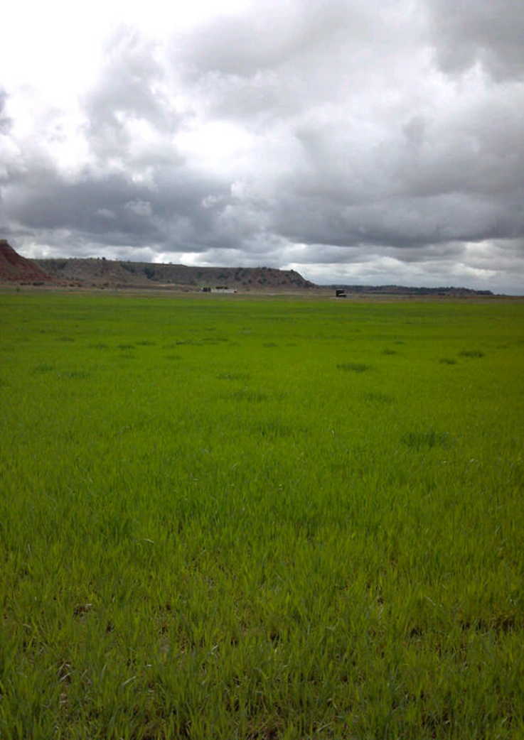
Sensor Based N Management
Visually, we can determine N deficiencies very easily

Slide 81
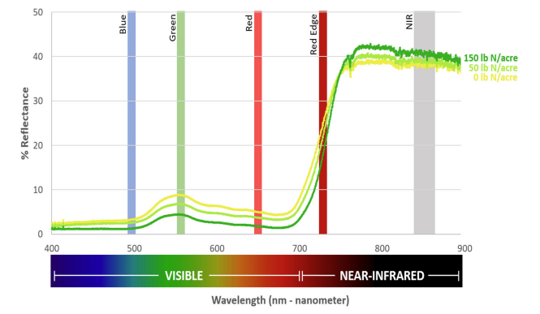
Sensor Based N Management

Slide 82
Sensor Based N Management
Requires:
Reference Strip
Comparison between unlimited N, and check N
Sensor
Sense the difference between the areas
Calculation
Algorithm developed from years of data collection

Slide 83
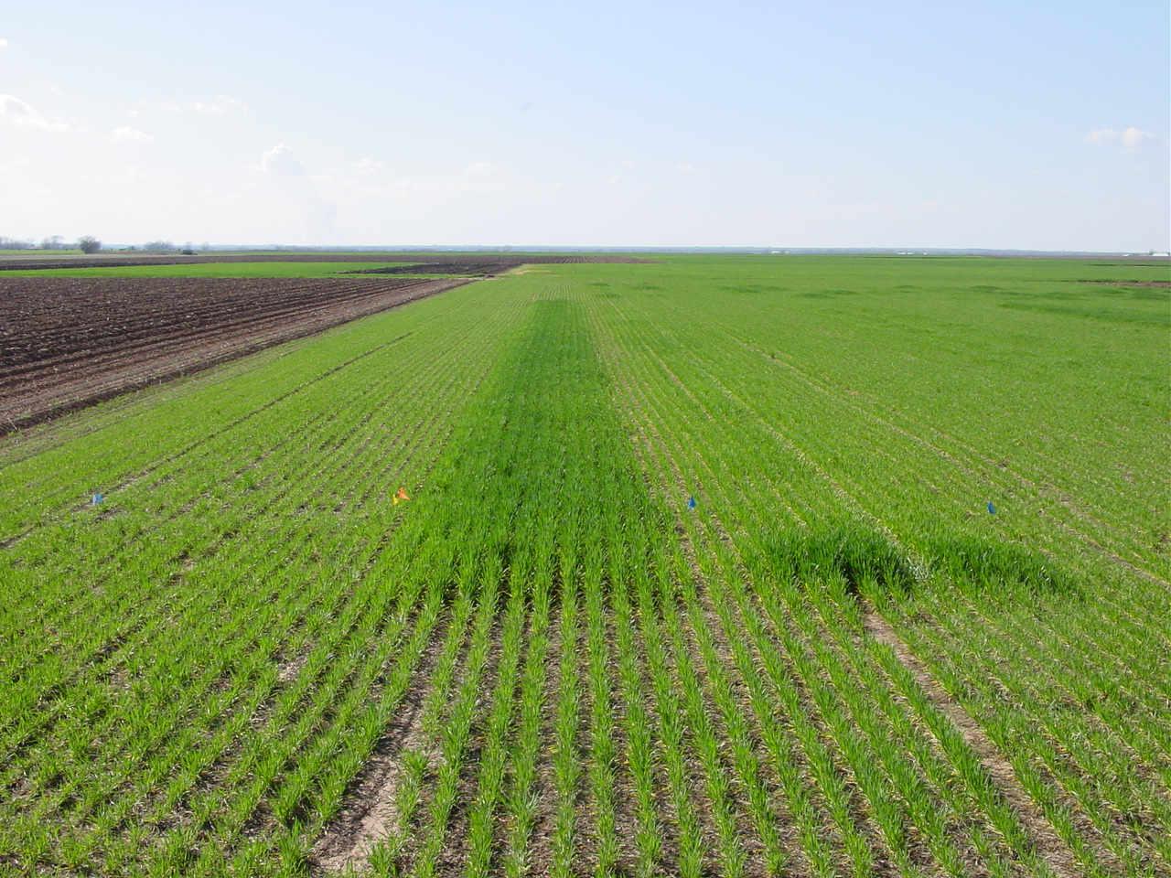

Slide 84

GreenSeekerTM Sensor Light Detection and Filtering
Detection of
Reflected
NIR and RED
+Sun
Notes:
84
The GreenSeeker emits its own light and filters out that of the sun. This means the Sensors can be operated day or night and the amount of direct sunlight is not a factor.

Slide 85
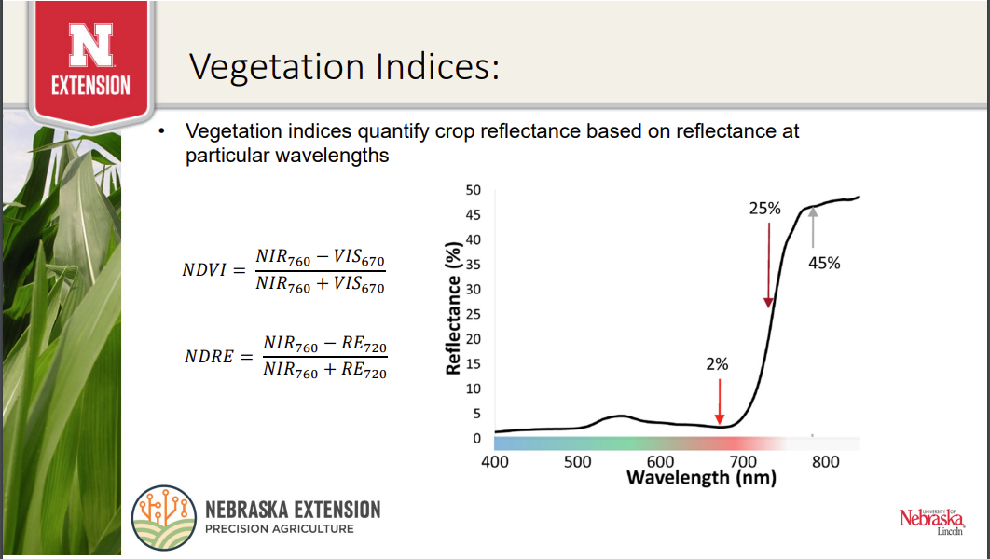

Slide 86
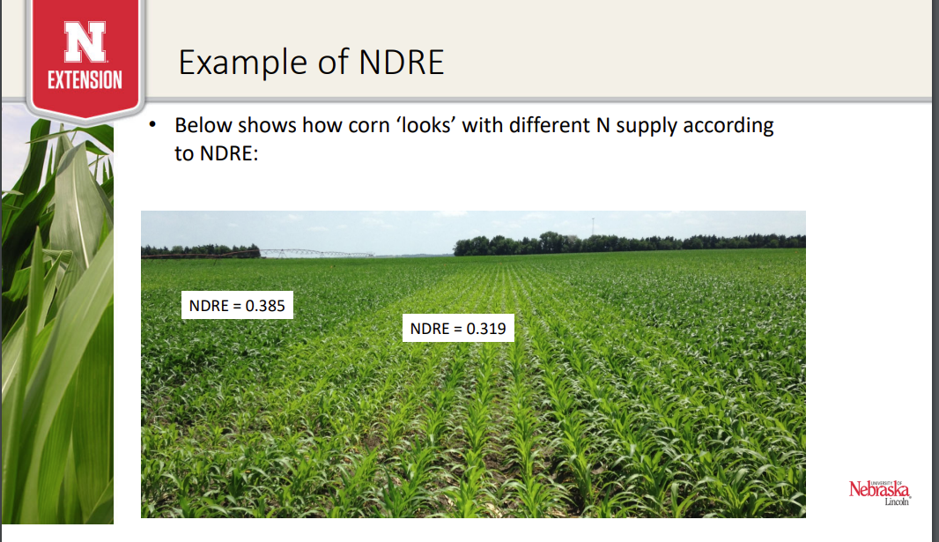

Slide 87
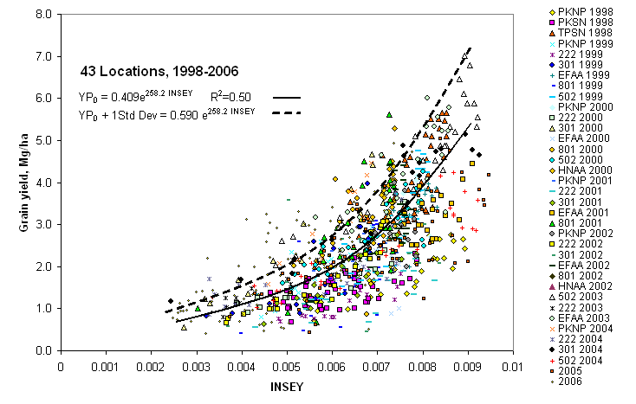

Slide 88
Sensor Based N Management
Active Sensors
Generate their own source of light, can be sensed at any time in any conditions (other than rain)
Generally ground based
Trimble GreenSeeker, Crop Circle, Ag Leader Opt Rx
Passive Sensors
Rely on sunlight reflection
UAVs, Satellites, Airplane, Ground Based

Slide 89

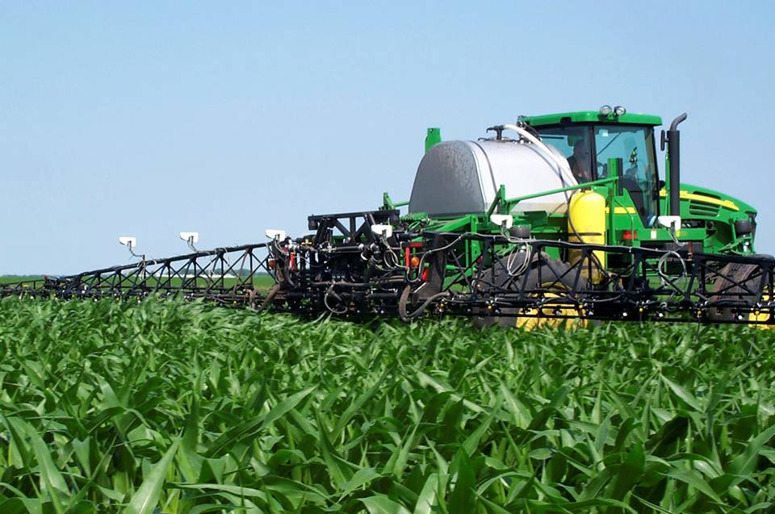

Sensor Based N Management

Slide 90
Sensor Based N Management
Benefits
Only apply what is needed
Reduce waste in areas of the field that isn’t needed
Great risk mitigator
Drought, heat stress, dead crop
Drawbacks
Barrier of Entry
Must be able to apply most fertilizer in season
Requires patience
Sensing only provides estimation of CURRENT growing conditions, not if something changes

Slide 91
Nitrogen Fertilizer Sources

Slide 92
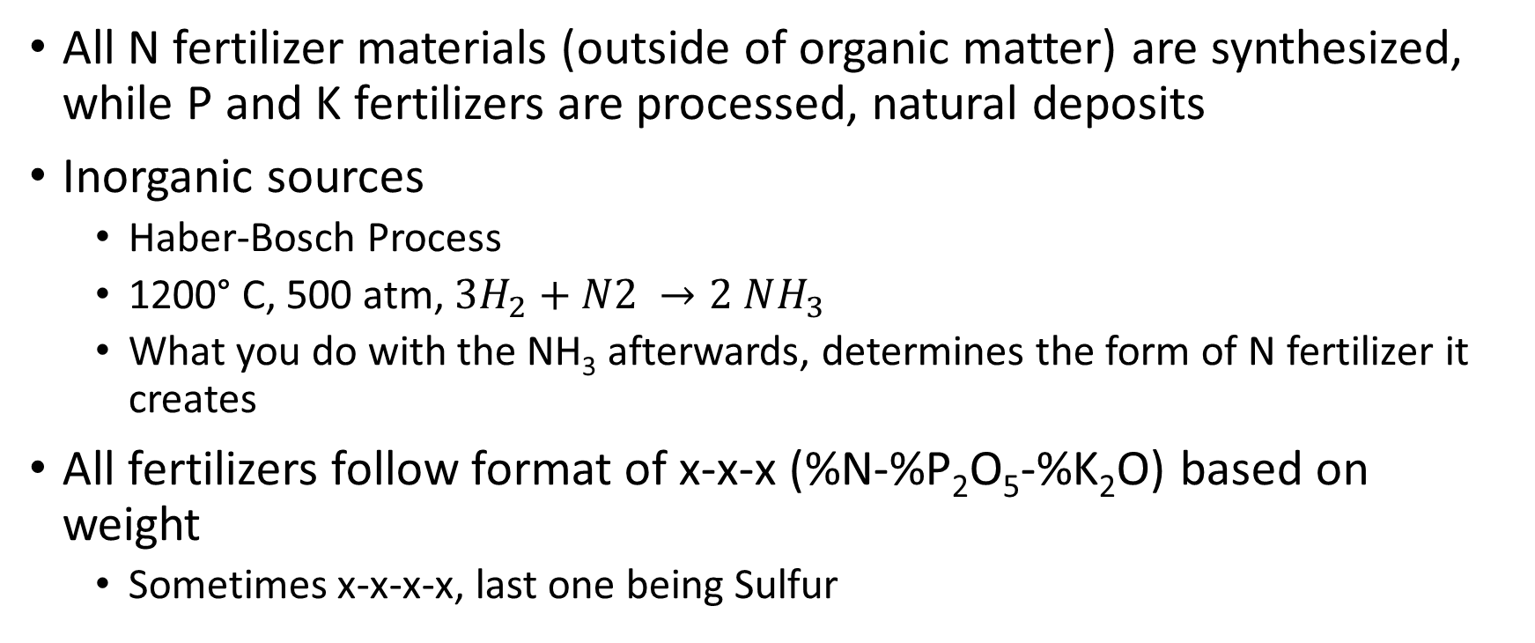
Nitrogen Fertilizer Sources
All N fertilizer materials (outside of organic matter) are synthesized, while P and K fertilizers are processed, natural deposits
Inorganic sources
Haber-Bosch Process
1200° C, 500 atm, $3H_{2}+N2 →2 NH_{3}$
What you do with the NH₃ afterwards, determines the form of N fertilizer it creates
All fertilizers follow format of x-x-x (%N-%P₂O₅-%K₂O) based on weight
Sometimes x-x-x-x, last one being Sulfur

Slide 93
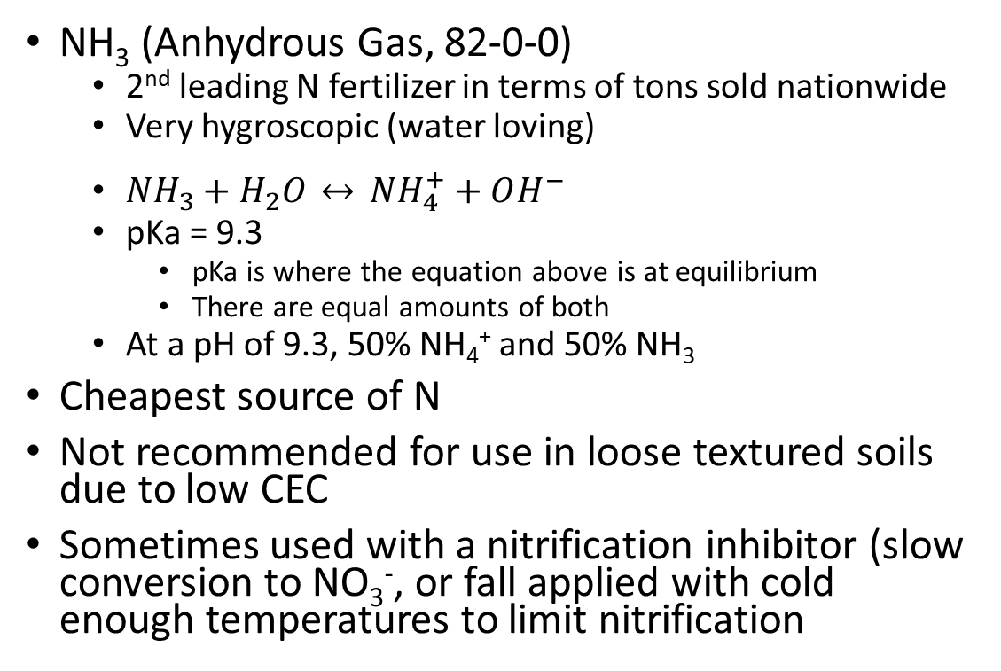
Nitrogen Fertilizer Sources – NH₃
NH₃ (Anhydrous Gas, 82-0-0)
2nd leading N fertilizer in terms of tons sold nationwide
Very hygroscopic (water loving)
$NH_{3}+H_{2}O \underset{↔}{} NH_{4}^{+}+OH^{−}$
pKa = 9.3
pKa is where the equation above is at equilibrium
There are equal amounts of both
At a pH of 9.3, 50% NH₄⁺ and 50% NH₃
Cheapest source of N
Not recommended for use in loose textured soils due to low CEC
Sometimes used with a nitrification inhibitor (slow conversion to NO₃⁻, or fall applied with cold enough temperatures to limit nitrification
pH | Base (NH₃) (%) | Acid (NH₄⁺) (%)
7.3 | 1 | 99
8.3 | 10 | 90
9.3 | 50 | 50
10.3 | 90 | 10
11.3 | 99 | 1

Slide 94
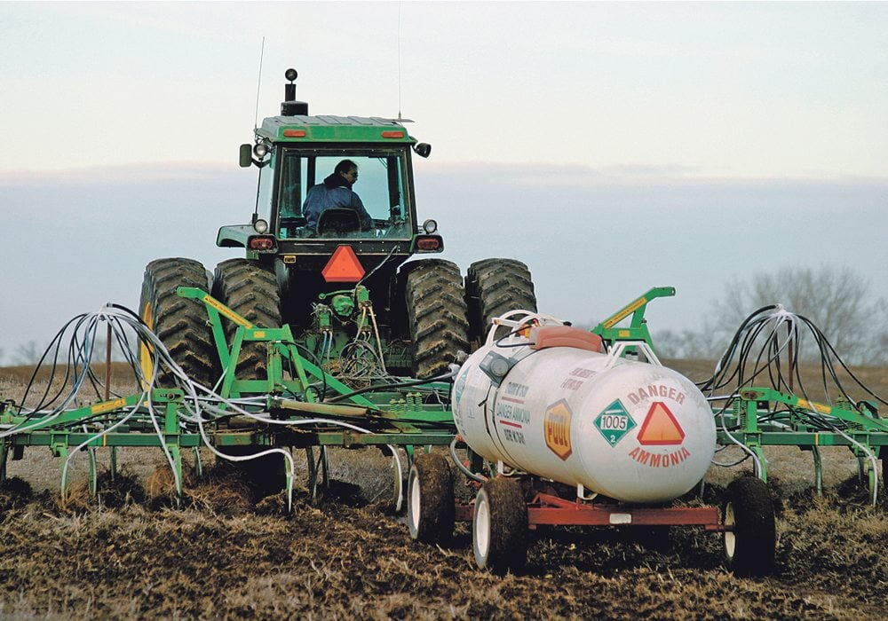
Nitrogen Fertilizer Sources – NH₃
Immediately reacts with soil-water in the soil
Very hazardous material, special safety precautions must be taken with its use
Most important is to avoid leaks in hoses and couplings, and ALWAYS have a supply of water on hand for washing

Slide 95
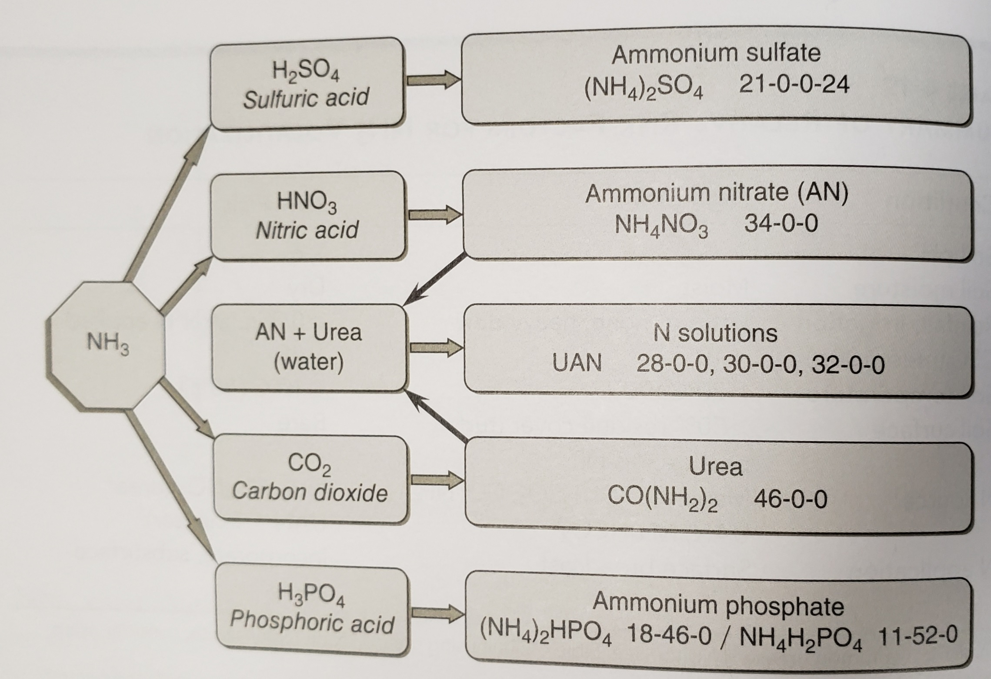
Nitrogen Fertilizer Sources

Slide 96
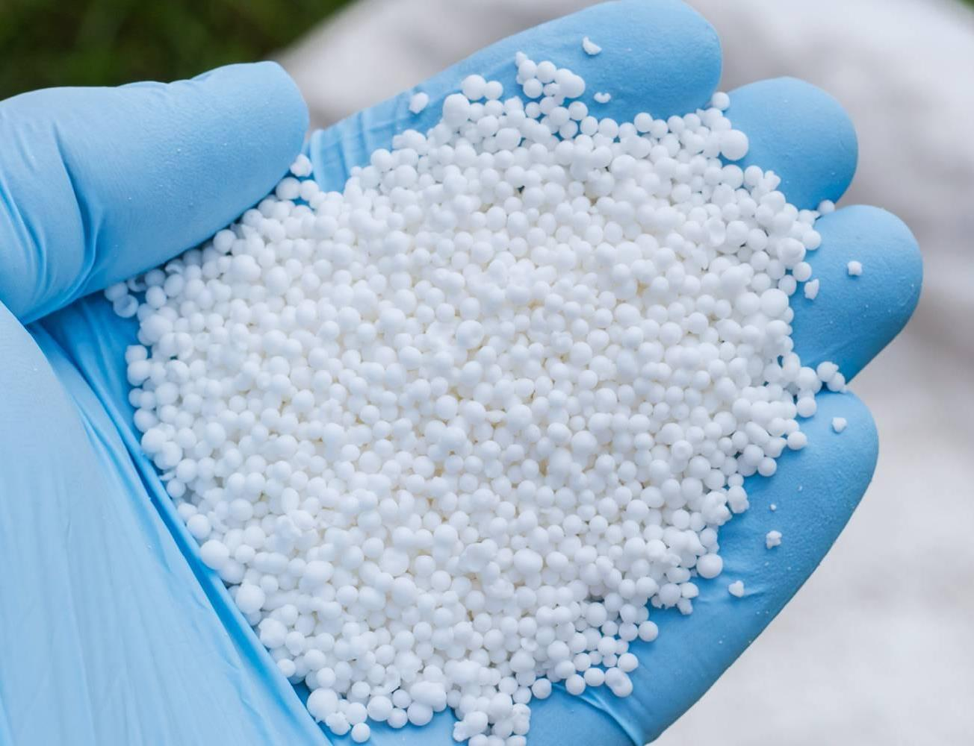
Nitrogen Fertilizer Sources – Urea
Urea CO(NH₂)2 – 46-0-0
Most popular form of N fertilizer
Produced as either a crystal or prill (small bead-like shape)
Very soluble in water, highest analysis solid material sold commercially
Not hazardous, has fairly low corrosive properties
Hygroscopic (attracts water) and requires storage free of humid air
Mobile in soil because it remains an uncharged molecule after it dissolves
After it dissolves, it hydrolyzes to ammonium, bicarbonate, and hydroxide (OH⁻) in the presence of urease

Slide 97
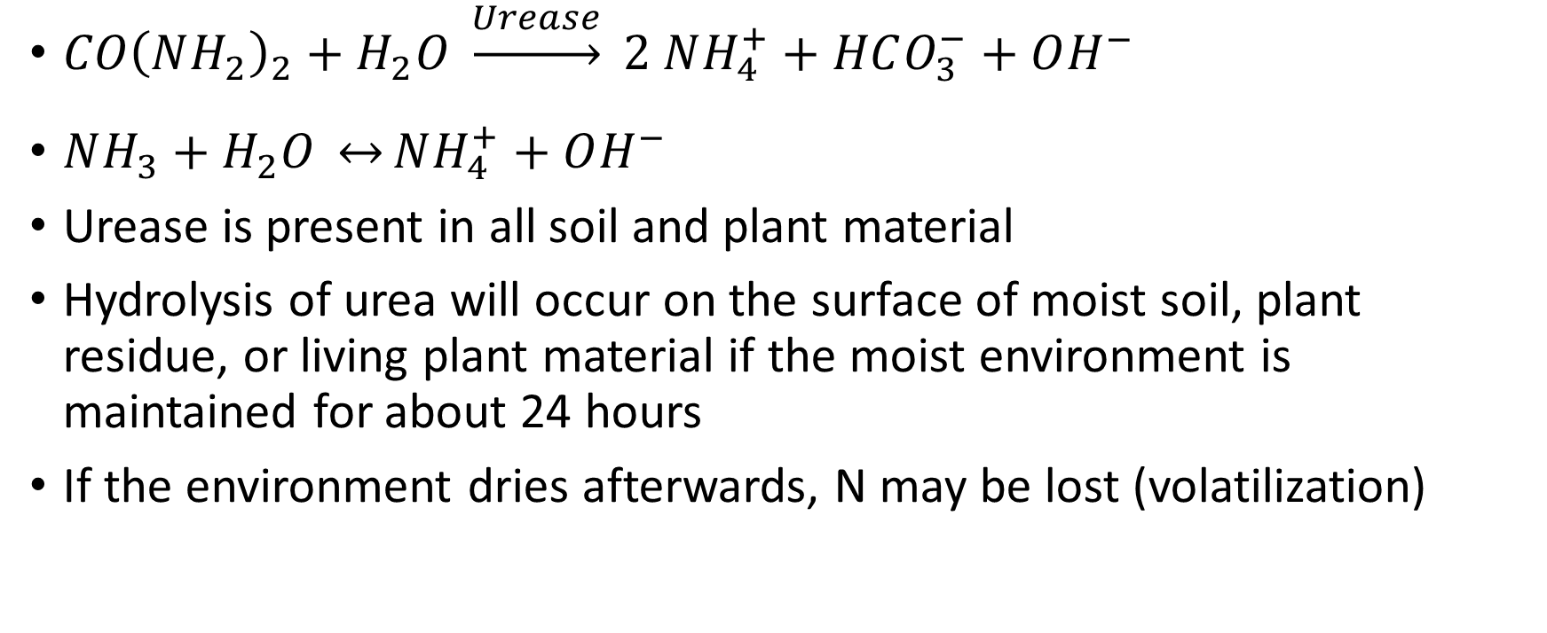
Nitrogen Fertilizer Sources – Urea
$CO{\left(NH_{2}\right)}_{2}+H_{2}O \underset{→}{Urease} 2 NH_{4}^{+}+HCO_{3}^{−}+OH^{−}$
$NH_{3}+H_{2}O \underset{↔}{}NH_{4}^{+}+OH^{−}$
Urease is present in all soil and plant material
Hydrolysis of urea will occur on the surface of moist soil, plant residue, or living plant material if the moist environment is maintained for about 24 hours
If the environment dries afterwards, N may be lost (volatilization)

Slide 98
Nitrogen Fertilizer Sources – Urea
Environments that are already basic (high pH) and lack exchange sites to hold NH₄⁺ (low CEC soils, sandy soils) will favor loss
Easy to blend with other fertilizers, but should be incorporated by cultivation, irrigation, or rain within a few hours of application if the surface is moist and temperatures are warm (>60°F)
There is little or no loss of ammonia when urea is surface applied during cool weather or remains dry during warm weather

Slide 99
Nitrogen Fertilizer Sources – AN
Ammonium Nitrate (33/34-0-0) NH₄NO₃
Very prevalent in the 1980’s, until the popularity of urea rose
OKC bombing led to fewer and fewer dealers to hold it
Many retailers will still offer “34-0-0” material because of its popularity with homeowners, but is most likely a blend of urea and other product to make it that analysis
Fairly hygroscopic, will form a crust or cake if it gets moisture
Very corrosive to metals
Preferred form for no-till and sod crops, because it works great as a broadcast, no incorporation fertilizer. Why?

Slide 100
Nitrogen Fertilizer Sources – AN
NO₄NH₃ added to soil solution just solubilizes into NH₄⁺ and NO₃⁻. There is no pH change near the prill, so low chance of volatization
Biggest issue with AN is that it provides one-half of N in a mobile form, so leaching can be an issue.
Gold standard in research, because we don’t have to worry about volatilization.

Slide 101
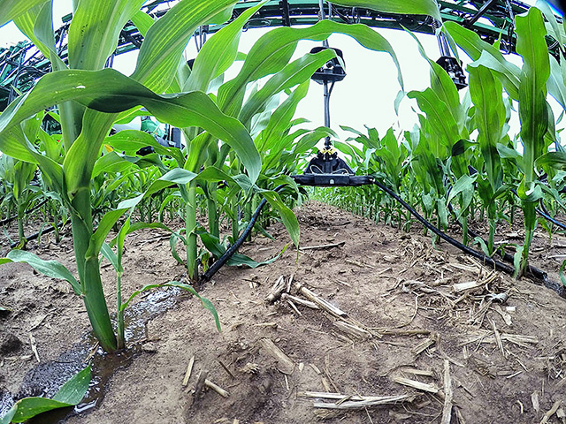
Nitrogen Fertilizer Sources – UAN
UAN (Urea-Ammonium Nitrate, 28/30/32-0-0)
Urea and Ammonium nitrate combined with water in a 1:1:~1 ratio by weight
Liquid fertilizer, very popular for use as a sidedress application
Applies uniformly and accurately, easy/safe to handle
Is prone to volatilization due to it being partly urea
Can often be a carrier for pesticides
Can salt out at different temperatures, which is why there are 28/30/32% versions
32% salts out <28°F, 28% salts out <0°F

Slide 102
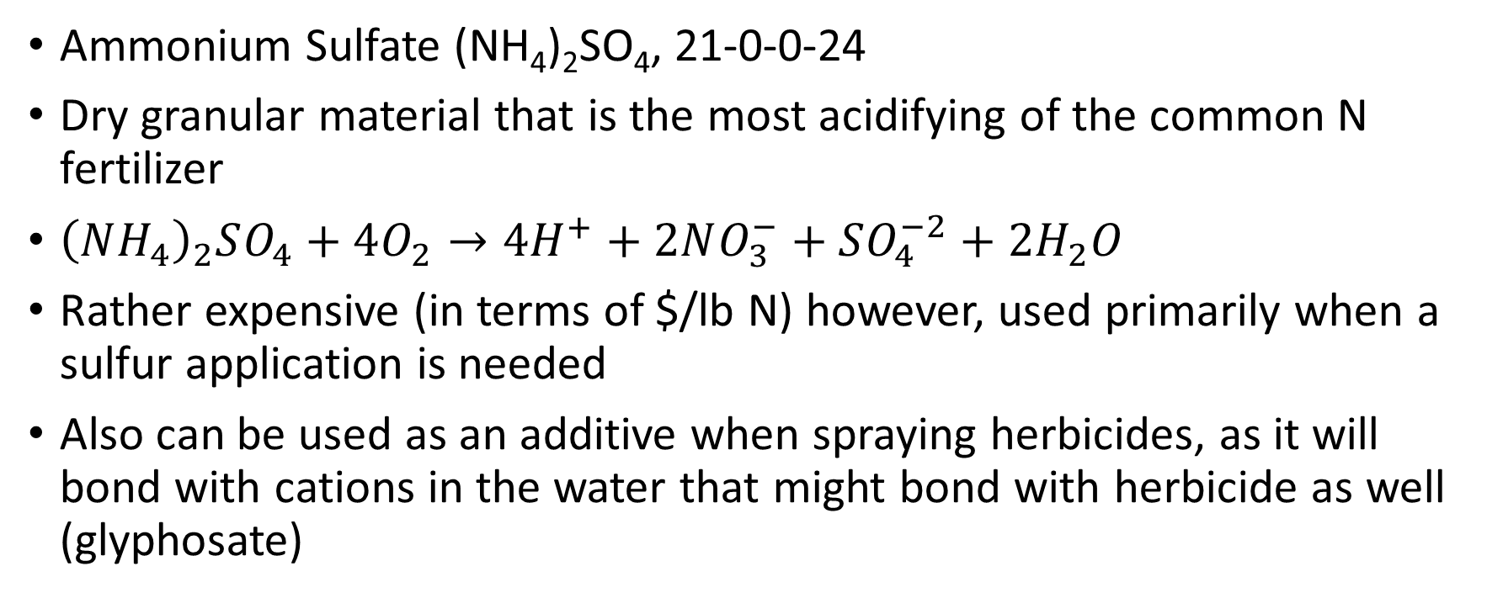
Nitrogen Fertilizer Sources - AMS
Ammonium Sulfate (NH₄)₂SO₄, 21-0-0-24
Dry granular material that is the most acidifying of the common N fertilizer
${\left(NH_{4}\right)}_{2}SO_{4}+4O_{2}→4H^{+}+2NO_{3}^{−}+SO_{4}^{−2}+2H_{2}O$
Rather expensive (in terms of $/lb N) however, used primarily when a sulfur application is needed
Also can be used as an additive when spraying herbicides, as it will bond with cations in the water that might bond with herbicide as well (glyphosate)

Slide 103
Nitrogen Fertilizer Sources – Ammonium Phosphates
Mono-Ammonium Phosphate (MAP) 11-52-0
Di-Ammonium Phosphate (DAP) 18-46-0
Generally used as the P source, not necessarily for N
Dry, granular sources, great for dry blends

Slide 104
Nitrogen Fertilizer Sources – APP
Ammonium PolyPhosphate (10-34-0)
Liquid P source, considerably more expensive than MAP or DAP, but convenient due to it being liquid
Just as affective as other phosphorus sources

Slide 105
Nitrogen Fertilizer Sources
Ammonium Chloride (NH₄Cl) 25-0-0
Ammonium Bicarbonate (NH₄HCO₃) 19-0-0
Calcium Ammonium Nitrate 17-0-0
Trees and Vegetables out west

Slide 106
Nitrogen Fertilizer Sources
Slow Release Fertilizers
Prevents immediate release into soil where environment and biologicals have impact
Coated
Chemistry
Inhibitors
Prevent the biological activity that impacts the N cycle
Since early 60’s, at least 15 substances thoroughly researched

Slide 107
Nitrogen Fertilizer Sources – Controlled/Slow Release
2-3 times more expensive than normal non-coated fertilizers
Not generally used in conventional agriculture, but rather in production systems that are less sensitive to fertilizer costs, and which desire a somewhat uniform supply of N to the plants over the cycle
Turfgrass systems
Advantage of these materials is that one application may provide a uniform supply of N to the plants for several weeks

Slide 108
Nitrogen Fertilizer Sources – Controlled/Slow Release
Urea-formaldehyde (38% N)
Synthetic organic material of low solutility, whos N release depends upon microbial breakdown, and thus temperature dependent
IBDU (isobutylidene diurea, 31% N)
Synthetic organic material, release depends upon particle size, moisture, and pH
Triazone (28% N)
Urea coated with triazone
S-coated urea (32-36% N)
Urea encapsulated with elemental S in the prilling process. Release depends upon breakdown of S coat
Polymer Coated fertilizers
N release occurs via diffusion with water, very slow release.
Osmocote

Slide 109
Nitrogen Fertilizer Sources – Inhibitors
Urease Inhibition
Basically prevents/slows urea’s conversion to ammonia, slowing down volatization
NBPT (n-butyl-thiophosphoric triamide): Studied since the 80’s (Agrotain, Super U)
Patent expired; currently looking at 8 formulations
MIC: (Maliec Itaconic Copolymer Ca Salt)
Binding of nickel ions necessary for the formation and function of the enzyme
ATS (Ammonium ThioSulfate): Has been shown to slow urea hydrolysis as well
10-14 days of protection

Slide 111
Nitrogen Fertilizer Sources – Inhibitors
Urease Inhibitors are sorta cheap, and will pay for themselves in the right situations
NOT Beneficial:
Incorporated
Rain or irrigation ½” or more shortly after application
Soil and air temp < 50° F
Dry soil/air
Banding
No rain expected for 14+ days
UAN vs. Urea

Slide 112
Nitrogen Fertilizer Sources – Inhibitors
BENEFICIAL:
Surface applied
No-till systems
High humidity
Light rains, heavy dews, mists
Soil and air temp > 50° F
Wet soil
Soil with high pH >7.5
Rain within 10 days

Slide 113
Nitrogen Fertilizer Sources – Inhibitors
Nitrification Inhibitors
Prevents/slows ammonium’s conversion to nitrate
Ammonium (+) is immobile in the soil, Nitrate (-) is mobile. In high rainfall, irrigated, well drained soil, NO₃⁻ is easily lost
NO₃⁻ can be lost by leaching and Denitrification
Both take water!
2-6 weeks of use (falls off during that time as well)
Nitrapyrin – registered pesticide, used since the 60’s
DCD – Suppresses, does not kill nitrosomonas

Slide 114
Nitrogen Fertilizer Sources – Inhibitors
BENEFICIAL
Areas with plentiful rainfall/irrigation
10 days of continual rainfall
NOT BENEFICIAL
Dry areas

Slide 115
Nitrogen Fertilizer Sources – Organic forms
Before Haber-Bosch process, most N was from organic sources
Currently accounts for 40% of the total N use in US
Generally provides 1-12% N, so not necessarily the best source for a primarily N fertilizer application
Non-manure sources
Manure sources

Slide 116
Nitrogen Fertilizer Sources – Organic forms
Non-manure sources
Generally by-products of animal- or plant- processing facilities, and municipal waste treatment
Biosolids – Municipal waste
1-6% N
Heavily regulated
Animal/plant by-products
Animal by-products have relatively high N content, which leads to low C:N ratio
Mineralization
Plant by-products have relavitvely low N content, which leads to high C:N ratio
Not necessarily providing much N

Slide 117
Nitrogen Fertilizer Sources – Organic forms
Manure sources
Near 150 million tons produced a year
Mostly deposited in the same fields (grazing)
2-6% N, but has many factors
Animal
Animal Feed
Method of manure handling/storage
Quantity of added materials (bedding/water/hay)
Method of application

Slide 118
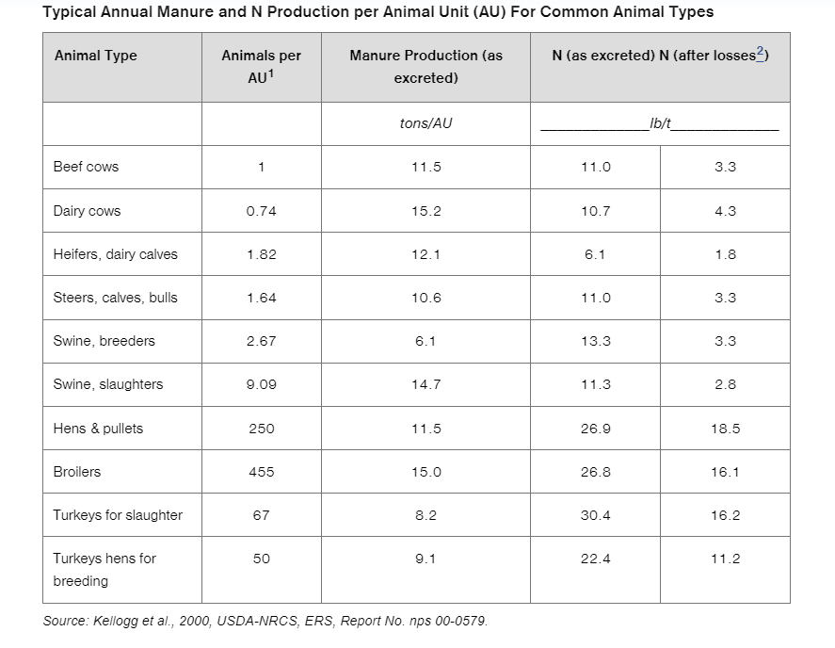
Nitrogen Fertilizer Sources – Organic forms

Slide 119
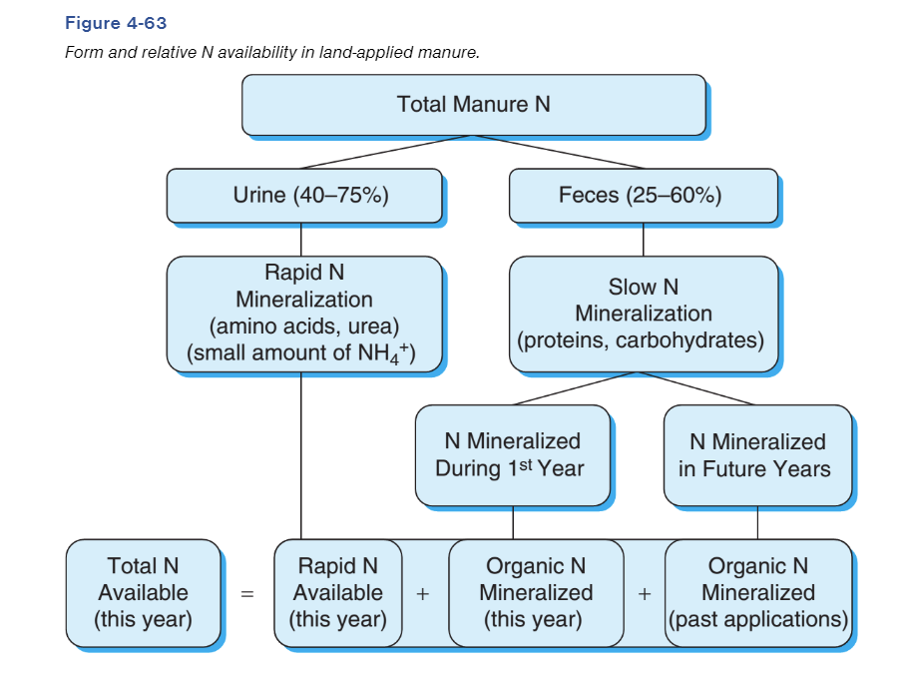
Nitrogen Fertilizer Sources – Organic forms
N sources from manure
50-75% of Total N is organic N
25-50% is NH₄⁺
Large portion of the NH₄⁺ is volatilized during storage and handling
Mineralization is key to organic N
Denitrification is also a consideration

Slide 120
Nitrogen Fertilizer Sources – Organic forms
Manure application considerations
N is not in high quantities, and majority can be lost (volatization, denitrification)
Think about timing of application
Dry, hot?
Cool, wet?

Slide 121
Methods of N application
Broadcast
Incorporated
Non-incorporated
Dry
Liquid
Injected
NH₃
Liquid
Dry
Banded

Slide 122
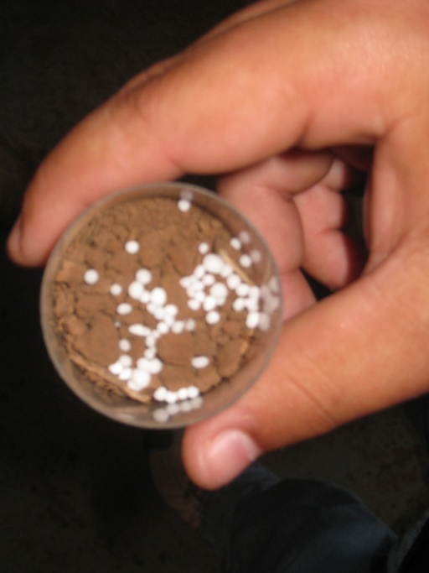
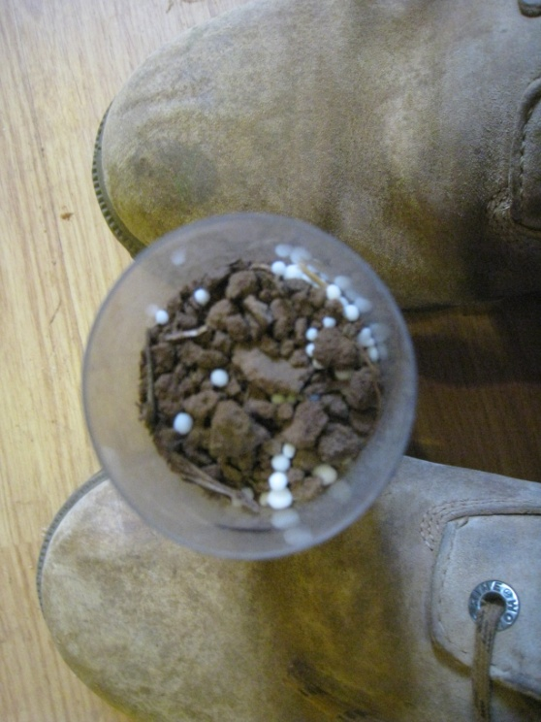
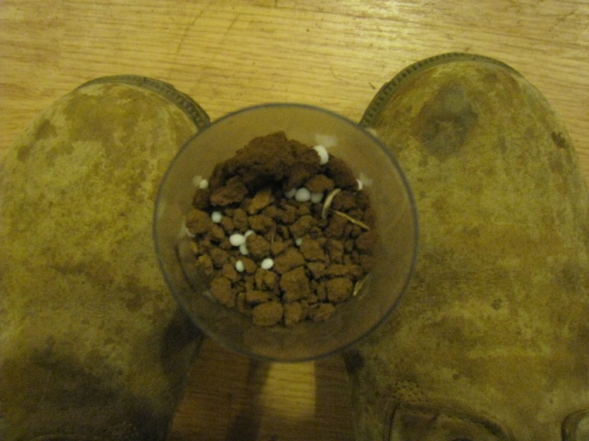
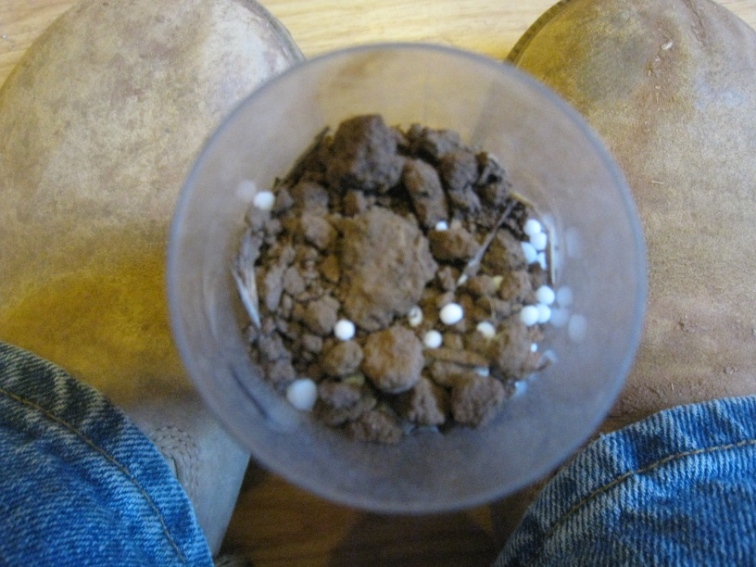
Dry, Broadcast application – 1, 3, 6, 9

Slide 123
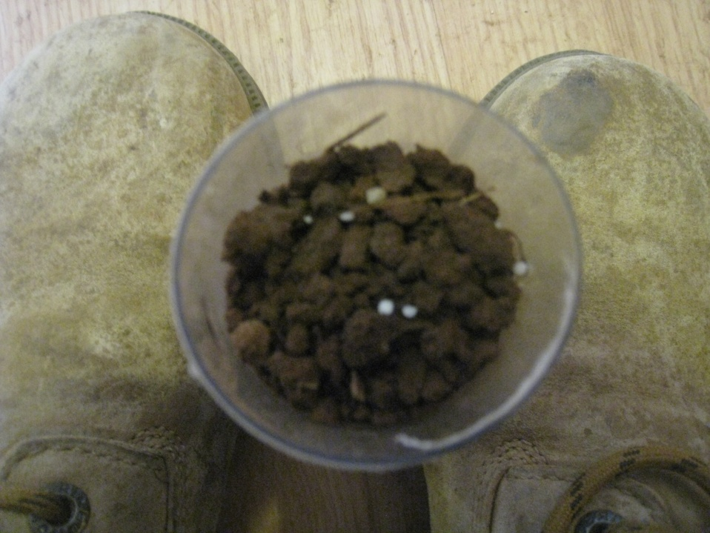
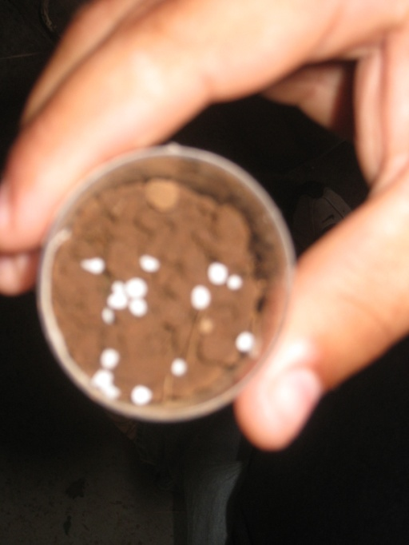
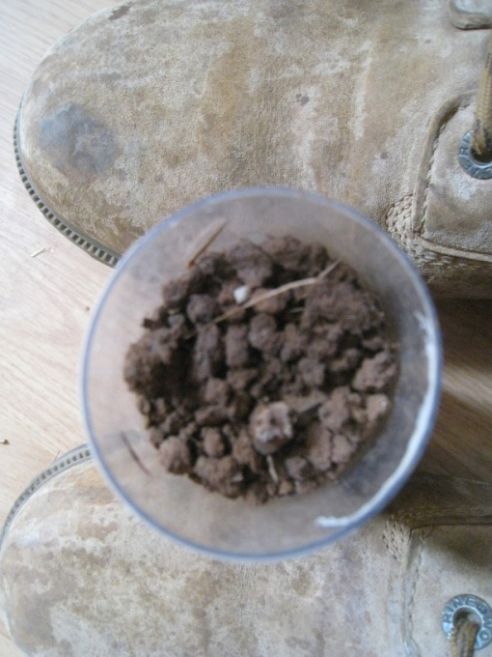
Dry soil, mist: 0, 1, 2

Slide 124
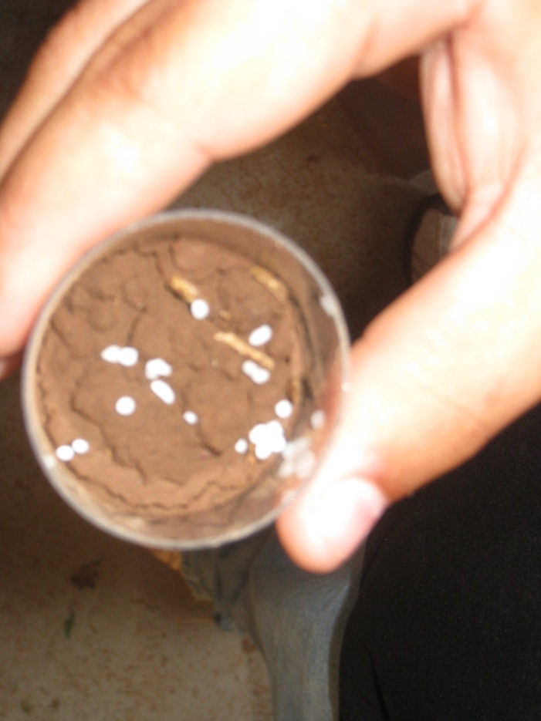
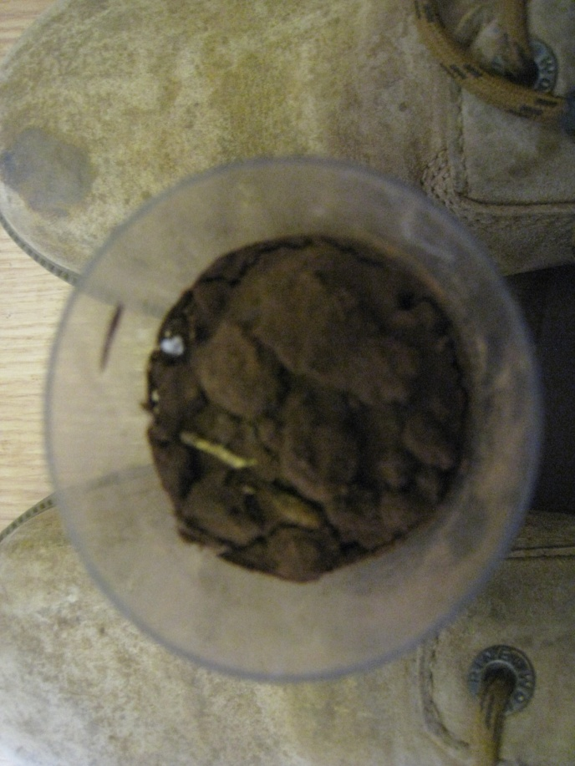
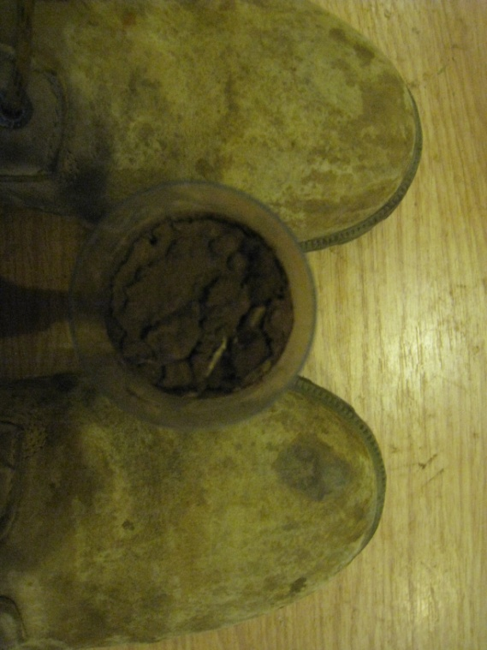
Rain – 1, 2, 3

Slide 125



Subsoil moist – 1, 2, 3

Slide 126




Wet – 1, 2, 3, 4

Slide 127



Wet Fridge – 1, 3, 6, 9

Slide 128


Wet Freezer – 1, 9

Slide 129
Methods of N application
Foliar Application
Liquid only
N has some benefits of foliar
CANNOT REPLACE SOIL APPLICATIONS
Can realistically apply 2-5 lbs/ac as foliar source

Slide 130




Slide 131



Slide 132




Slide 133





