Slide 1
Problem Soils: Acidity, Alkalinity, Salinity, and Sodicity
Chapter 4

Slide 3
Why study acid, alkaline, saline, and sodic soils?
These soils have unique chemical and physical properties that influence how plants grow
Since availability of nutrient ions is determined by their chemistry, it is important to understand how nutrient availability will be influenced by the special chemical properties of these soils

Slide 4

Secondary/
Micronutrients
Nitrogen
P & K
Soil pH
Soil Test

Slide 5
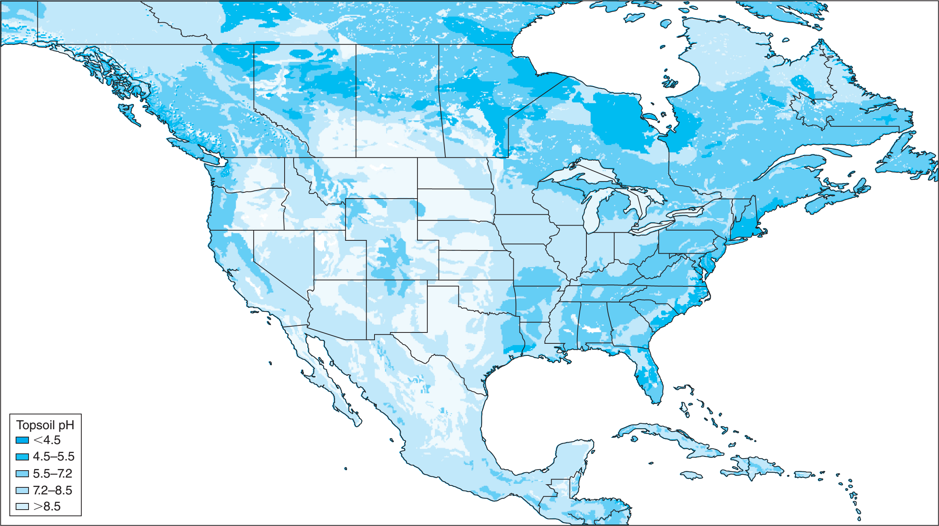
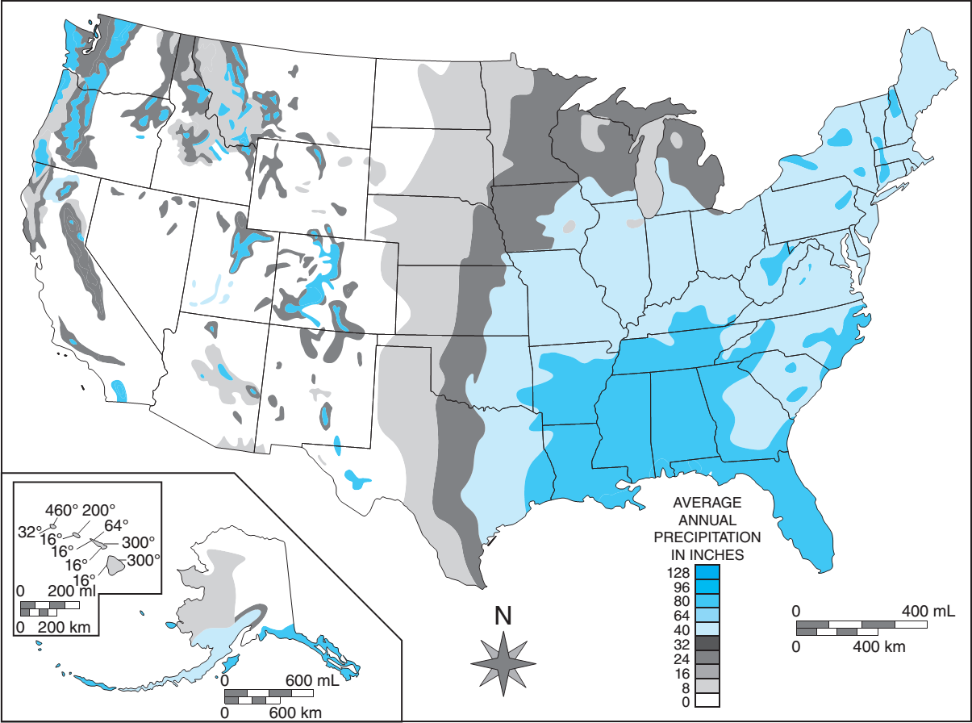

Slide 6
Acid/alkaline soils
Acid soils are a natural phenomenon related to soil parent material and rainfall conditions under which the soil developed
Soils developed from limestone parent material, for example, will often be neutral or alkaline in their pH (pH > 7)
Granitic parent material will favor development of an acid soil
In Mississippi, >50% of samples have a pH < 6.0

Slide 7
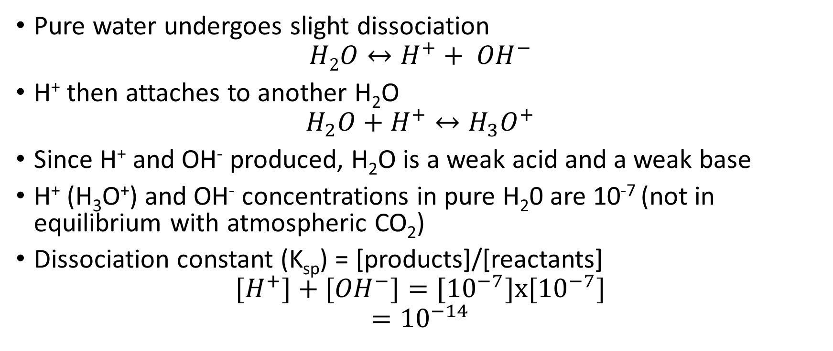
Acidity in water
Pure water undergoes slight dissociation
$$H2O↔H^{+}+ {OH}^{−}$$
H⁺ then attaches to another H₂O
$$H_{2}O+H^{+}↔H_{3}O^{+}$$
Since H⁺ and OH⁻ produced, H₂O is a weak acid and a weak base
H⁺ (H₃O⁺) and OH⁻ concentrations in pure H₂0 are 10⁻⁷ (not in equilibrium with atmospheric CO₂)
Dissociation constant (K_{sp}) = [products]/[reactants]
$$[H^{+}]+{[OH}^{−}]=[{10}^{−7}]x[{10}^{−7}]$$
$$={10}^{−14}$$

Slide 8
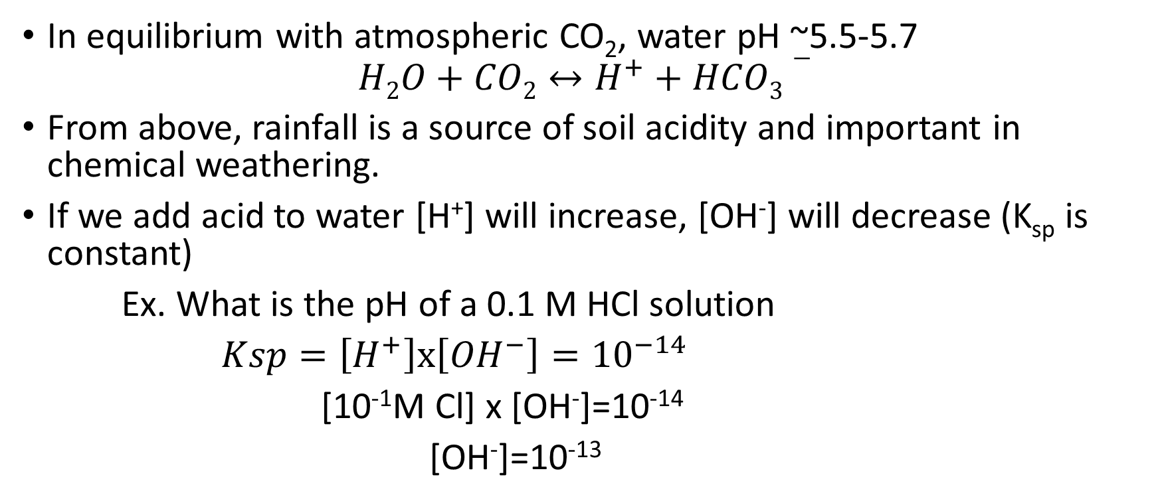
Acidity in water
In equilibrium with atmospheric CO₂, water pH ~5.5-5.7
$$H2O+CO2↔H^{+}+HCO3−$$
From above, rainfall is a source of soil acidity and important in chemical weathering.
If we add acid to water [H⁺] will increase, [OH⁻] will decrease (K_{sp} is constant)
Ex. What is the pH of a 0.1 M HCl solution
$Ksp=\left[H^{+}\right]x\left[{OH}^{−}\right]={10}^{−14}$
[10⁻¹M Cl] x [OH⁻]=10⁻¹⁴
[OH⁻]=10⁻¹³

Slide 9

Acidity in water
[H+]can be expressed as the pH
  $pH=log\frac{1}{{(H}^{+})}=−\log\left(H^{+}\right)$
  Ex.
    A solution with [H⁺] =10⁻⁵ has a pH of 5.0
    $${10}^{−5}M→−\log\left[{10}^{−5}\right]=−\left[−5\right]=5$$
    Soil pH is classified like this:
<4.5 | Extremely acidic | 6.6-7.3 | Neutral
4.5-5.0 | Very strongly acidic | 7.4-7.8 | Mildly alkaline
5.1-5.5 | Strongly acidic | 7.9-8.4 | Moderately alkaline
5.6-6.0 | Medium acidic | 8.5-9.0 | Strongly alkaline
6.1-6.5 | Slightly acidic

Slide 10
Where does H⁺ come from in soil?
Natural Causes
  Atmospheric Rainfall
  Break down of organic matter
  Basic Cation Losses
Artificial Sources
  Basic Cation Removal
  Fertilizer/amendment application

Slide 11
Where does H⁺ come from in soil? – Natural
Sources of H from within soil
  Carbonic Acid (weak acid. Negligible below pH 5)
CO₂ +H₂O → 6H₂CO₃ → HCO₃⁻ + H⁺
  Acids from metabolism (organic matter decay)
  (RCH₂OH....) + O₂ + H₂O → RCOOH → RCOO⁻ +H⁺
  Oxidation of N
NH₄⁺ + 2O₂ → H₂O + 2H⁺ + NO₃⁻
  Oxidation of S
FeS₂ +3.5O₂ + H₂O → FeSO₄ +2H⁺ +SO₄²⁻

Slide 12
Where does H⁺ come from in soil? – Natural
Acid precipitation
  HNO₃
  H₂SO₄
Loss of basic cations
  Leaching (loss of basic cations and anion with water)
  Plant uptake (proton pump)

Slide 13
Loss of Basic Cations
“Basic Cations” are cations that when combined with OH⁻ form a compound that would dissolve in water, and create and alkaline solution
Tha cations Na⁺, K⁺, Ca ²⁺, and Mg ²⁺ are good examples.
In contrast, the hydroxides of Al ³⁺ and Fe ³⁺ are so insoluble the ions would not be present in solution unless the solution were acidified to dissolve them
Al ³⁺ and Fe ³⁺ are usually referred to as “acidic” cations for this reason. Plants generally absorb nutrient cations in excess of nutrient anions. In this process, electrical neutrality or ion-charge balance may be maintained by simultaneous absorption of OH⁻ or the exudation of H⁺ by the plant root
In either case the result is a contribution of acidity to the soil

Slide 14
Removal of Base Cations via hydrolosis
As base cations decrease and soil pH drops, Al+3 saturation increases
Nutrient removal from fields (hay or stubble)
Aluminum in solution goes through stages of hydrolysis and produces acid H+
Al³+ H₂0 = Al(OH)²⁺ + H⁺
Al(OH)²⁺ + H₂0 = Al(OH)₂⁺ + H⁺
Al(OH)₂⁺ + H₂0 = Al(OH)₃⁰ + H⁺
Ca²⁺
Mg²⁺
K⁺
Ca²⁺
Ca²⁺
Mg²⁺
K⁺
Ca²⁺
H⁺
Ca²⁺
-
-
-
-
-
-
-
Mg²⁺
K⁺
H⁺
K⁺
H⁺
Ca²⁺
Ca²⁺
Ca²⁺
Ca²⁺
Mg²⁺
Mg²⁺
H⁺
K⁺
Al³⁺
Al³⁺
Al³⁺
Al³⁺
Al(OH)_{x} insoluble
Al³⁺

Slide 15
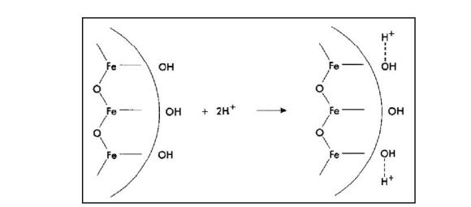
Where does H⁺ come from in soil?
Mineral Exchange
  H⁺ dissociation from clay minerals, Fe and Al oxides and OM surfaces
  This is the same mechanism we discussed in the last chapter with pH dependent charges

Slide 16
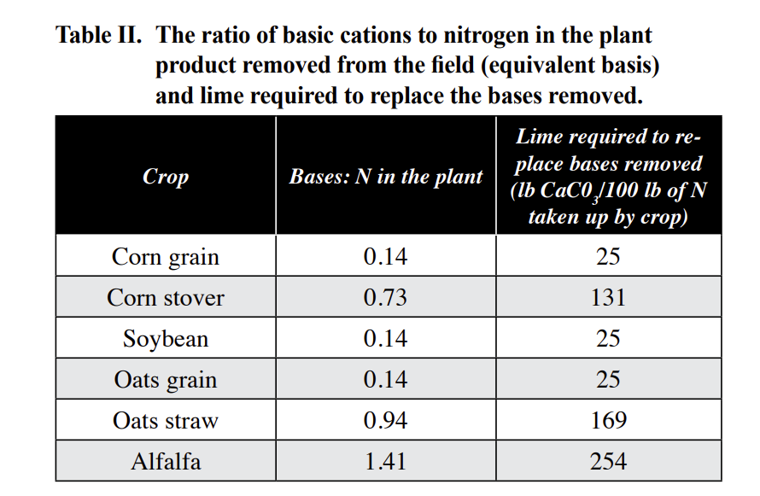
Where does H⁺ come from - Artificial
Removal of Basic Cations

Slide 17
How about inputs?
Artificial
Lime required to neutralize the soil acidity produced by fertilizers if all ammonium-N is converted to nitrate-N.
Nitrogen source | Chemical Formula | Composition | Lime required (lb CaCO₃ / lb N)
Anhydrous ammonia | NH₃ | 82-0-0 | 1.8
Urea | (NH₂) ₂ CO | 46-0-0 | 1.8
Urea-Ammonium Nitrate (UAN) | (NH₂) ₂ CO, NH₄NO₃ | 28-0-0 | 1.8
Ammonium nitrate | NH₄ NO₃ | 34-0-0 | 1.8
Ammonium sulfate | (NH₄) ₂SO₄ | 21-0-0-24 | 5.4
Monoammonium phosphate | NH₄H₂PO₄ | 10-52-0 | 5.4
Diammonium phosphate | (NH₄) ₂HPO₄ | 18-46-0 | 3.6
Triple super phosphate | P₂O₅ | 0-46-0 | 0.0
Adapted from Havlin et al., 1999.
Vary in their changes in soil pH
In general
  NO₃⁻ are less acid than NH₄⁺ sources
  NH₄⁺ are more influential on soil pH than P fertilizers
    Acidifying effect of NH₄⁺ when combined with an S or P source
    Causes formation of Phophoric and Sulfuric acid

Slide 18
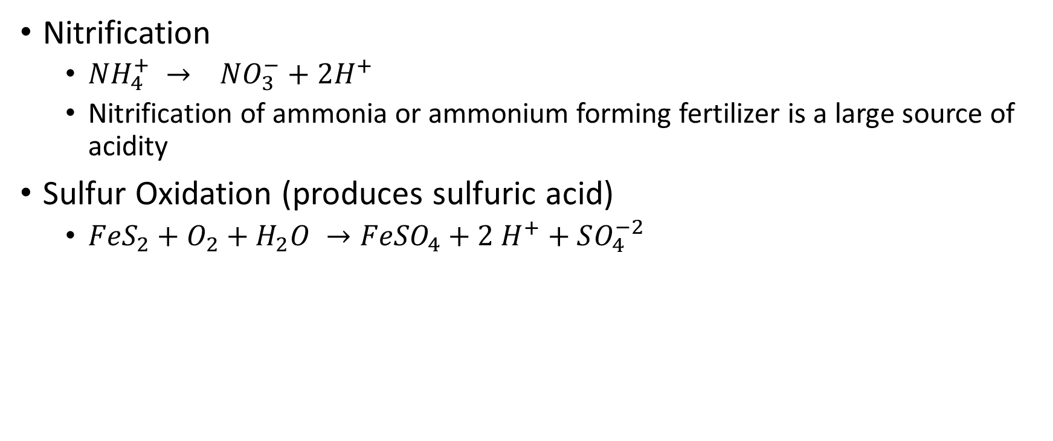
What’s so special about N and S?
Nitrification
  $NH_{4}^{+} → NO_{3}^{−}+2H^{+}$
  Nitrification of ammonia or ammonium forming fertilizer is a large source of acidity
Sulfur Oxidation (produces sulfuric acid)
  $FeS_{2}+O_{2}+H_{2}O →FeSO_{4}+2 H^{+}+SO_{4}^{−2}$

Slide 19
Soil CEC and Buffer Capacity
The strength with which cations are adsorbed to cation exchange sites is directly proportional to the product of the charges involved, and inversely proportional to the square of the distance between charges
-Coulombs law
Remember back to when we talked about CEC
Soils behave as a system made up of the salt from a weak acid and strong base
Isomorphic substitution
Consequently, the lyotropic series describing the adsorption of cations on clay particles in soils is generally considered being:
Al ³⁺ ≅ H⁺ > Ca ²⁺ ≅ Mg ²⁺ > K⁺ ≅ NH4⁺ > Na⁺
CEC and BUFFERING CAPACITY ARE DIRECTLY TIED

Slide 20
Soil acidity and Soil Buffer Capacity
Soil will act like a weak acid that will buffer pH
  Acid Soils
  End Result is no real change in pH, thus soil is buffered
  As more base is added, pH will only slowly increase until critical point is reached
Adsorbed Al³⁺
↕
Solution Al³⁺ →Al³⁺ + H₂O ↔ AlOH²⁺ + H⁺ pK_{a}~4.95
+ lime
↓
AlOH²⁺ + H₂O ↔ Al(OH)₂⁺ + H⁺ pK_{a}~5.60
+ lime
↓
Al(OH)₂⁺ + H₂O ↔ Al(OH)₃ + H⁺ pK_{a}~6.70

Slide 21
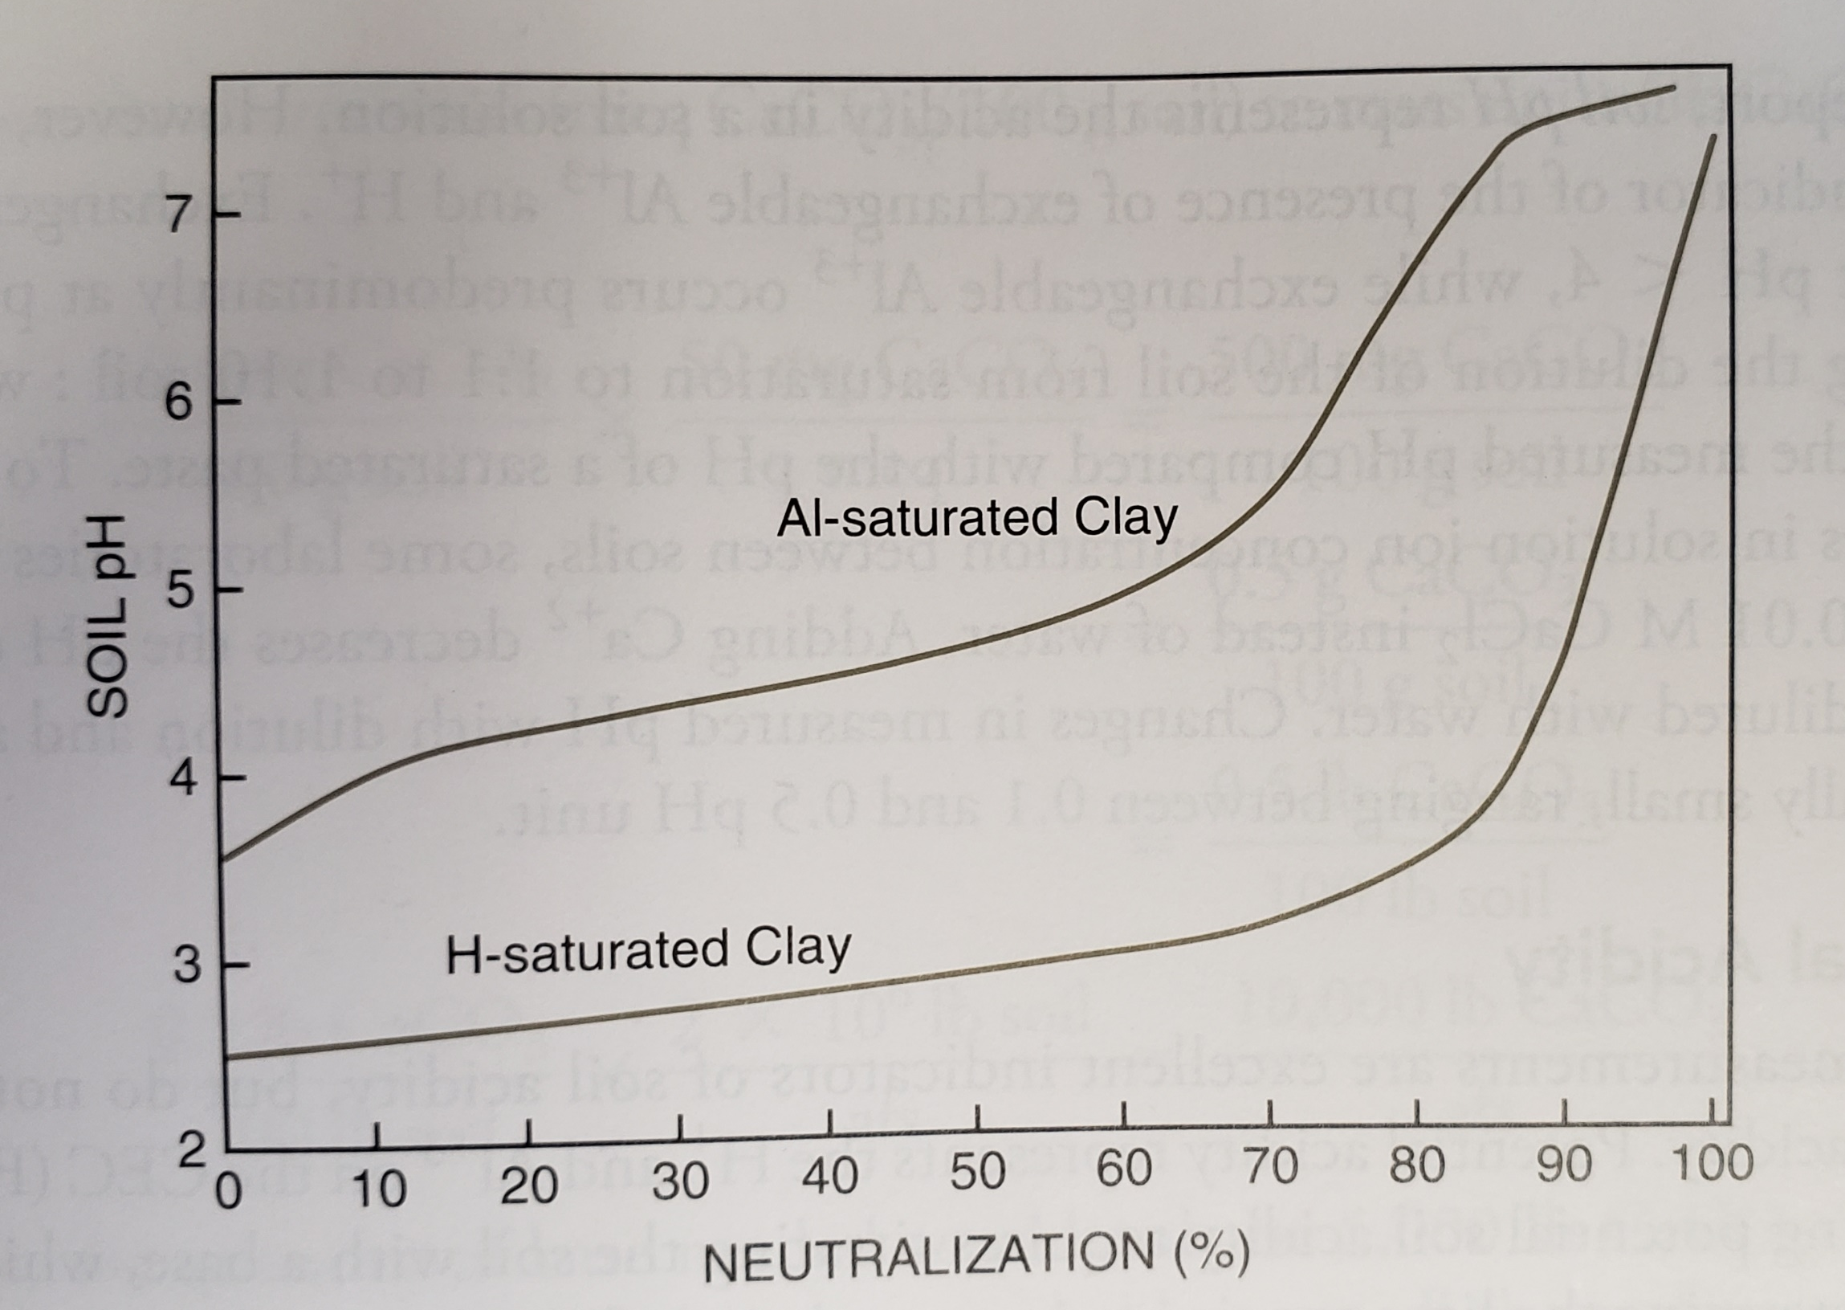
Soil pH Buffering
Soil will RESIST changes of pH
Titration Curves
  Flat portion of the curve represents the buffering capacity
    As we add base (Neutralization), pH changes slowly
    This is the influx of H⁺ form the hydrolysis reaction
  Rapid increase in pH (~75%)
    Al³⁺ and hydroxides have converted to Al(OH)₃ (gibbsite) and precipitated
Note: Reverse can occur
  As acid is added to the soil, OH⁻ can be added as Al compounds solubilize.

Slide 22
Active vs Potential/Exchangeable Acidity
Active Acidity
  H⁺ and Al³⁺ in soil solution
  Measured in a soil/water solution with pH meter and electrodes
  Soil pH on test report is active acidity
  Gives a good indication of the presence or absence of H⁺ and Al³⁺ in the soil solution
  H⁺ present at pH < 4
  Al³⁺ present at pH < 5.5

Slide 23


Slide 24
Active vs Potential/Exchangeable Acidity
Potential/Exchangeable Acidity
  H⁺ and Al³⁺ in the soil CEC
  Requires titration with a base
  Related to active acidity and CEC
  Higher clay/ OM -> Higher lime requirement
  Lower Clay/OM -> lower Lime requirement

Slide 25
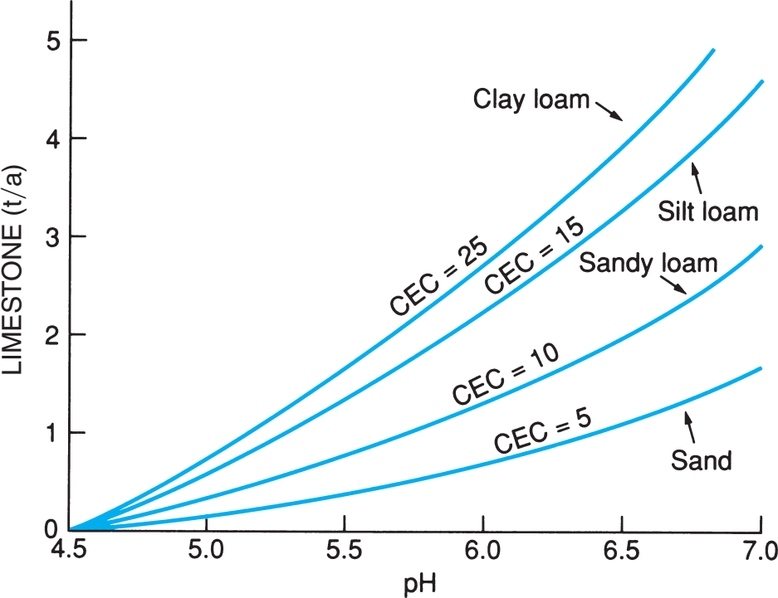
Soil pH Buffering

Slide 26
Soil pH Buffering
Amount of potential acidity that needs to be neutralized

Slide 27
Effect of Soil Acidity on Plants
Plant species vary in their response to acidic soil conditions.
  Those evolved and cultivated in humid regions tolerate acidic soils better than other species grown in arid and semiarid climates
  Fescue/Blueberries/Azalea vs. Bermudagrass/wheat
  Non-legumes require soil pH > 5.5 because of toxic levels of Mn and Al
  Legumes usually grow best at soil pH > 6.0 due to rhizobium involved in fixing atmospheric N₂ seem to thrive in an environment rich in basic cations
  Crops which grow well in acidic soils can tolerate metal ions (Mn, Al), and perhaps have harder time getting Fe in more basic soils
Primary Problems
  Acid toxicity effects on root growth
  Reduced nutrient availability

Slide 28
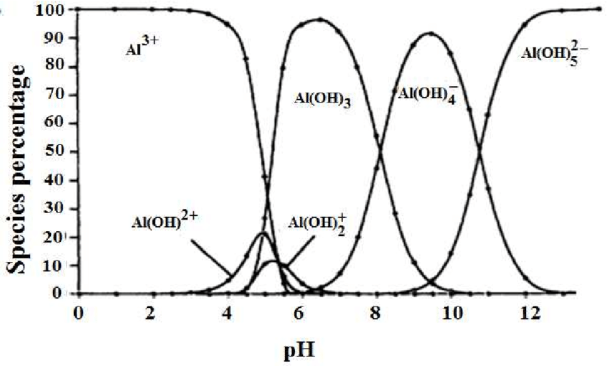
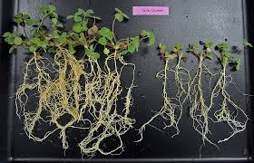
Acid Toxicity
Al, Mn, H toxicity pH < 5.5
  Stunted Growth
  Reduced root growth (rapid)
  Root discoloration
H⁺ toxicity pH < 4.0
  Same as above
  Deteriorates root membrane causing loss of material and functionality

Slide 29
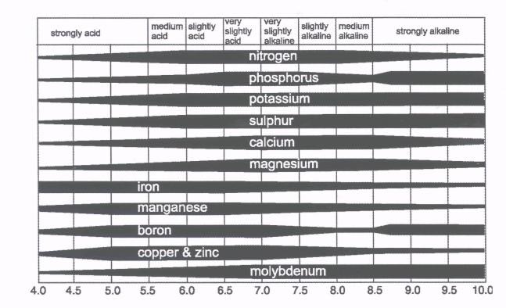
Reduced Nutrient Availability
Ca²⁺, Mg²⁺, P deficiency
  Result of high Al in solution
  Ca²⁺, Mg²⁺ uptake inhibited
  P complexation (talk more in P)
Others
  N deficiency
  Mo deficiency
  K deficiency

Slide 30
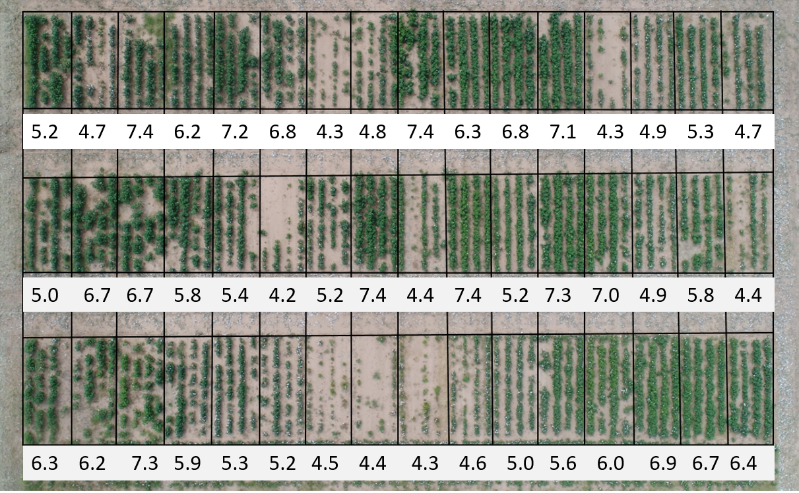

Slide 31
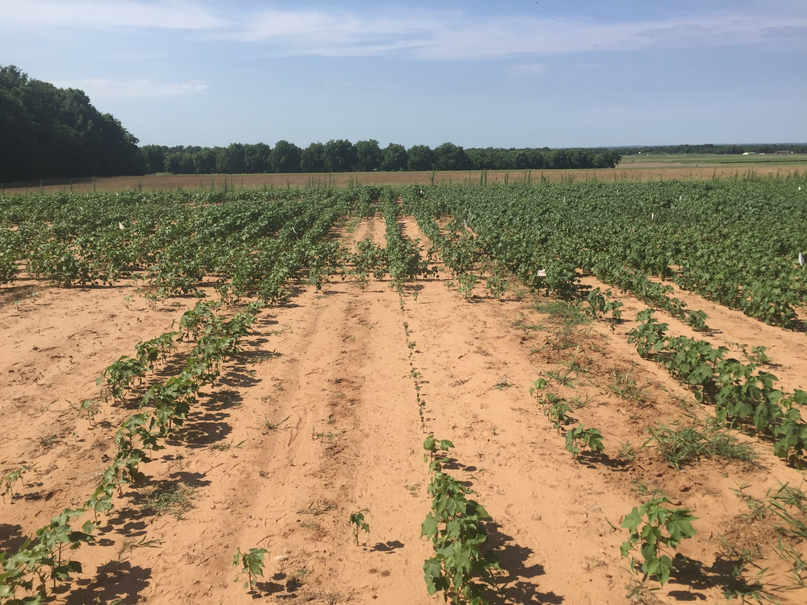
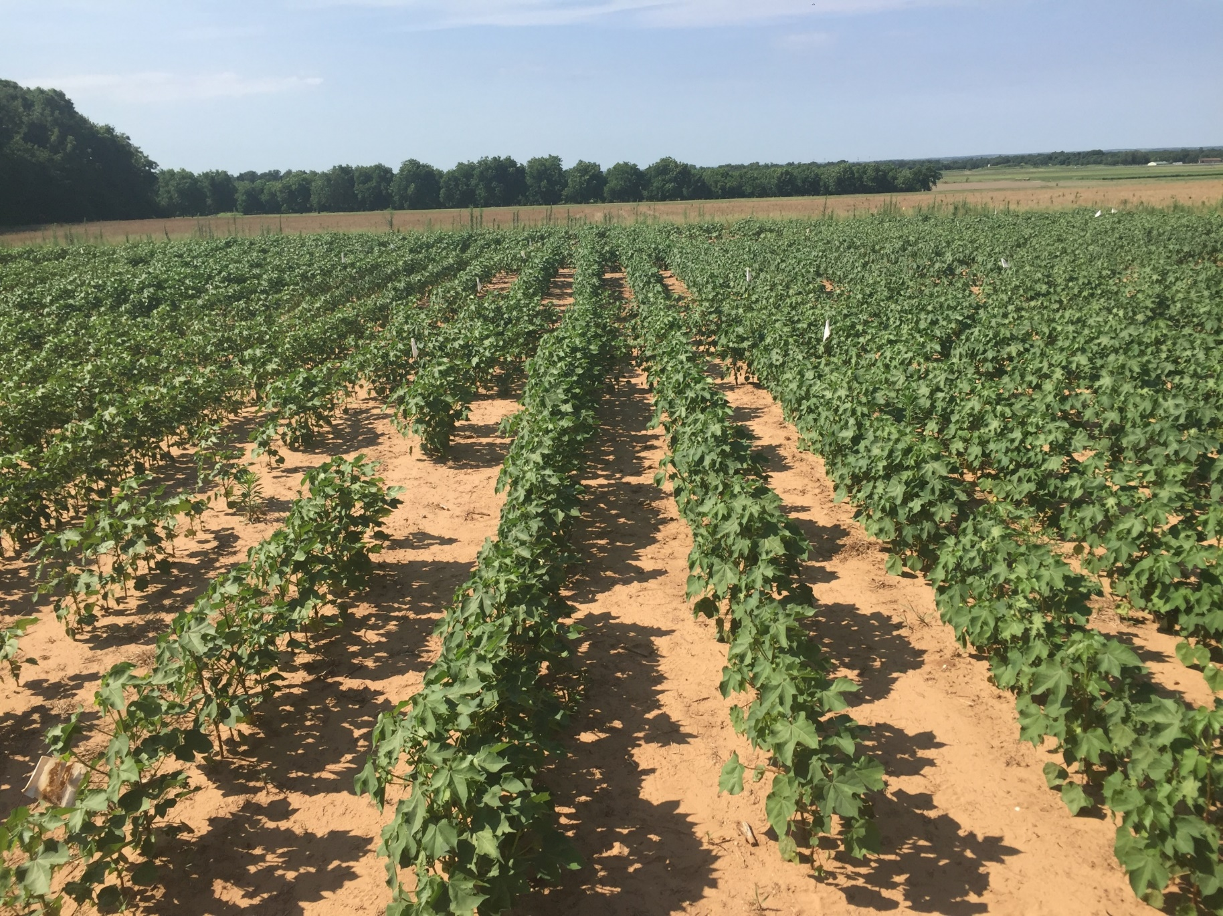
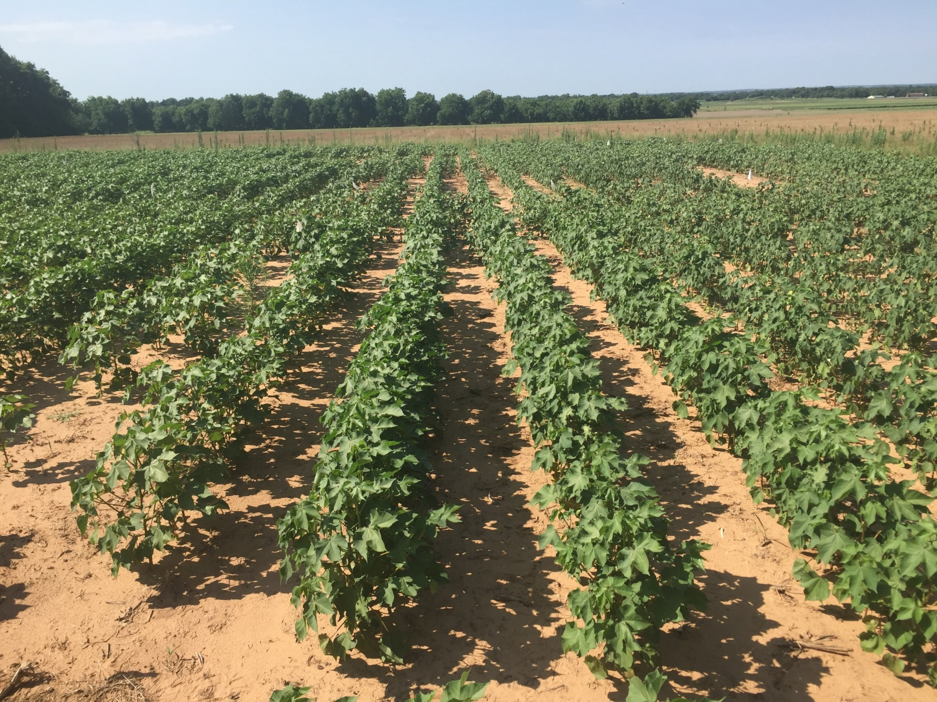

Slide 32
Other issues with soil pH
Some herbicides are pH resistant

Slide 33
ALS Inhibitors – Group 2 Herbicides
Imidazolinones
  Pursuit
  Raptor/Beyond
Sulfonylureas
  Maverick
  Osprey
  Classic
Sulfonanilides
  PowerFlex
  FirstRate
  Python
Sulfonylaminocarbonyl-triazolinones
  Olympus
  Everest

Slide 34
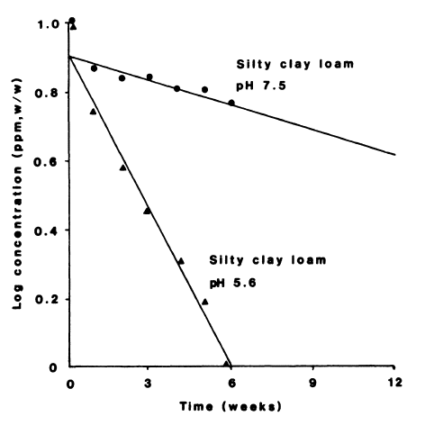
Sus are more persistent at higher soil pH
Glean (chlorsulfuron)
Herbicide concentration
Soil pH 7.5
Half-life ≈ 10 weeks
Soil ph 5.6
Half-life ≈ 2 weeks

Slide 35
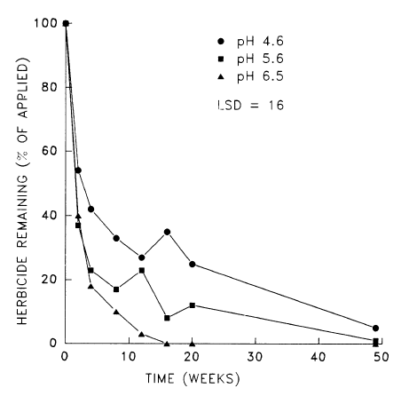
IMIs are more persistent at lower soil pH
Pursuit (imazethapyr)
Soil ph 4.6
Soil ph 5.6
Soil ph 6.5

Slide 36
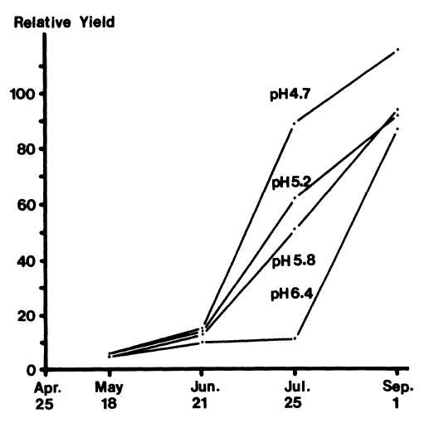
PSII inhibitors – atrazine, sencor
No weed control
10% control after 2 months
Weed growth
More persistent at higher pH
90% control after 2 months
Complete weed control
Hiltbold and Buchanan, Weed Sci. 25:515-520

Slide 37
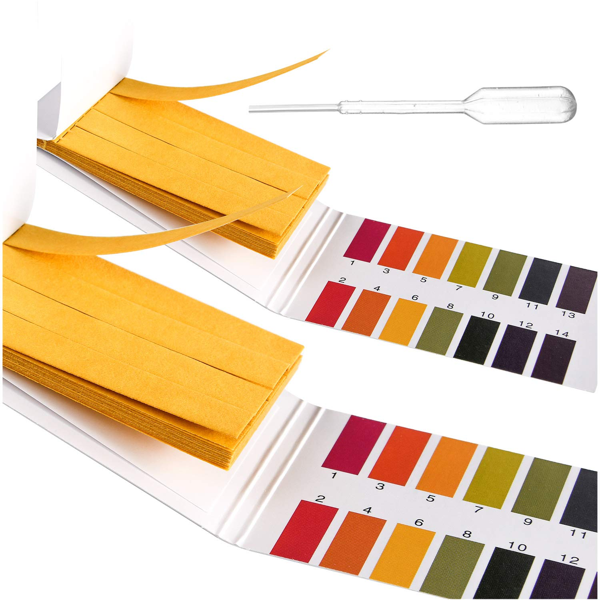
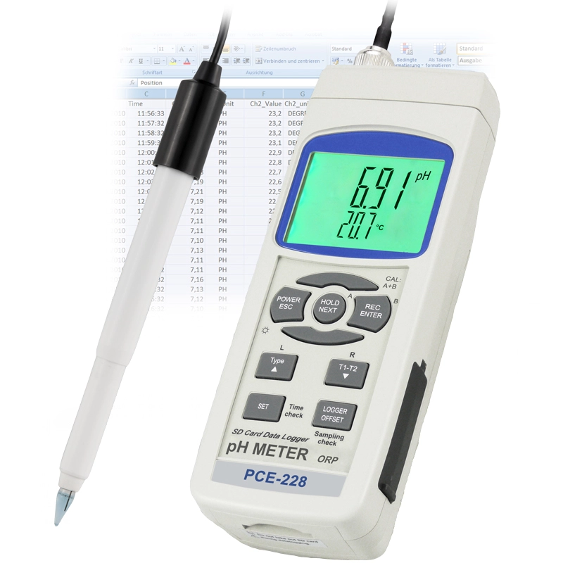
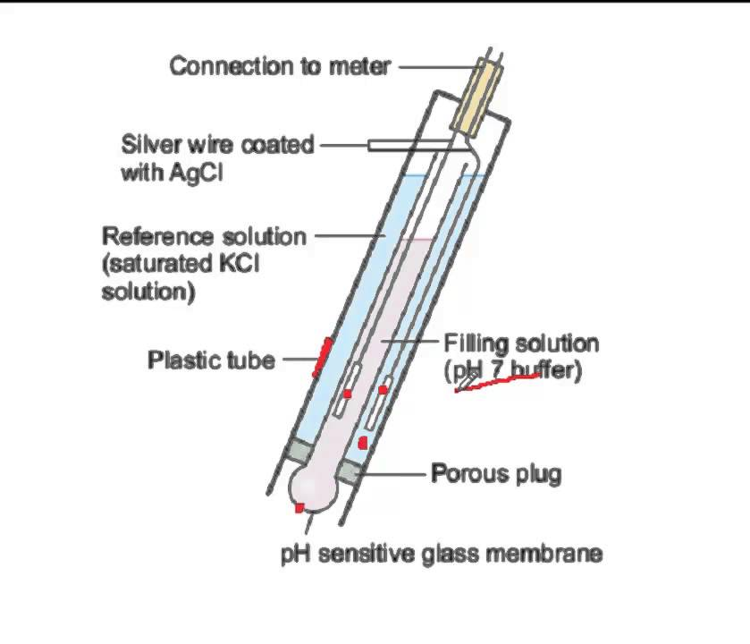
How do we measure soil pH?
Remember, we are measuring H⁺ concentration
pH paper
  Paper treated with H⁺ sensitive chemicals, that change color to reflect soil pH
  Very coarse reading, but good for fast measurement
pH probe/meter
  Reads electrical potential from solution, compares to a known standard, to give a accurate estimation of soil pH

Slide 38
How to we handle Soil Acidity issues?
Genetics
  Al tolerant varieties
Plant a different crop
Neutralize Soil Acidity

Slide 39
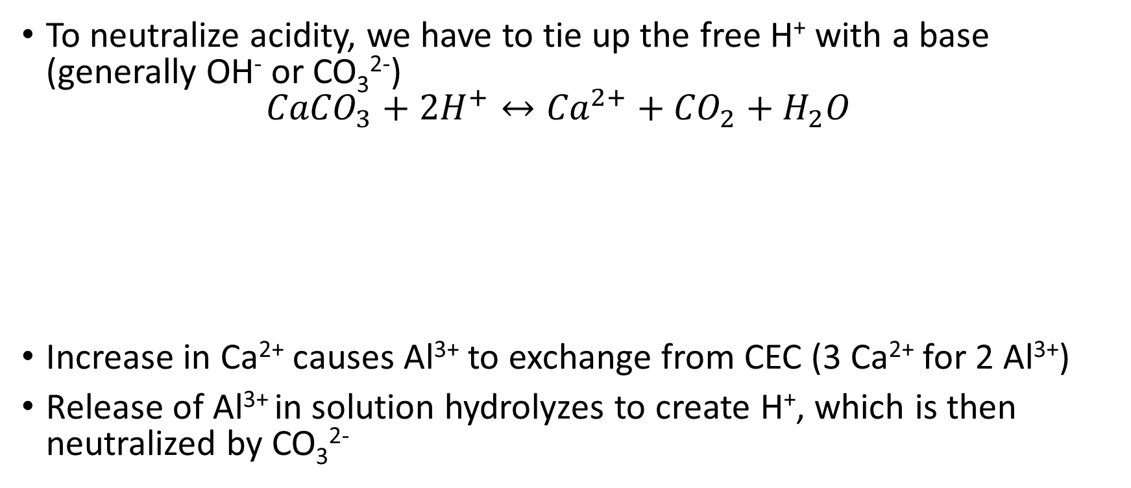
Neutralizing Soil Acidity
To neutralize acidity, we have to tie up the free H⁺ with a base (generally OH⁻ or CO₃²⁻)
${CaCO}_{3}+{2H}^{+}↔{Ca}^{2+}+{CO}_{2}+H_{2}O$
Increase in Ca²⁺ causes Al³⁺ to exchange from CEC (3 Ca²⁺ for 2 Al³⁺)
Release of Al³⁺ in solution hydrolyzes to create H⁺, which is then neutralized by CO₃²⁻

Slide 40
Neutralizing Soil Acidity
Ca containing Carbonates (CaCO₃, CaMg(CO₃)₂)
  Calcium is NOT the neutralizing factor
  CO₃ is!
  Calcium can exchange on sites, but does nothing for acidity
NaOH could be used to neutralize solution H⁺
  What is the biggest source of soil acidity?
  Potential/Exchangeable
Exchangeable/Potential acidity accounts for 99% of the soil acidity
  Buffer Index

Slide 41
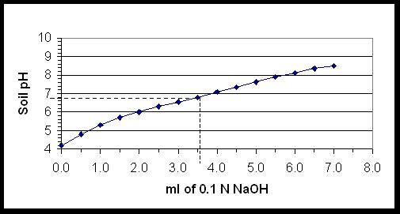
How do we determine lime requirements?
Lime Requirements can be determined directly in a laboratory by quantitatively adding small amounts of a solution of known strength base (e.g. 0.1 normal NaOH) to a known amount of acid soil mixed with water
By measuring pH as the base is added, the amount of base required to obtain any pH can be estimated
Titration

Slide 42
How do we determine lime requirements?
Direct Determination
  Most time consuming, theoretically most accurate, but has drawbacks. Therefore, rarely done.
  Identifies the amount of base, such as CaCO₃, that must be applied if all the acidity is able to react with the base that is added
  In practice, this is virtually impossible because of size differences between clay and organic matter colloids (very small) and the finely ground (relatively large) lime particles
  Field studies (calibration) can be conducted to develop the relationship between amounts of lime identified by direct laboratory titration and crop response

Slide 43
How do we determine lime requirements?
Indirect Determination
  Most labs use this
  Involves adding a known quantity of a lime-like chemical solution (i.e. buffer solution of pH 7.2) to an acid soil and water mixture
  After equilibrium has been obtained (about 2 hours) the pH is measured
  This pH is often called the “buffer pH” or “buffer index”. The buffer index, by itself, does not identify how much lime must be added to neutralize an acid soil
  Field studies relating lime additions to soil pH are required to calibrate the buffer index, just as they would be in a direct titration approach

Slide 44
How do we determine lime requirements
Indirect Determination
  Buffer Methods
Method | Buffer pH | Target pH | Intended Use | CaCO₃ Required/0.1 Decrease in Buffer pH (ton/ac)
SMP | 6.8 | 6.8 6.4 6.0 | Exchangeable Al-alfisols | 0.27 0.22 0.18
Woodruff | 7.0 | 6.5-7.0 | Mollisols | 0.22
Modified Woodruff | 7.2 | 6.5-7.0 | Mollisols | 0.22
Adams-Evans | 8.0 | 6.5 | Low CEC – ultisols | 0.04
Mehlich | 6.6 | 6.0 | Exchangeable Al-ultisols | 0.07
Sikora | 8.0 | 6.5 | Low CEC – ultisols | 0.23

Slide 45
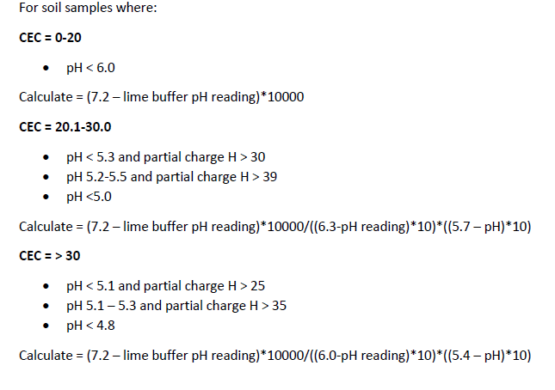
How does MSU determine lime requirements?
Soil pH
Buffer pH
  Modified Woodruff Buffer
CEC

Slide 46
How does MSU determine lime requirements?
Based on 100% CCE
  Calcium Carbonate Equivalent (CaCO₃)

Slide 47
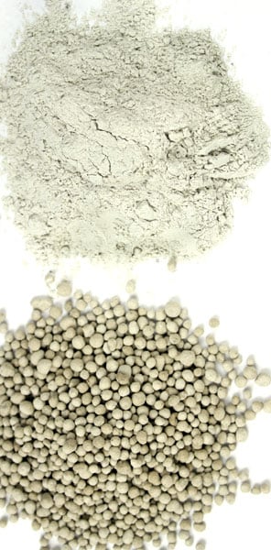
Liming Materials
Use CO₃⁻, OH⁻, or O²⁻ to consume active acidity (solution)
Have Ca to help release potential acidity
Ag Lime
  Mainly CaCO₃ and CaMg(CO₃)₂ (dolomite)
  Pelletized lime
    Fine powder mixed with a water-soluble binding agent
    Easy to broadcast, but more expensive
  Fluid or suspension lime
    50/50 mix of Ag-Lime and water plus suspending agents
    Can be applied with UAN
    Single pass application rates <500 lbs/ac
    Easy use, but also more expensive

Slide 48
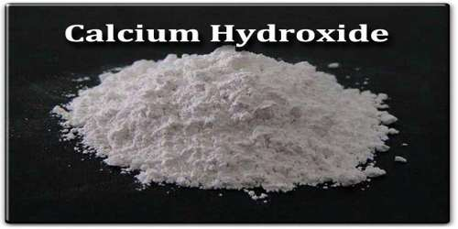
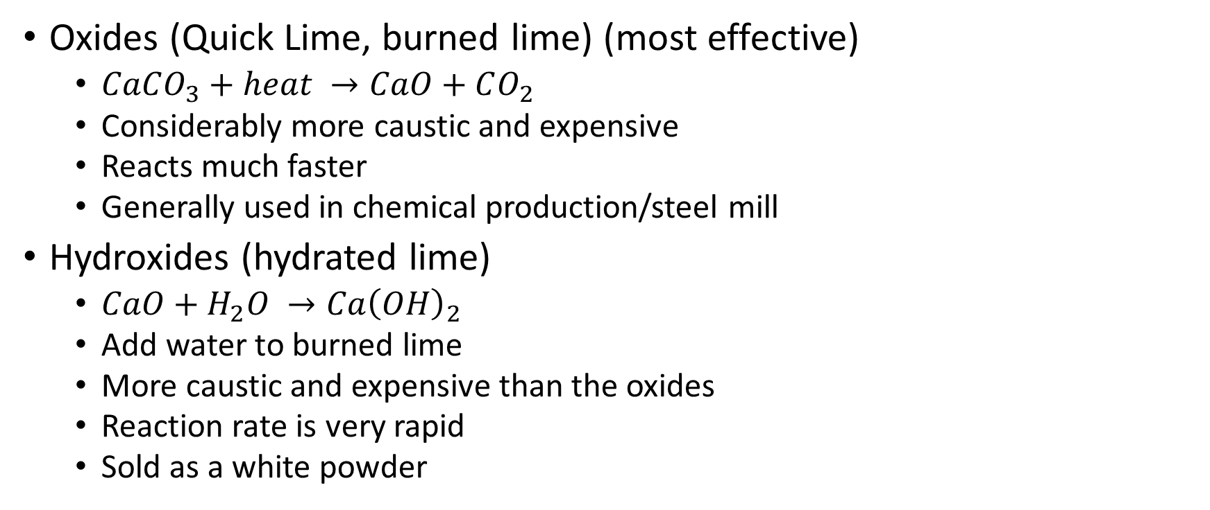
Liming Materials
Oxides (Quick Lime, burned lime) (most effective)
  $CaCO_{3}+heat →CaO+CO_{2}$
  Considerably more caustic and expensive
  Reacts much faster
  Generally used in chemical production/steel mill
Hydroxides (hydrated lime)
  $CaO+H_{2}O →Ca{\left(OH\right)}_{2}$
  Add water to burned lime
  More caustic and expensive than the oxides
  Reaction rate is very rapid
  Sold as a white powder

Slide 49
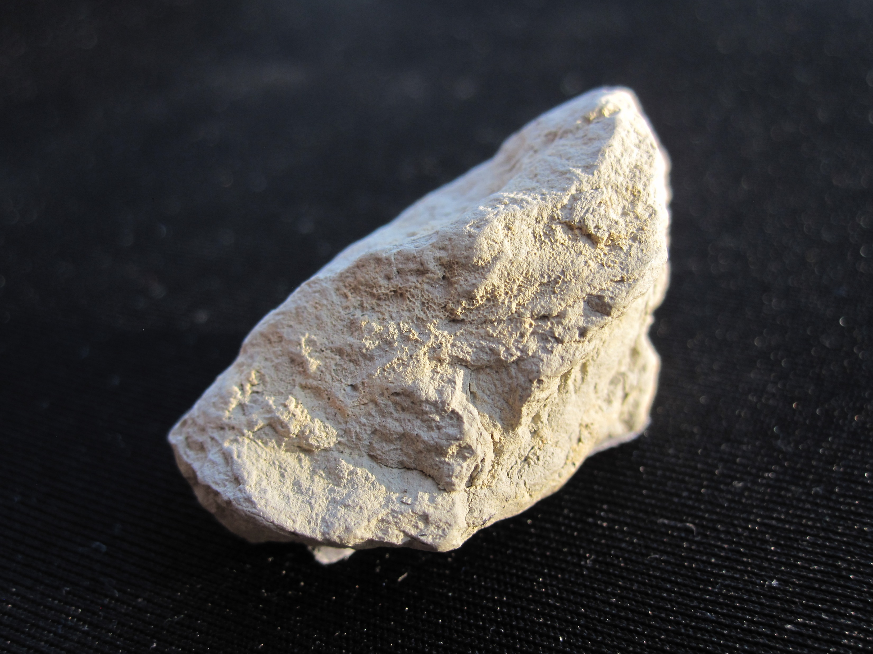
Liming Materials
Marl
  Soft deposits of CaCO₃
  Generally has a lot of impurities
  Generally very moist
Calcium Silicate/slag
  Surface mined
  Byproduct of Fe manufacturing
    Generally high in Ca, Mg, and P
Ash Products
  Neutralizing ability is highly variable
  May have heavy metals

Slide 50
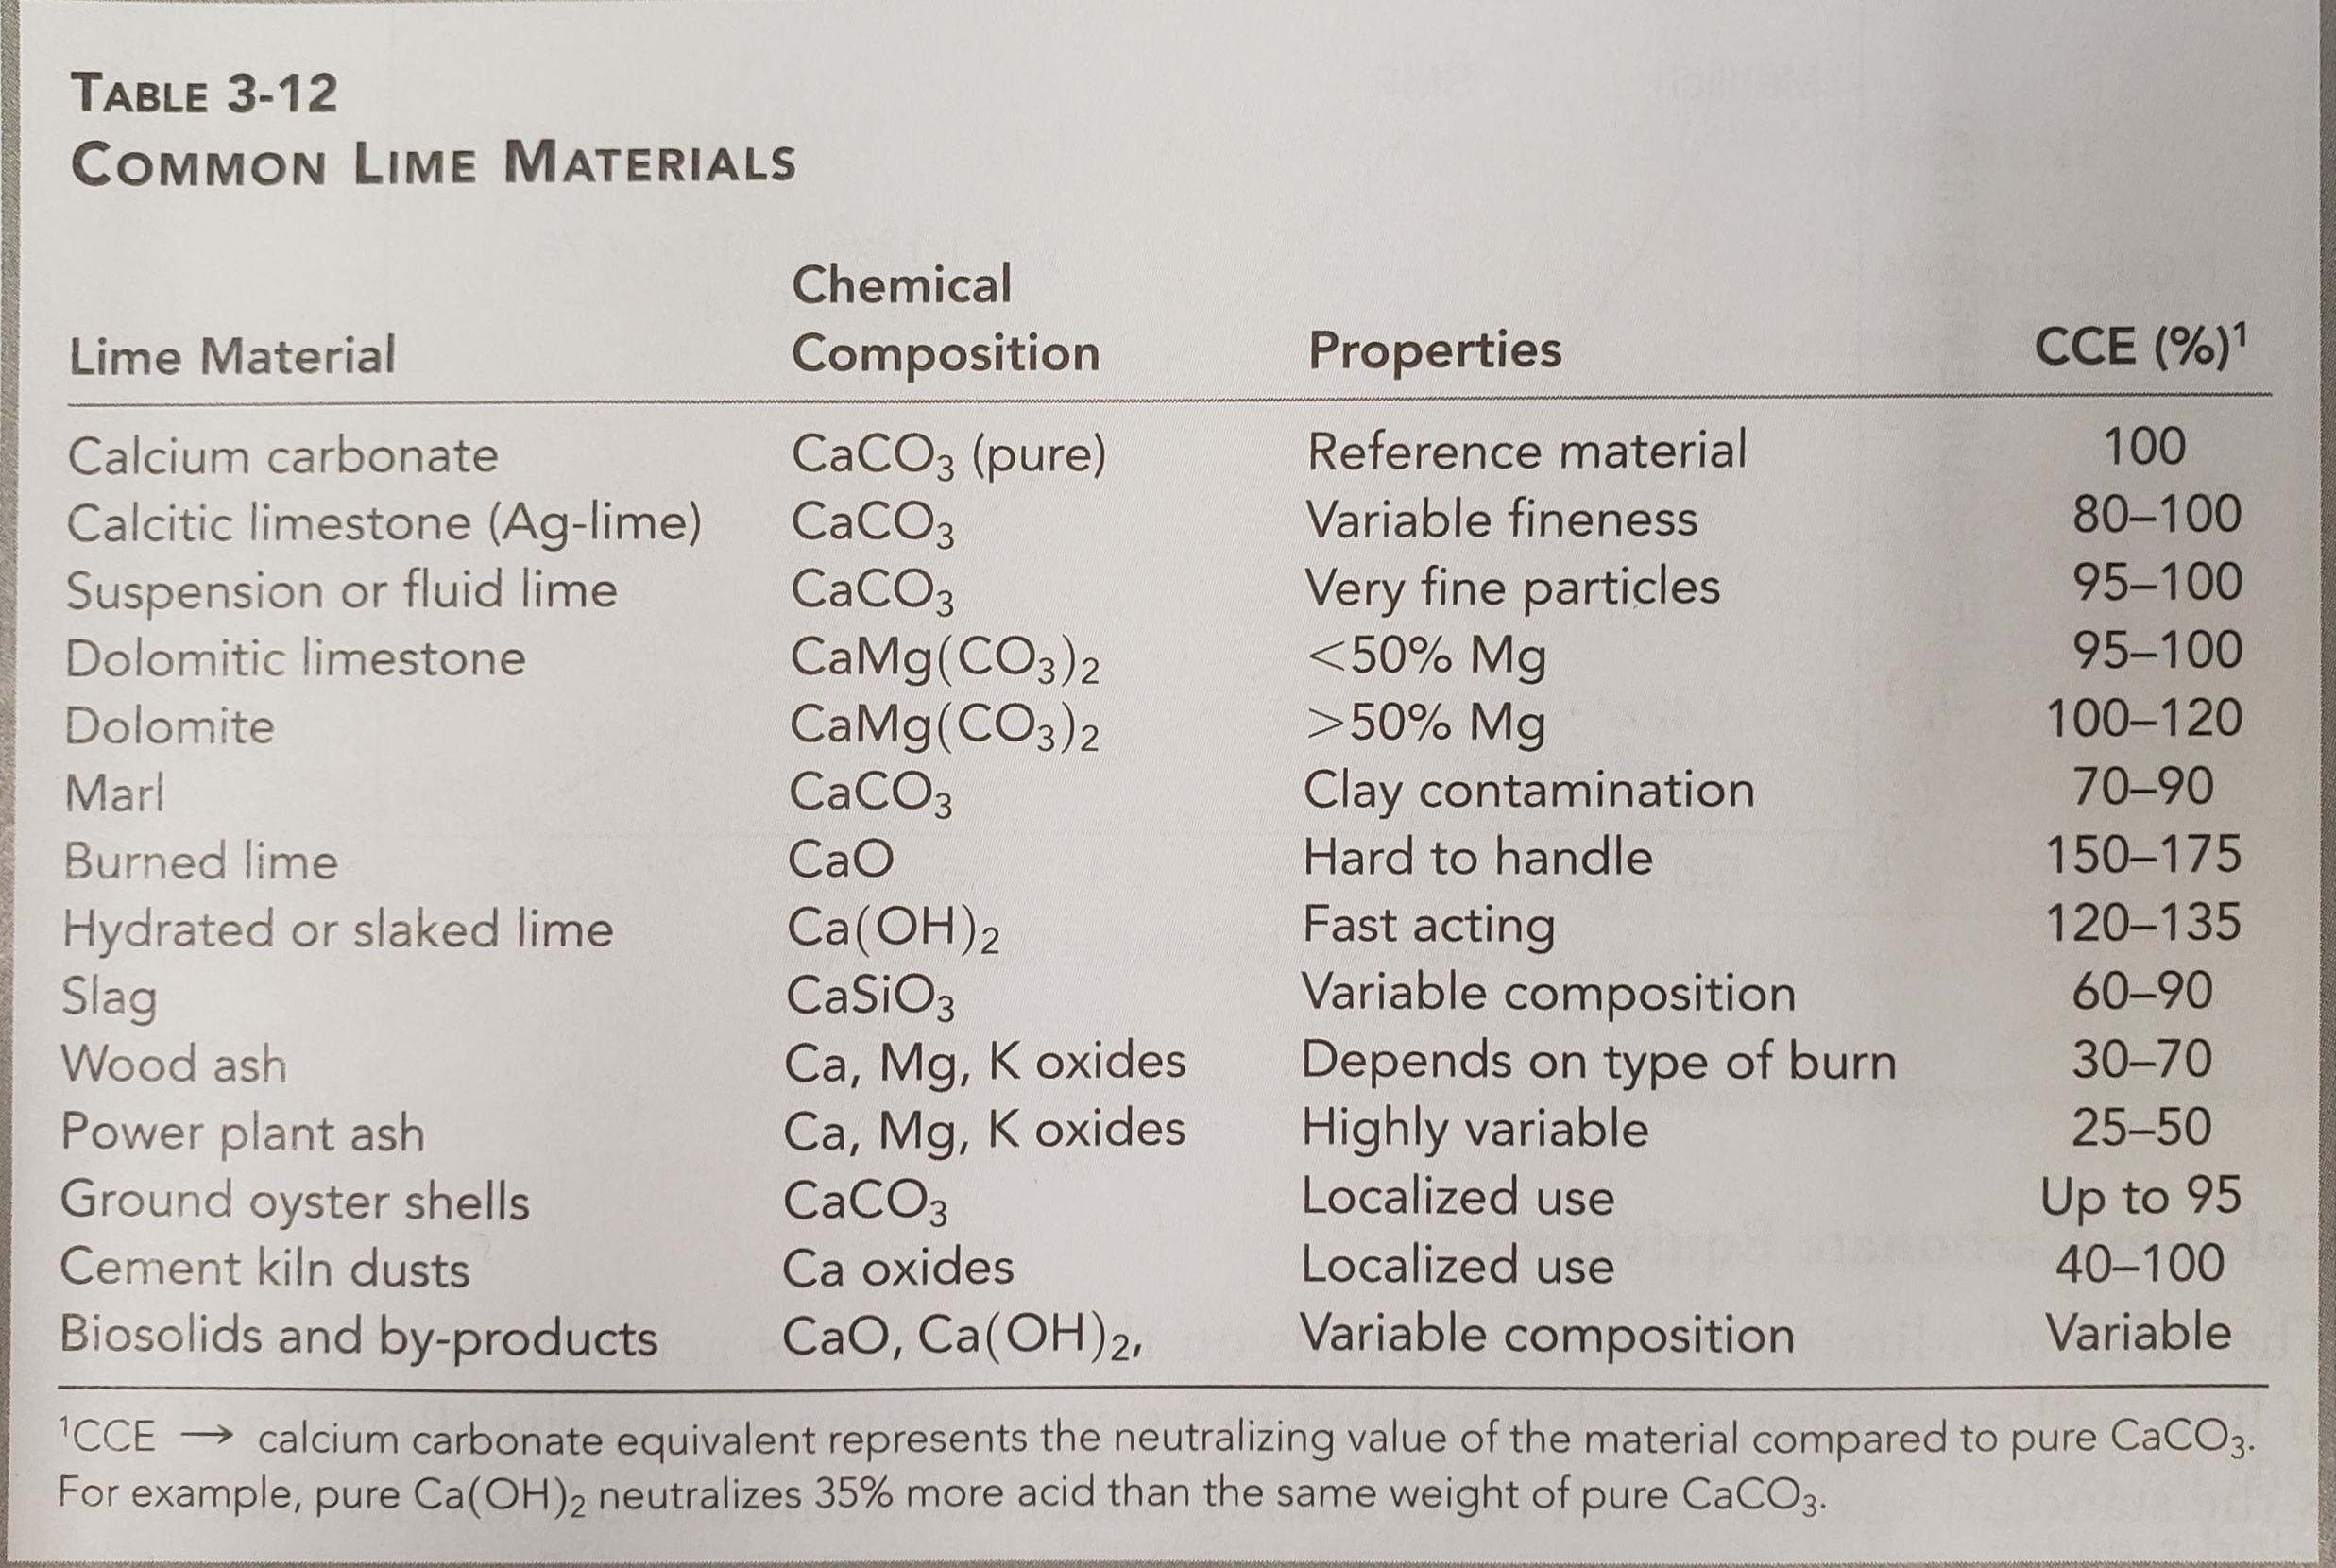
Lime Requirements – CCE
Based on CaCO₃

Slide 51
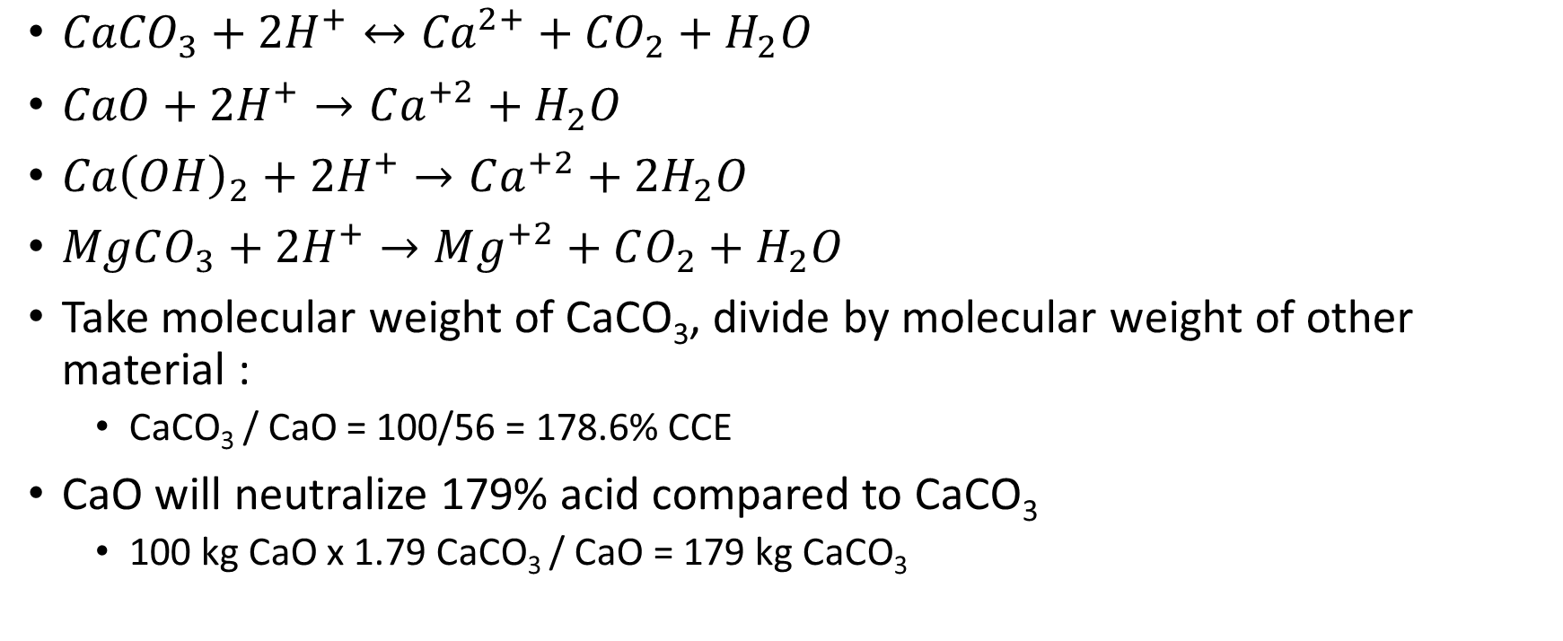
How to calculate CCE?
${CaCO}_{3}+{2H}^{+}↔{Ca}^{2+}+{CO}_{2}+H_{2}O$
$CaO+2H^{+}→Ca^{+2}+H_{2}O$
$Ca{\left(OH\right)}_{2}+2H^{+}→Ca^{+2}+{2H}_{2}O$
$MgCO_{3}+2H^{+}→Mg^{+2}+CO_{2}+H_{2}O$
Take molecular weight of CaCO₃, divide by molecular weight of other material :
  CaCO₃ / CaO = 100/56 = 178.6% CCE
CaO will neutralize 179% acid compared to CaCO₃
  100 kg CaO x 1.79 CaCO₃ / CaO = 179 kg CaCO₃

Slide 52

How to calculate CCE
Dolomite
  CaMg(CO₃)₂
  $CaMg{\left(CO_{3}\right)}_{2}+4H^{+}→Ca^{+2}+Mg^{+2}+{2H}_{2}O$
  $\frac{100g CaCO_{3}/mole}{0.5 x 184 gCaMg(CO)_{2}/mole}=1.09 CCE$

Slide 53
Lime Requirements - Purity
Rarely are all products pure, depending on their source
If CaO from earlier example is only 95% pure, then 100 kg would only supply 95 kg of CaO
So = 100 kg of 95% Cao x 1.79 CaCO₃/CaO = 169 kg of CaCO₃

Slide 54

Lime Requirements - Fineness
Also require certain fineness
Fineness impacts neutralizing value
  Finer Material reacts faster
  Ag – Lime < 200 mesh
  Pell lime is still at that mesh, just bound
Fineness of limestone is measured by passing the material through a series of sieves. 50 mesh and 10 mesh sieves are generally used in MS

Slide 55
Lime Requirements - Fineness
Evaluation of Mississippi liming materials
  Passes a 50 mesh sieve 100% efficiency
  Passes a 10 mesh sieve, but not 50 50% sufficiency
This can be extrapolated once you know how much passed through each sieve
37% passes through a 50 m sieve, and 51% passes through a 10 m sieve
  0.37*100% = 37%
  (51%-37%)*50% = 7%
  Sum = 44%
  44% effectiveness

Slide 56
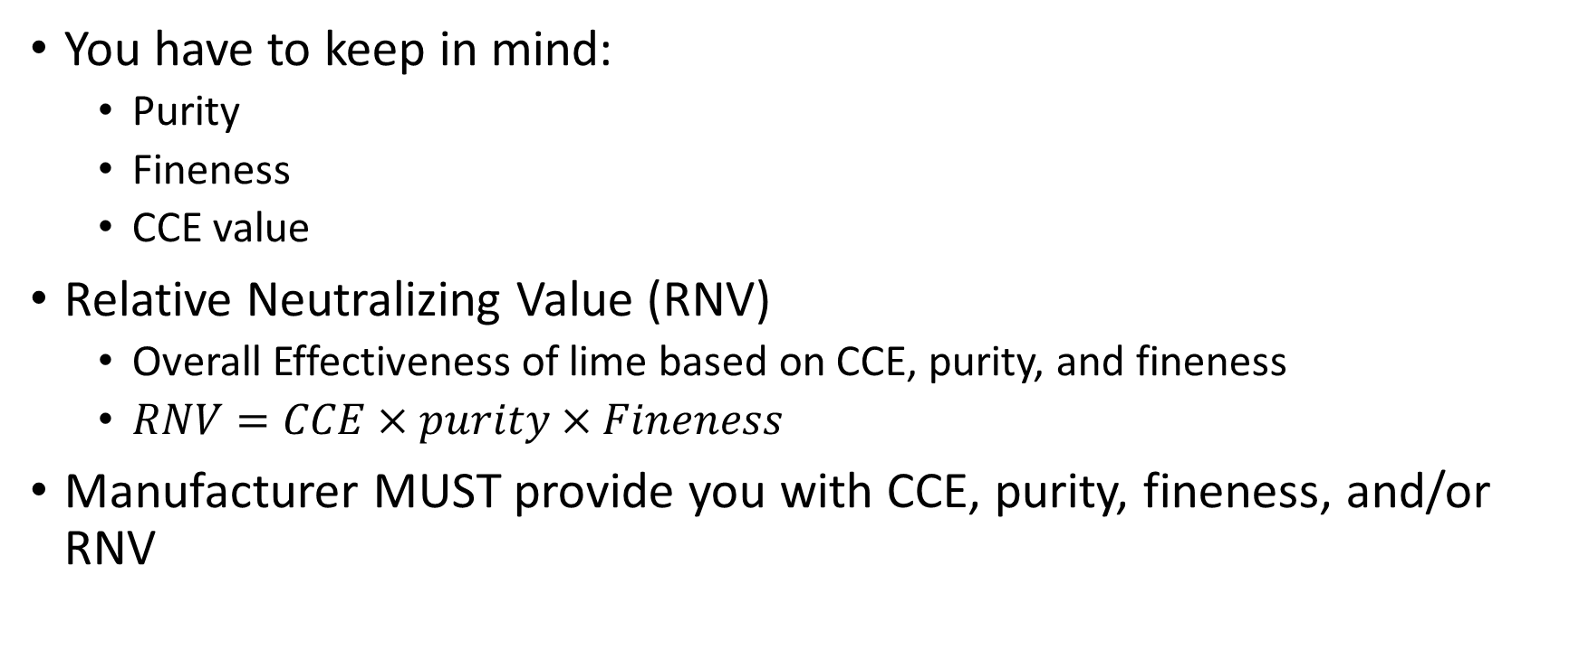
Lime Requirements - RNV
You have to keep in mind:
  Purity
  Fineness
  CCE value
Relative Neutralizing Value (RNV)
  Overall Effectiveness of lime based on CCE, purity, and fineness
  $RNV=CCE×purity×Fineness$
Manufacturer MUST provide you with CCE, purity, fineness, and/or RNV

Slide 57
Lime Requirements - RNV
Source: CaMg(CO₃)₂
Purity: 85%
Fineness: 65%
Calculate RNV

Slide 58
Lime Requirements - RNV
Source: CaO
Purity: 95%
Fineness: 95%
Calculate RNV

Slide 59
Considerations for Lime Application
Soil Testing is extremely important
  Must be reliable, and representative
  Keep in mind your timing
    3-6 months to see any large scale impact
  Generally recommend lime application every 3-4 years for locations with soil acidity issues
Incorporation speeds up the process
Amount of lime depends on the crop you are growing
  Applying 3 tons of lime on pH 5.0 for blueberries is dumb
  Applying 0.5 tons of lime on pH 4.5 for soybeans is just as dumb

Slide 60
Considerations for Lime Application
No-till
Normal tillage

Slide 61
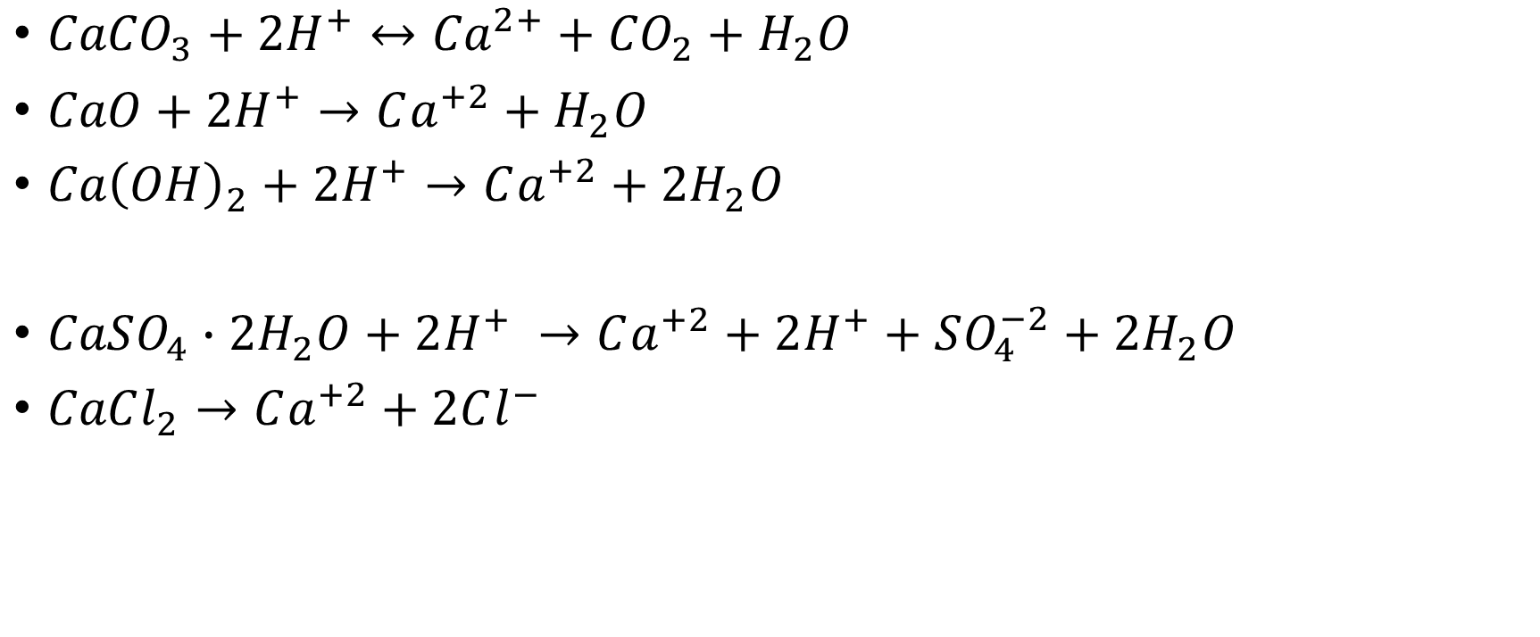
Remember, Ca IS NOT what impacts pH
${CaCO}_{3}+{2H}^{+}↔{Ca}^{2+}+{CO}_{2}+H_{2}O$
$CaO+2H^{+}→Ca^{+2}+H_{2}O$
$Ca{\left(OH\right)}_{2}+2H^{+}→Ca^{+2}+{2H}_{2}O$
$CaSO_{4}∙2H_{2}O+2H^{+} →Ca^{+2}+2H^{+}+SO_{4}^{−2}+2H_{2}O$
$CaCl_{2}→Ca^{+2}+2Cl^{−}$

Slide 62
Calcareous Soils
Calcareous soils are those that contain enough free CaCO₃ from parent material that it will even react with an acid.
pH is greater than 7.0, and considered a basic soil
Calcareous soils can also arise through long term irrigation with water than contains small amounts of dissolved carbonate that can accumulate with time
  Calcareous soils can contain from 3% to >25% CaCO₃ by weight with pH values with a range of 7.6-8.3

Slide 63
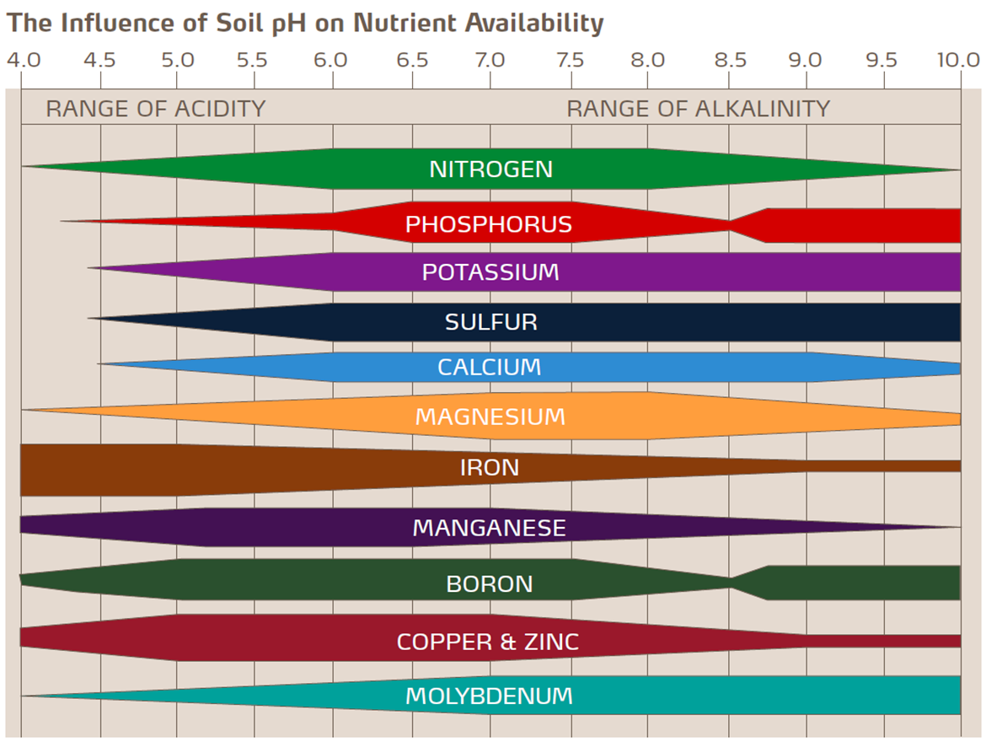
Calcareous soils

Slide 64
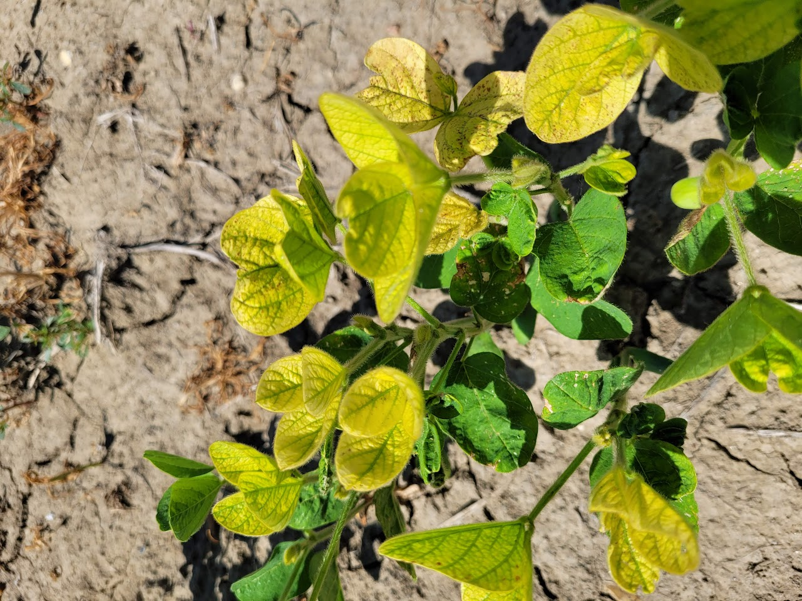
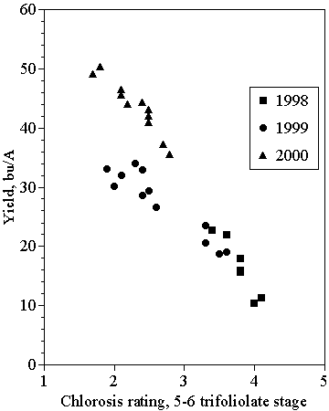
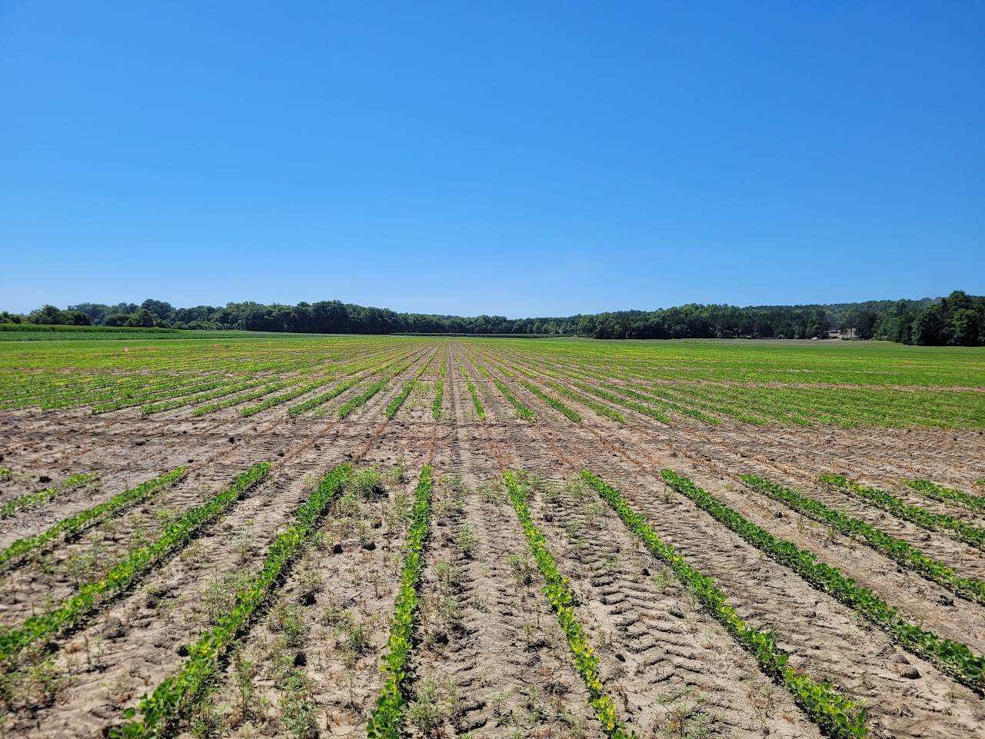
Iron Deficiency Chlorosis

Slide 65
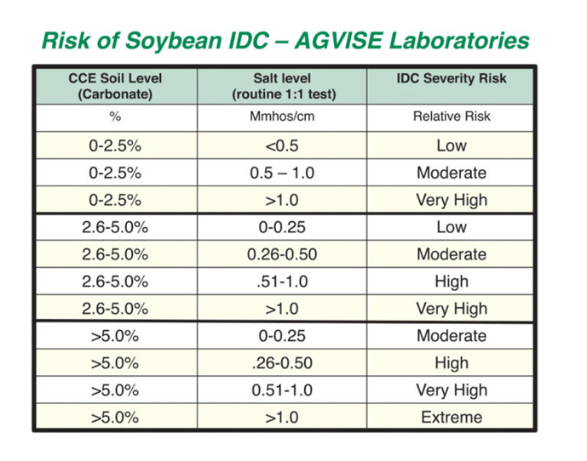
Iron Deficiency Chlorosis
Research has shown that chlorosis persisting into the fifth and sixth-trifoliate leaf stage will reduce yield. For fields with soybean IDC now, you should take preventative action for following years:
  Evaluate which soybean varieties are most tolerant or susceptible to IDC
  Identify soybean IDC hotspots on field maps
Factors contributing to IDC
  High Carbonate Levels
  High Salinity Levels
  Low Fe

Slide 66
IDC Chlorosis
IDC is not correctable with an in-season fertilizer application.
Foliar application of iron products may have short-term cosmetic effects, but foliar Fe applications have not consistently increased yield of soybeans affected by IDC
Chlorosis symptoms often alleviate naturally as environmental conditions improve (drier, warmer weather), but severe cases can persist and cause yield loss
Fertilizer application at planting of some iron chelate containing fertilizer should help

Slide 67
Saline Soils
Soil is classified as saline when they contain high enough concentration of soluble salts tot interfere with normal growth and development of salt-sensitive plants
Soluble salts, like NaCl, CaCl₂, etc.
These ions hold water quite tightly, salty water
  Tightly enough by the ions that plants cannot use it (apparent moisture stress)

Slide 68
Saline Soils
Can come from:
  Parent material
  High water table with high evaporative demand
  Exposure to sea water
  Poor quality irrigation water
  Excessive applications of salts in fertilizer
Saline soils characteristically remain moist longer than the rest of the field
  Occupy poorly drained areas of the landscape
  White surface layer of salt after they become dry
  Occur in semi-arid, temperate regions
  Saline soils are uncommon in the moisture extremes of deserts and tropical rain forests.

Slide 69
Saline Soils
Determined using saturated paste extraction
  Saturate soil sample for 4 hours
  Extract the water
  Measure the solutions ability to conduct electricity using EC meter
    The more ions present in the water, the easier electricity is conducted
Soils are considered saline if it has an EC greater than or equal to 4000 micromhos/cm

Slide 70
Saline Soils
Reclaimed by:
  Leaching soluble salts out of the soil profile with GOOD QUALITY WATER
  Create good surface and internal drainage
  Incorporating large amounts of organic matter (create large pores in the surface soil)
    If incorporating large amounts of organic matter, deep tillage should be avoided
  Salt tolerant species like bermudagrass or barley should be planted to provide a vegetative cover
    Reduces surface evaporation (which makes salinity worse)
    Encourages water movement

Slide 71
Sodic soils
Abnormally high levels of exchangeable sodium (Na⁺)
When enough Na accumulates, clay particles begin to repel each other
Dispersed colloids become oriented as water moves into soil, and eventually they plug soil pores. This causes poor water infiltration and drainage
Crops will fail because of excess surface water, or for lack of water, even though there may have been adequate rainfall or irrigation
Occurs when the exchangeable sodium percentage (ESP) is greater or equal to 15% (found when determining CEC)

Slide 72
Sodic soils
Reclaimed very similarly to saline soil, but:
  Incorporating Gypsum (CaSO₄)
  Gypsum dissolves to supply a high concentration of Ca²⁺ in soil solution that replaces exchangeable Na⁺, freeing it to be washed out of the soil
  Ca²⁺ helps bind colloids into aggregates and restore soil permeability.

Slide 73
Saline-Sodic Soils
Often times, will be both
Contains salts in excess of 4000 micromhos/cm and exchangeable Na⁺ in excess of 15%
Have all the same features of the saline soil, and if reclamation procedures are used that do not include gypsum, they will become sodic soils when the salts are leached out
Reclamation takes several years, dependent on time required to get about two pore volumes of good quality water to pass through the soil
Most soils are about 50% pore space, and so a “pore volume-depth” for a four-foot profile would be about two feet.
Sandy soils may be reclaimed quite rapidly

Slide 74
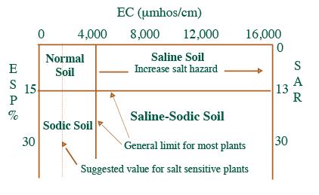
Saline-Sodic Soils

