Slide 1
Chapter 3
Basic Soil-Plant Relationships

Slide 2
Soil Fertility
Interaction of soil chemistry, soil biology, and soil physics to supply essential nutrients in an adequate amount and proper balance
Complex interaction between soil solid phase, the soil solution phase, and the plant root
Soil Fertility centers on the ability of the solid phase to supply the solution phase with nutrients such that roots can absorb them
Soil Biology
Organic Matter
Microbial Diversity
Active Carbon
N fixation
Etc.
Soil Chemistry
Nutrients
Buffer Capacity
pH
CEC
Etc.
Soil Physics
Water
Bulk Density
Soil Stability
Etc.
Soil Fertility

Slide 3
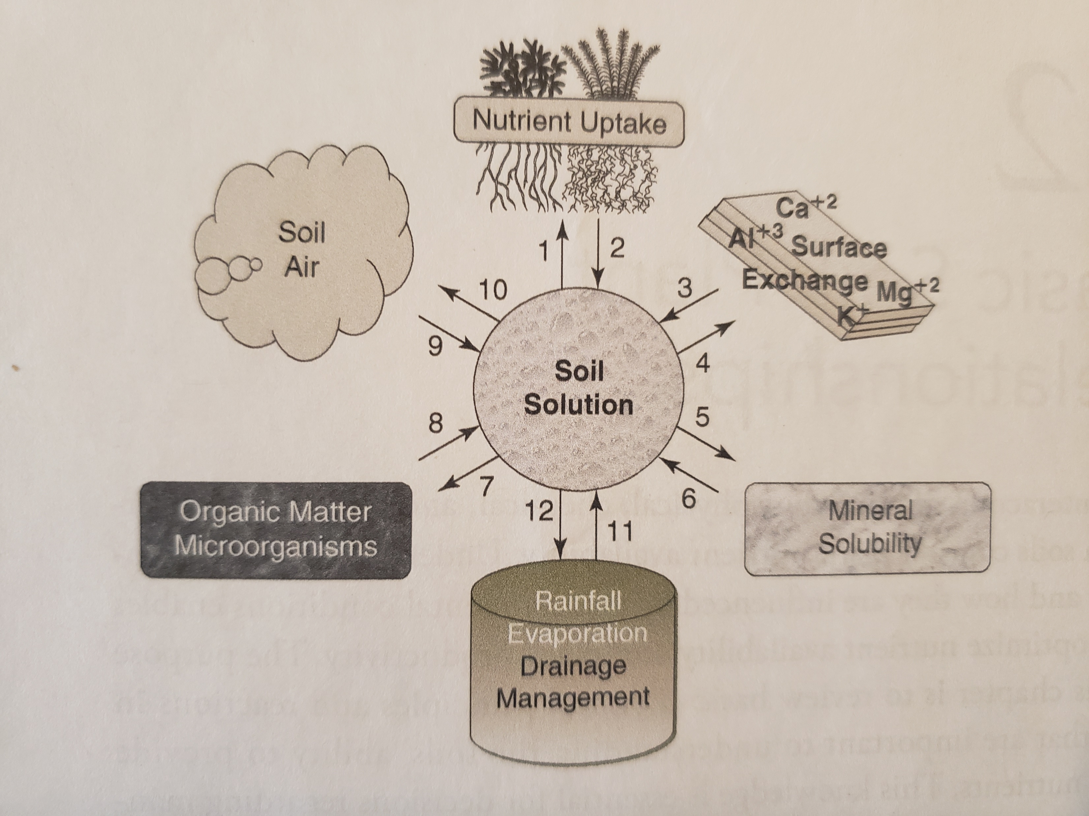
Dynamic Process centered around soil solution
Plants are able to grow based upon nutrients in soil solution
Complex reactions create a cycle of nutrients moving in and out of soil solution
Large part of the governance of these reactions is due to the soil physical properties, its constituents

Slide 4
Solid Phase of soil
Soil constituents
  Sand
    2mm to 0.05mm
    Mostly Quartz (SiO₂, Chemically inert)
  Silt
    0.05mm to 0.002mm
    Some quartz, feldspars (Chemically inert)
  Clay
    0.002mm and smaller
    Site of all of our chemical, physical, and biological reactions
  Humus
    organic products and byproducts
    Very chemically reactive
Not going to mess with these right now
Important in nutrient fertility

Slide 5
Clay and Humus - Colloids
General properties
  Size
    Less than 1 micron (0.000001 m)
    Some say less than 2 micron to match clay definition
  Surface area
    Small size yields large surface area
    Surface area allows for points of which reactions can occur
      Adsorption
      Catalysis
      Precipitation
      Microbial Colonization

Slide 6
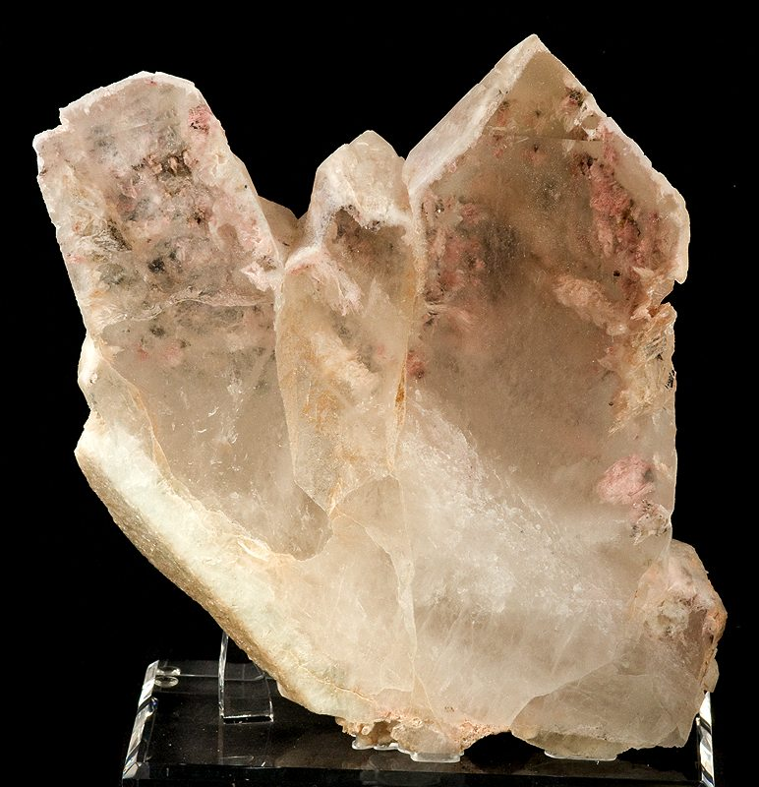
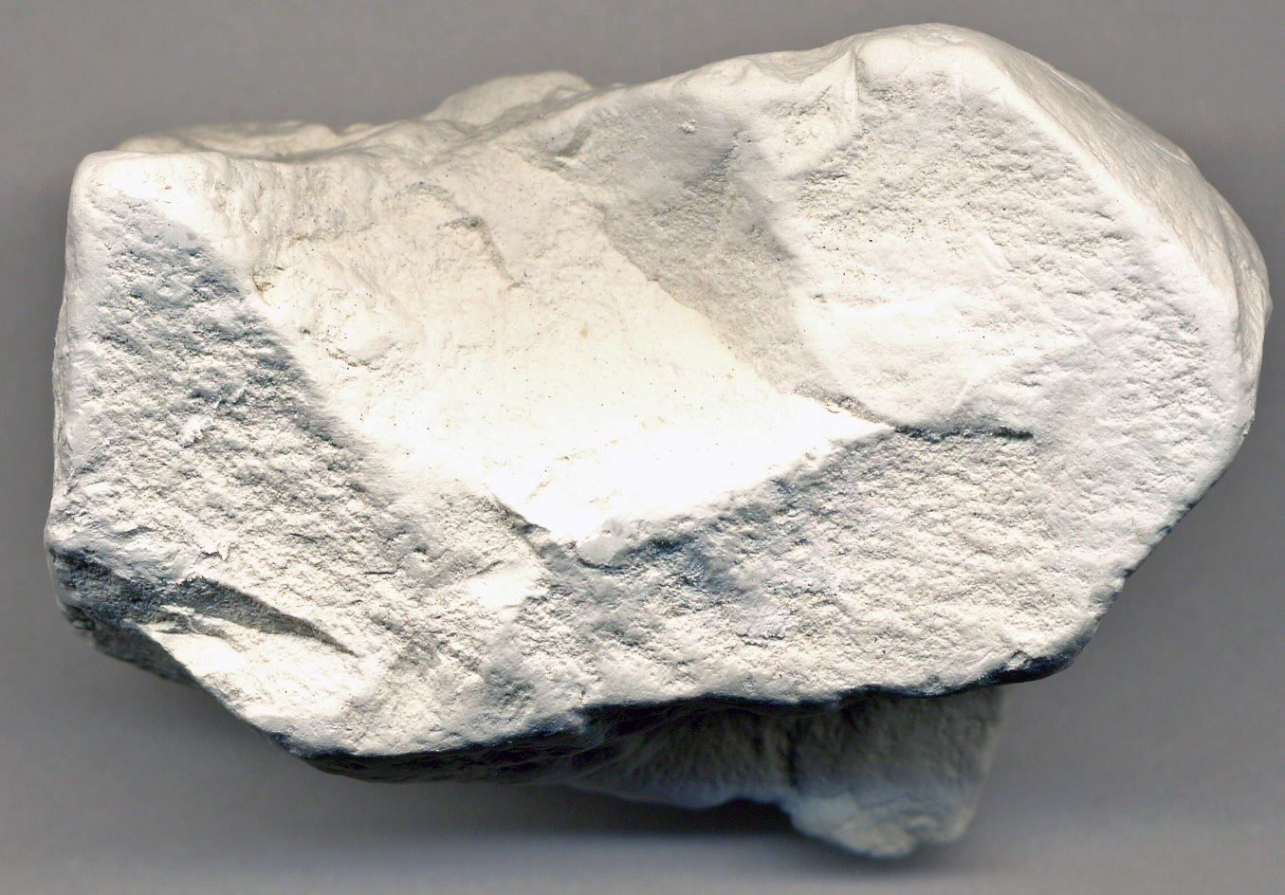
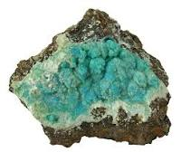
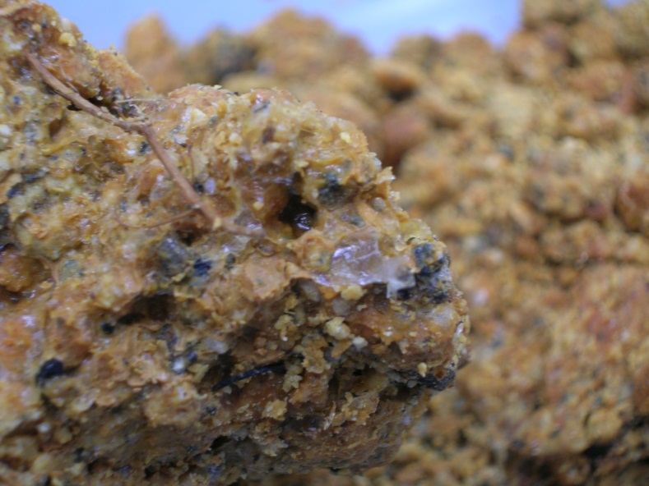
Types of Colloids
Crystalline silicate clays
  Dominate in most soils
  Layered
  Different properties based on types
Non-Crystalline silicate clays
  Tightly bonded Si, Al, O, but not crystalline shape
  Allophane and Imogolite
  Common in Volcanic soils

Slide 7
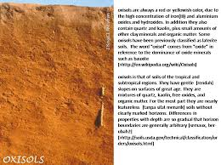
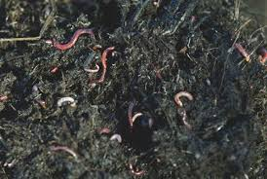
Types of Colloids
Iron and Aluminum Oxides
  Important in highly weathered soils
  Gibbsite (AlOH) and Geothite (FeOH) crystalline sheets
  Other amorphous coatings
Organic (Humus)
  Not mineral or crystalline
  Chains of C bonded with H, O, and N
  Among smallest colloids
  Can absorb lots of water
  Lots of charge (+ and -)
  Net charge always negative

Slide 8
CEC
Types of colloids will impact CEC, or Cation Exchange Capacity
It is the ability to hold cations (+) by electrical attraction
AEC (anion Exchange capacity) is also a thing, but we are less concerned with it here
  HIGHLY weathered soils have AEC, or a net POSITIVE charge (Think tropical soils; Brazil)

Slide 9
Impact of soil particles on CEC
CEC by texture
 | Cmol_{c} kg⁻¹
Sands | 1-5
Fine sandy loams | 5-10
Loams + silt loams | 10-25
Clay loams | 15-30
Clays | >30

Slide 10
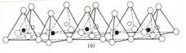
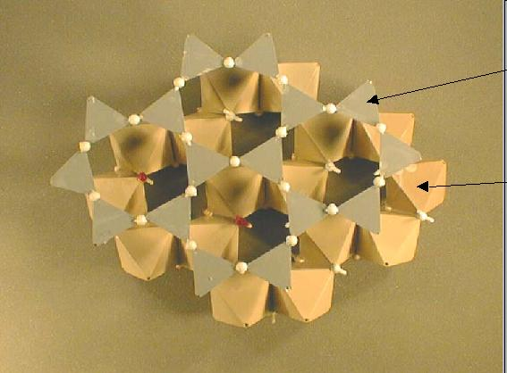
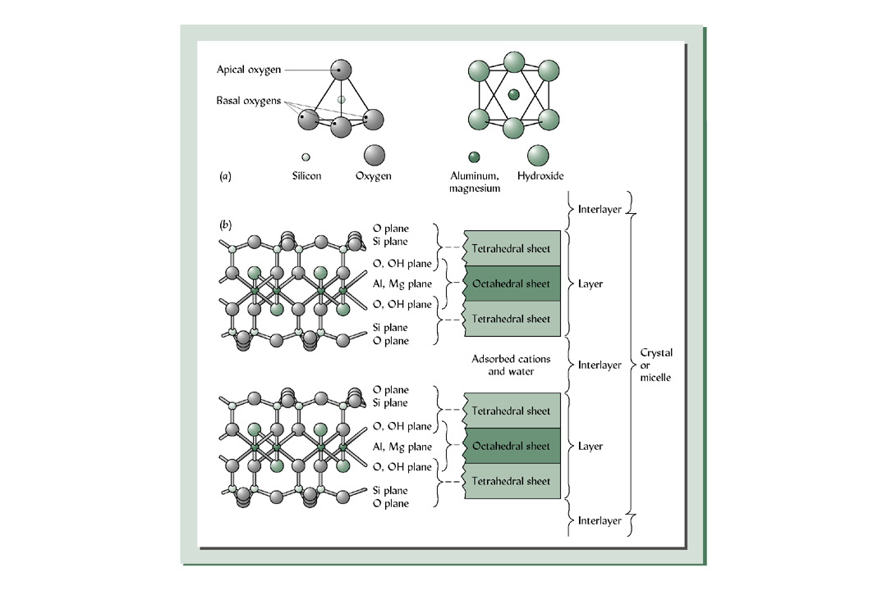
Building Blocks of Silicate Clays
Tetrahedral Sheets
  Si surrounded by 4 O
  Sheet made by sharing basal O

Slide 11
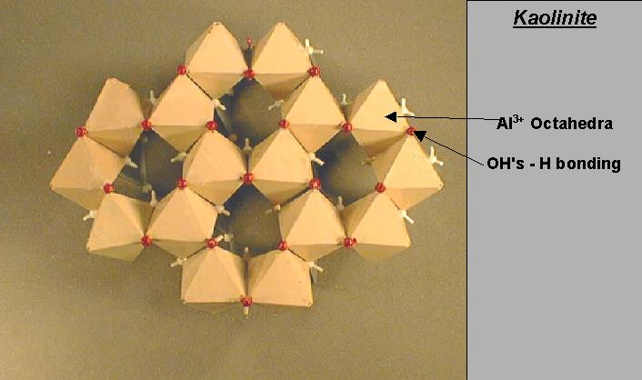
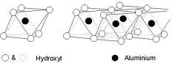
Building Blocks of Silicate Clays
Octahedral Sheets
  Al or Mg surrounded by 6 OH
  Octahedra held together by sharing OH groups

Slide 12
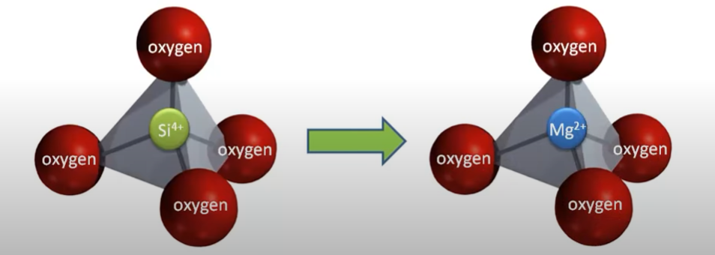
Where does CEC come from?
Isomorphic substitution (iso – equal, morphic – size)

Slide 13
Where does CEC come from?
Isomorphic substitution (iso – equal, morphic – size)
  Substitution of one ion for another with similar size in the center of the tetrahedral or octahedral clay
  Tetrahedral (Si⁴⁺, Al³⁺, or Fe³⁺)
  Octahedral (Al³⁺, Fe^{3+ or 2+}, Mg²⁺, Zn²⁺)
  Difference in charge substitution will lead to charge difference
  Can result in net electronegative charge
  Negative charge can attract cations (CEC – Cation Exchange Capacity)

Slide 14
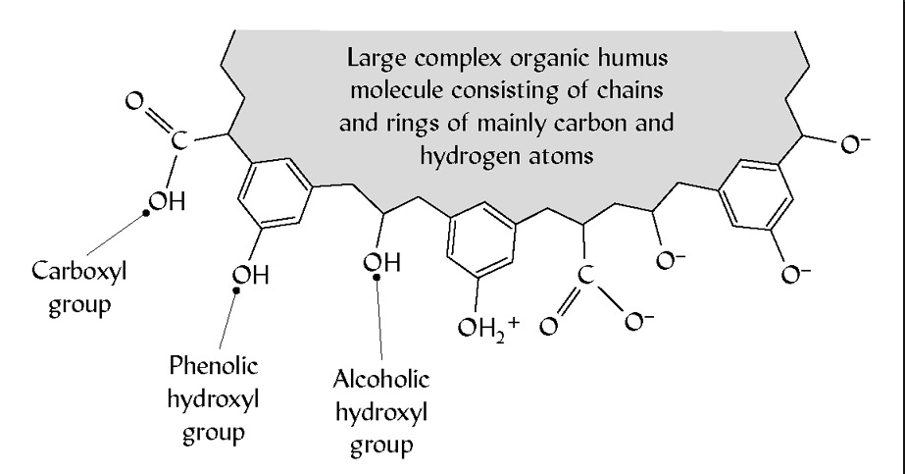
Where does CEC come from?
Hydrogen reactions on colloids
  pH dependent reactions associated with hydroxy groups on the colloids in equilibrium with soil solution H⁺
  Protonation
    Gain of H on the hydroxyl group associated with octahedral sheet or organic matter at low pH
  Deprotonation
    Loss of H from the hydroxyl group associated with octahedral sheet of organic matter at high pH
pH dependent charge
  Major player in oxides and organic matter
  Generally negligible in the silicate clays
Low pH soil = lots of H⁺ in solution
High pH soil = not a lot of H⁺ in solution

Slide 15
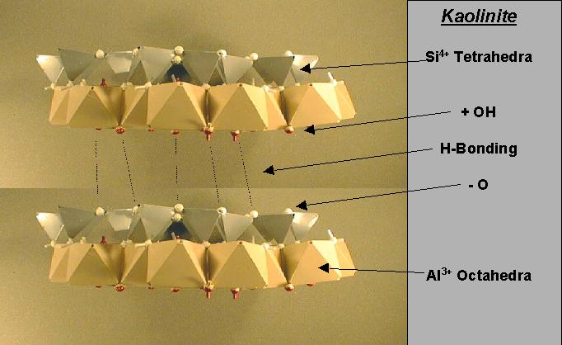
Organization of Silicate Clays
The way these sheets organize can impact the reactions in the soil
1:1 Clay (ex Kaolinite)
  1 Tetrahedral sheet combined with 1 octahedral sheet
  Sheets are held together by sharing Oxygen atoms
  Layers are held together by hydrogen bonding
  Not very much isomorphic substitution
Low CEC (-1 to -15 cmol/kg)

Slide 16
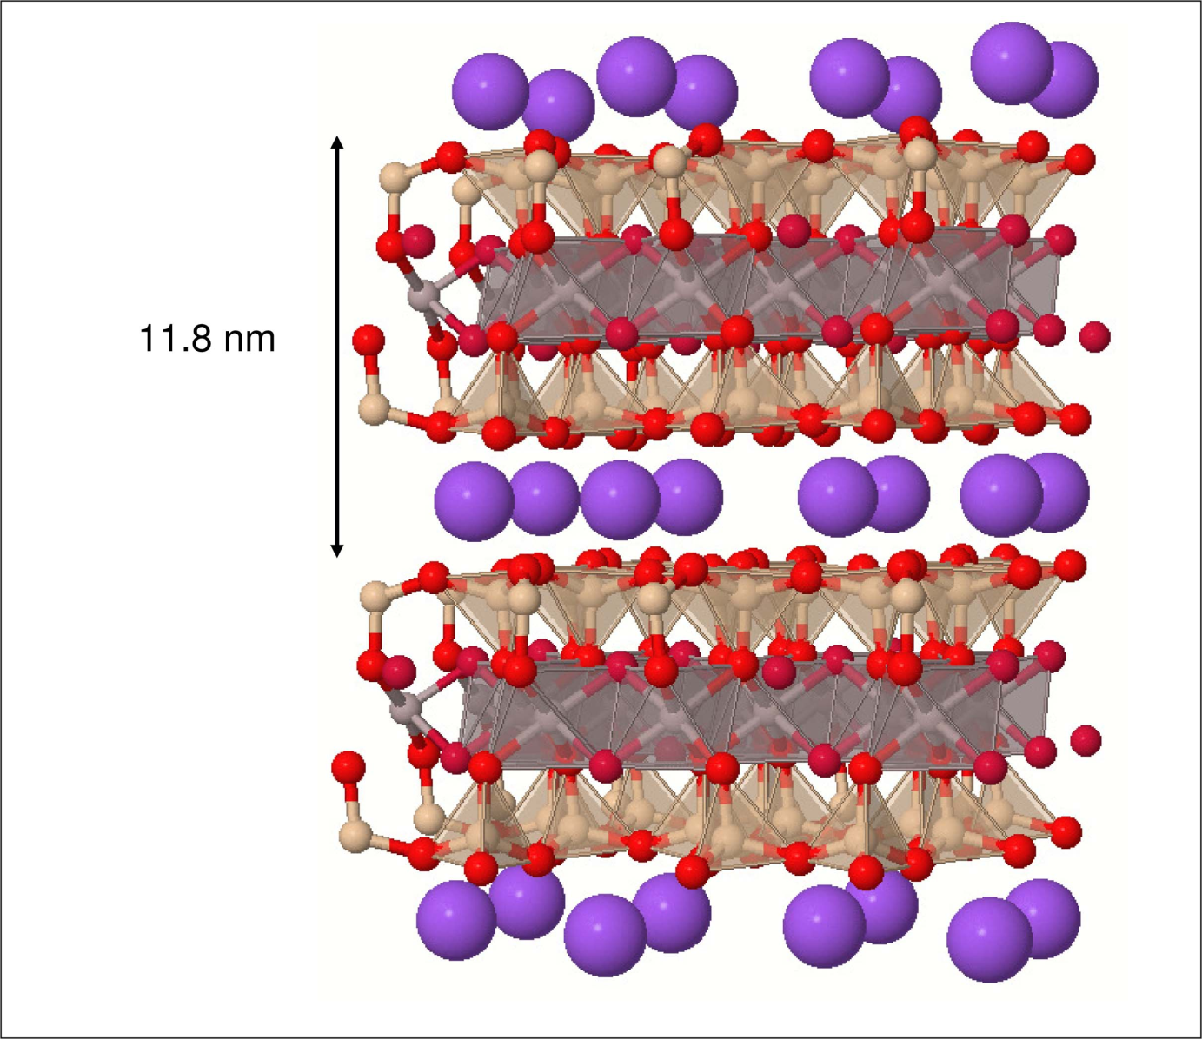
Organization of Silicate Clays
2:1 Type Clays
  Layers contain two tetrahedral sheets sandwiching one octahedral sheet
Four general groups
  Smectite (expanding)
  Vermiculite (expanding)
  Fine-grained micas (illite, nonexpandting)
  Chlorite (nonexpanding)

Slide 17
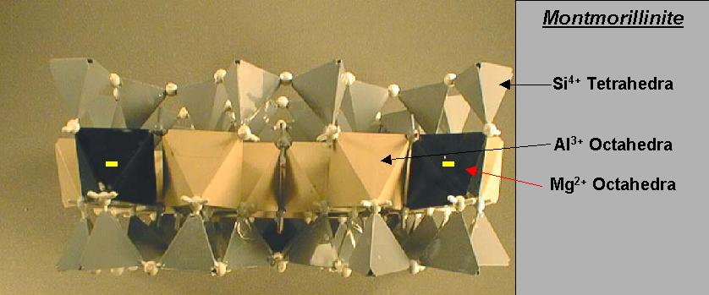
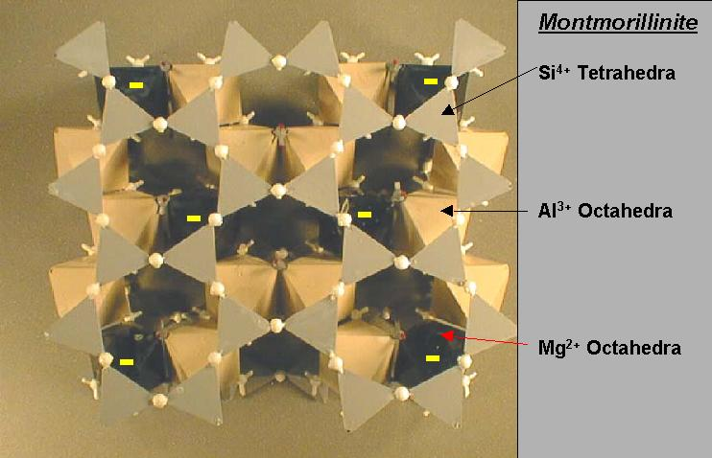
Organization of Silicate Clays
Smectite (Montmorillinite most common)
  Interlayer expansion
  Layers are held together by weak oxygen to oxygen bonds, or cation to oxygen bonds = allows expansion
  Total surface area is high (700-800 m²/g)
  High CEC (-80 to -150 cmolc/kg) (Mg²⁺ substituting for Al³⁺ in the octahedra mostly)

Slide 18
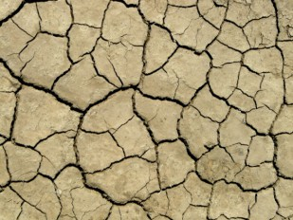
Smectite: Shrink-Swell soils

Slide 19
Organization of Silicate Clays
Vermiculite
  Structure similar to smectite
  High CEC (-100 to -200) (Al³⁺ substituting for Si⁴⁺ in the tetra)
  Adsorbed interlayer molecules bridge so expansion limited

Slide 20
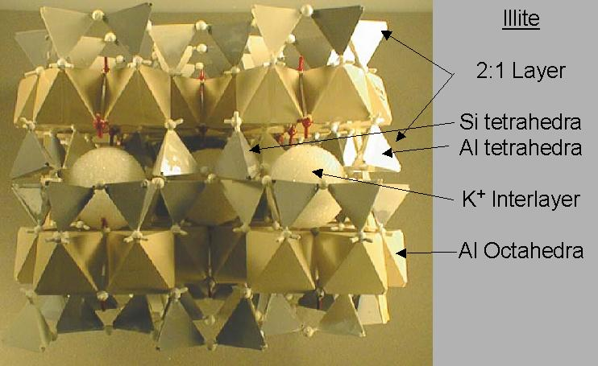
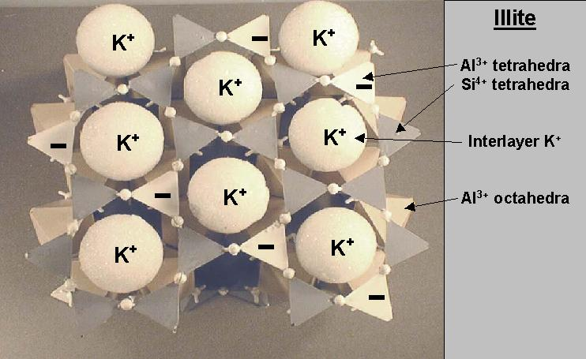
Organization of Silicate Clays
Illite/Mica (Muscovite and biotite)
  Particles are much larger than smectites
  High CEC (~20% of tetra sites occupied by Al³⁺)
  K⁺ binding the layers together = low net CEC (-10 to -40 cmolc/kg)

Slide 21
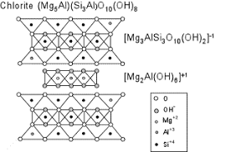
Organization of Silicate Clays
Chlorites
  2:1:1 type minerals
  2:1 layers alternate with a trioctahedral sheet = 2:1:1 ratio
  Negative charge is about the same as the fine-grained micas
  H bonding between layers = nonexpanding

Slide 22
Impact of soil particles on CEC
CEC by texture
 | Cmol_{c} kg⁻¹
Sands | 1-5
Fine sandy loams | 5-10
Loams + silt loams | 10-25
Clay loams | 15-30
Clays | >30

Slide 23
Humus
Noncrystalline
Organic
  40-60% C, 30-50% O, 3-7% H, and 1-5% N
  Very large molecular wts 10,000 to 100,000 g/mol
  Actual structure hard to determine
Net negative charge very high (-100 to -500 cmolc/kg)
Can also adsorb hydrophobic, nonpolar compounds

Slide 24
Humus
Metal cations
Lignin residues
Polysaccharides
Peptide residues
Long-chain fatty acids
Simpson, Kingery, et al. Naturwissenschaften (2002)

Slide 25
What does CEC impact?
Solid phase reactions that control nutrient availability to the solution phase, it does this 3 ways
Cation Exchange
  The colloids have an overall negative electrical charge
  Negative charge attracts and retains cations (+)
Specific adsorption
  Formation of covalent bonds between ion and soil phase
  Primarily P reactions at low pH (Al- and Fe- PO₃)
Precipitation/dissolution
  Based on solubility constant
  Important for P at high pH (Ca- and Mg- PO₃)

Slide 26
Cations and Anions on the exchange surface
Most of the exchangeable cations are plant nutrients
  Ca²⁺, Mg²⁺, K⁺, NH₄⁺
Also interested in
  Al³⁺, Na⁺, H⁺
Strength of cation adsorption depends on
  Hydrated radius (Size) (Hydrated, not as in water, as in hydrogen)
  Charge
  Lyotropic series
    Al³⁺ ≅ H⁺ > Ca²⁺ ≅ Mg²⁺ > K⁺ ≅ NH₄⁺ > Na⁺
    Strict interpretation is problematic (a lot of stuff goes into bonding energies)
The strength with which cations are adsorbed to cation exchange is directly proportional to the product of the charges involved, and inversely proportion to the square of the distance between charges
- Coulombs Law

Slide 27
Cation Exchange Reactions
Exchangeable cation adsorbed to surface of negatively charged clay and organic colloids
Subject to exchange or displacement into soil solution by another cation or in response to a diffusion gradient (plant update)
To be considered cation exchange
  Reactions are reversible
  Stoichiometric (equal charge replacement)
  Fast (generally occur in 10-15 minutes)
Cation Exchange Capacity
  Number of positive charges a soil can “hold”

Slide 28
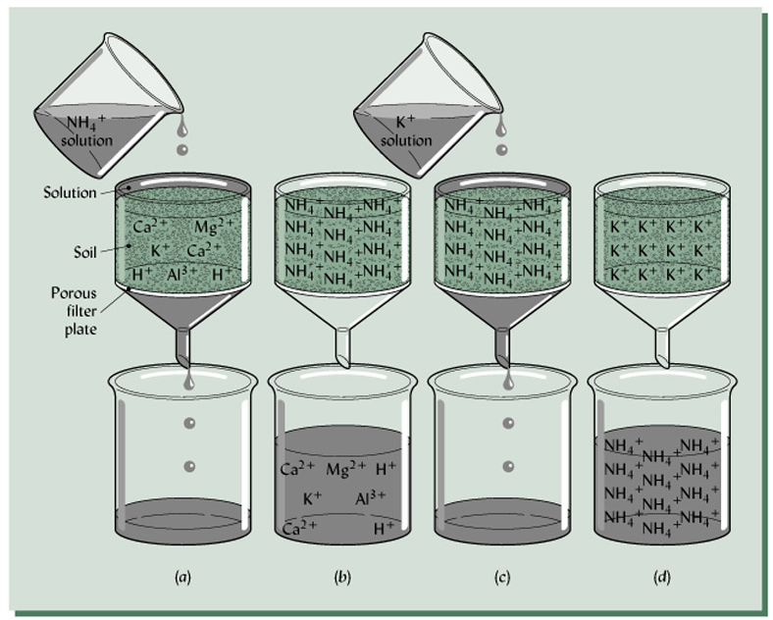
How do we determine CEC?
Add acidic solution that strips clay of cations, and then analyze the solution for its cation materials
Can take one step further, and leach out acidic solution, measure its analytes for total CEC analysis, but won’t get individual nutrient analysis

Slide 29
“Basic” and “Acidic” Cations
Basic cations are cations, that when combined with hydroxide (OH⁻) form a compound that when dissolved in water creates an alkaline solution
  Na⁺, K⁺, Ca²⁺, and Mg²⁺ are good examples
Acidic cations are cations that when combined with hydroxide are basically insoluble
  Al³⁺ and Fe³⁺

Slide 30
Percent (%) Saturation
Percent of total CEC occupied by an ion or group of ions
  % Base Saturation
    Amount of CEC occupied by Ca²⁺, Mg²⁺, K⁺, and Na⁺, divide by total CEC
    % Base Sat = (Sum Exchangeable Bases/CEC) x 100
Soil pH – Base Saturation Relationship
  As base saturation increases, soil pH does as well
  Base Saturation can be helpful in determining lime requirements

Slide 31
Percent (%) Saturation
  % Acid Saturation
    Amount of CEC occupied by Al³⁺ and H⁺ divided by total CEC
    % Acid Sat = (Sum acid cation/CEC) x 100

Slide 32
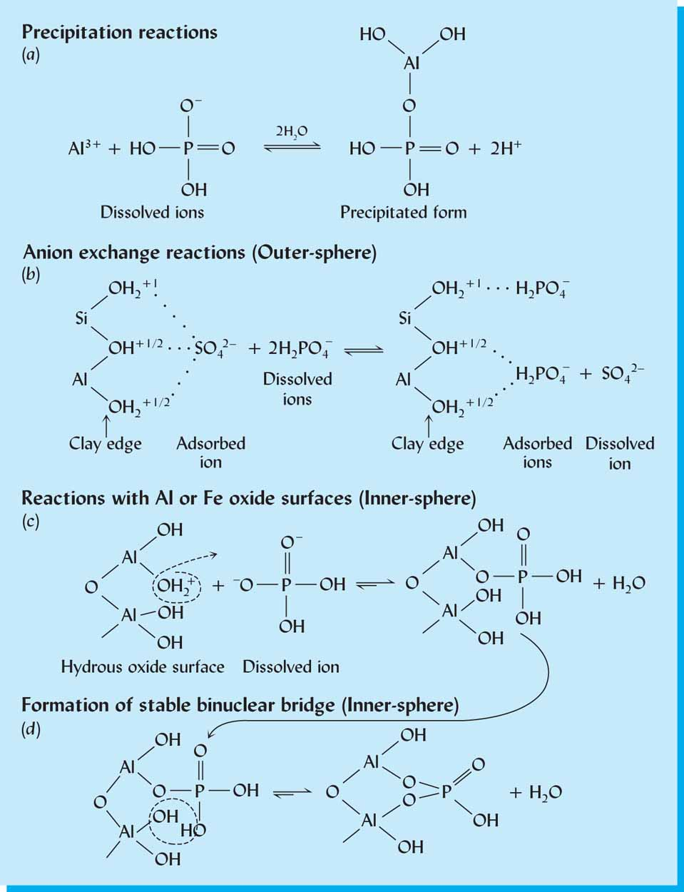
Specific Adsorption
Primary Reactions
  Specific adsorption of anions
    Poorly soluble anions:
    (H₂PO₄⁻, HPO₄²⁻, H₃BO₃, H₄BO₄⁻, MoO₄²⁻,)
    Poorly soluble cations
    (Al³⁺, Fe³⁺, Mn⁴⁺, Cu²⁺, Zn²⁺)
  Occurs primarily on hydrous ouxide surfaces (Al, Fe, Mn compounds)

Slide 33
Specific Adsorption
Usually exponential with time
  Initial rapid adsorption (1-15 days)
  Slower Secondary adsorption
  Generally reaches equilibrium after about 30 days
Solution concentration
0 30
Time (days)
What connotations does this have for fertilization?

Slide 34
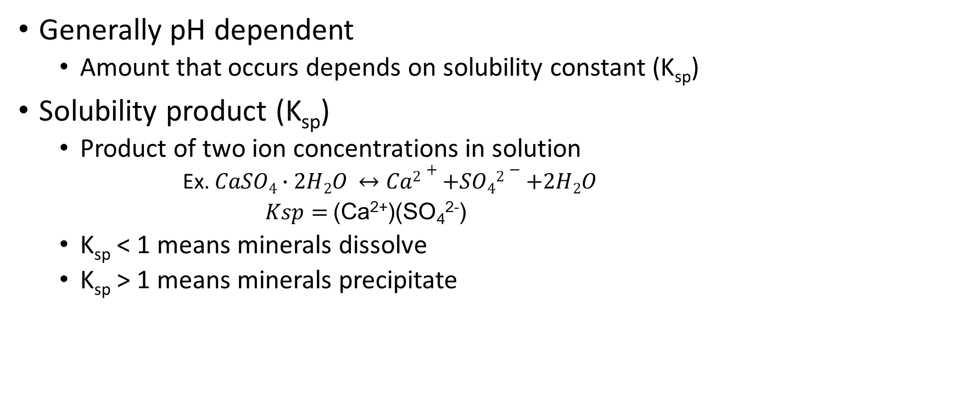
Precipitation/Dissolution
Generally pH dependent
  Amount that occurs depends on solubility constant (K_{sp})
Solubility product (K_{sp})
  Product of two ion concentrations in solution
    Ex. $CaSO4∙2H2O ↔Ca2++SO42−+2H2O$
    $Ksp=$(Ca²⁺)(SO₄²⁻)
  K_{sp} < 1 means minerals dissolve
  K_{sp} > 1 means minerals precipitate

Slide 35
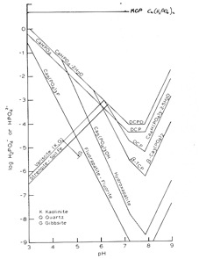
Precipitation/Dissolution
Particularly important with P
  pH < 6, Al (Variscite)
  pH < 6, Fe (Strengite)
  pH > 7, Ca (bunch of compounds)
  Note that none of these are particularly soluble

Slide 36
So now, we’ve talked about the idea of solids supplying the solution
Involves all solid components of the soil system
  Clays
    Exchange sites (CEC, AEC)
    Complexes (Fe and Al Phosphates)
    Precipitants (Ca and Mg Phosphates)
  Organic Matter
The ability for this to happen depends on the capacity of the soil solids to maintain solution concentration
  Buffering Capacity

Slide 37
Buffer Capacity
Buffer Capacity is directly related to CEC
It is the ability of the soil (through all its chemical constituents) to replenish nutrients/minerals in the soil
Remember, solid and solution nutrient energies are at a thermodynamic equilibrium
  A change in soil concentration (root uptake) will cause a change in solid phase activity
  Will continue until equilibrium is re-established
Will be discussed more in soil acidity chapter, as well as individual nutrient chapters

Slide 38
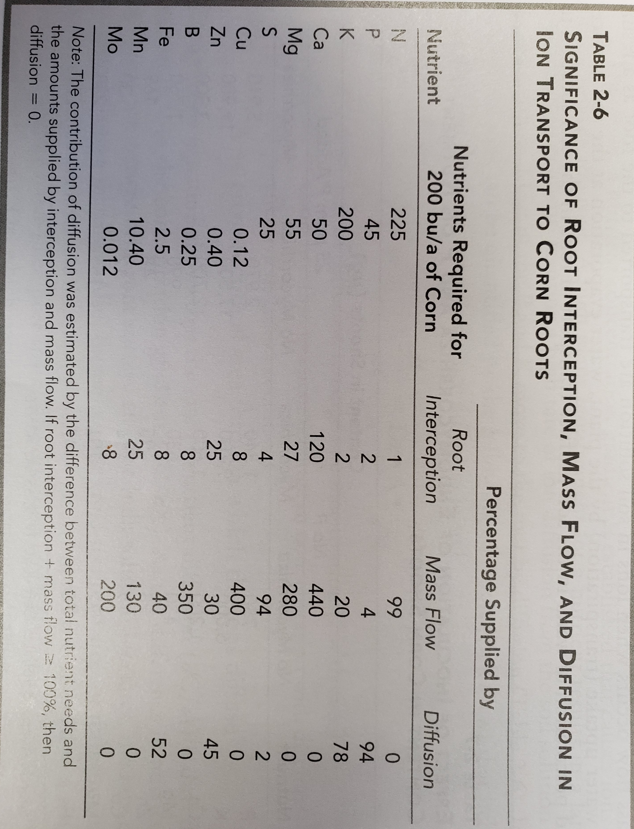
Methods of Nutrient Supply
For ion absorption by roots to occur, there must be contact between ion and the root surface
  Root interception
  Mass Flow
  Diffusion

Slide 39
Root Interception
Roots occupy 1-3% of the soil volume of the root zone.
By this mechanism, plants are thought to take up nutrients that they encounter as roots grow into unexplored soil volume
In truth, plant roots grow in the voids between soil particles, either avoiding the solids or pushing them aside, and plants take up nutrients from solution rather than from solids

Slide 40
Root interception
Exchange of ions through physical contact between root and soil solids
Roots have CEC which interacts with soil CEC
Overlapping oscillation volumes of ions allows for ions to exchange places on sites of adsoprtion
Enhanced by increased root growth through “new” (untapped) soil
Not particularly significant (look at previous slide)

Slide 41
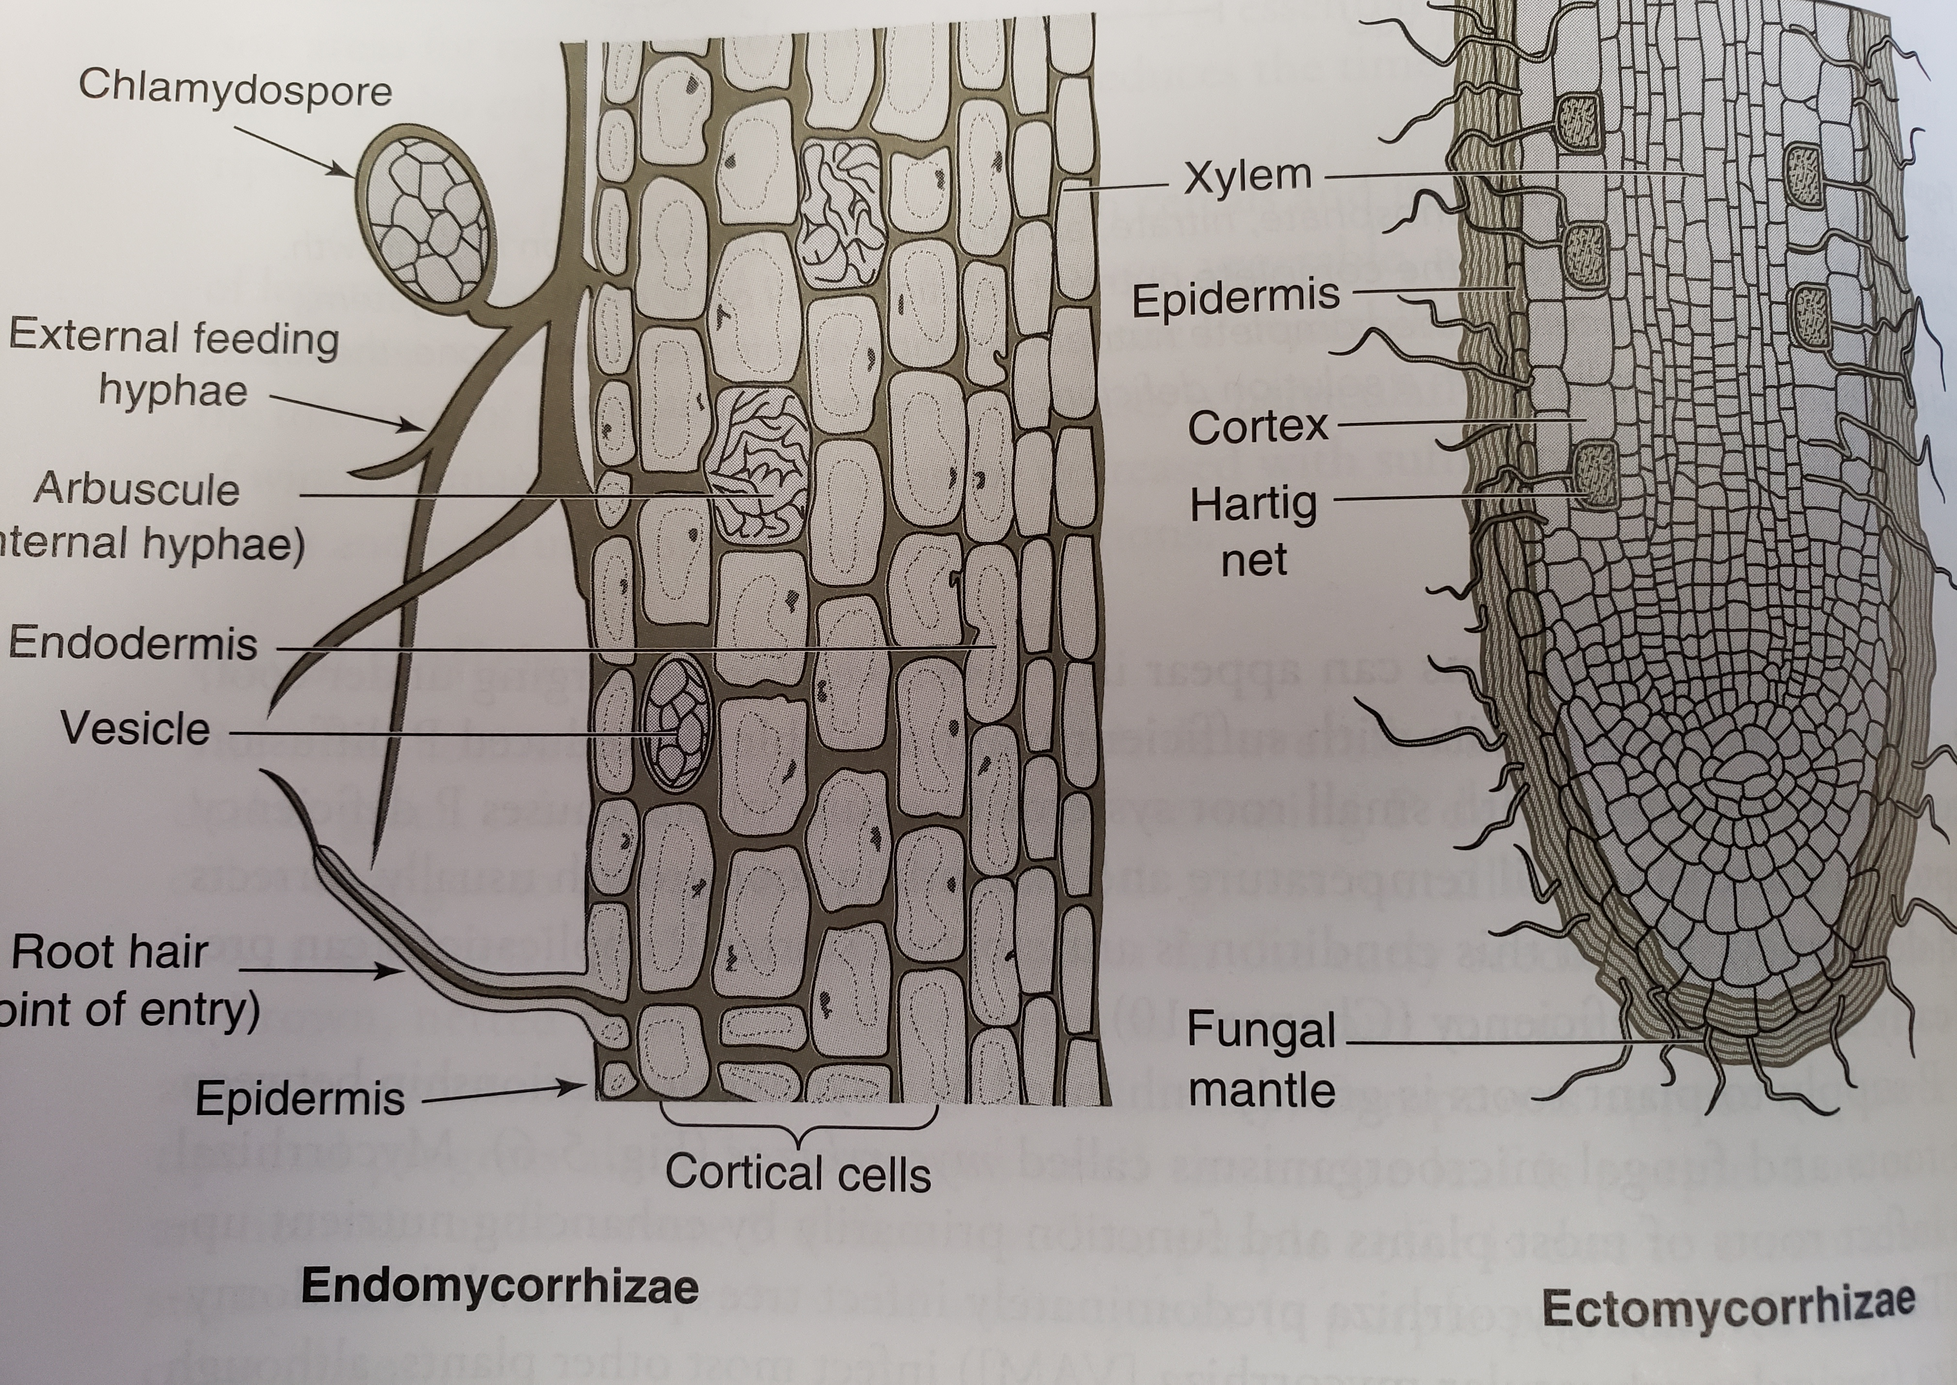
Root interception
Enhanced by mycorrhiza, fungi symbiotically associated with plant roots
  Massively increases root volume
  Very important in low P soils
    Endomycorrhiza
    Ectomycorrhiza
    Vesicular arbuscular mycorrhiza
      Fungus grows into the root cortex
      Exchanges nutrient through arbuscule

Slide 42
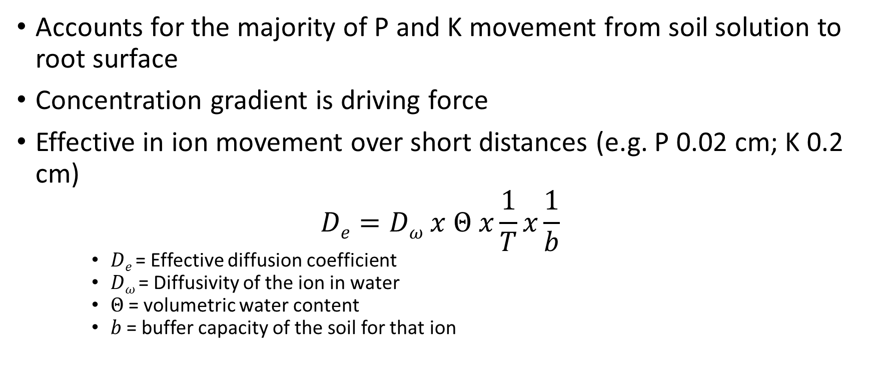
Diffusion
Accounts for the majority of P and K movement from soil solution to root surface
Concentration gradient is driving force
Effective in ion movement over short distances (e.g. P 0.02 cm; K 0.2 cm)
$$De=Dω x Θ x\frac{1}{T}x\frac{1}{b}$$
    $De$= Effective diffusion coefficient
    $Dω$= Diffusivity of the ion in water
    $Θ$= volumetric water content
    $b$= buffer capacity of the soil for that ion

Slide 43
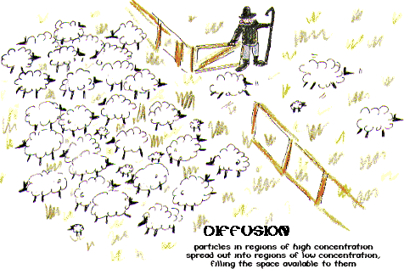
Diffusion
Think drop of ink in water
Perfume diffusing across a room

Slide 44
Mass Flow
Movement of ions to the plant root with the convective flow of water as a result of root transpiration
Important in transporting mobile ions (NO₃⁻, SO₄²⁻) from the root system sorption zone to the root surface
Amount determined by the rate of water flow multiplied by the solution concentration of the ion.

Slide 45
Plant Uptake of Nutrients
Passive Uptake
  Nutrients moved from high concentration (soil) to lower concentratioun in free space (between cell in the cortex or cell wall) by diffusion and ion exchange (cells have an internal negative charge)
  Indiscriminate and does not require expenditure of plant energy
  Process occurs outside Casparian strip and plasmalemma that are barriers to diffusion and ion exchange
Active Uptake
  Nutrients are moved AGAINST a concentration gradient across the plasmalemma by a carrier mechanism. This process requires expenditure of plant energy (hence ACTIVE)

Slide 46
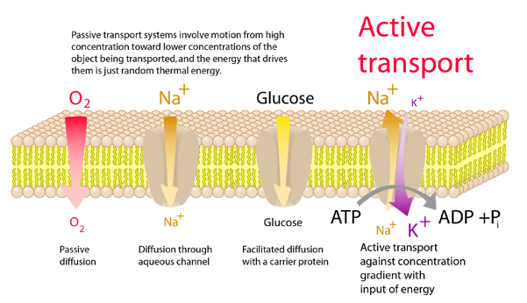
Active Uptake

