Slide 1
Chapter 2
Basic Chemistry, Solubility, Nutrient Demand, and Deficiency

Slide 2

Plant Required Nutrients
17 nutrients
Plants do not require: organic matter, enzymes, or hormones as nutrients taken up from the soil
Plant requirements for these substances is met by the plant’s availability to manufacture them
Except for carbon (C), hydrogen (H), oxygen (O), and boron (B), the nutrients are absorbed primarily as chemical ions from the soil solution

Slide 3
Nutrient | Symbol | Forms Absorbed | Primary Source | Soil Mobility | Plant Mobility
Hydrogen | H | H₂O | Rainfall / Soil Solution | Mobile | Mobile
Oxygen | O | H₂O, O₂ | Rainfall / Soil Solution | Mobile | Mobile
Carbon | C | CO₂ | Atmosphere | - | -
Nitrogen | N | NO₃⁻ NH₄⁺ | Soil Solution (SS) SS and Exchange Sites | Mobile Immobile | Mobile
Potassium | K | K⁺ | SS and Exchange Sites | Immobile | Mobile
Calcium | Ca | Ca²⁺ | SS and Exchange Sites | Immobile | Immobile
Magnesium | Mg | Mg²⁺ | SS and Exchange Sites | Immobile | Mobile
Phosphorus | P | H₂PO₄⁻ ; HPO₄²⁻ | SS and Exchange Sites | Immobile | Mobile
Sulfur | S | SO₄²⁻ SO₂ | Soil Solution Atmosphere | Mobile - | Immobile
Iron | Fe | Fe²⁺ Fe³⁺ | SS and Exchange Sites | Immobile | Immobile
Chlorine | Cl | Cl⁻ | Soil Solution | Mobile | Mobile
Boron | B | H₃BO₃ | Soil Solution | Mobile | Immobile
Manganese | Mn | Mn²⁺ | SS and Exchange Sites | Immobile | Immobile
Zinc | Zn | Zn²⁺ | SS and Exchange Sites | Immobile | Mobile
Copper | Cu | Cu²⁺ | SS and Exchange Sites | Immobile | Immobile
Molybdenum | Mo | MoO₄²⁻ | Soil Solution | Mobile | Mobile
Nickel | Ni | Ni²⁺ | SS and Exchange Sites | Immobile | Mobile

Slide 4
Plant Required Nutrients
CHOPKNS CaFe Mg B Mn Cl CuZn Mo and Ni
Nickel was recently added 2004
18th and 19th Nutrients have been “suggested”
Sodium (Na)
Specific function in the concentration of CO₂ in a limited number of C₄ plants, and thus is essential to these plants, but this in itself is insufficient to generalize it as essential for higher plants
Silica (Si)
Plants can grown in hydroponic solutions without Si. However, some anaerobic plants (Rice) need it
https://www.cropnutrition.com/nutrient-knowledge

Slide 5
What makes nutrients ESSENTIAL?
Must satisfy 3 specific criteria:
Necessary - Plants cannot complete their life cycle without the element
Irreplacable - Deficiency symptoms for the element can be correctly only by supplying the element in question
Direct - The element is directly involved in the nutrition of the plant, apart of its effect on chemical and physical properties of the soil

Slide 6
Availability of the nutrients?
Most of the nutrients are absorbed as ions (+/-) from the soil solution or the soil cation exchange complex
Understanding the general chemistry of nutrient ions is critical to understanding how they become available for plants
Nutrient Ion Solubility
Ionic and molecular charges of the group I, II, VII of the periodic table that have only one standard valence in the soil
Valence meaning one charge, or exists (in soil) as a ion with one particular charge
To know “standard” ions is as important to this class as knowing multiplication tables!

Slide 7
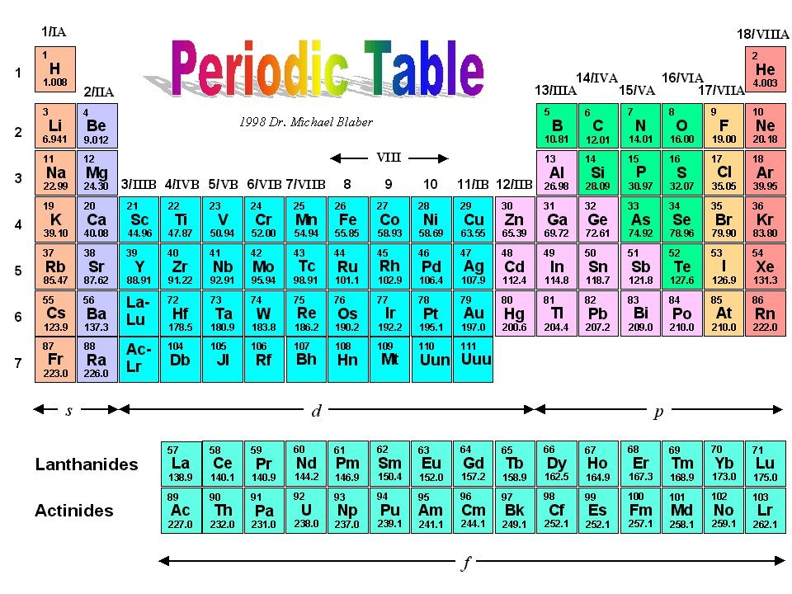
www.webelements.com

Slide 8
Chemistry Basics
Elements WANT to get to their “happy place”
Full electron cloud (8/2)
They will share electrons or add/shed electrons in order to get there
Two MAIN types of bonds that we will discuss
Ionic Bond:
Electrostatic forces that exist between ions of opposite charge (think magnetism)
Covalent Bond:
Sharing of electrons between atoms
Hydrogen Bond:
Less of a bond, more of an attraction
Covalent bonds are stronger, then ionic, then hydrogen

Slide 9
Molecular Bonds
Ionic bonds generally come from groups I, II, and VII
Covalent bonds (in soil science) usually come from III-VI
Hydrogen bonds can occur with any compounds that have unequal distribution of electrons
CO₂
Covalent
NaCl
Ionic

Slide 10
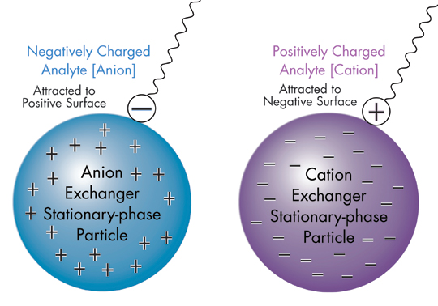
Ions
Charged version of an element
Cation
Positively charged ion (more electrons than protons)
Anion
Negatively charged ion (more protons than electrons)

Slide 11
Ions
Elements that have only one valence state in the soil environment

Slide 12


Slide 13
Oxidation States
In simple ions, the oxidation number is equal to the charge of that ion
Na⁺ = +1 Cl⁻ = -1
The oxidation number of an atom is zero in neutral substances that contain atoms of only one element
O₂ = 0 P₄ = 0
The oxidation number of H can be either +1/-1
Nonmetals: CH₄ NH₃ H₂O
Metals: LiH NaH CaH₂
The metals in Group 1A form compounds (ex. Li₃N, Na₂S) in which the metal atom has an oxidation state of +1

Slide 15
Oxidation States
Elements of Group IIA form compounds (ex. Mg₃N₂, CaCO₃) in which the metal atom has +2 oxidation number
Oxygen usually has an oxidation state of -2. Exceptions include molecules and polyatomic ions that contain O-O bonds, such as O₂, O₃, H₂O₂, and the O₂⁻² ion
The elements in Group VIIA often form compound (such as AlF₃, HCl, ZnBr₂) in which the nonmetal has a -1 oxidation state
Elements toward the bottom left corner of the periodic table are more likely to have positive oxidation numbers than those toward the upper right corner of the table (SO₂)

Slide 16
www.webelements.com

Slide 17
Oxidation State
Determine covalent pairings using oxidation number/state
Charge of an atom that results when the electrons in a covalent bond are assigned to the more electronegative atom
Sum of negative and positive charges in an atom, which indirectly indicates the number of electrons it has accepted/donated
Charge = n(element’s oxidation state) + n(element’s oxidation state)
H₂O
Charge = 0 H = +1 O = -2 0 = 1(-2) + 2(+1)
CO₂
Charge = 0 O = -2 C = 4 0 = 2(-2) + 1(+4)

Slide 18
Oxidation State
Ion/molecule Name Oxidation State
NH₃ ammonia -3
NH₄⁺ ammonium -3
N₂ diatomic N 0
N₂O nitrous oxide +1
NO nitric oxide +2
NO₂⁻ nitrite +3
NO₃⁻ nitrate +5
H₂S hydrogen sulfide -2
SO₄⁼ sulfate +6
N: 5 electrons in the outer shell
loses 5 electrons (+5 oxidation state NO₃)
gains 3 electrons (-3 oxidation state NH₃)
O: 6 electrons in the outer shell
is always being reduced (gains 2 electrons to fill the outer shell)
H: 1 electron in the outer shell
N is losing electrons to O because O is more electronegative
N gains electrons from H because H wants to give up electrons
Some can be different
Reduction, Net Gain of Electrons
Oxidation, Net Loss of Electrons
8 is the Magical Number

Slide 19
Oxidation State
Using this information, we can determine the charge of molecules of the oxidation state of elements in a charged molecule
CO₃⁻²
MgO
Mg(OH)₂
The Chemical formula, name, charge of each molecule below should be carefully studied (memorized). Significance of each to soil fertility is presented and discussed in later chapters

Slide 20
General effect of ion charge on solubility
Availability of nutrient ions to plants and the solubility of compounds they come from, or may react to form, can be discussed from the perspective of the general reaction:
A^{n+} + B^{m-} ← → A_{m}B_{n}

Slide 21
General effect of ion charge on solubility
Reactant ions A^{n+} and B^{m-} combine to form a compound (usually a solid) predicted by their electrical charges
The higher the charge of either the cation or anion, the greater is the tendency for the compound or solid to be formed
When the solid is easily formed, only small concentrations of the reactants are necessary for the reaction not take place. Because of this, the compound or solid that forms is also relatively insoluble (it will not easily dissolve in water), and reaction will primary move to the right.
Conversely, if the cation and anion are both single charged, then the compound is not as easily formed, and therefore, relatively soluble, with the reaction will primarily move to the left
A^{n+} + B^{m-} ← → A_{m}B_{n}

Slide 22
Examples of charge-influenced solubility
NaCl
Very soluble, easily dissolves in water
Solid NaCl does not reform in solution until Na⁺ and Cl⁻ are present in high concentration
Think evaporation
Iron Oxide Fe(OH)₃
Represents multiple charged ions forming a relatively insoluble material
Na⁺ + Cl⁻ ← → NaCl
A^{n+} + B^{m-} ← → A_{m}B_{n}

Slide 23
How does this relate to nutrient availability?
With regard to solubility of inorganic compounds, we may expect that when both the cation and anion are single charged, the resulting compound is usually very soluble
Examples: H⁺, NH₄⁺, Na⁺, K⁺, and OH⁻, Cl⁻, NO₃⁻, H₂PO₄⁻, and HCO₃⁻ (bicarbonate).
Bolded are nutrient ions

Slide 24
How does this relate to nutrient availability?
Because monovalent ions are very soluble, when a monovalent cation reacts with OH⁻ to form a base, the base is very strong (NaOH, KOH).
Similarly, when monovalent anion reacts with H⁺ to form an acid, the acid is a strong acid (HCl, HNO₃).
The monovalent molecules H₂PO₄⁻ and HCO₃⁻ which are products of multi-charged ions that have already reacted with H⁺ are exceptions
Except for H⁺ and OH⁻, whenever either the cation or anion is single charged and reacts with a multiple charged ion, the resulting compound is usually very soluble.
Another exception to this rule is for F⁻, which reacts with Al³⁺ to form insoluble AlF₃, a reaction important to soil test extractants of P in acid soils

Slide 25
Multiple charged ions
Divalent cations Mg ²⁺ , Ca²⁺ , Mn²⁺ , Fe²⁺ , Cu²⁺ , Zn²⁺
Divalent anions SO₄²⁻, CO₃²⁻ (carbonate), HPO₄²⁻, and MoO₄²⁻
Trivalent cations Fe ³⁺ and Al ³⁺
Trivalent anion PO₄³⁻
When monovalent anions Cl⁻ or NO₃⁻ react with any of the multi-charged cations Mg ²⁺ , Ca²⁺ , Mn²⁺ , Fe²⁺ , Cu²⁺ , Zn²⁺ Fe ³⁺ and Al ³⁺ the solid compounds are all quite soluble.
Similarly, when any of the monovalent cations NH₄⁺, Na⁺, or K⁺ reacts with any of the multi-charged anions SO₄²⁻, CO₃²⁻, HPO₄²⁻, MoO₄²⁻, or PO₄³⁻, the solids are all quite soluble.
If both the cation and anion are divalent, the resulting compound will be only sparingly soluble. An example is gypsum (CaSO₄*2H₂O).
If one of the ions is divalent and the other is trivalent, the compound will be moderately insoluble. An example is tricalcium phosphate, Ca₃(PO₄)₂.
If both the anion and cation are trivalent, the compound is very insoluble. An example is iron (ferric) phosphate, FePO₄
AlPO₄ ?

Slide 26
How can these general rules be simplified
Once charges of the ions in a compound are known, we can get some idea of the compound solubility by sampling adding the charges
For example, if the sum of the anion and cation charges is 2, then the compound is very soluble (NaCl)
As the sum of the charges increases, the solubility of the compound decreases
Whenever one of the ions is monovalent, the compound is usually very soluble (KCl, CaCl₂, FeCl₃ are all soluble even though the sum of the charges is 2, 3, and 4)
Many examples where these simple rules are a good predictor of solubility
CaSO₄ or CaCl₂?
The sum of charges in Ca(H₂PO₄)₂ is 3 (Ca²⁺ and H₂PO₄⁻) and it is more soluble than CaHPO₄, where the sum of charges is 4 (Ca²⁺ and HPO₄²⁻).
Similarly, Ca₃(PO₄)₂ has a charge sum of 5 (Ca ²⁺ and PO₄³⁻) and is less soluble than CaHPO₄.

Slide 27
Relative Solubility of ions with different charges

Slide 28
Nutrient Mobility
With a general understanding of nutrient ion solubility, it is now easier to examine the relative nutrient mobility in soils
Bray: Nutrient management is closely linked to how mobile the nutrients are in the soil
Our soils have a net negative (-) charge, we’ll talk more why in the next chapter
Relative mobility of nutrients in soils is governed primarily by:
Inorganic solubility
Ionic charge
Ionic adsorption (ex. Cations on the soil cation exchange sites)
Biological immobilization

Slide 29
Are all highly soluble nutrients mobile in the soil?
Monovalent nutrient ions have a good chance of being mobile in soils
Monovalent anions Cl⁻ and NO₃⁻ are mobile in the soil because they are not adsorbed on ion exchange site
They have the wrong charge (-) for adsorption on cation exchange sites and they are too weakly charged, compared to SO₄⁻ for example, to be adsorbed on anion exchange sites.
Furthermore, most soils have limited anion exchange capacity (tropical soils are an exception)
Monovalent cation nutrients, K⁺ and NH₄⁺ are highly water soluble, but relatively immobile in soils because they are adsorbed on cation exchange sites. These nutrient ions become more mobile in sandy, low organic matter soils that have extremely low cation exchange capacity.
Plants absorb B as the uncharged, undissociated, boric acid molecule (H₃BO₃). Since this form of B is highly water-soluble and has no charge, it is mobile in soils.

Slide 30
Are all divalent and trivalent nutrient ions immobile in the soil?
Divalent and Trivalent nutrients are immobile in soils (exception SO₄²⁻)
In tropical soils, there are enough anion exchange sites to provide significant adsorption of SO₄²⁻ and cause it to be somewhat immobile. Although sulfate compounds such as CaSO₄ and MgSO₄ are relatively insoluble, the equilibrium concentration of SO₄²⁻ with these solid compounds is far greater than that needed for plant growth.
Phosphate (HPO₄²⁻) is immobile in soils because it tends to form insoluble compounds with Ca in neutral and calcareous (pH ~> 6.0 pH) and Al and Fe in acidic soils (described in more detail in P chapter)
Molybdate (MoO₄²⁻) reacts to form insoluble solids similar to the solid-forming reactions described for phosphate.

Slide 31
Are all divalent and trivalent nutrient ions immobile in the soil?
The divalent cation nutrients Ca ²⁺ , Mg²⁺ , Cu²⁺ , Mn²⁺ , and Zn²⁺ are adsorbed on cation exchange sites in soils, which prevents them from being mobile. In addition, when divalent and trivalent anions are present, these cations will react to form sparingly soluble and insoluble solids (e.g. Ca₃(PO₄)₂).
Iron absorption by plants involves both Fe²⁺ and Fe³⁺.
Both are immobile in soils
Reduced form is usually not present in significant amounts, but could be absorbed on cation exchange sites.
Trivalent iron forms insoluble solid oxides (rust) that prevent the ion from being mobile
Reduced (Fe⁺⁺) Oxidized (Fe⁺⁺⁺) gains electrons loss of electrons
Ferrous Ferric

Slide 32
What are the plant concentrations, functions, and deficiency symptoms of the essential nutrients?
Plant concentration of nutrients is helpful in managing nutrients that are mobile in the soil
For these nutrients, the crop requirement can be estimated by multiplying yield times plant concentration

Slide 33
Essential Nutrients
Grouped according to crop removal
Primary (N, P, K)
Removed in largest amount by crop
Most commonly deficient
Secondary (Ca, Mg, S)
Micro (Fe, Mn, Cu, Zn, B, Cl, Mb, Ni)

Slide 34
Primary Nutrients
*Range of total amount in soil. From Chemical Equilibria in Soils. W.L.Lindsay, 1979. Wiley & Sons.
Nutrient
Nitrogen (N)
Potassium (K)
Phosphorus (P)
Soil (lb/a)*
400 – 8,000
800 - 60,000
400 – 10,000
Crop (lb/a)**
180
54
88
**Calculated for 200 bushel corn

Slide 35
Secondary Nutrients
* Range of total in soil. From Chemical Equilibria in Soils. W.L.Lindsay, 1979. Wiley & Sons.
Nutrient
Calcium
Magnesium
Sulfur
Soil (lb/a)*
14,000 – 1,000,000
1,200 - 12,000
60 – 20,000
Crop (lb/a)**
3
1
14
**Calculated for 200 bushel corn.

Slide 36
Micro Nutrients
*Range of total in soils. From Chemical Equilibria in Soils. W.L.Lindsay, 1979. Wiley & Sons.
Nutrient
Iron
Manganese
Copper
Zinc
Boron
Chlorine
Molybdenum
Nickel
Soil (lb/a)*
14,000 – 1,100,000
40 – 6,000
4 - 200
20 - 600
4 - 200
40 – 1,800
0.4 - 10
6 - 2000
Crop (lb/a)**
1
0.1
0.08
0.2
0.16
Trace
Trace
Trace
**Calculated for 200 bushel corn.

Slide 37
Plant Essential Nutrients
Primary
Nitrogen (N)
Potassium (K)
Phosphorus (P)
Secondary
Calcium (Ca)
Magnesium (Mg)
Sulfur (S)
Micro
Iron (Fe)
Zinc (Zn)
Manganese (Mn)
Copper (Cu)
Chlorine (Cl)
Boron (B)
Molybdenum (Mo)
Nickel (Ni)

Slide 38
Common Deficiencies in Mississippi
Nitrogen
Phosphorus
Potassium
Sulfur

Slide 39
Uncommon Deficiencies in Mississippi
Calcium
Iron

Slide 40
Rare Deficiencies
Chlorine
Manganese
Boron
Magnesium
Zinc
Molybdenum
Copper
Nickel

Slide 41
Nutrient | Symbol | Forms Absorbed | Primary Source | Soil Mobility | Plant Mobility
Hydrogen | H | H₂O | Rainfall / Soil Solution | Mobile | Mobile
Oxygen | O | H₂O, O₂ | Rainfall / Soil Solution | Mobile | Mobile
Carbon | C | CO₂ | Atmosphere | - | -
Nitrogen | N | NO₃⁻ NH₄⁺ | Soil Solution (SS) SS and Exchange Sites | Mobile Immobile | Mobile
Potassium | K | K⁺ | SS and Exchange Sites | Immobile | Mobile
Calcium | Ca | Ca²⁺ | SS and Exchange Sites | Immobile | Immobile
Magnesium | Mg | Mg²⁺ | SS and Exchange Sites | Immobile | Mobile
Phosphorus | P | H₂PO₄⁻ ; HPO₄²⁻ | SS and Exchange Sites | Immobile | Mobile
Sulfur | S | SO₄²⁻ SO₂ | Soil Solution Atmosphere | Mobile - | Immobile
Iron | Fe | Fe²⁺ Fe³⁺ | SS and Exchange Sites | Immobile | Immobile
Chlorine | Cl | Cl⁻ | Soil Solution | Mobile | Mobile
Boron | B | H₃BO₃ | Soil Solution | Mobile | Immobile
Manganese | Mn | Mn²⁺ | SS and Exchange Sites | Immobile | Immobile
Zinc | Zn | Zn²⁺ | SS and Exchange Sites | Immobile | Mobile
Copper | Cu | Cu²⁺ | SS and Exchange Sites | Immobile | Immobile
Molybdenum | Mo | MoO₄²⁻ | Soil Solution | Mobile | Mobile
Nickel | Ni | Ni²⁺ | SS and Exchange Sites | Immobile | Mobile

Slide 42
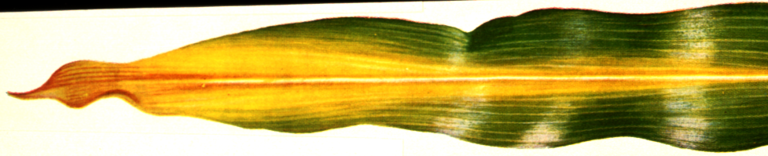
Nitrogen
Major component of chlorophyll
Most common in non-legume crops
Deficient plants are stunted
Low protein content
Develop Chlorosis (yellowing) at the tip, progressing along the mid-rib toward the base of the leaf
Found primarily in old growth (mobile in plant)
Occurs due to N removal from previous crop

Slide 43
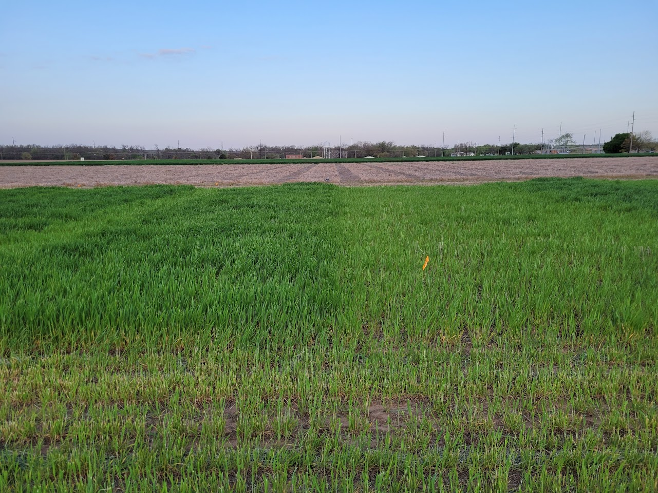
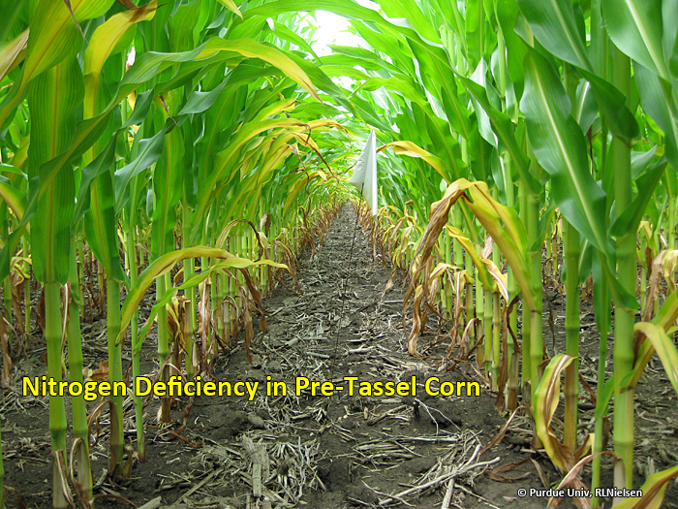
Nitrogen

Slide 44
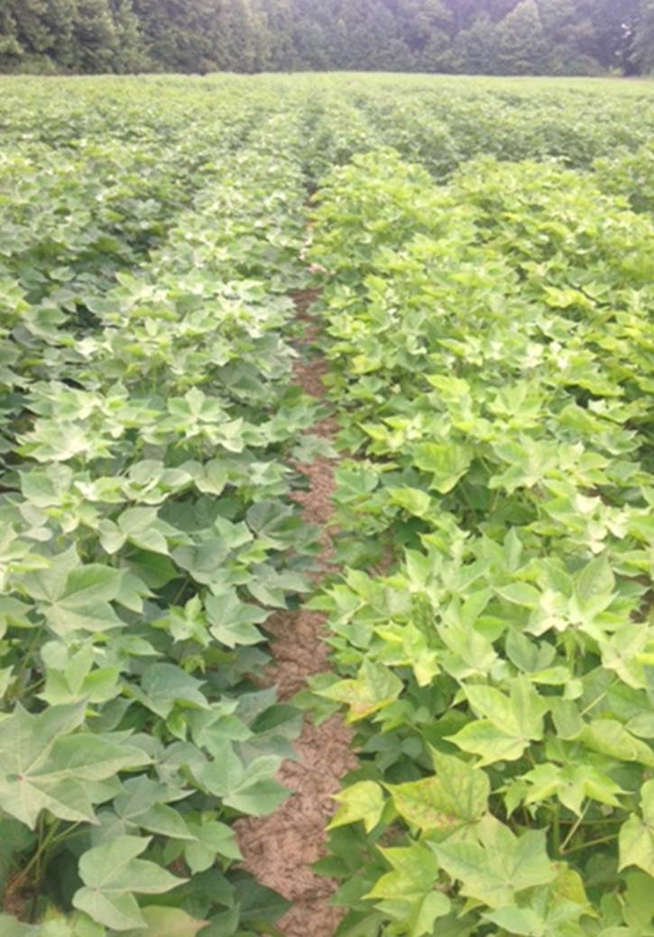
Nitrogen

Slide 45
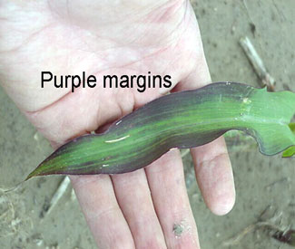
Phosphorus
Needed for storage and transfer of energy
Poor root and seed development
Purple discoloration of Leaves
Discoloration of corn stalk or cotton petiole is sometimes a genetic trait, not from P deficiency
Found in old growth (mobile in the plant)
Occurs more prevalent in areas with acidic pH (<5.5), but can occur anywhere with crop removal

Slide 46
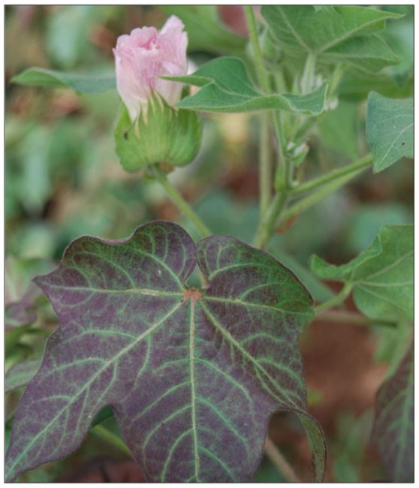
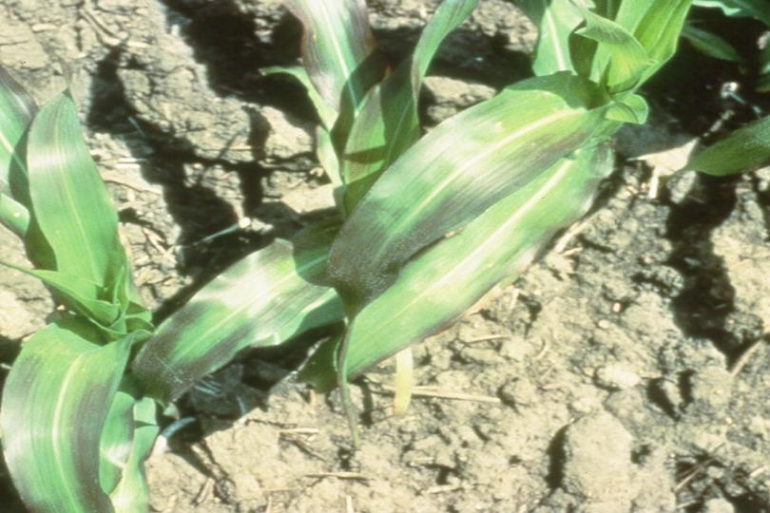
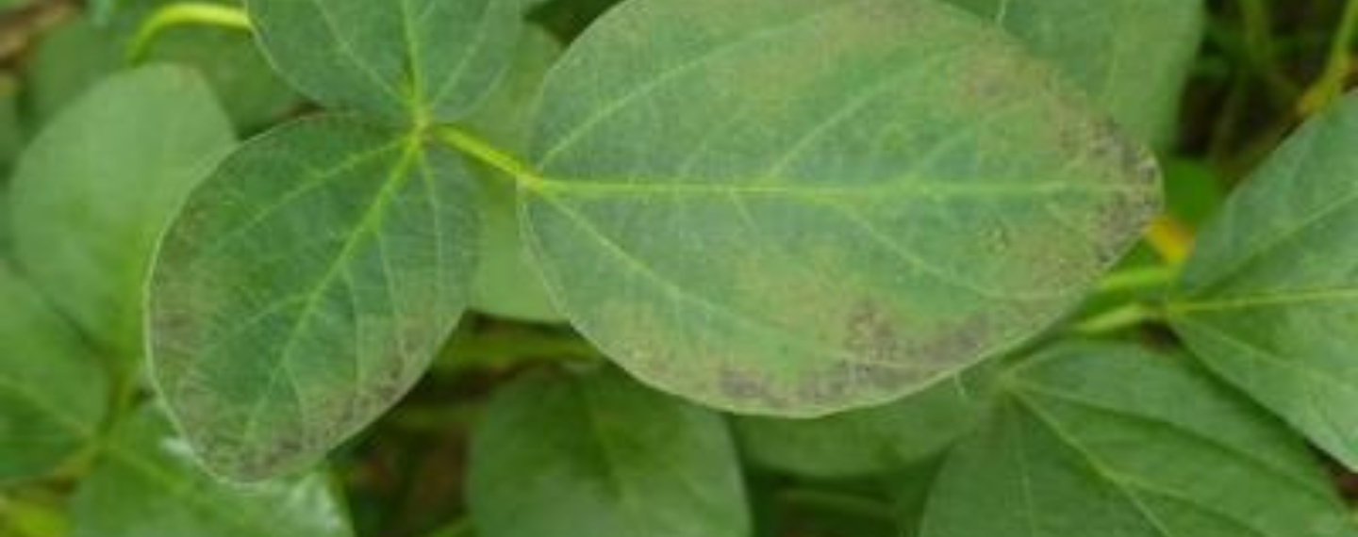
Phosphorus
CORN

Slide 47
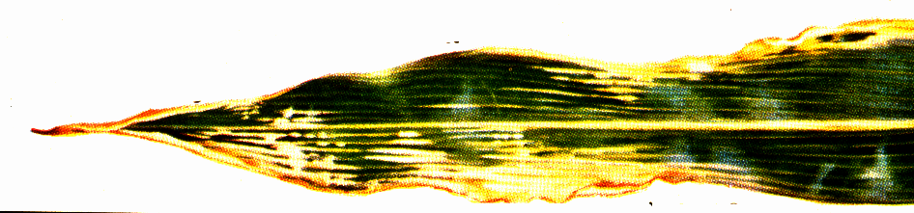
Potassium
Required for nutrient movement, enzyme reactions, regulation of water
Similar to N, deficiencies are yellowing/chlorosis from the tip along the leaf margins (N is in the midrid)
Deficiencies are related to soil parent material, fertilizer use, and cropping histories
Common in crops grown in weathered soils under high rainfall
Found on old growth (mobile in the soil)

Slide 48
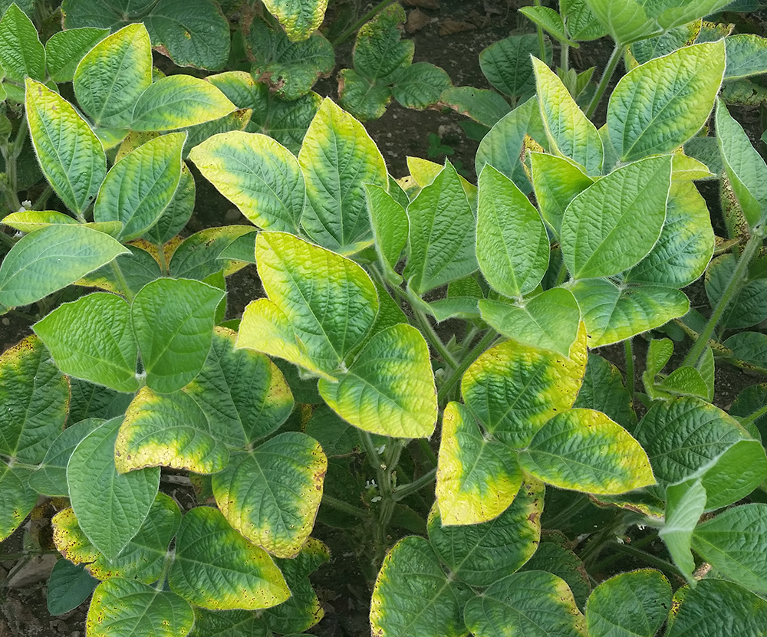
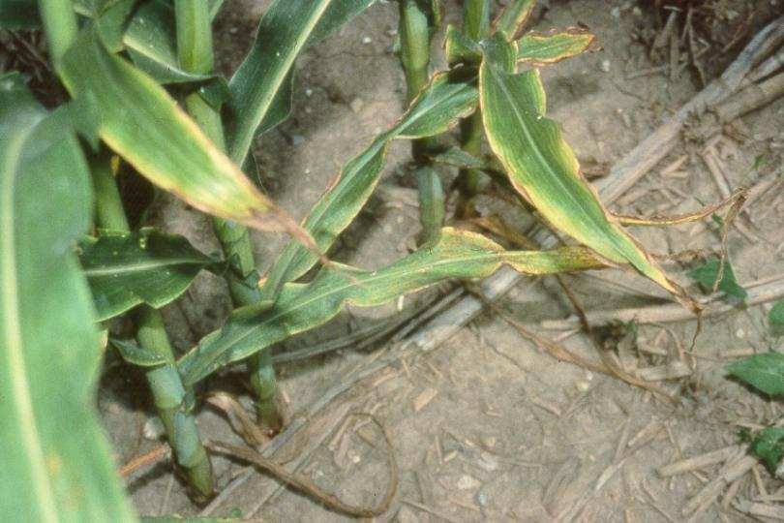
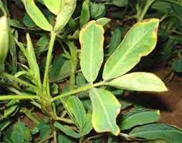
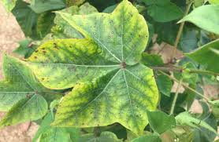
Potassium

Slide 49
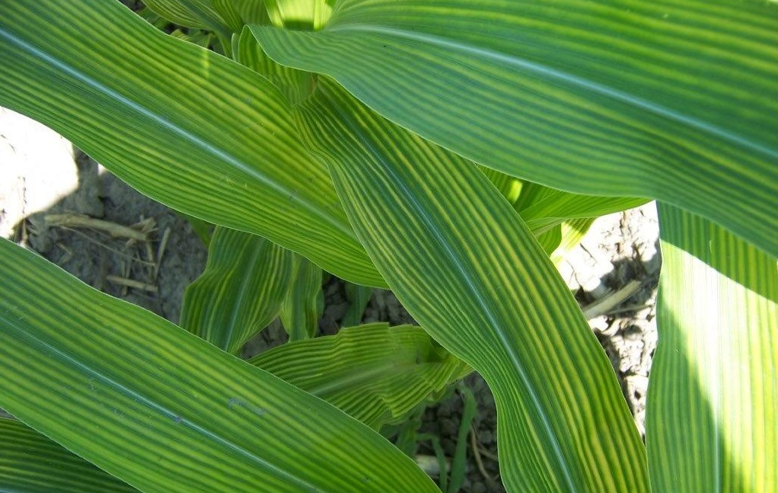
Sulfur
Component of key amino acids
Overall light green color, worse on new leaves during rapid growth
Mobile in plant

Slide 50
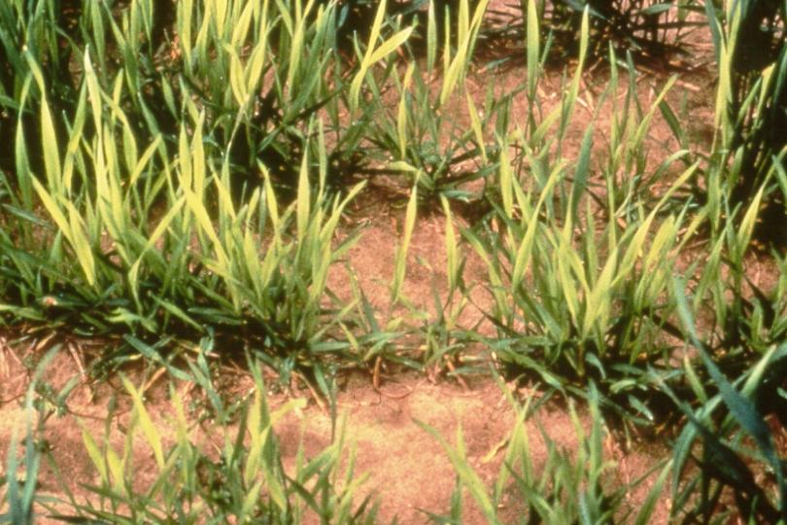
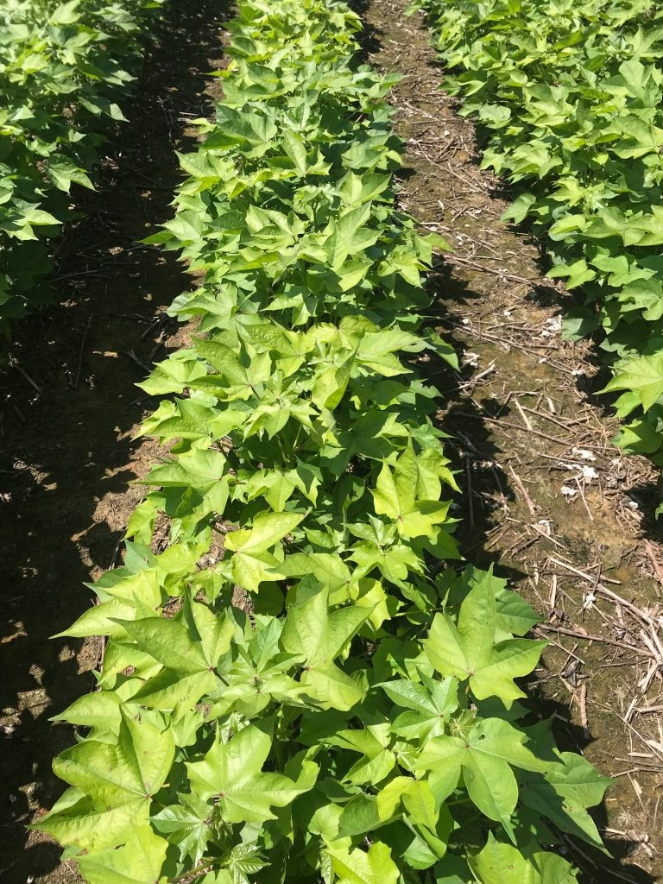
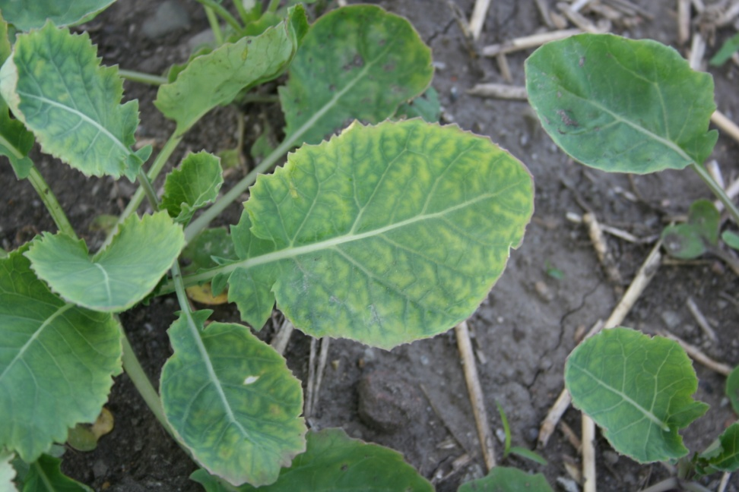
Sulfur

Slide 51
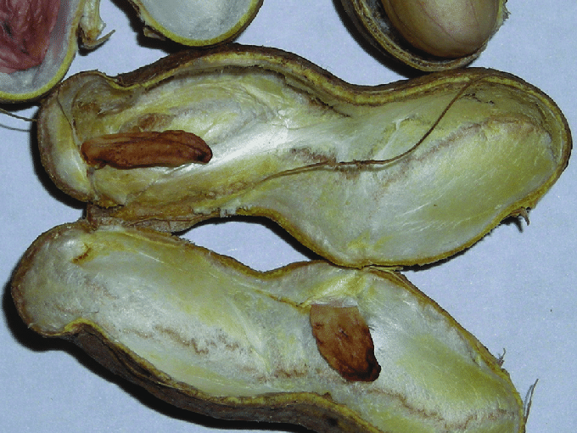
Calcium
Primary function is formation and differentiation of cells
Deficiency results in development of a gelatinous mass in the region of the apical meristem where new cells would normally form
Immobile in soil, but can be somewhat mobile in sandy soils
Immobile in plant

Slide 52
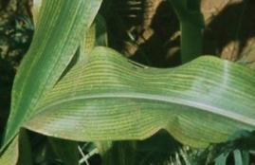
Magnesium
Functions as a co-factor for several enzyme reactions, and is centrally coordinated metal atom inside of chlorophyll molecule
Interveinal chlorosis in lower leaves (mobile in plant)
Rare, but if they happen, under deep, well drained soils under high rainfall

Slide 53
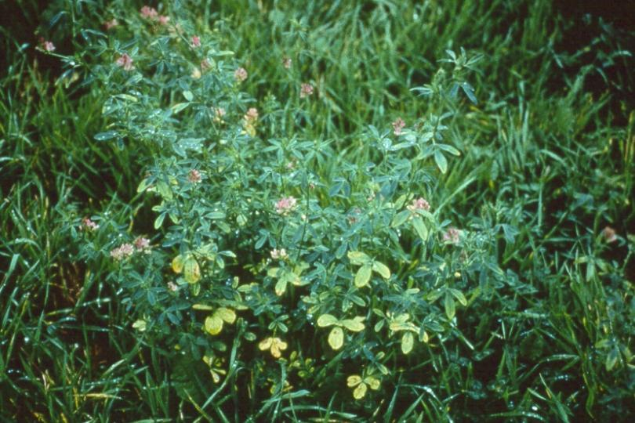
Magnesium

Slide 54
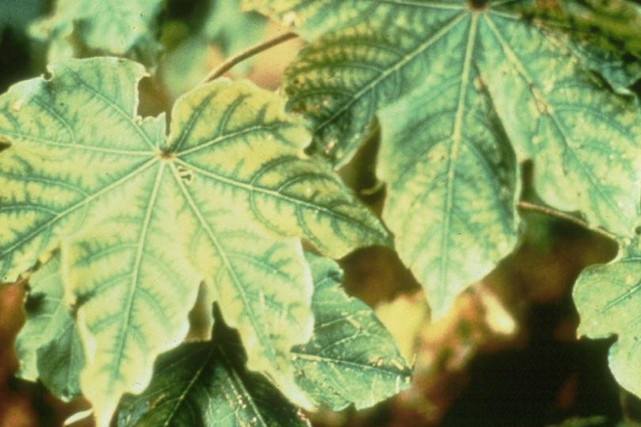
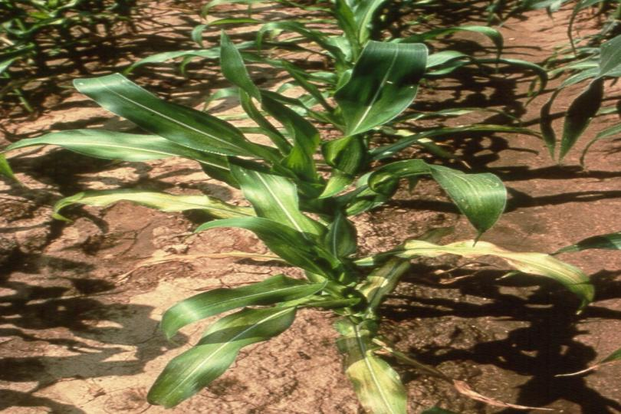
Zinc
Used in enzyme reactions and oxidation-reduction reactions
Usually found in high pH, low organic matter soils, sensitive crops
Pecans, Corn, Soybeans, cotton
Shortened internodes, bronze coloring
Mobile in plants

Slide 55
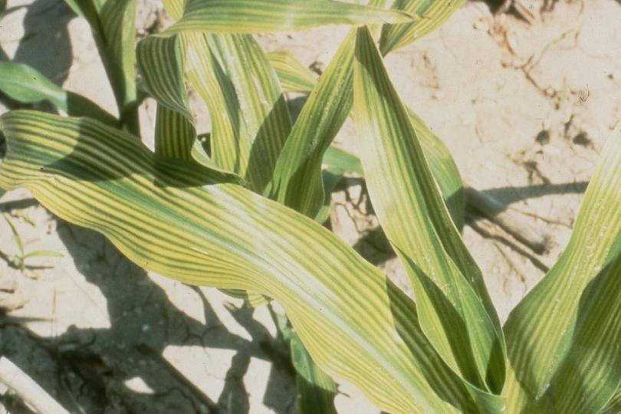
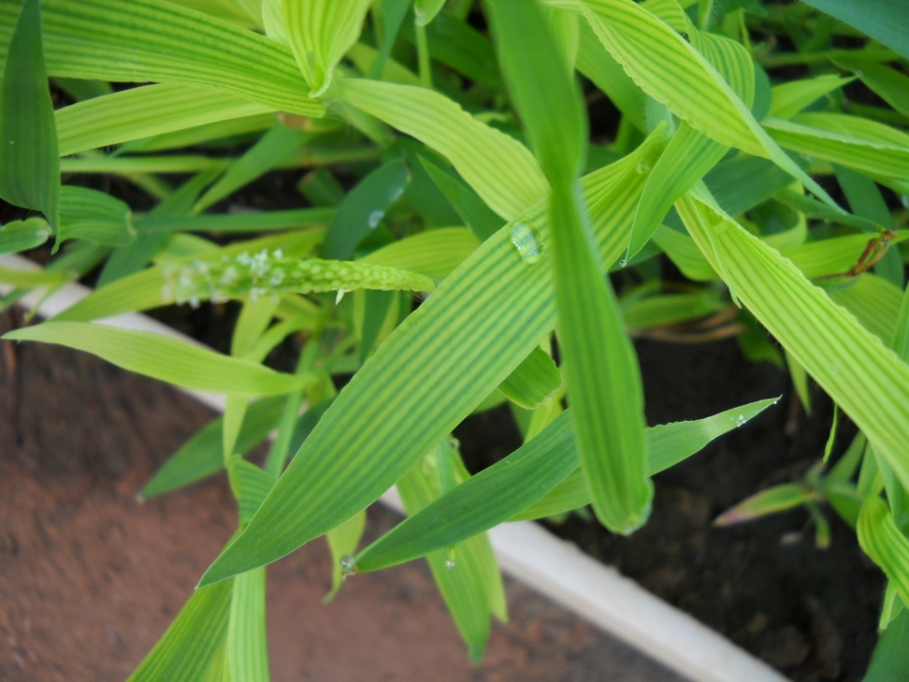
Iron
Immobile in plants
Involved in synthesis of chlorophyll
Symptoms are a dramatic interveinal chlorosis (yellowing) of the newest leaves
Generally found in high pH soils, or on sensitive crops
Grain Sorghum
Sorghum Sudan
Wheat

Slide 56
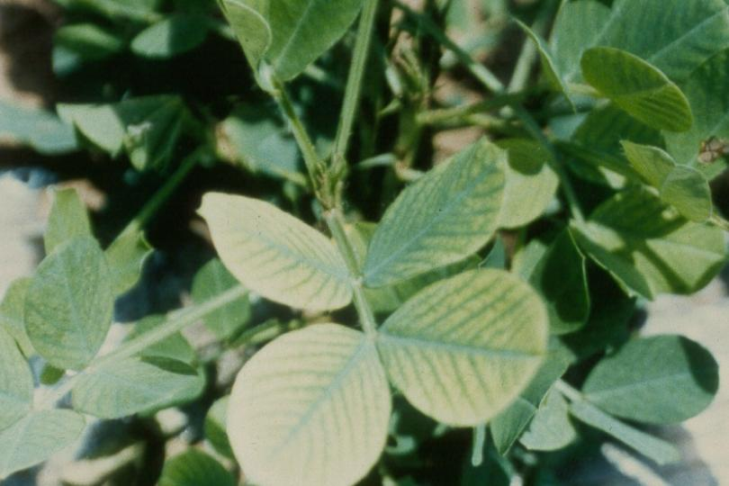
Iron
Peanuts

Slide 57
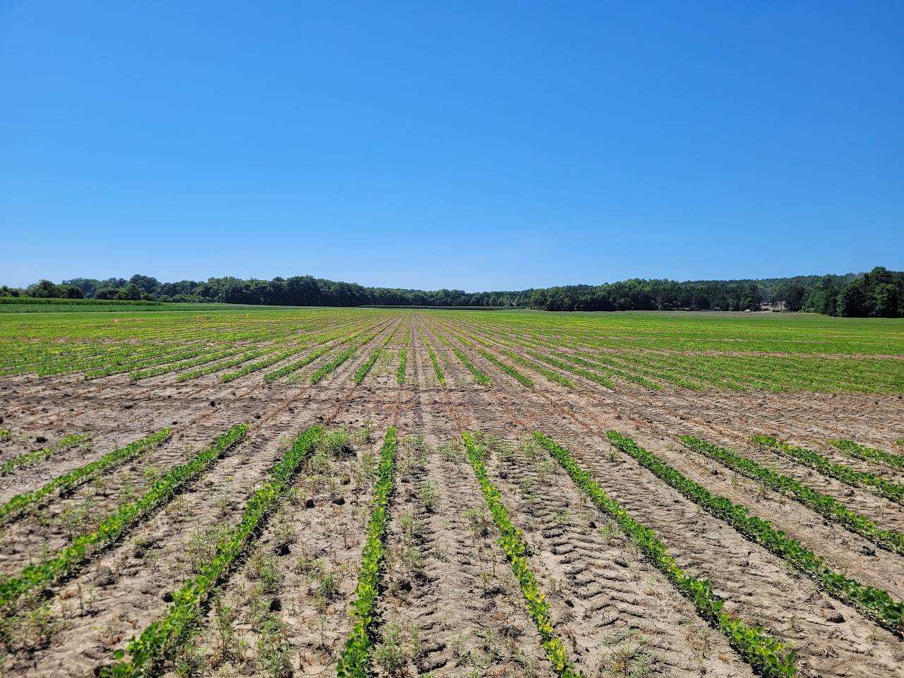
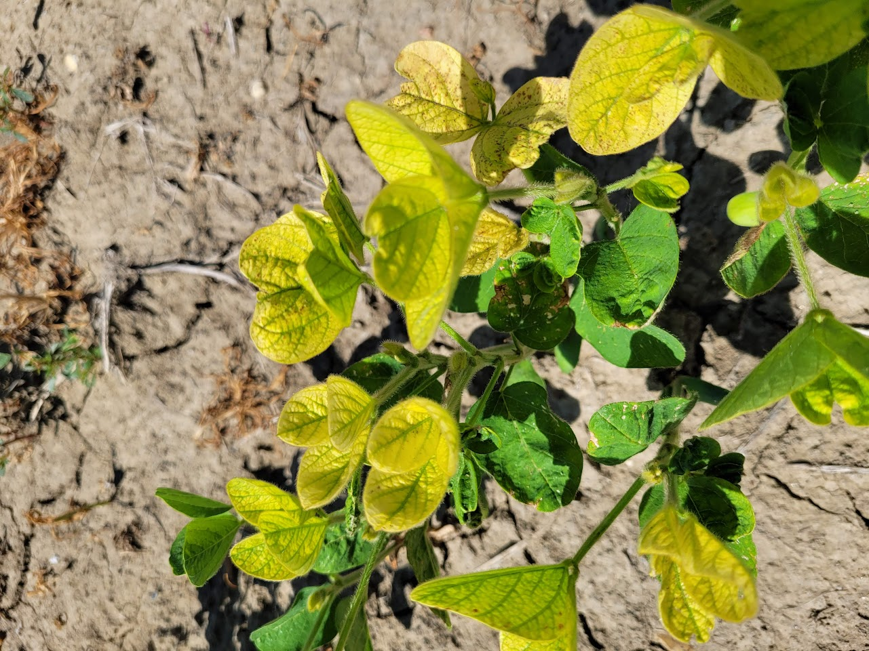
Iron

Slide 58
Molybdenum
Critical to enzymes, nitrate reductase
Deficiency symptoms are similar to N deficiency
Deficiencies are rare, and are associated with very acid soils, and soils that have a high content of iron oxides
Mobile in plants, so will be in old growth

Slide 59
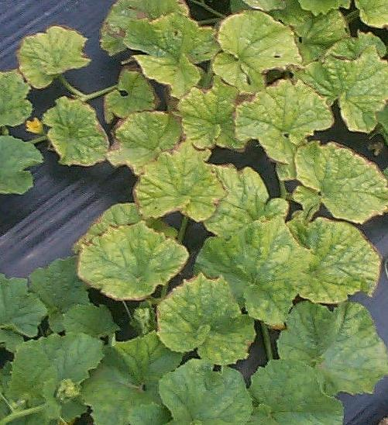
Molybdenum

Slide 60
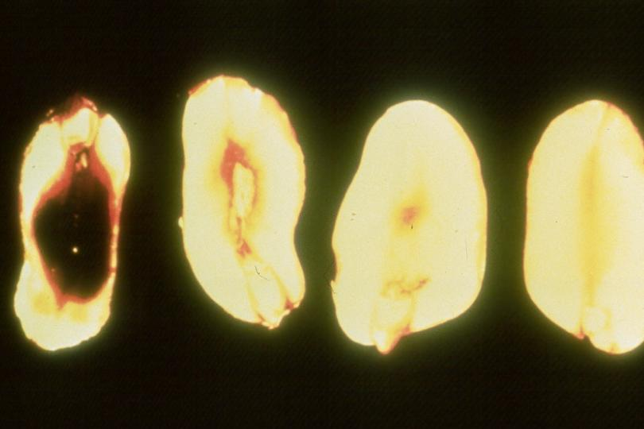
Boron
Most commonly deficient of micronutrients, however, rare in regions with relatively high rainfall
Immobile in plants, though it plays a roll in sugar translocation
Deficiency symptoms include poor root and internal seed development (“hollow heart” in peanuts)

Slide 61
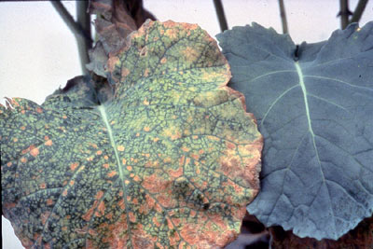
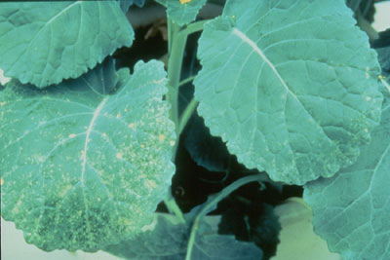
Boron
Canola

Slide 62
Chlorine
Believed to function in internal water regulation
Deficiencies are generally only found in sandy soils, and soils that do not receive annual K fertilization
Main source of fertilizer is KCl (Muriate of Potash, potash, 0-0-60)
Some research has shown a positive response to Cl fertilization in disease suppression
Mobile in plants, chlorotic leaf spot

Slide 63
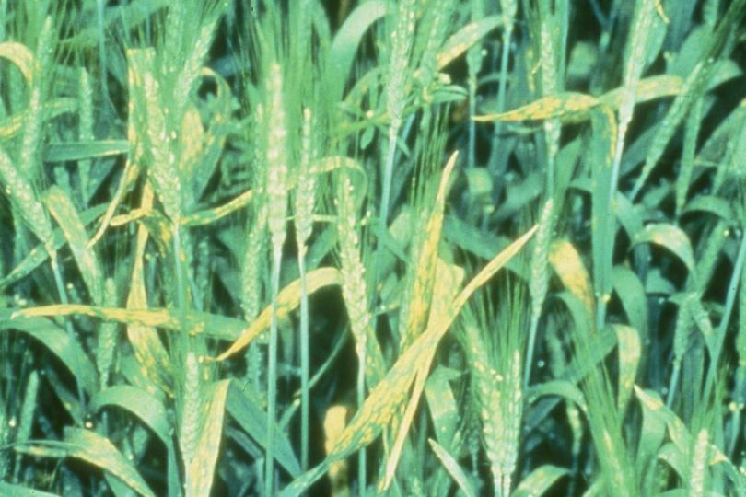
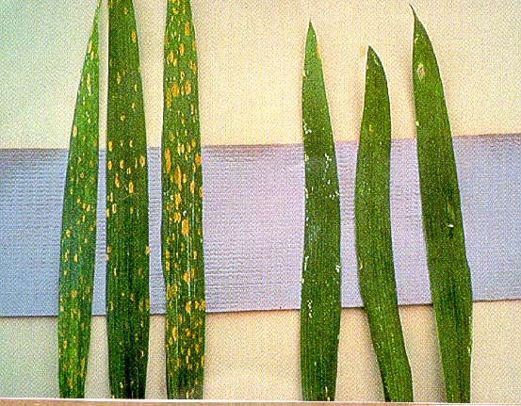
Chlorine

Slide 64
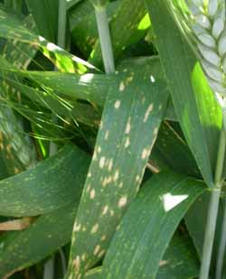
Chlorine

Slide 65
Nickel
No Ni deficiencies have been observed under crop-growing conditions, but in research, we’ve been able to reproduce deficiency symptoms, such as chlorosis of young leaves and dead meristematic tissue
Component of urease enzyme, converting urea to ammonia in plant tissue
Mobile in plant

Slide 66
BENEFICIAL Nutrients
Defined as nutrients that stimulate growth in certain plant species
Or do not meet criteria for essential nutrients
Generally, lesser known about deficiencies/toxicities in many cases
Developments in analytical chemistry and in methods to minimize contamination during growth experiments may lead to reclassification of depths

Slide 67
Beneficial Elements
Na, Sodium
Si, Silicon
Co, Cobalt
Se, Selenium
Al, Aluminum

Slide 68
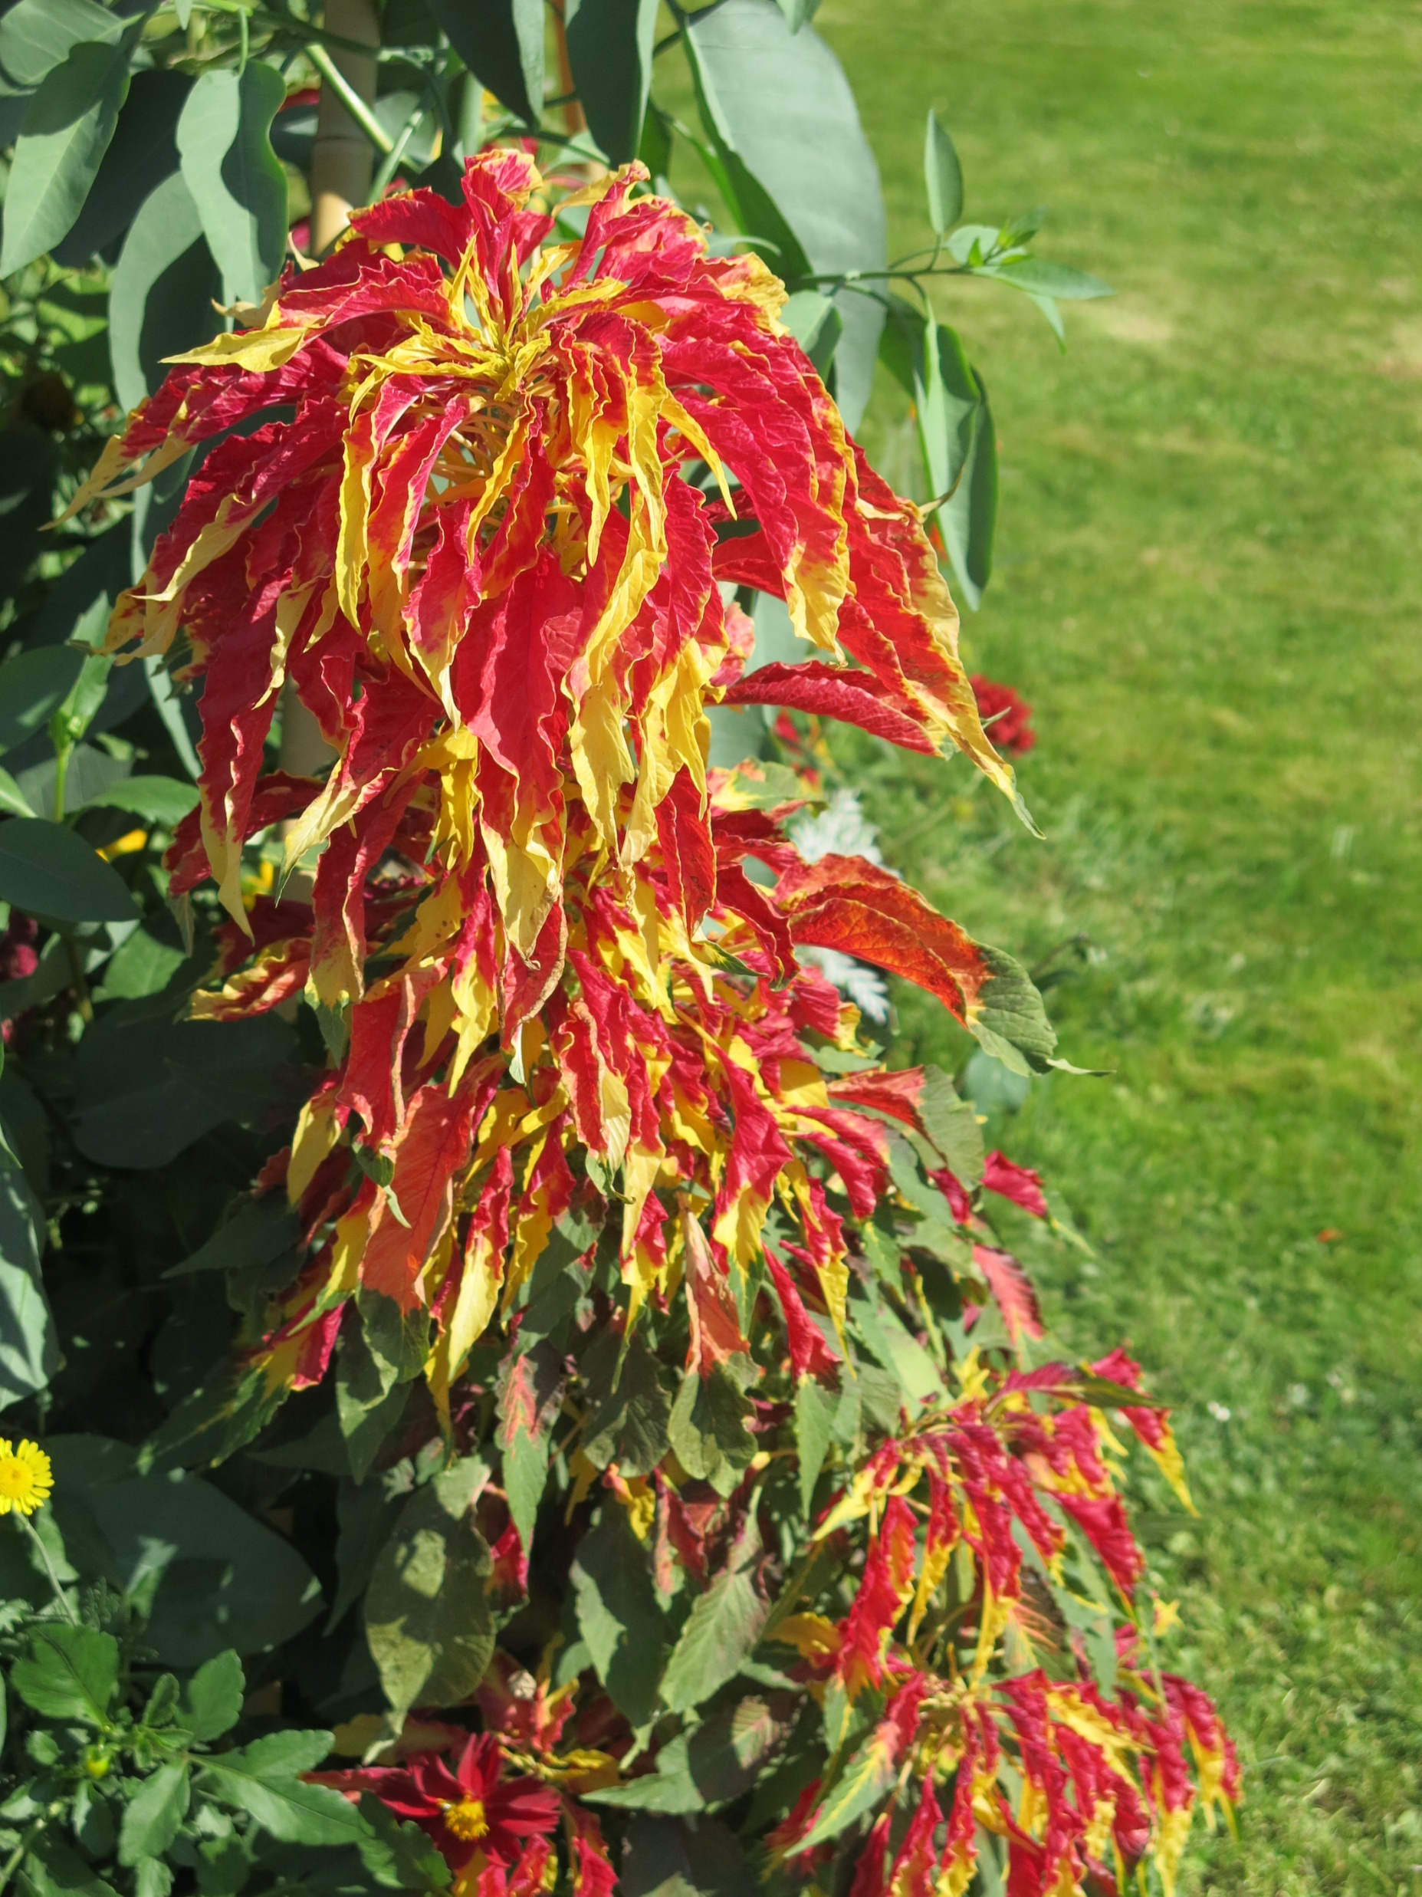
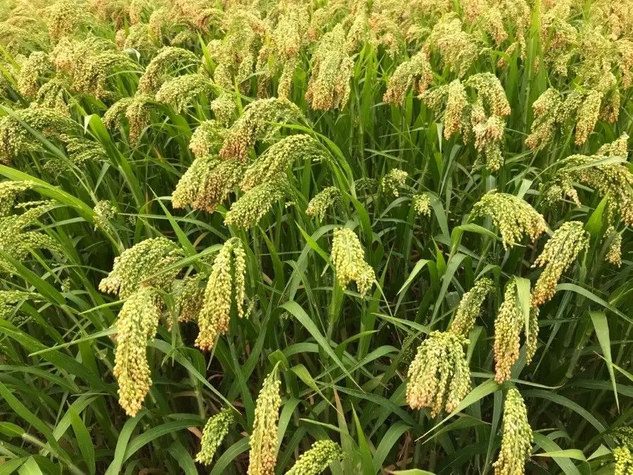
Sodium
C4 Photosynthesis
K Substitute (in some plants: wheat, barley, canola)
Essential for some C4 species (Atriplex, Amaranthus)
Water Relations

Slide 69
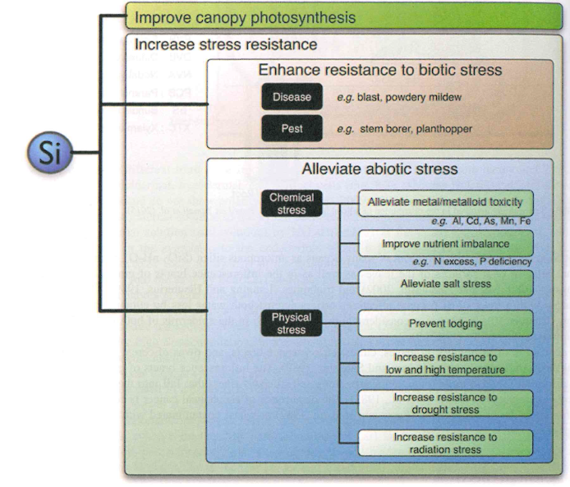
Silicon
Important for some crops, such as rice, sugarcane (LA)
Important for structure, resistance against biotic stresses

Slide 70
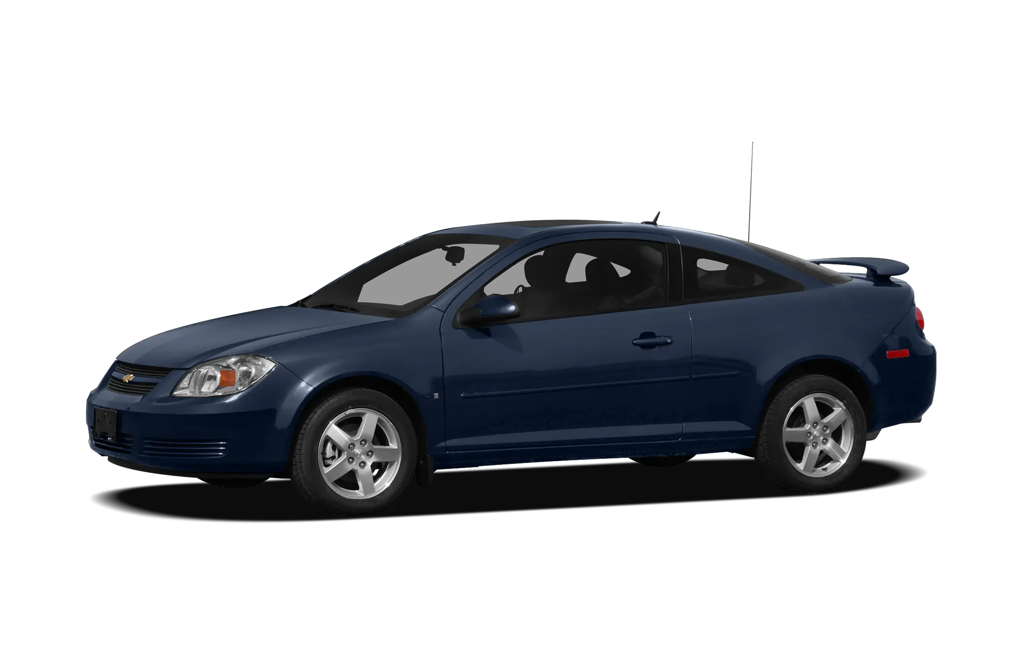
Cobalt
Required for Eukaryotes, and animals, but essentiality has not been proven in all plants
Important for legumes
Essential for Rhizobium and other N₂ – Fixing bacteria
Required for synthesis of coenzyme vitamin B₁₂ (cobalamin)
Methionine synthesis
Leghemoglobin production
Nodule Metabolism

Slide 71
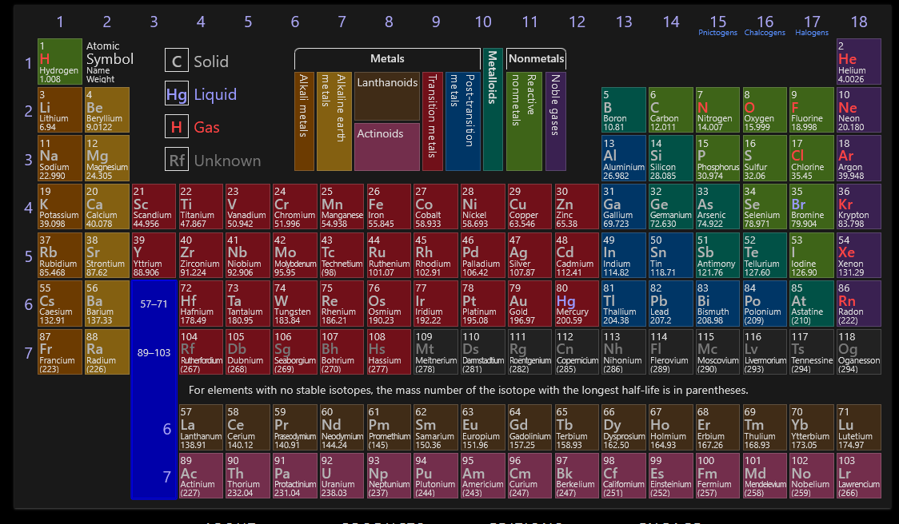
Selenium

Slide 72
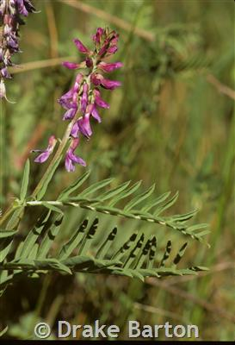
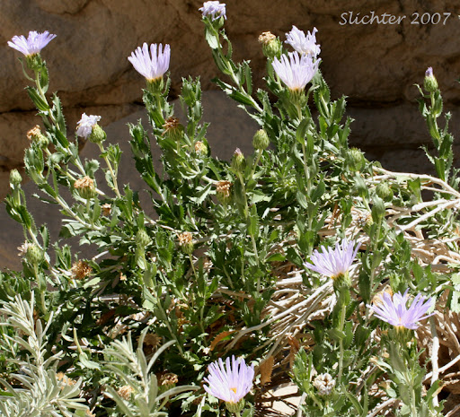
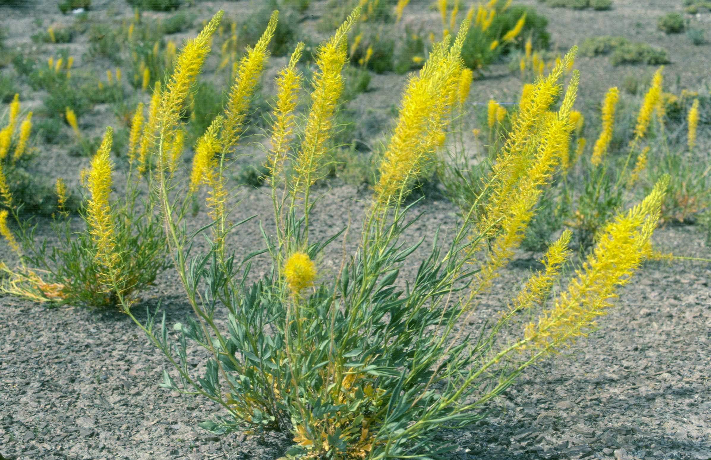
Selenium
Similar to Sulfur, and in SOME plants, can be used as S replacement
Non-accumulators (corn, soy, tomato, sunflower)
Accumulators (brassicas, alliums)
Hyper-accumulators
Biofortification

Slide 73

Aluminum
Beneficial to acid-soil adapted species
Not a ton is known

Slide 74
Other possible nutrients
Iodine and Vanadium
Fungi, non-vascular plants (algae)
New research may suggest vascular plants, helping with stress tolerance and antioxidant capacity
V and Cerium (Ce) improve growth and stress tolerance of tomato and pepper palnts
Titanium on growth, enzyme activities, and photosynthesis of various species
Rare earth metals are becoming more interesting, such as La, Ce

