Slide 1
PSS 4313/6313: Soil Fertility and Fertilizers
Spring 2026

Slide 2


Slide 3
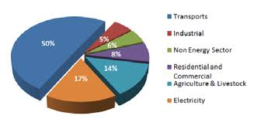

Slide 4
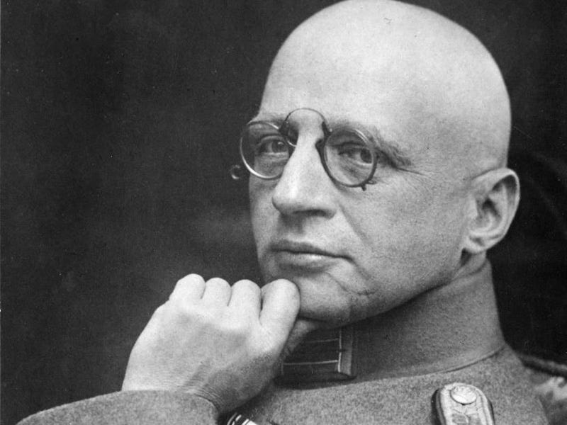

Slide 5
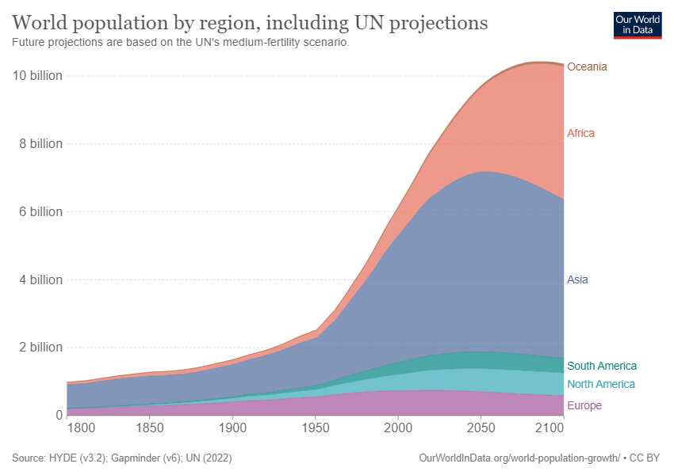

Slide 6
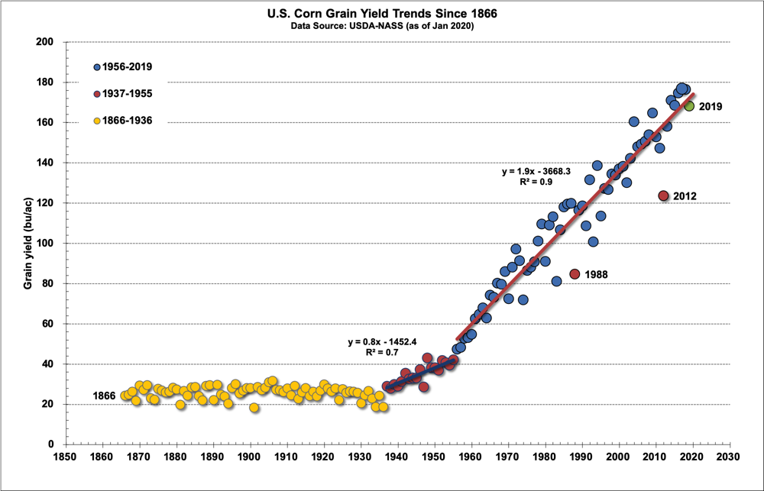

Slide 8
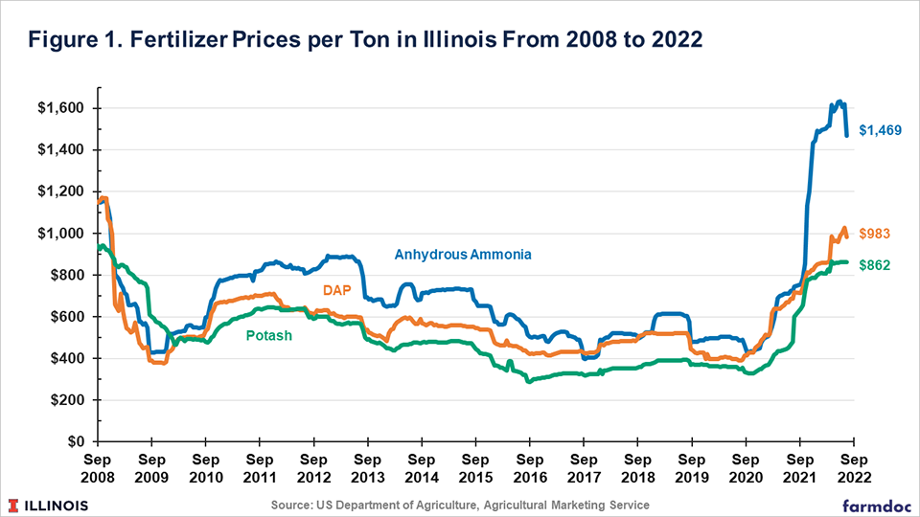

Slide 9
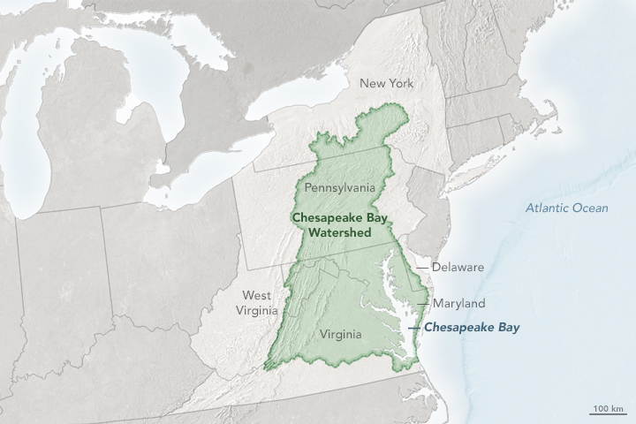

Slide 10
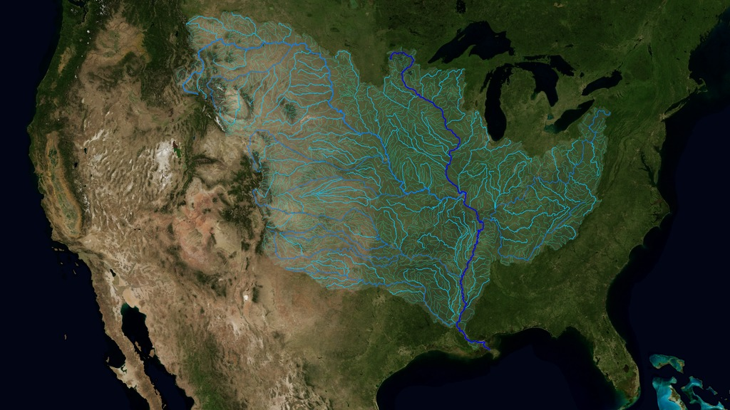

Slide 11
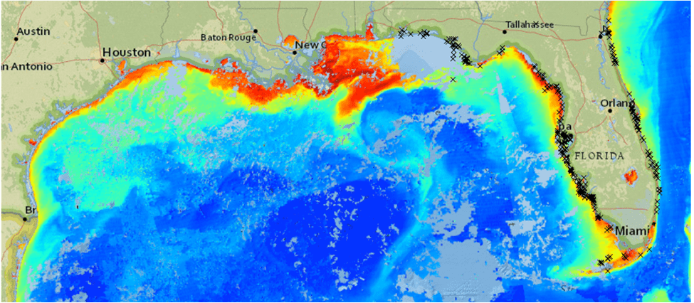

Slide 12
Soil Nutrients
Plant Uptake
Plant Matures
Plant Dies
Biomass Decomposition

Slide 13
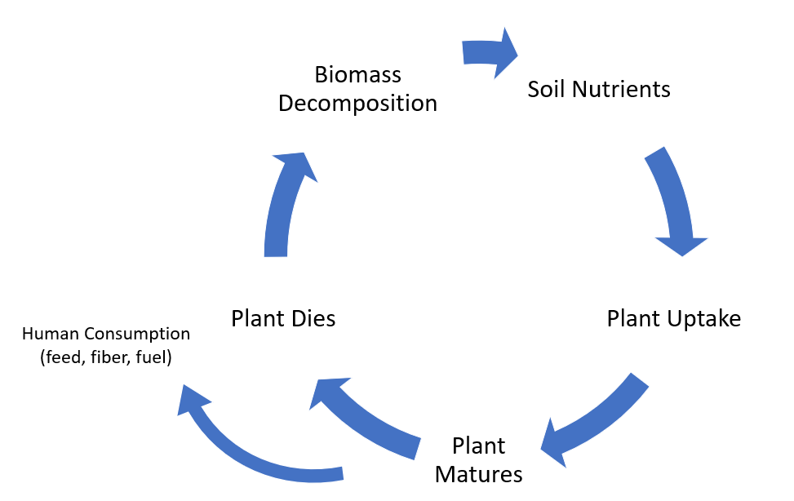

Slide 14
We can’t rely on great soils forever
Soil have finite resources
New Tech (genetics, tillage, pesticides, etc.) can’t replace loss of plant nutrients
When we deplete soils, we have to determine which of the 17 essential nutrients we must replace

Slide 15
What is Soil Fertility/Nutrient Management
Management of Fertility
Optimize Productivity
Optimize Profitability
Optimize quality crops
Maximizes efficiency
Minimizes detrimental Environmental consequences
The challenge in nutrient management is to provide adequate, but not excessive, availability of nutrients to achieve the yield (food crops), growth rate (turf), and appearance (ornamentals) of plants we manage.

Slide 16
My goal:
Think Critically
Advise you to ask the RIGHT questions
Advance our Science Literacy

Slide 17
Syllabus
Please email me, don’t canvas message me.
511 Rice Hall – Office
232 Walker Hall – Lab
If my door is open, I’m there, come on in

Slide 18
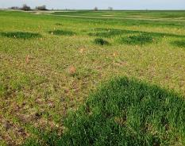
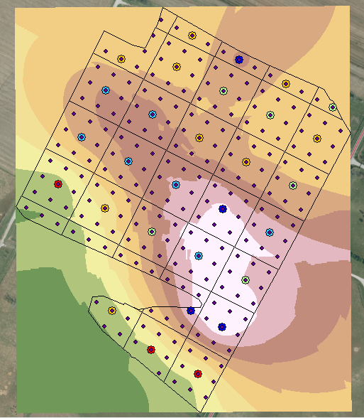
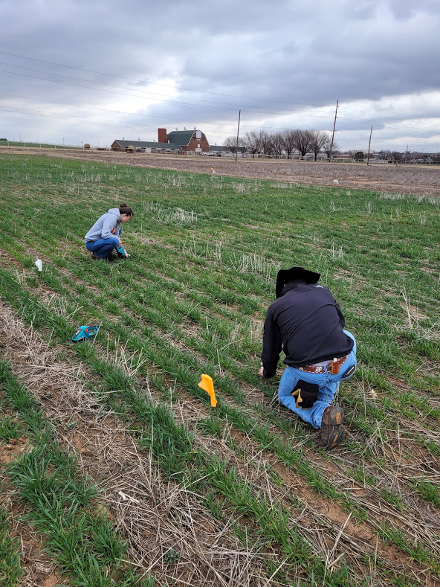
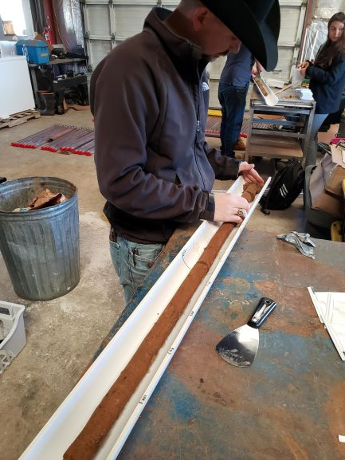
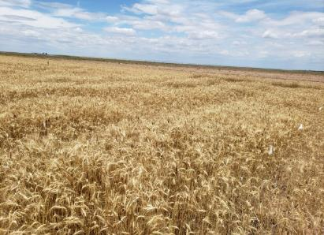
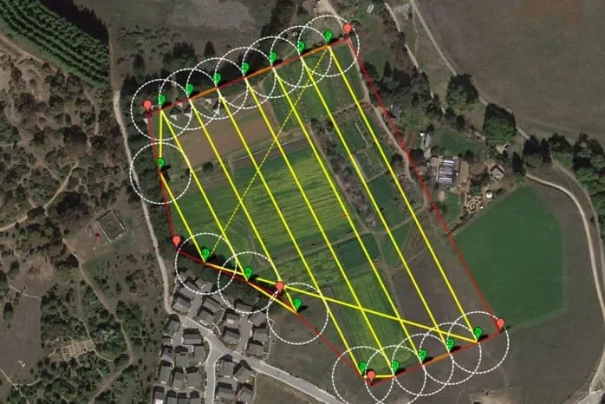
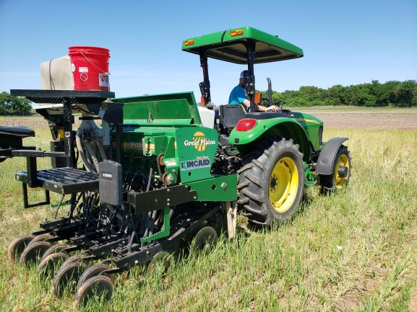
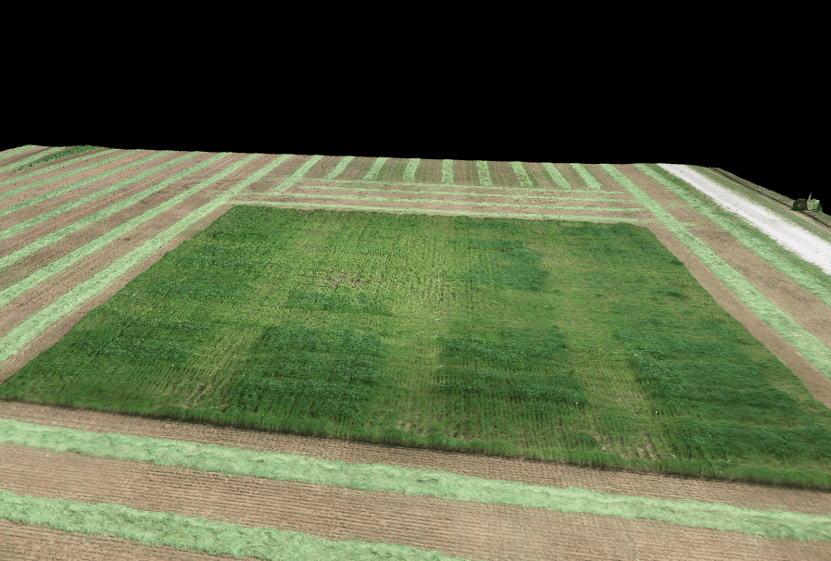
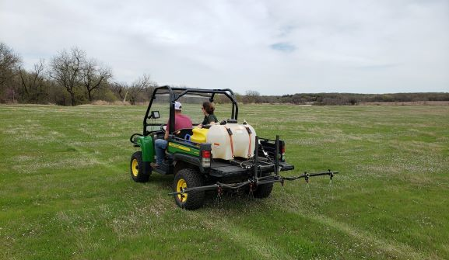
Assistant Professor of Soil Fertility
Actual: 157 lb K/ac
Predicted: 214.4 lb K/ac
Actual: 267 lb K/ac
Predicted: 261.7 lb K/ac
Actual: 187 lb K/ac
Predicted: 233.6 lb K/ac

Slide 19
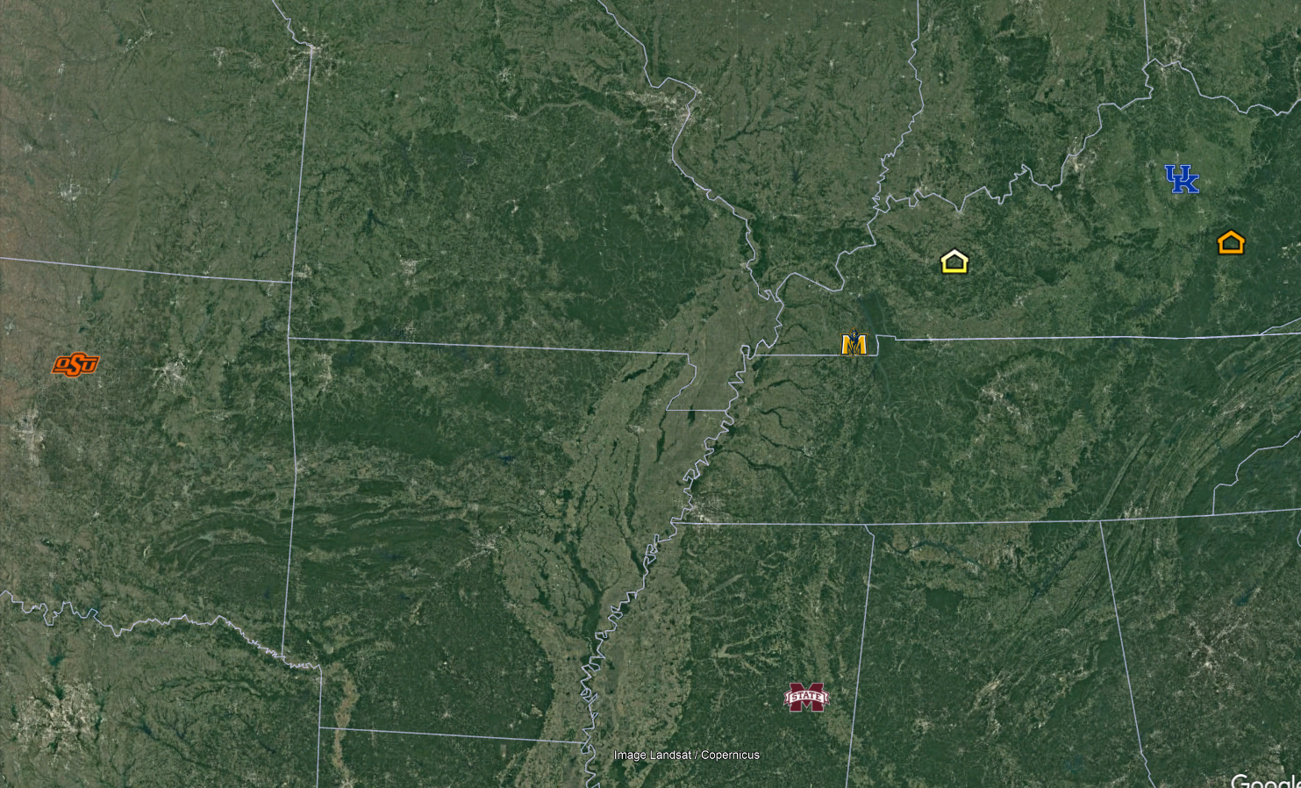

Slide 20



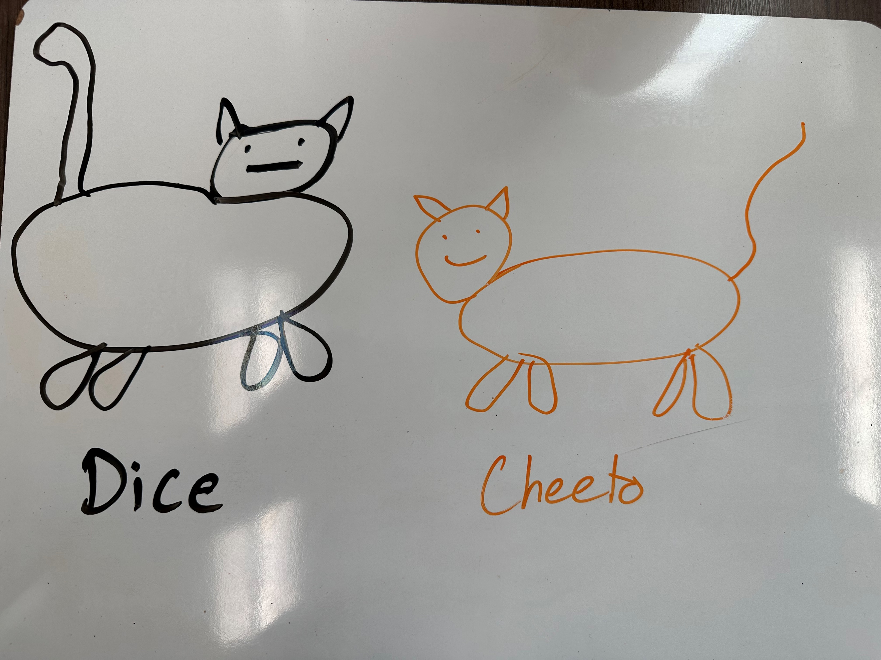

Slide 21
Quiz 1
Name
Major
Year/Status (Undergrad: Jr/Sr; Grad: MS/Phd 1st/2nd/3rd)
Grad: Advisor

Slide 22
Chapter 1 Introduction
Spring 2026

Slide 23
History of Soil Fertility

Slide 24
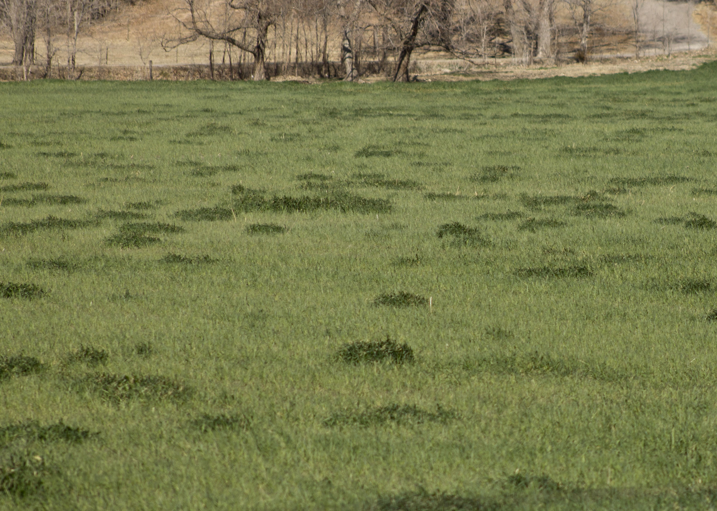
Ancient History
Early Fertilizers
Manure
Bone meal
Meat scrap
Dried blood
Cottonseed meal
Fish scraps
Peruvian guano; (Bat Droppings)
“Additives”
Salt

Slide 25
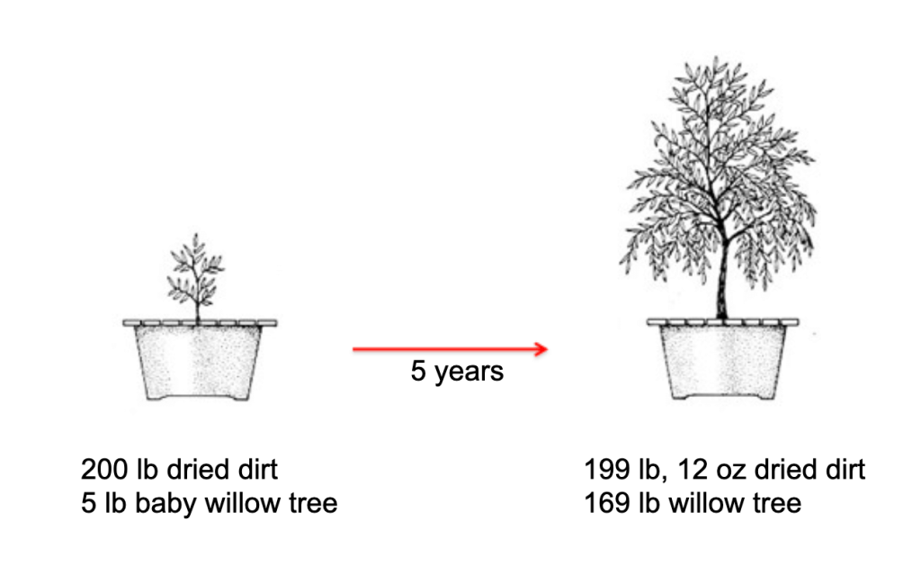
Van Helmont (1577-1644)
Belgian Chemist
Willow Tree Experiment
Water was the sole nutrient!

Slide 26
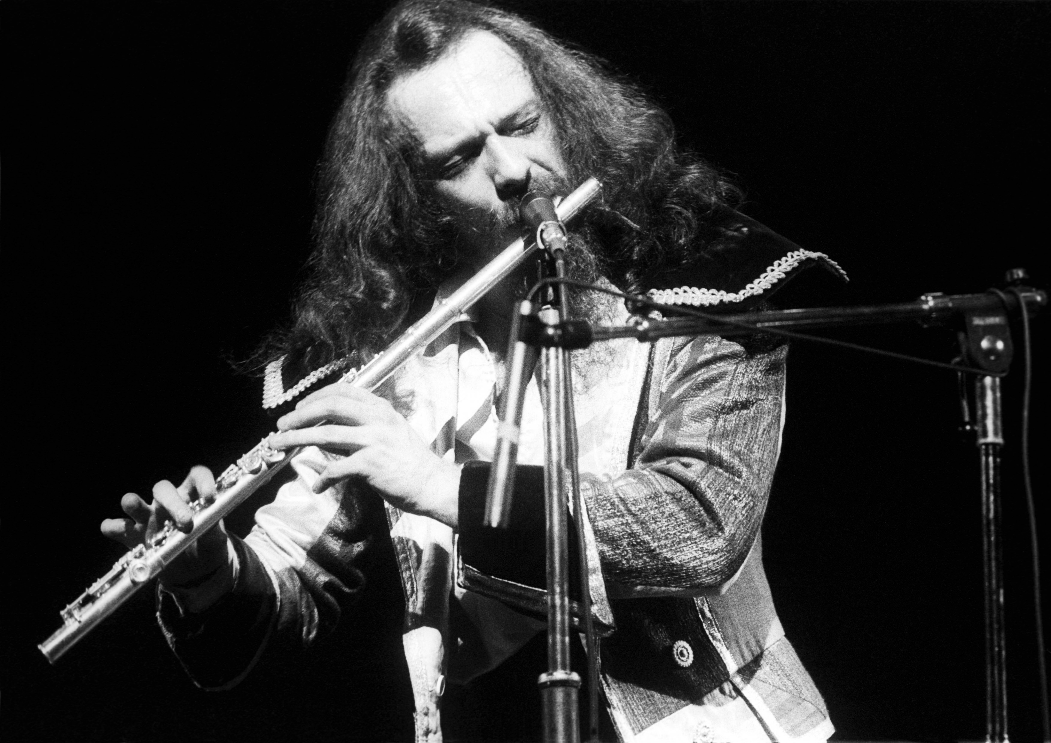
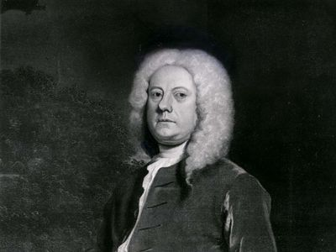
Jethro Tull (1674-1741)

Slide 27
Jethro Tull (1674-1741)
English Agriculturist
Observed that plant grew better if the soil was “pulverized”
“Pabulum for the lacteal mouths of roots”
Plants ate soil
Credited with invention of cultivator and grain drill
Notes:
Rather proud man, a little angry. Went out to the field, hated he couldn’t get seed in the ground very well sometimes, broadcasting seed didn’t always work. So he tilled it up, loosened the soil, then seeds would come up much easier.

Slide 28
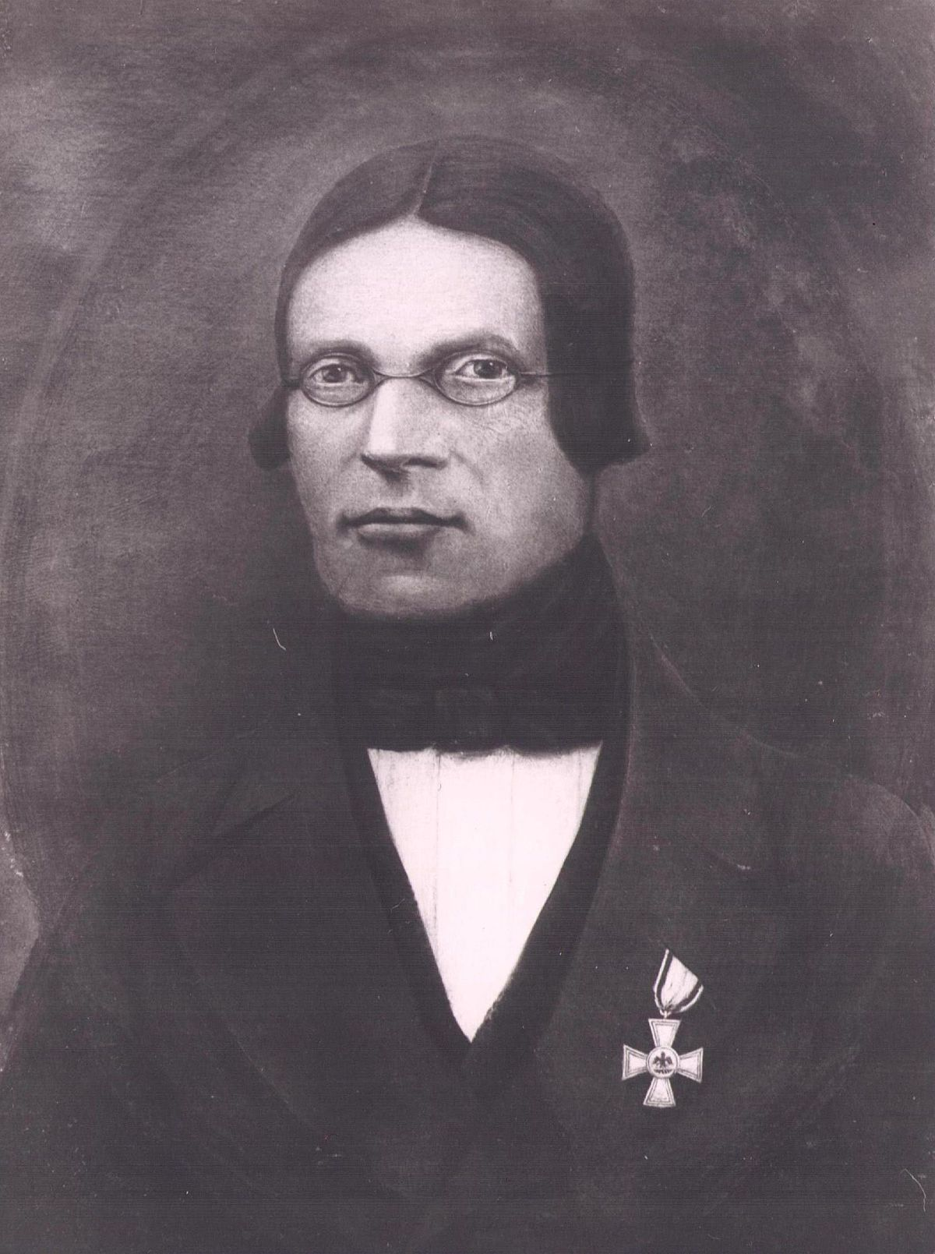
Carl Sprengel (1787-1859)
German Botanist
Worked to develop currently accepted principles of plant nutrition/soil fertility
Dispelled the humus theory
Plants lived on humus extracts and could generate other elements
Established 20 elements as plant nutrients
In essence formulated “Law of the Minimum
Notes:
Went to Daniel Thaer’s school in Germany, who pushed humus theory

Slide 29
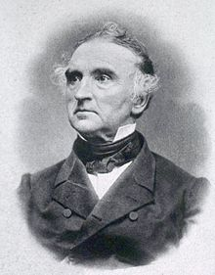
Justus von Liebig (1803-1873)
German Chemist
“Father of Agricultural Chemistry”
Plant C comes from CO₂
Plant O comes from H₂O
Alkaline metals neutralize acid formed by plant metabolism
P necessary for seed formation
Plants absorb everything, excrete non-needed stuff
Law of the minimum (1862)

Slide 30
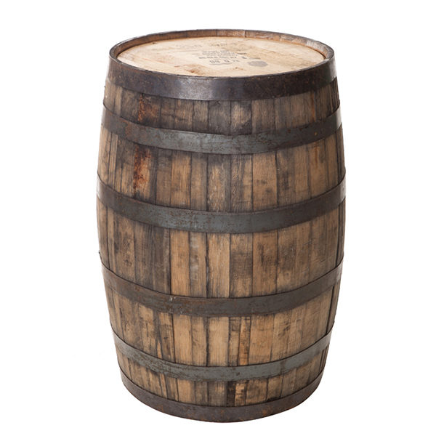

Slide 31
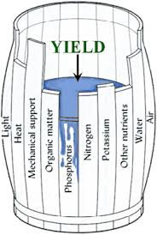
Law of the Minimum
Grow Proportionally to the least available growth factor
Growth Factors
150 bu/ac Genetics
100 bu/ac Nitrogen
200 bu/ac P & K
50 bu/ac water
Foundation of soil fertility!!

Slide 32
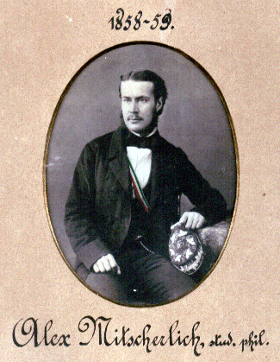
Alexander Mitscherlich (1836-1918)
Developed the relationship between yield and quantity of “plant food” constituents
Essentially the Law of Diminishing Returns
Used extensively in correlation and calibration of fertilizer recommendations
Foundational work!

Slide 33
Growth Factors
Growth (G) may be expressed as a function of each growth factor
G = f(x₁, x₂, x₃, …, x_{n})
How do plants respond to growth factors?
Initially, very little growth
As leaves develop and capacity to capture sunlight, photosynthesis takes over, and we see rapid increase in growth or biomass
Growth slows down as the plant enters the reproductive phase, and begins seed development, stopping with full maturity
Growth

Slide 34
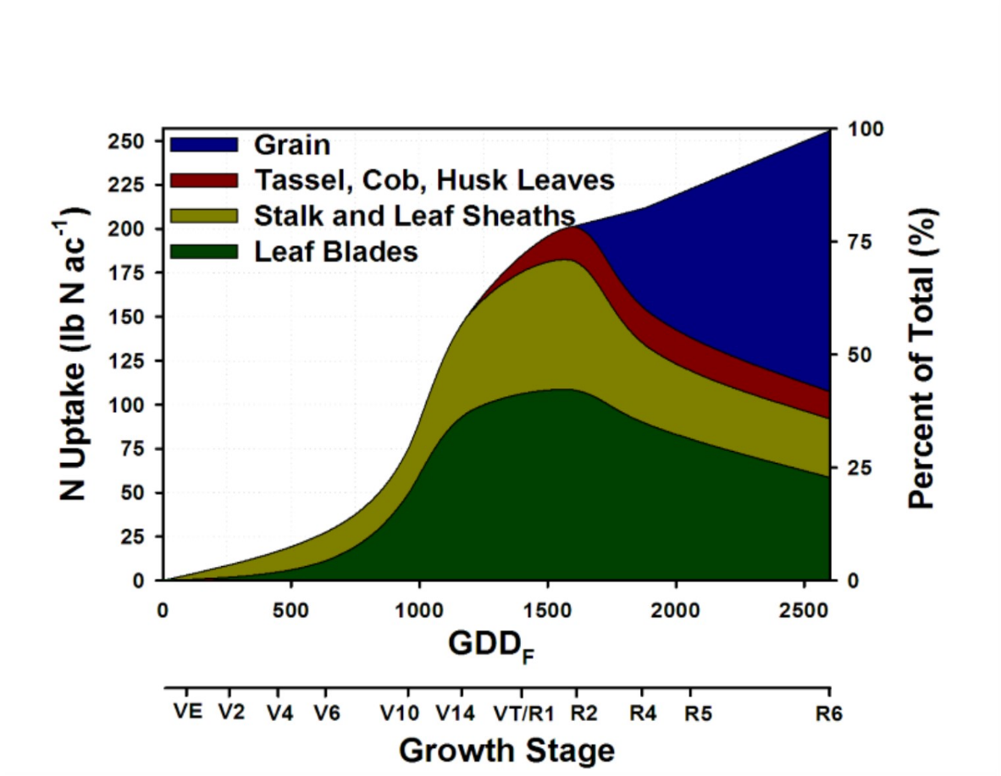
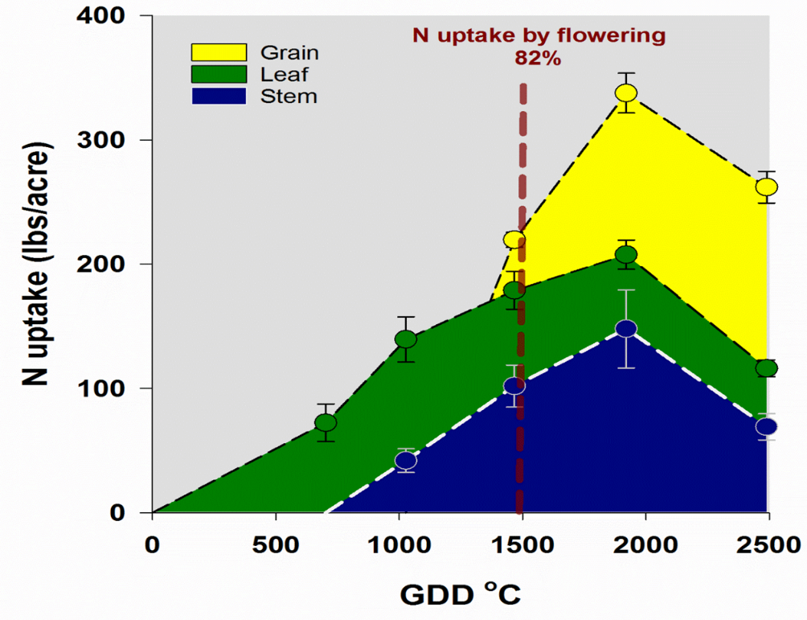
Law of Diminishing Returns

Slide 35
Growth Factors

Slide 36
How do plants respond to growth factors
If the precise cause and effect relationship of each growth factor is known, then the growth response to each factor can be mathematically predicted.
These mathematical expressions, or models, can be useful in management of plants when the growth factors can be controlled
Use of fertilizer is an example of how we might manage nutrients as a growth factor, and, in turn, plant growth.

Slide 37

How do plants respond to growth factors

Slide 38

How do plants respond to growth factors

Slide 39
How do plants respond to growth factors

Slide 40
Interaction of Growth Factors
When a limiting factor is removed by some force, it will generally improve plant response to other limiting growth factors

Slide 41
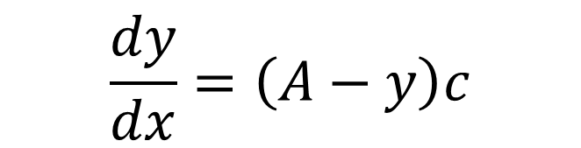
Mitscherlich Law of Diminishing Returns
Yields diminished more with each added increment of a growth-limiting factor
Where:
dy/dx is the change of yield (Δy₁) from an increment (x) addition of a single limiting growth factor
A is the maximum yield when all growth factors are at their optimum
y is the yield initially or from the last addition of the limiting nutrient
c is proportially constant, or efficiency factor
$$\frac{dy}{dx}=\left(A−y\right)c$$

Slide 42
Mitscherlich Law of Diminishing Returns
Yield increase will be proportional to the difference between maximum yield obtained by adding the growth factor and yield at the given level of the growth factor

Slide 43
Mitscherlich Law of Diminishing Returns
Researchers found that this response curve could be used to describe yield, at any deficient level of a growth factor, as a percentage of the maximum yield possible
% Sufficiency

Slide 44
Mitscherlich Law of Diminishing Returns
Liebig Law of the Minimum:
Growth Factors
200 bu/ac Genetics
100 bu/ac Nitrogen
150 bu/ac P & K
50 bu/ac water
Mitsherlich:
Growth Factors
100% Yield Potential
50% N Potential
75% P&K Potential
25% water potential

Slide 45
How does this work in practice?
Hypothetical Corn Grain Yields:
Yield (bu/ac) | Soil Test P (lb/ac) | P Sufficiency (%)
80 | 0 | 25
120 | 25 | 50
150 | 50 | 65
170 | 75 | 90
180 | 100 | 100
180 | 125 | 100

Slide 46
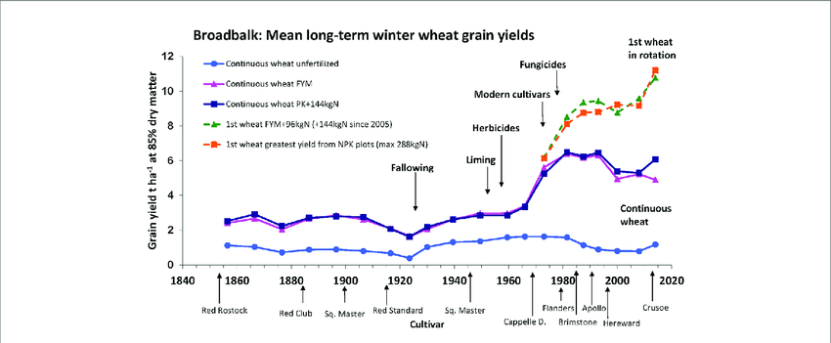
Agricultural Research Stations
Rothamstead 1843
Longest established soil fertility long term studies

Slide 47
Agricultural Research Stations
Rothamstead 1843
Longest established soil fertility long term studies
Morrill Act 1862/1890
Established Land Grant Institutions
Hatch Act 1888
Established state experiment stations
Smith-Lever 1914
Established Extension Service

Slide 48
Roger Bray (1900’s)
US Scientist
Proposed that plant response to availability of soil nutrients should be strongly influenced by how easily the nutrient is moved with water in the soil
Considered nutrients as relatively mobile or immobile in the soil
As the mobility of a nutrient in soil decreases, the amount needed in the soil increases from a value equal to the product of maximum yield and optimum plant composition to a constant.
In other words, for a nutrient that is 100% mobile in the soil, the amount required for a crop is a product of yield and plant composition.

Slide 49
Bray’s Nutrient Mobility Concept

Slide 50
Bray’s Nutrient Mobility Concept
Liebig’s Law of the Minimum
“Yield of a plant would be directly proportional to the most limiting growth factor”
Misterlich Law of Diminishing Returns
“Yield increase will be proportional to the difference between maximum yield obtained by adding the growth factor and yield at the given level of the growth factor

Slide 51
Bray’s Nutrient Mobility Concept
Bray’s concept of how plants responded to soil nutrient availability could be represented as a straight-line response for a nutrient that is 100% mobile in the soil and a curvilinear response for relatively immobile nutrients
Complete mobility probably does not exist in soils, except for water, which is an important consideration

Slide 52
Bray’s Nutrient Mobility Concept
https://nue.okstate.edu/Index_Publications/Bray.pdf

Slide 53
Bray’s Nutrient Mobility Concept
How does this apply in concept?
When plants are grown close together, as in intensive agriculture, it becomes clear that the volumes of soil that each plant extracts mobile nutrient from may overlap, while the volumes supplying immobile nutrients for plants do not

Slide 54
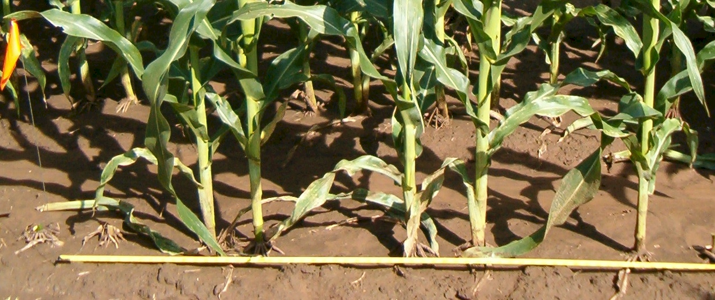
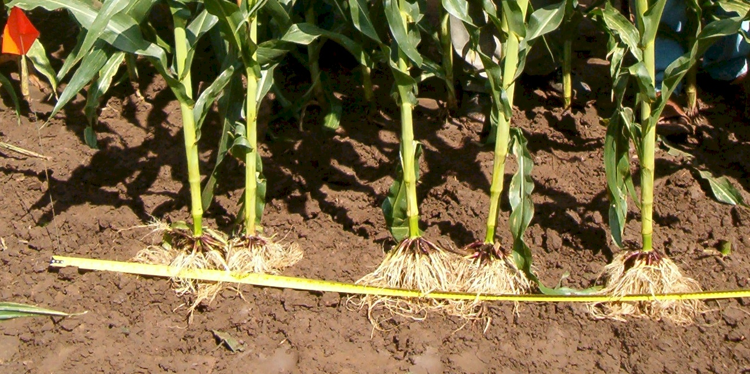

Slide 55
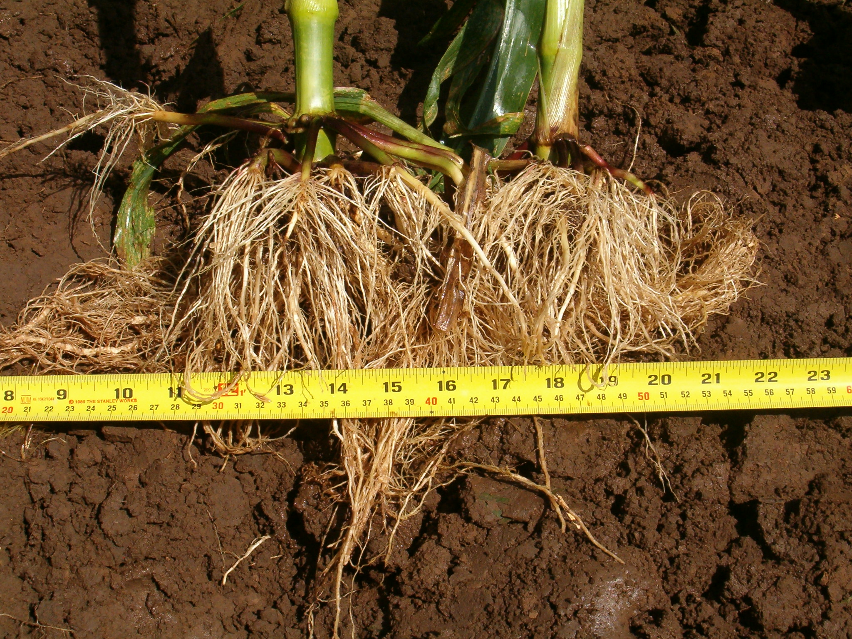

Slide 56
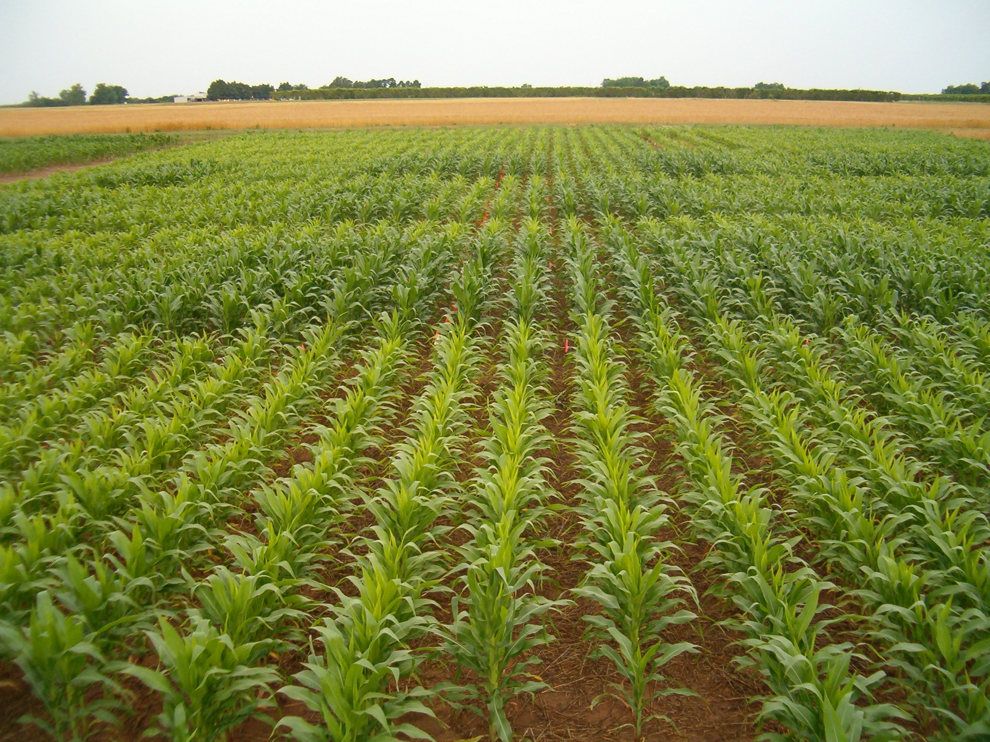

Slide 57
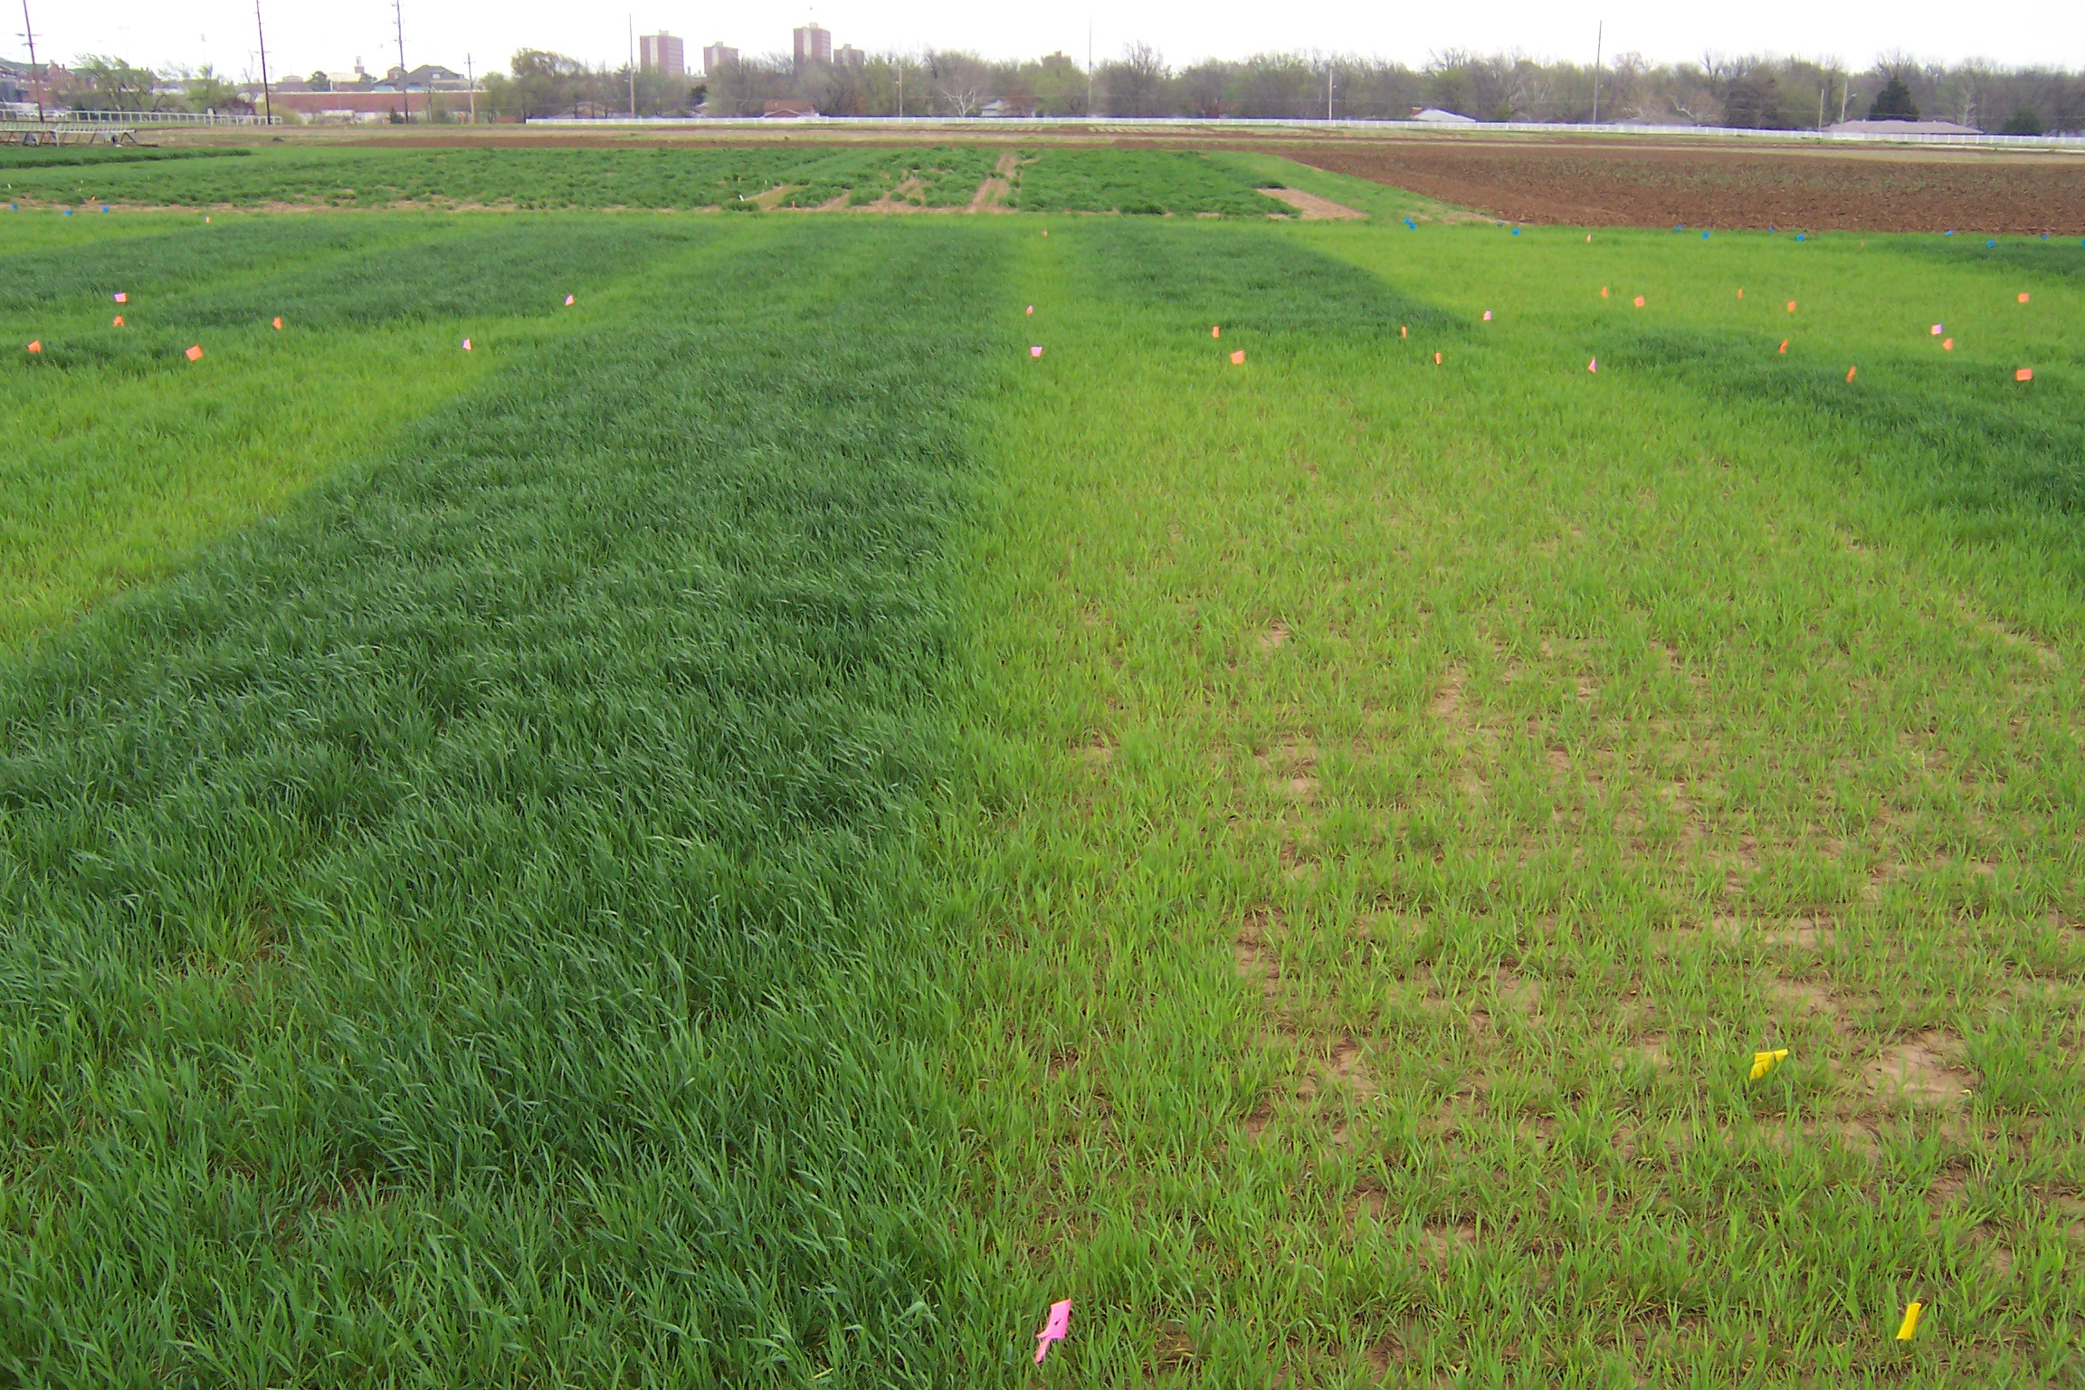

Slide 58

Impact of among-plant competition for mobile nutrients
Plants will compete among each other for mobile nutrients if they are spaced close enough together
As cropping systems increase yield by planting more densely, there will be a direct increase in demand by the crop for the mobile nutrients
If both plants are going to grow normally, it will be necessary to add more of the mobile nutrient to eliminate the competition among plants

Slide 59
Impact of among-plant competition for immobile nutrients
When plants are growing close together, there is no competition among plants for extracting immobile nutrients from the soil. This is because the plant root is extracting immobile nutrients from an extremely small volume of soil, often soil within a mm or two from the root surface
As plants grow, they obtain additional supplies of an immobile nutrient by developing more roots that will explore new volumes of soil. However, even with a large number of hair-roots developing for each plant, there is seldom found any common soil volume being explored by hair-roots of adjacent plants
Notes:
When plants are growing close together, there is no competition among plants for extracting immobile nutrients from the soil. This is because the plant root is extracting immobile nutrients from an extremely small volume of soil, often soil within a mm or two from the root surface

Slide 60
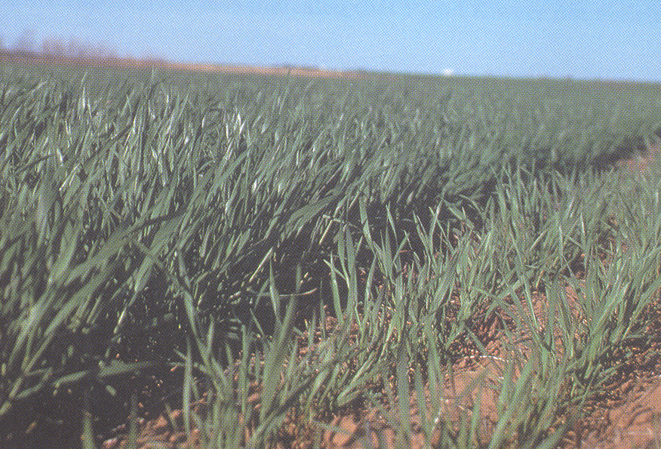
Impact of among-plant competition for immobile nutrients
What does this mean?
Immobile nutrients are extracted from only a fraction of the total surface soil volume
If a soil is 100% sufficient in supplying an immobile nutrient for a dryland crop of 60 bu/ac of corn, it will also be sufficient if the field is irrigated, and a yield of 180 bu/ac
Sufficiency: INDEPENDENT OF YIELD LEVEL

Slide 61
Combined effects of mobile and immobile nutrient deficiencies all models
Think back to “Law of the minimum”
The most limiting of mobile nutrients will determine the maximum yield possible.
N/S and water are treated as mobile nutrients
150 bu/ac N potential, 100 bu/ac S potential, 200 bu/ac water potential?

Slide 62
Combined effects of mobile and immobile nutrient deficiencies all models
Think about Mitscherlich:
Deficiencies of immobile nutrients reduce the potential yield of a site or field by “sufficiency %” factor, and identify the ultimate potential yield

Slide 63
Combining all models
200 bu/ac potential from genetics
100 bu/ac potential from Nitrogen, Sulfur, and water
75% sufficiency potential from P & K
75 bu/ac yield!

Slide 64
Combining all models
When two immobile nutrients are deficient, the expected yield will be the product of their percent sufficiency's, times the maximum possible yield
100 bu/ac crop
K 90% sufficient
P 80% sufficient
.90*.80 = 0.72
72% sufficient!

Slide 65
Combining all models
250 bu/ac potential of N
200 bu/ac potential of S
75% sufficiency of P
75% sufficiency of K
_____________

Slide 66
What evidence do we have that mobility concept works?
Natural distribution of plants in relation to availability of the mobile nutrient water, as influenced by annual rainfall

Slide 67

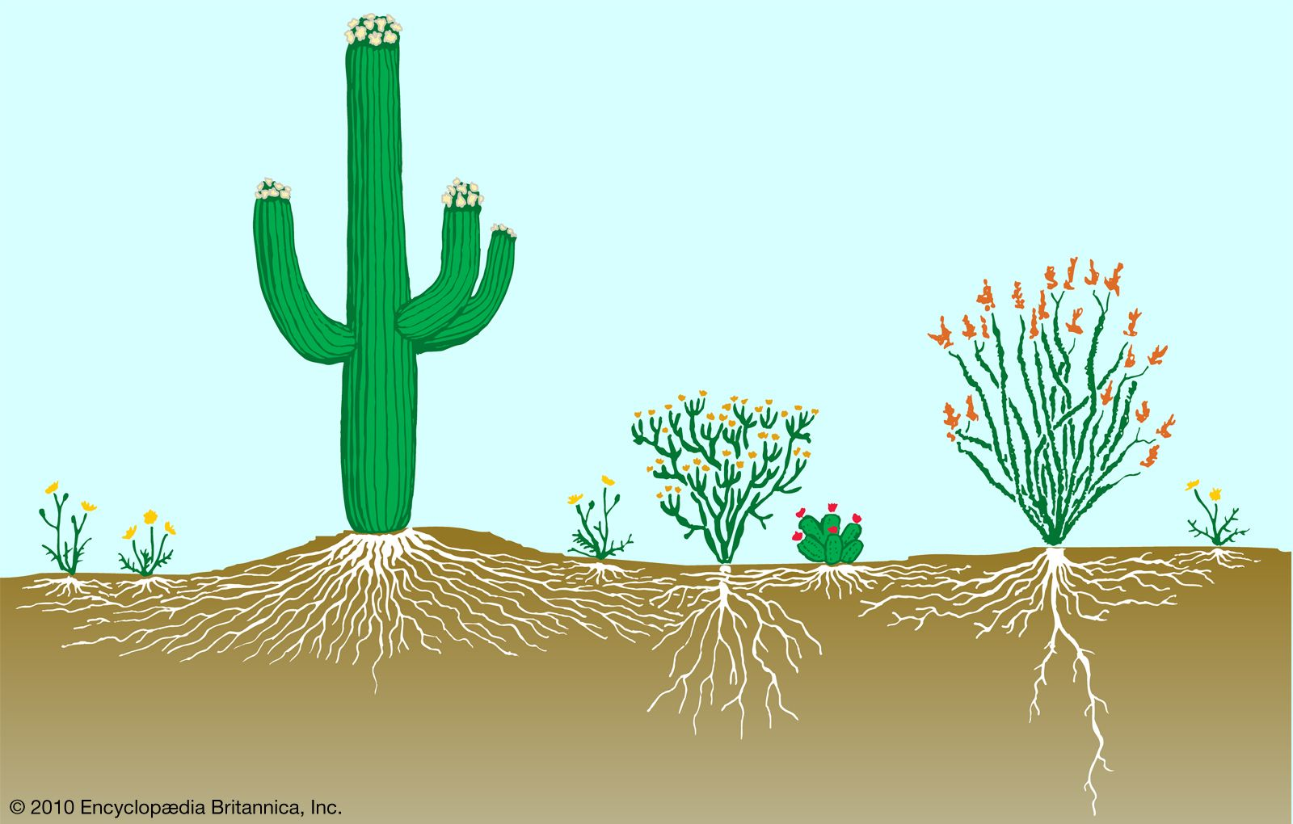

Slide 68



Slide 69
What evidence do we have that mobility concept works?
Natural distribution of plants in relation to availability of the mobile nutrient water, as influenced by annual rainfall
Desert: Spare spacing, plants will not compete for water even in the driest years
Volume of soil that receives, stores, and then provides water for plants is relatively large for each plant because this volume is only occasionally refilled
Tropical: Dense spacing, water not limiting
Volume of soil serving each plant is refilled frequently & doesn’t need to be very large

Slide 70
What can we infer from the mobility concept?
Mobile and immobile nutrients must be managed differently
Requirement for mobile nutrients is directly related to yield
In-season deficiencies of mobile nutrients can be corrected by soil addition
Availability of mobile nutrients, in the root sorption zone, changes dramatically during the growing season and from one season to another depending on the valance between external nutrient input (fertilization) and yield (harvest)
Mobile nutrients may be lost by leaching in high rainfall environments
Accurate assessment of soil supply of mobile nutrients must include surface and subsurface measurement

Slide 71
What can we infer from the mobility concept?
Requirement for immobile nutrients is related to the concentration at the root surface, and not related to the yield goal
In-season fertilization of immobile nutrient is usually no benefit.
Leaching has little impact on availability of immobile nutrients
Availability of immobile nutrients in the subsoil is of little value to meeting crop needs
Plant response to fertilizer additions of immobile nutrients will be maximized by placing the fertilizer where roots will be growing

Slide 72
Crop Response Models
Models used by scientists and general agronomists today are often simple, mathematical expressions of yield in relation to nutrient availability, but may also be very complex
Simple models are created using correlation-regression analysis that results in output of a regression equation, or model.

Slide 73
Linear response model
Linear response is described by the general expression: y = a + bx
Where
Y is yield
A is a constant (y intercept)
B is the slope
X is the level of nutrient input

Slide 74
Polynomial Model
Polynomial models have two or more terms where a constant (like the slope in the linear model) is multiplied times the value of representing the level of an available nutrient: y = a + b₁x + b₂x²
y, a, and x are the same as linear model
Two coefficients (b₁ and b₂)
Coefficients describe the slope of the line, which is not constant, but instead, changes with the change in the value x. The magnitude of the value for b₁ identifies how strong yield responds linearly to the nutrient

Slide 75
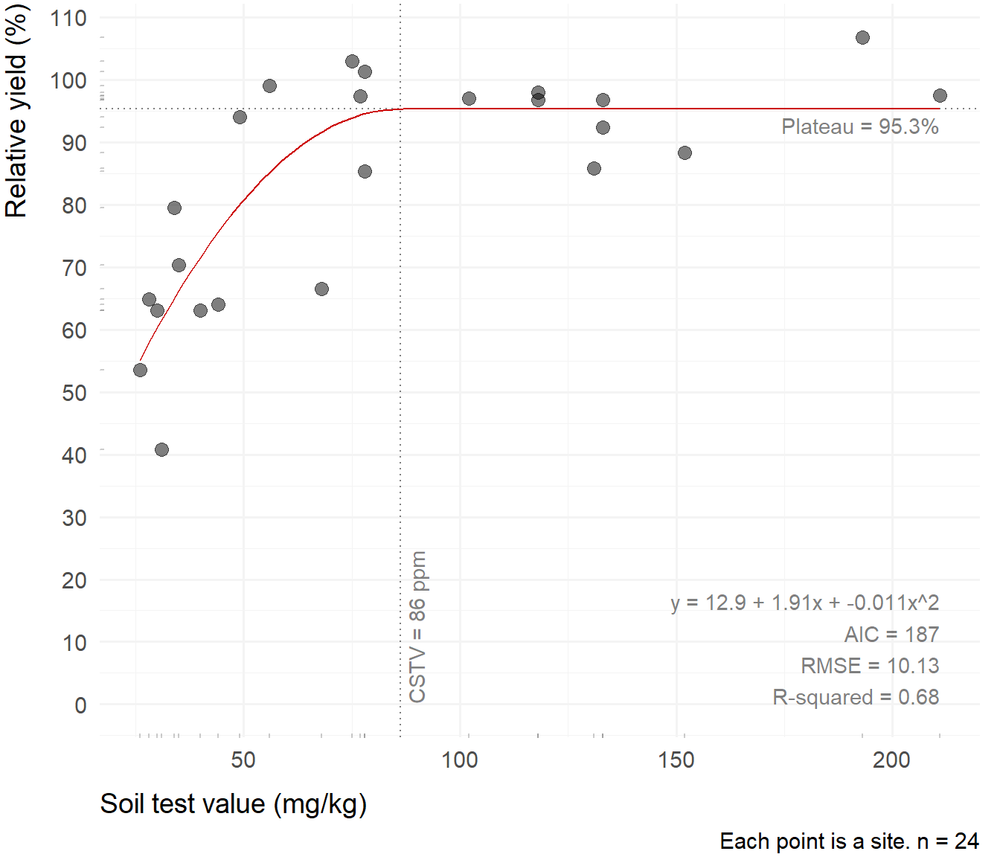
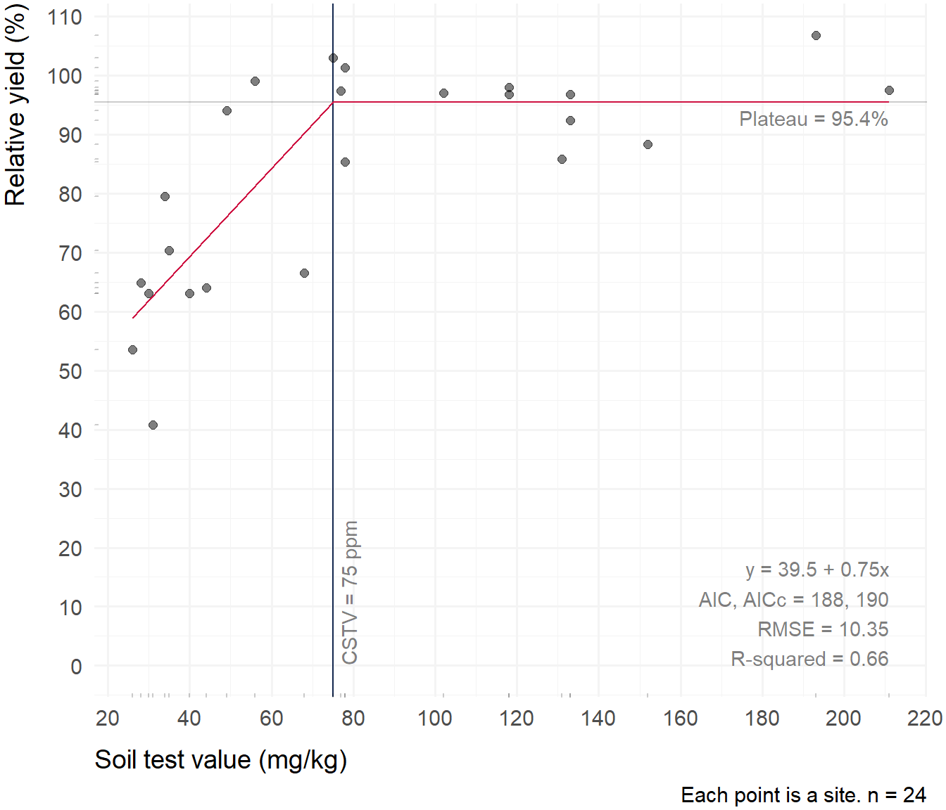
Non-Linear Models
Can be a combination of models
Linear-Plateau
Quadratic-Plateau
Many more…

Slide 76
Crop Response Models
Mobile Nutrient Response Models
Immobile Nutrient Response Models

Slide 77
Nutrient Response Interactions
When one growth factor is supplied at a higher level, it influences how plants will respond to a second limiting growth factor
Plants supplied with more water responded to fertilizer differently
Interaction between two nutrients may be either positive or negative
Sometimes the addition of the two nutrients has no interactive effect
General polynomial expression to identify interaction responses for N and P may be given as: y = a + b₁N + b₂P + b₃NP
Same as polynomial, but now take into account interactive effect of N and P
NOTE: N and P are being used as placeholders

Slide 78
NOTE: N and P are being used as placeholders

Slide 79
Yield response to N and P when there is no NxP interaction

Slide 80
Yield response to N and P when there is a positive NxP interaction

Slide 81
Yield response to N and P when there is a negative NxP interaction

Slide 82
Summary
Available soil nutrients are commonly under the control of farmers, crop production managers, and other non-food plant managers
Plant response to correcting deficient soil nutrients can generally be described by considering whether nutrients are mobile or immobile in the soil
Mobile soil nutrients (like water) impose the first limit to plant growth
Deficiencies of immobile nutrients impose a secondary yield limit as a percentage of the maximum yield possible
The ease of which computers have allowed evaluation of how crops respond to changing levels of nutrients and other growth factors, has led to the generation of many types of models, or mathematical expressions describing the responses. These models help managers estimate yield potential and the degree to which their crop may respond to increases in nutrient input.

Slide 83


