Slide 1
Chapter 10: Fertilizer Recommendations/Calculations

Slide 2
Fertilizer Recommendations
Understand the theory of Fertilizer Recommendations
Accumulation of all information we have learned this semester
Taking information from soil test analysis, and turn that into an actionable plan
Steps to make fertilizer recommendations
Read soil test report, determine what nutrient you need
Determine amount of each nutrient needed
Determine fertilizer sources available
Calculate fertilizer amounts
Calculate fertilizer costs

Slide 3
Why do Fertilizer Recommendations Suck?

Slide 4
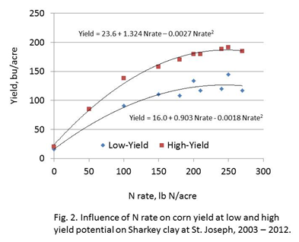
Nitrogen Recommendations
Row Crops + Non-legume Forages + In Horticulture crops
Rate Studies
3-5 rates
Fertilizer is applied to Maximize Yield
Economics
Rates are going to be in lb/ac or lb/sq ft for yield

Slide 5
Nitrogen Recommendations
Turf
Rate studies to maximize growth and durability
Too little nitrogen, doesn’t look good.
Too much nitrogen, turf won’t stand up to repeated wear and use
Forestry/Ornamental/Horticulture
Optimize Yield/appearance, not necessarily based on a yield component

Slide 6
Phosphorus and Potassium Recommendations
Correlation/Calibration

Slide 7
Correlation

Slide 8
Calibration

Slide 9
Phosphorus and Potassium Recommendations
Correlation/Calibration
Replacement
C/C + Replacement
Yield Goal

Slide 10
Other Recommendations
Lime
Correlate yield to different pH values
Calibrate lime incubations (take weeks) to
Micronutrients
Must get a response SOMEWHERE, in order to investigate

Slide 11
Where does it go wrong?

Slide 12
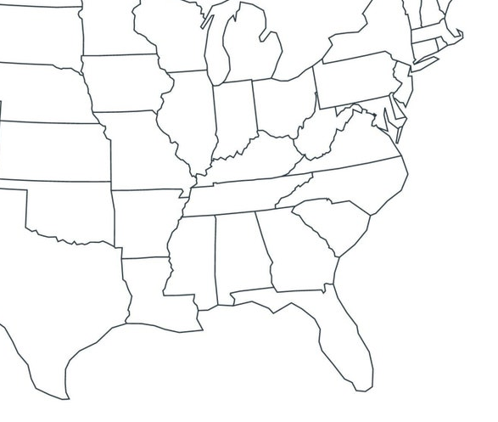

Slide 14
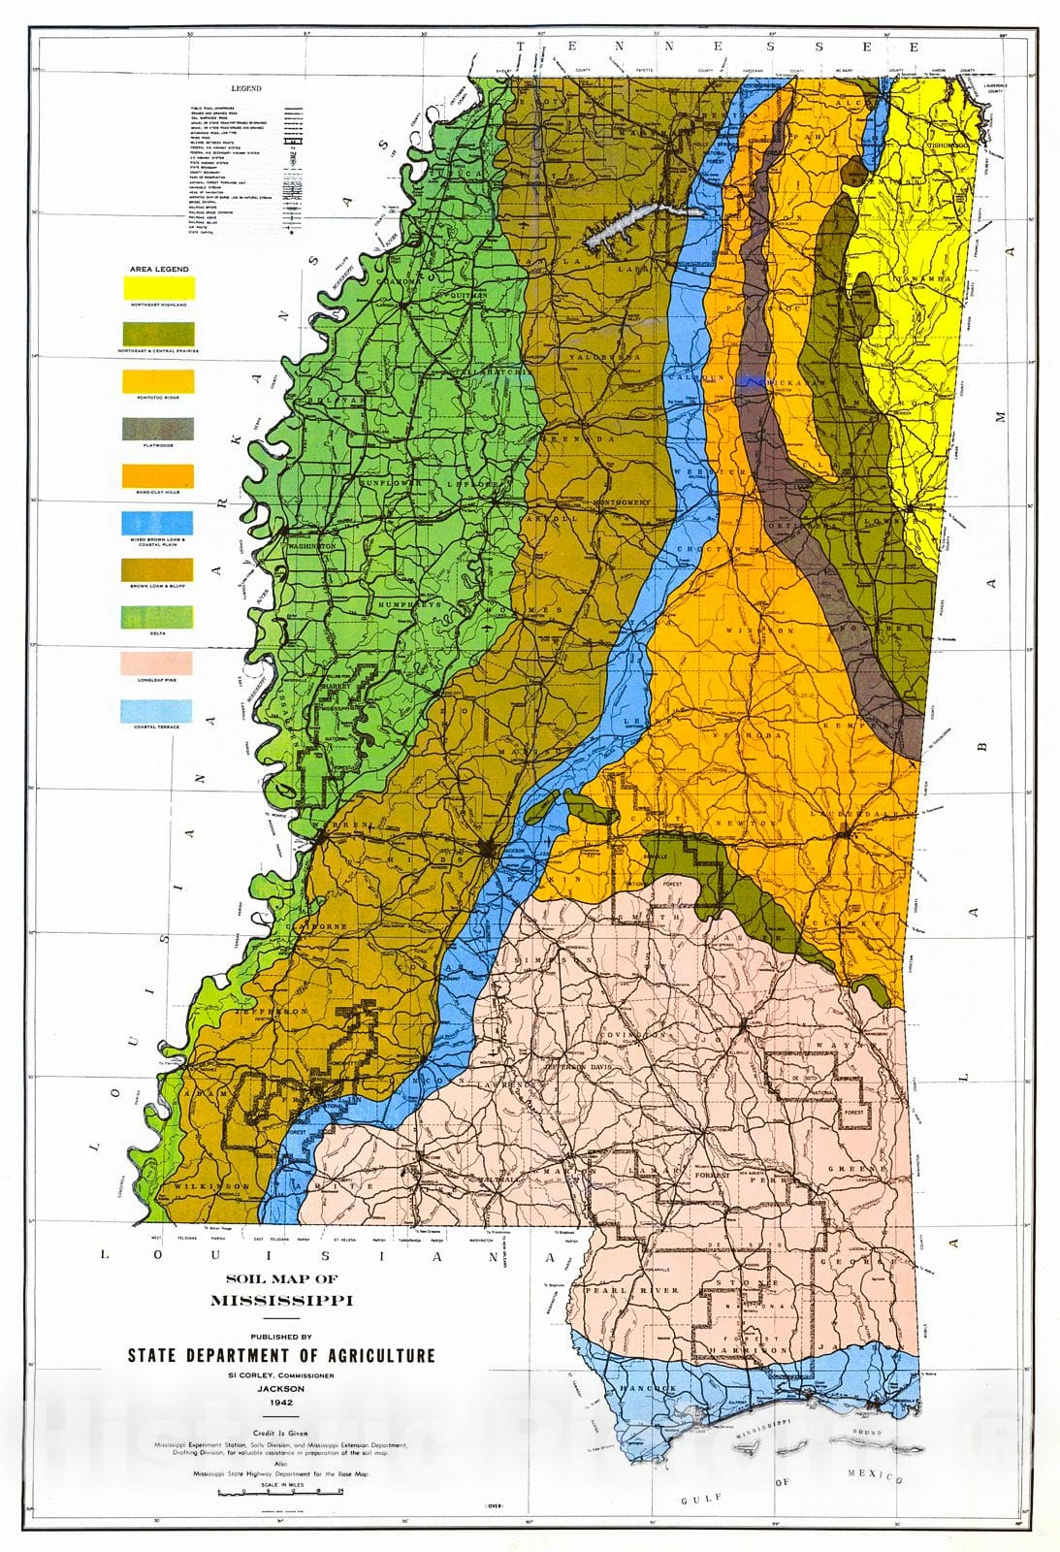
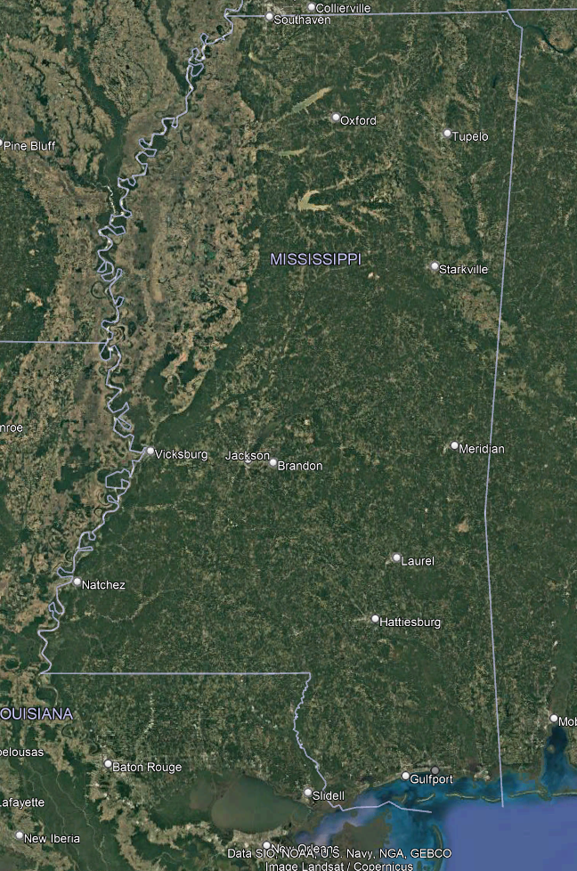

Slide 15
Correlation

Slide 16
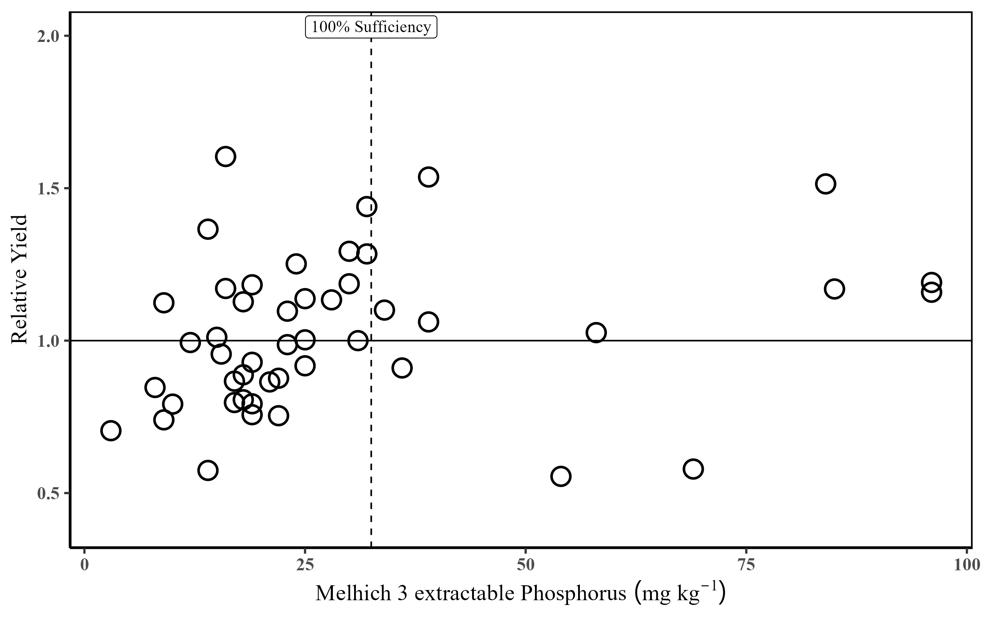

Slide 17
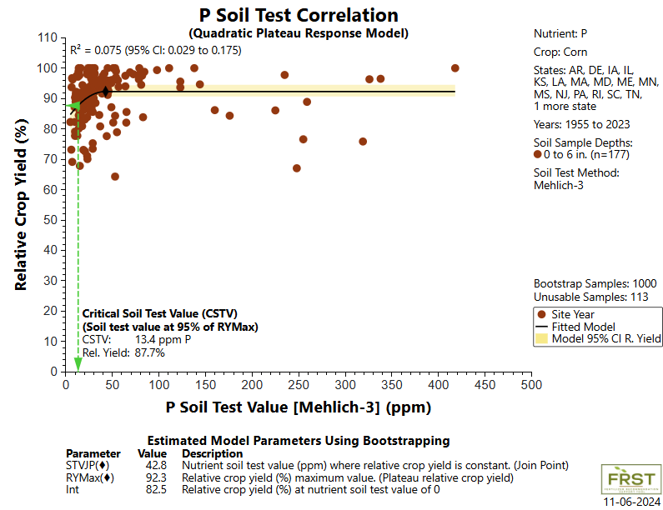

Slide 18
Okay, so we can’t make ONE recommendation across a state, what about a recommendation for a field or a region?

Slide 19
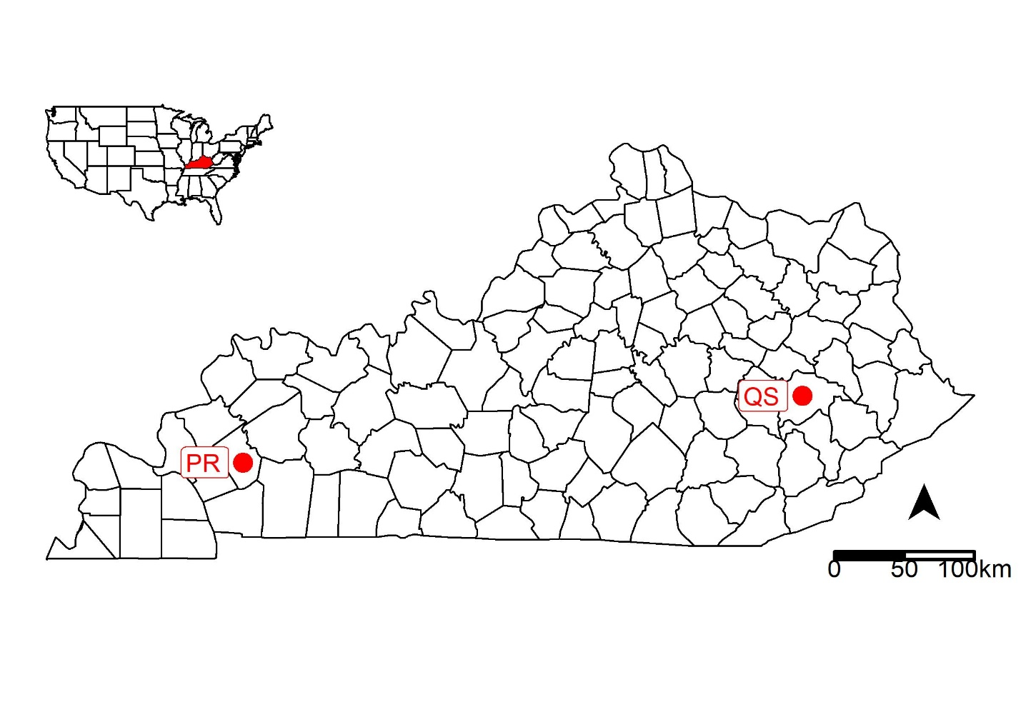

Slide 20
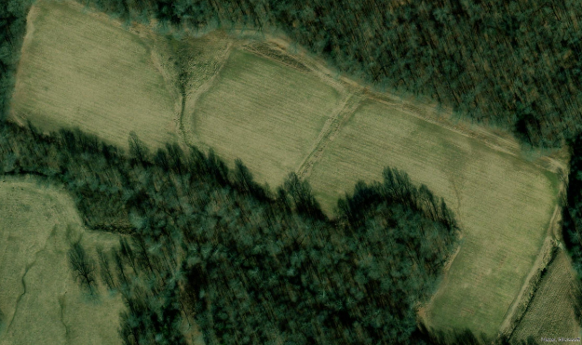
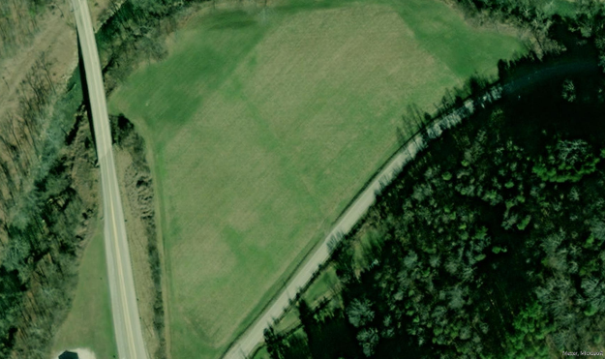
12 ac
6 ac

Slide 21
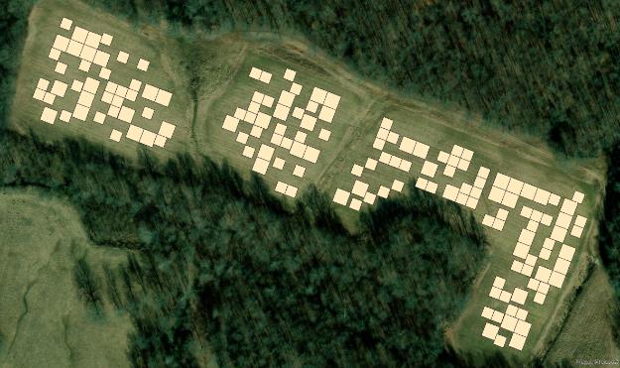
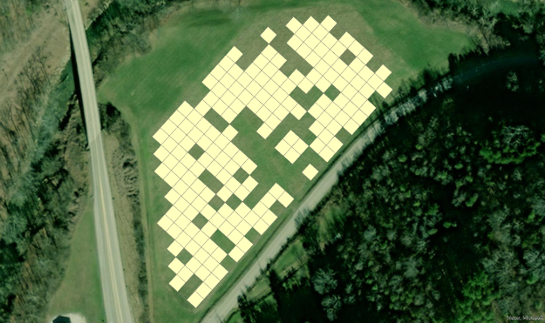

Slide 22
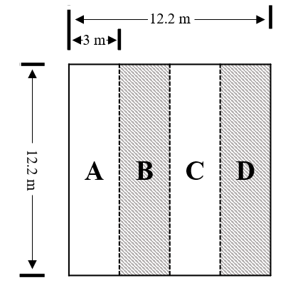
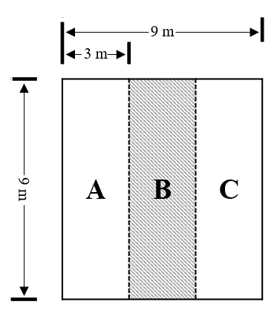
900 sq ft, 0.02 ac

Slide 23
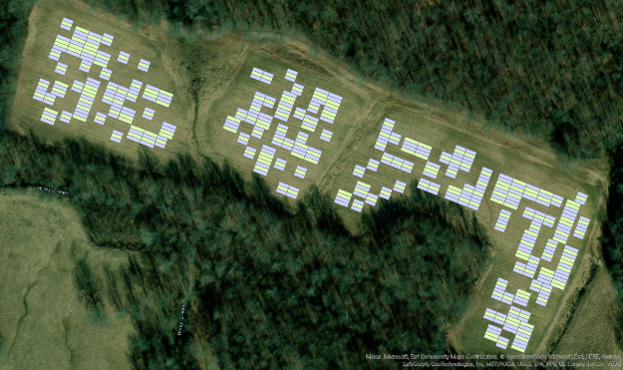
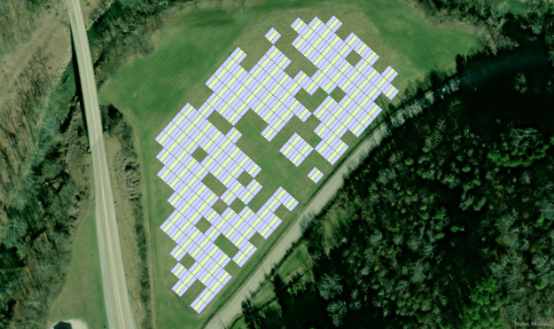

Slide 24
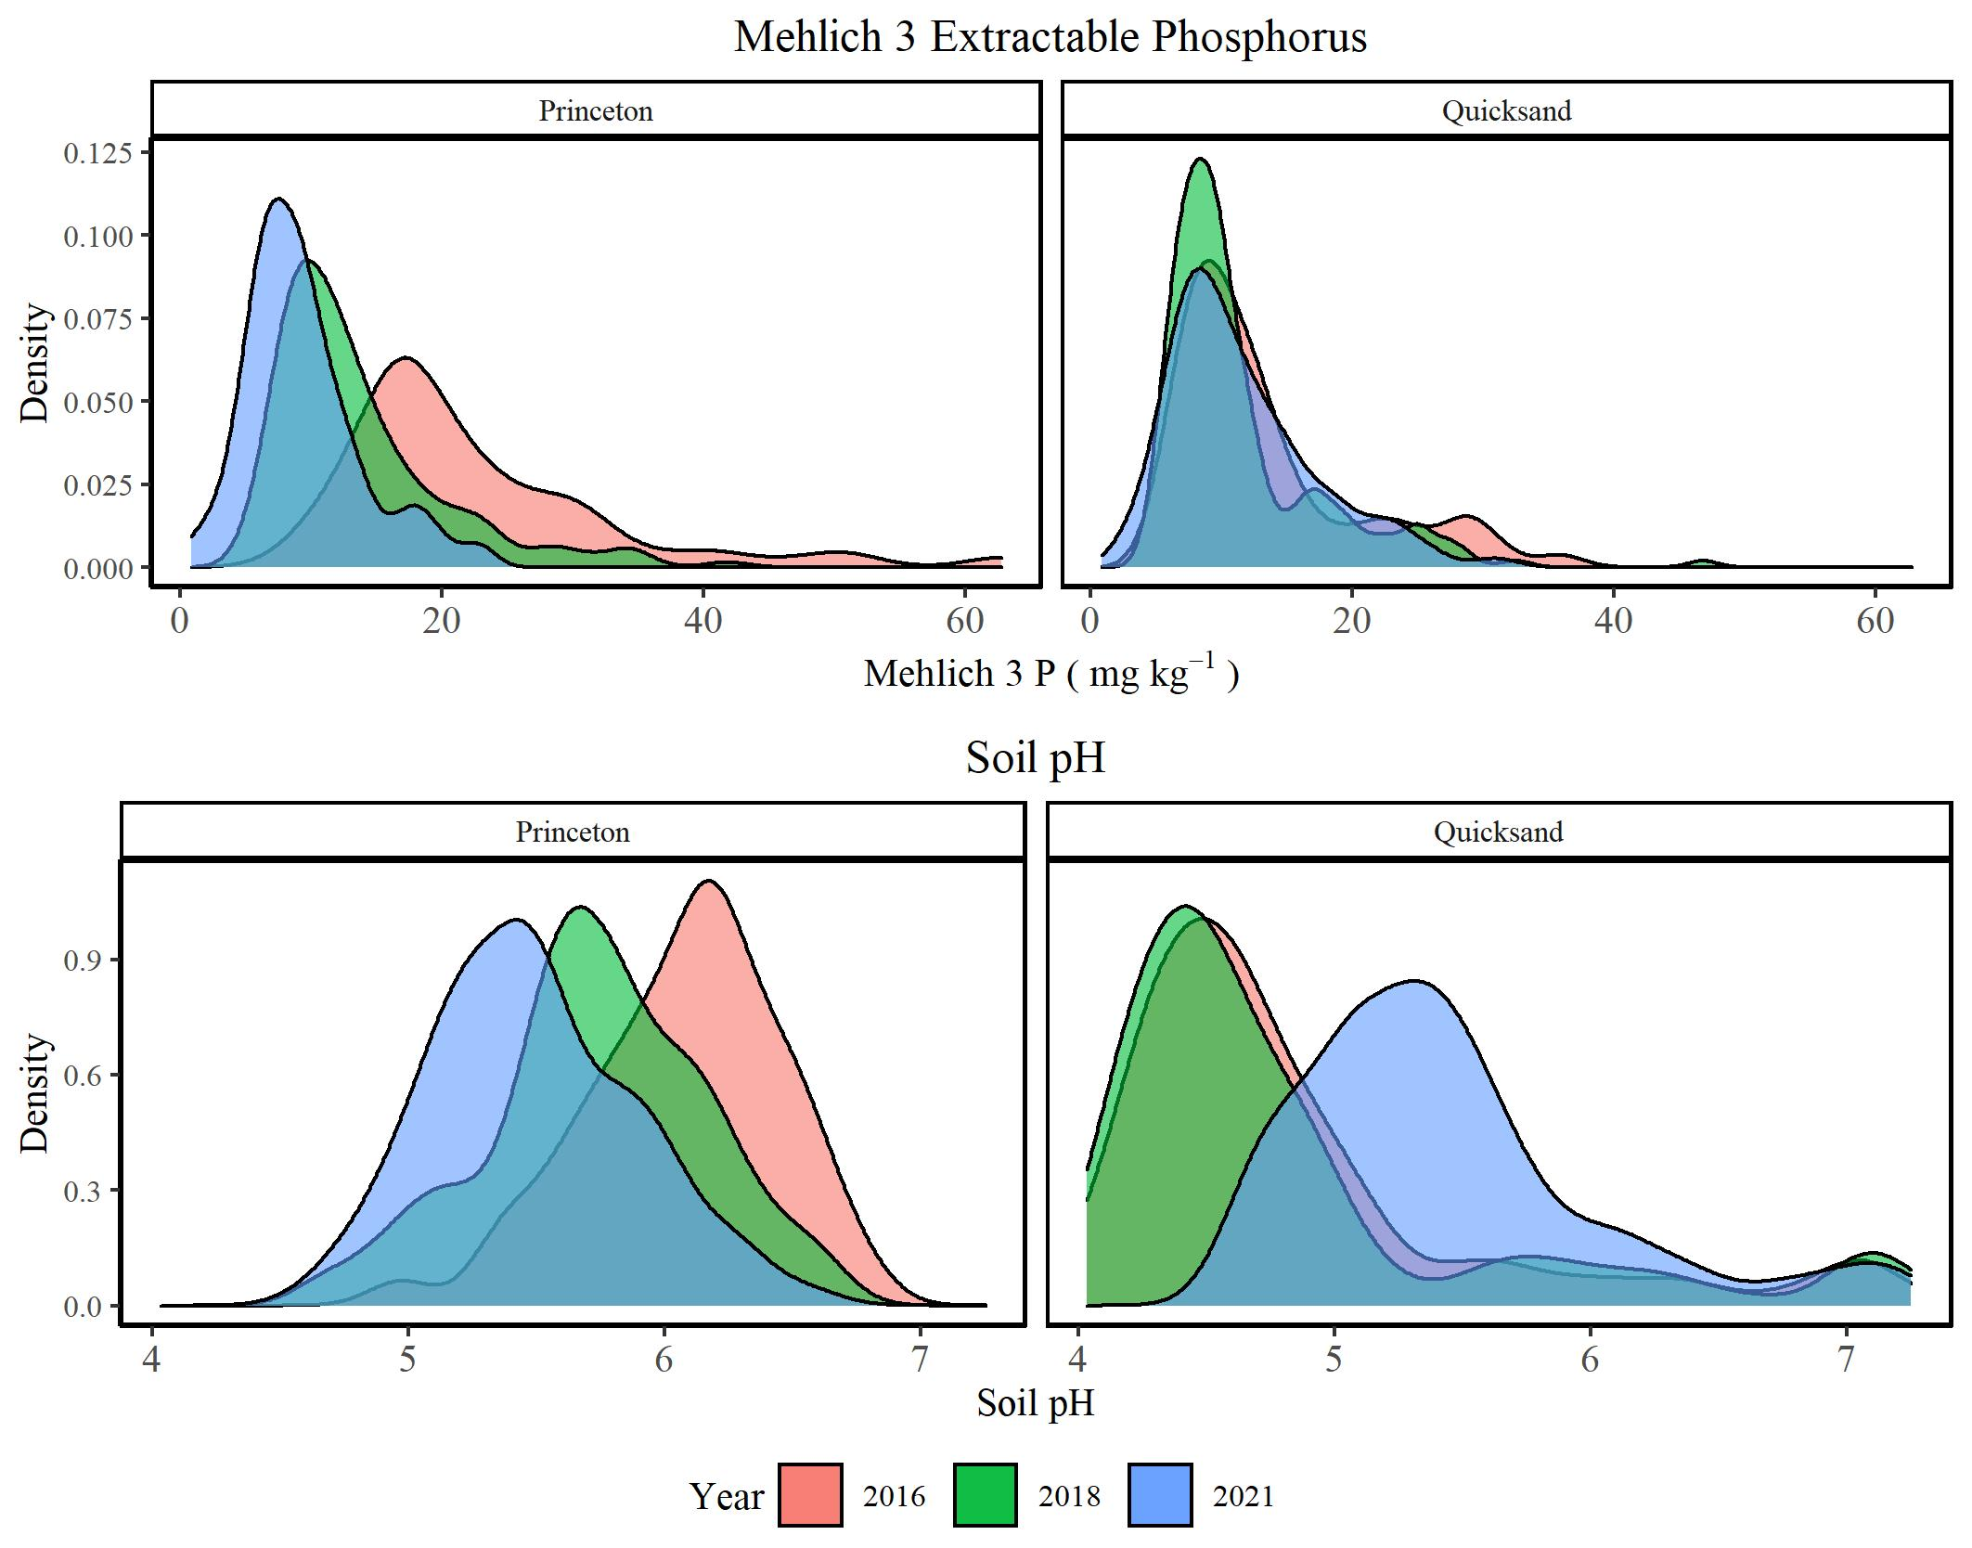

Slide 25

How accurate were recommendations
Year | STP (UK 100%: 30 ppm) | Recommendations | Yield w/o P fertilizer | Yield with P Fertilizer
2016 | 12 ppm | 80 lb P₂O₅ ac⁻¹ | 176 bu ac⁻¹ | 186 bu ac⁻¹
2018 | 11 ppm | 90 lb P₂O₅ ac⁻¹ | 233 bu ac⁻¹ | 243 bu ac⁻¹
2020 | 11 ppm | 80 lb P₂O₅ ac⁻¹ | 158 bu ac⁻¹ | 171 bu ac⁻¹
2021 | 12 ppm | 80 lb P₂O₅ ac⁻¹ | 128 bu ac⁻¹ | 141 bu ac⁻¹
Accurate =
Precise = ???

Slide 26
Relative Yield
Check/Yield
<1 = Yield > Check
Responsive
Relative Yield < 0.95

Slide 27
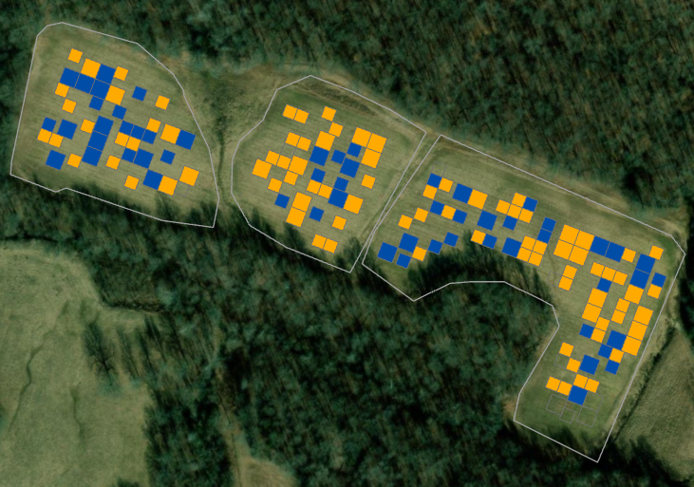
2020
2016
2018

Slide 28
2020
2016
2018

Slide 29
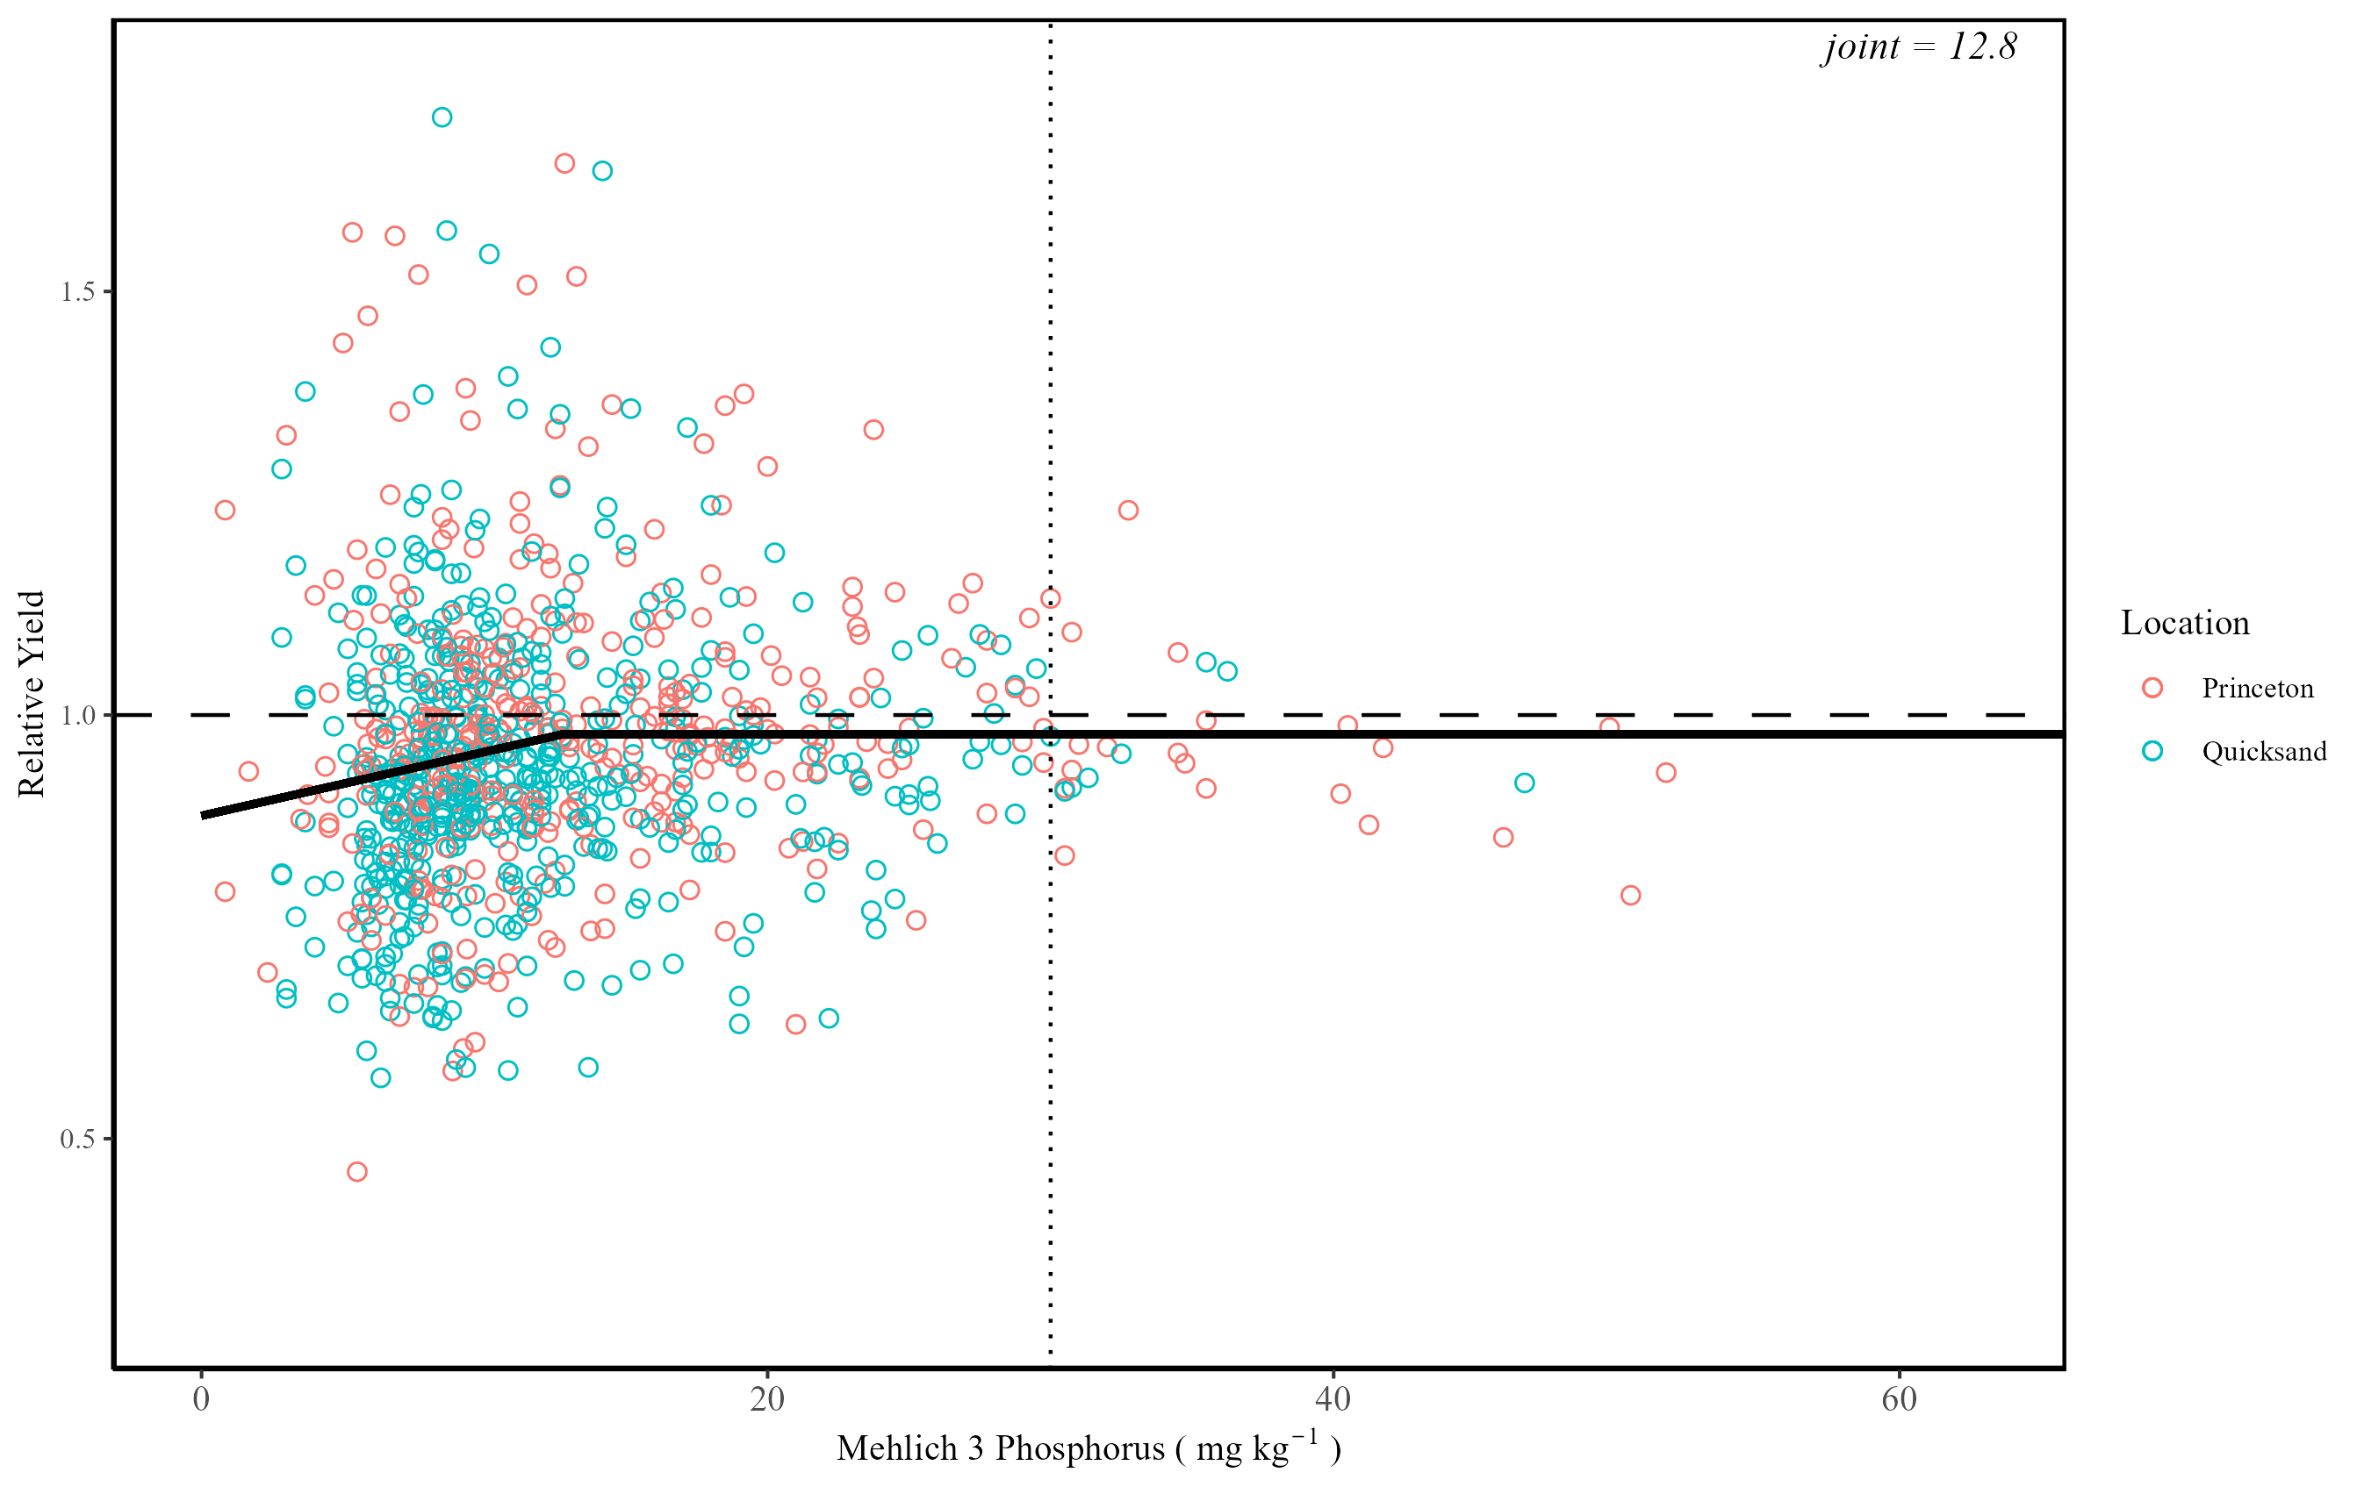

Slide 30
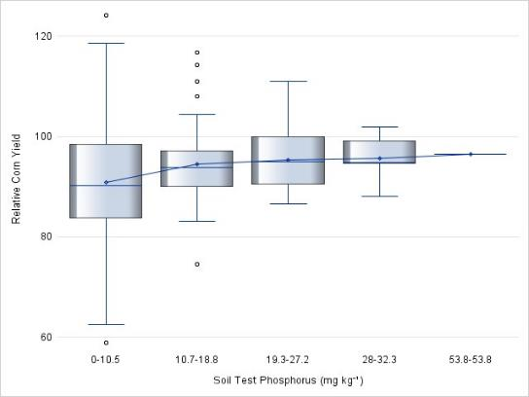
Variance decreases as soil P increases
Above threshold doesn’t mean no response…
Just less chance of it occurring

Slide 31
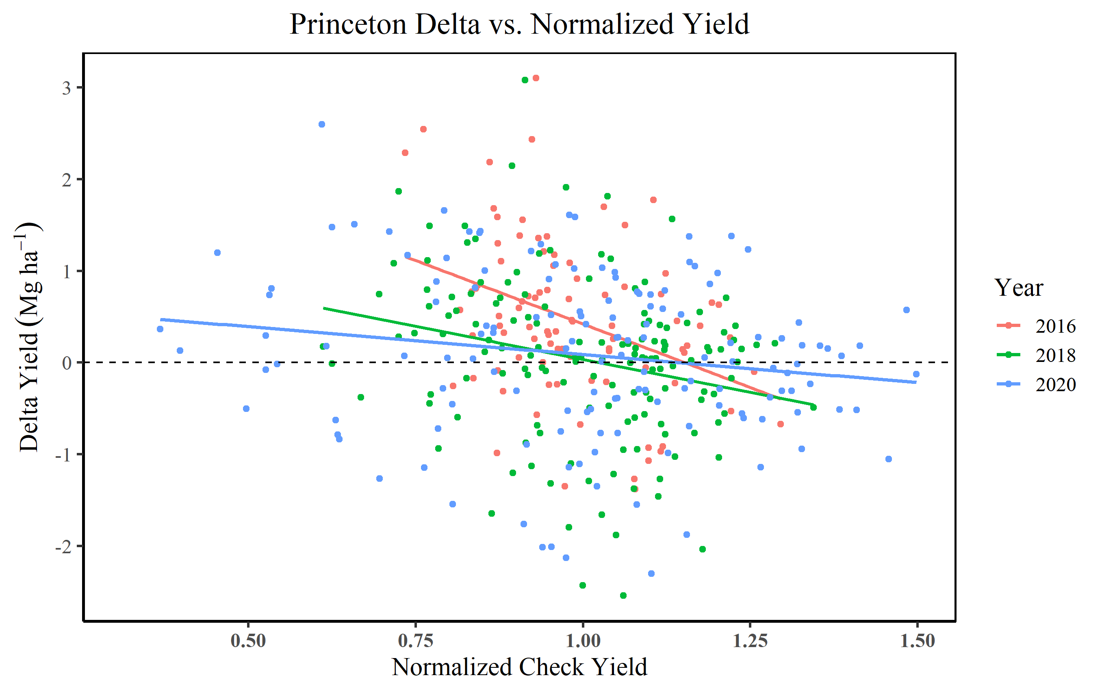

Slide 32
Best parts of the field do not have yield response
Worse parts of the field have the most yield response
???
But whats driving it

Slide 33
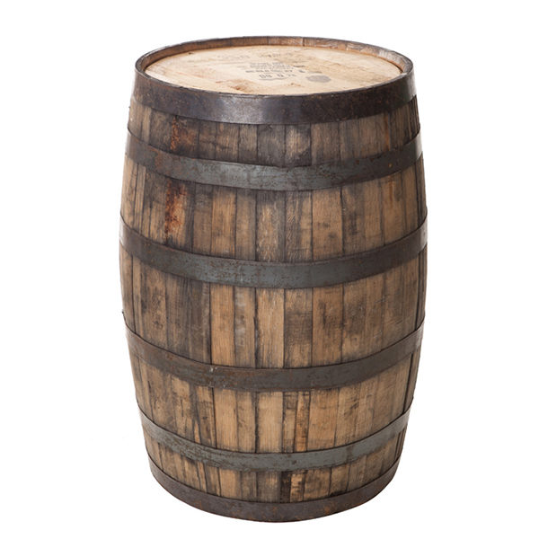

Slide 34
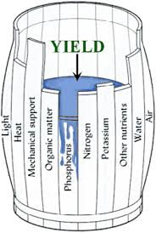
?
?
?

Slide 35
https://frst.scinet.usda.gov/tool

Slide 36
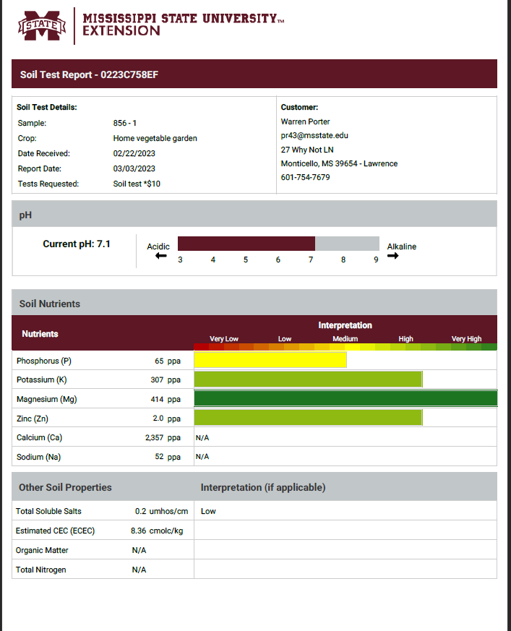

Slide 38
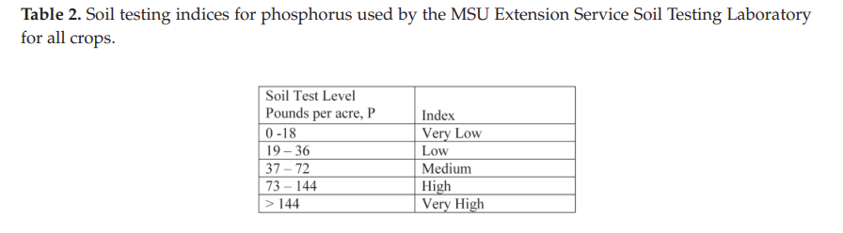
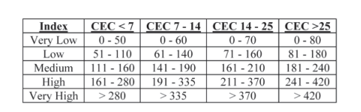
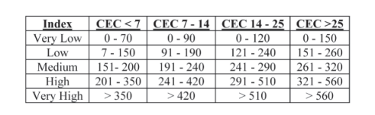
Soil Test Potassium (K)
Dryland corn, soybean, pasture, wheat
Irrigated corn, cotton, sweet potatoes, bermudagrass

Slide 39
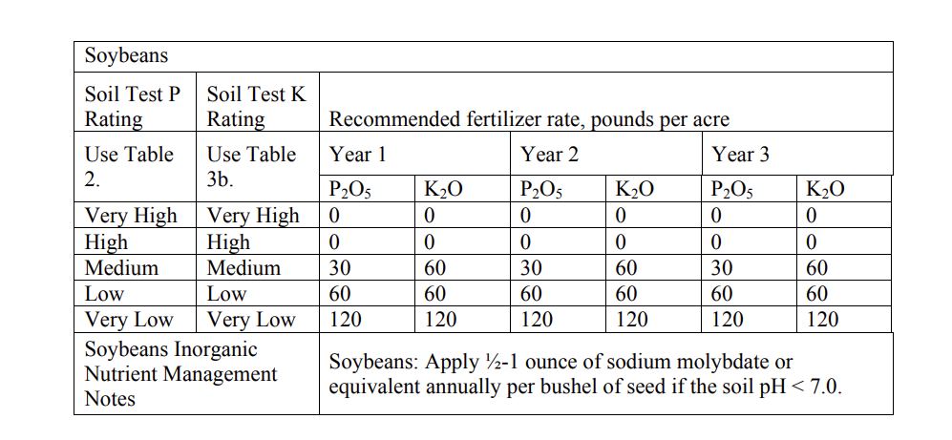

Slide 40
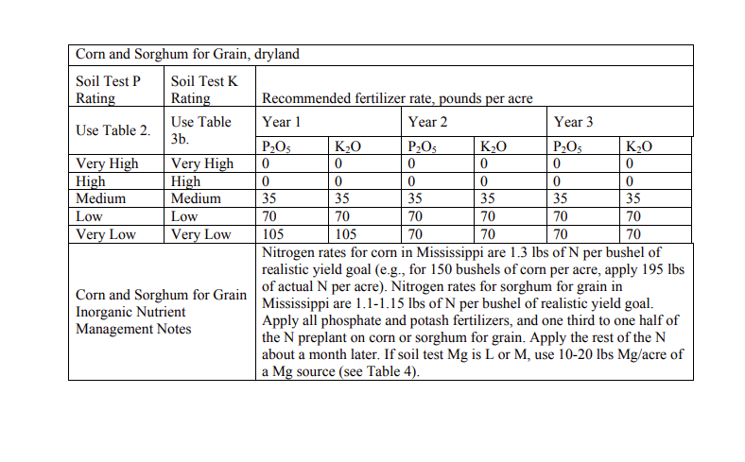

Slide 41
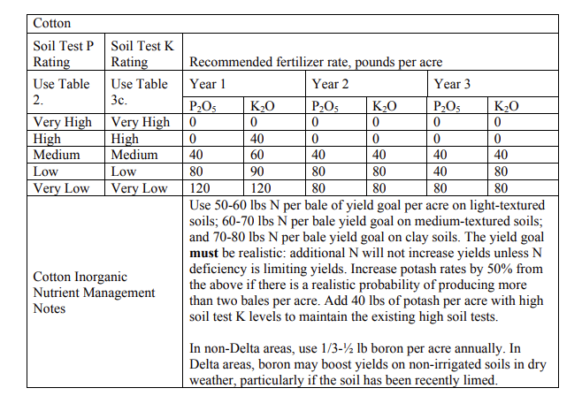

Slide 42
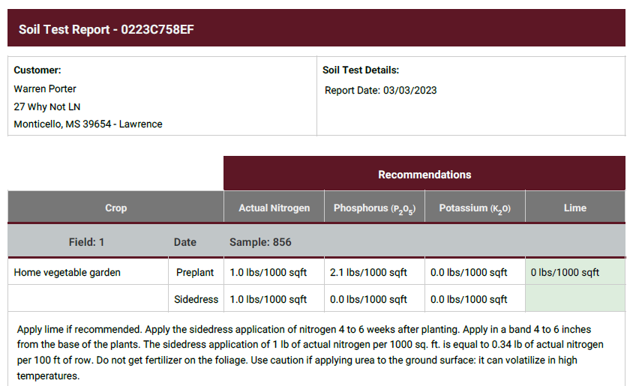

Slide 43
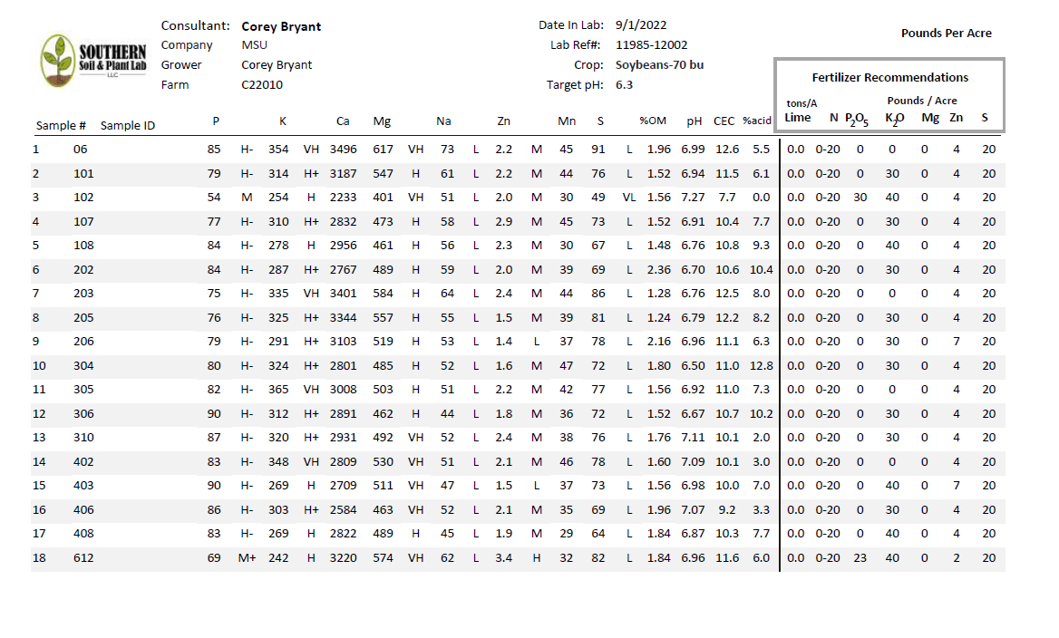

Slide 44
YOUR Soil Test

Slide 45
Steps to fertilizer recommendations
Read soil test report, determine what nutrient you need
Determine amount of each nutrient needed
Determine fertilizer sources available
Calculate fertilizer amounts
Start with mixed fertilizer sources first (more than one nutrient), making sure to “solve” for nutrient of highest analysis
11-52-0 – Solve for P requirement first
Then move to lowest nutrient provided of mixed analysis
11-52-0 – Solve for N next
Solve for remaining nutrients and fertilizer sources

Slide 46
Steps to fertilizer recommendation calculations
Irrigated corn, 275 bushel/ac potential
60 acre field
27 STP
68 STK
13 CEC
6.7 pH
Sources of fertilizer:
Urea (46-0-0)
DAP (18-46-0)
Potash (0-0-60)

Slide 47
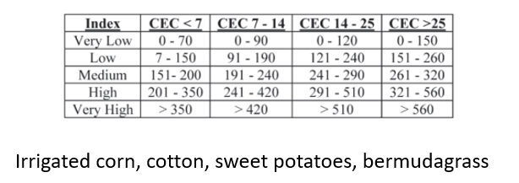
Irrigated corn, 275 bushel/ac potential
60 acre field
27 STP
68 STK
13 CEC
6.7 pH
P – Low
K – Very Low

Slide 48
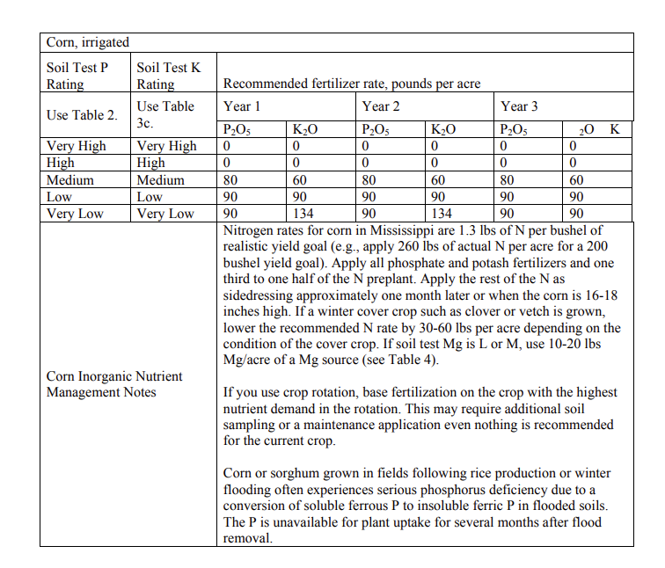
275 bu/ac * 1.3 lb N/bu = 357.5 lb N/ac
Irrigated corn, 275 bushel/ac potential
60 acre field
27 STP
68 STK
13 CEC
6.7 pH
P – Low
K – Very Low

Slide 49
Irrigated corn, 275 bushel/ac potential
60 acre field
27 STP
68 STK
13 CEC
6.7 pH
357.5 lb N/ac
90 lb P/ac
134 lb K/ac
Sources of fertilizer:
Urea (46-0-0)
DAP (18-46-0)
Potash (0-0-60)

Slide 50
Steps to fertilizer recommendations
Read soil test report, determine what nutrient you need
Determine amount of each nutrient needed
Determine fertilizer sources available
Calculate fertilizer amounts
Start with mixed fertilizer sources first (more than one nutrient), making sure to “solve” for nutrient of highest analysis
11-52-0 – Solve for P requirement first
Then move to lowest nutrient provided of mixed analysis
11-52-0 – Solve for N next
Solve for remaining nutrients and fertilizer sources

Slide 51
357.5 lb N/ac
90 lb P/ac
134 lb K/ac
90 lb P/ac ÷ .46 lb P/ lb DAP = 195 lb DAP / ac
195 lb DAP/ac × .18 lb N/lb DAP = 35 lb N/ac
Sources of fertilizer:
Urea (46-0-0)
DAP (18-46-0)
Potash (0-0-60)
357.5 lb N/ac – 35 lb N/ac = 322.5 lb N/ac
322.5 lb N/ac ÷ .46 lb N/lb urea = 701 lb Urea/ac
134 lb K/ac ÷ .60 lb K/lb potash = 223 lb Potash/ac

Slide 52
Irrigated corn, 275 bushel/ac potential
60 acre field
27 STP
68 STK
13 CEC
6.7 pH
357.5 lb N/ac
90 lb P/ac
134 lb K/ac
Sources of fertilizer:
Urea (46-0-0)
DAP (18-46-0)
Potash (0-0-60)
11,700 lb DAP
42,060 lb Urea
13,380 lb Potash
195 lb DAP / ac
701 lb Urea / ac
223 lb Potash/ac

Slide 53
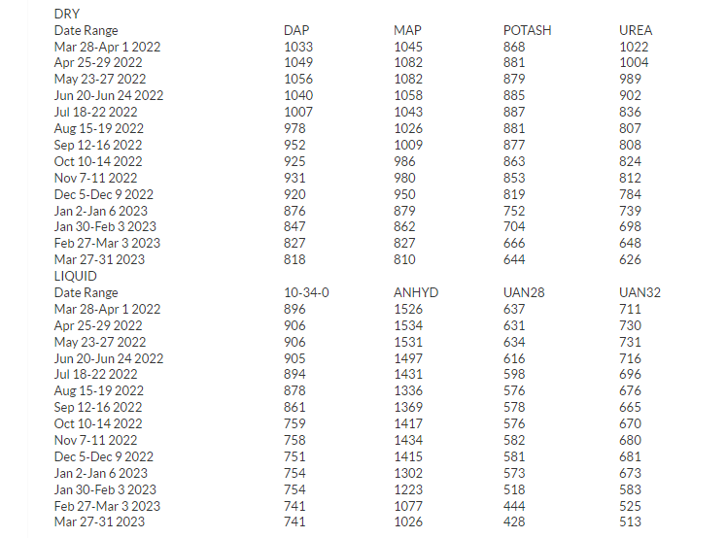
Estimating Fertilizer Cost
Progressive Farmer is a great source for fertilizer prices
https://www.dtnpf.com/agriculture/web/ag/crops/article/2025/04/23/uan32-retail-price-9-uan28-price-7

Slide 54
Estimating Fertilizer Cost
Priced at $/ton
For dry fertilizer, convert pounds to tons
195 lbs DAP/ac, DAP is $821/ton
195 lbs = 0.0975 tons
0.0975 tons/ac * $821/ton = $80.05/ac

Slide 55
DAP $821/ton
Urea $627/ton
Potash $645/ton
Irrigated corn, 275 bushel/ac potential
60 acre field
27 STP
68 STK
13 CEC
6.7 pH
357.5 lb N/ac
90 lb P/ac
134 lb K/ac
Sources of fertilizer:
Urea (46-0-0)
DAP (18-46-0)
Potash (0-0-60)
11,700 lb DAP
42,060 lb Urea
13,380 lb Potash
195 lb DAP / ac
701 lb Urea / ac
223 lb Potash/ac
DAP – $80.05 / ac
Urea – $219.76 / ac
Potash – $71.92 / ac

Slide 56
Cotton, 2.5 bale potential, medium textured soil
120 acre field
63 STP
243 STK
18 CEC
DAP $821/ton
Urea $627/ton
Potash $645/ton
Sources of fertilizer:
Urea (46-0-0)
DAP (18-46-0)
Potash (0-0-60)
K

Slide 57
DAP $821/ton
Urea $627/ton
Potash $645/ton
Cotton, 2.5 bale potential, medium textured soil
120 acre field
63 STP
243 STK
18 CEC
Sources of fertilizer:
Urea (46-0-0)
DAP (18-46-0)
Potash (0-0-60)
Fertilizer | Application (lb/ac) | Cost ($/ac) | Total Application (ton)
Urea | 345 | $108.16 | 20.7
DAP | 87 | $35.70 | 5.2
Potash | 100 | $32.25 | 6

Slide 58
Liquid Fertilizer Recommendations
With liquid fertilizer, we apply based on gallons per acre (gpa), so we have to take into account density of fertilizer
UAN 32-0-0
11.06 lb/gal
32% N
3.54 lb N/gal
APP 10-34-0
11.65 lb/gal
10% N, 34% P
1.17 lb N/gal 3.96 lb P/gal
UAN: $514/ton
APP: $740/ton

Slide 59
UAN: $514/ton
APP: $740/ton
Irrigated corn, 225 bushel/ac potential
60 acre field
27 STP
250 STK
13 CEC
6.7 pH
293 lb N/ac
90 lb P/ac
0 lb K/ac
UAN 32-0-0
11.06 lb/gal
32% N
3.54 lb N/gal
APP 10-34-0
11.65 lb/gal
10% N, 34% P
1.17 lb N/gal 3.96 lb P/gal
.3:1 ratio APP:UAN mix, applied at 97.7 GPA (or split apply)
22.7 gal APP/ac
90 lb P, 26.5 lb N
75 gal UAN/ac
267 lb N
APP: $98 / ac
UAN: $213 / ac

Slide 60
Cotton, 2.25 bale potential, heavy textured soil
150 acre field
15 STP
156 STK
27 CEC
UAN: $514/ton
APP: $740/ton
Potash $645/ton
Sources of fertilizer:
UAN (32-0-0)
APP (10-34-0)
Potash (0-0-60)
K

Slide 61
Steps to fertilizer recommendations
Read soil test report, determine what nutrient you need
Determine amount of each nutrient needed
Determine fertilizer sources available
Calculate fertilizer amounts
Start with mixed fertilizer sources first (more than one nutrient), making sure to “solve” for nutrient of highest analysis
11-52-0 – Solve for P requirement first
Then move to lowest nutrient provided of mixed analysis
11-52-0 – Solve for N next
Solve for remaining nutrients and fertilizer sources

Slide 62
Calibration of Fertilizer Applicators
Must calibrate in order to know how much you are applying at one time
Differs, depending on source of fertilizer applied, and how its being applied

Slide 63
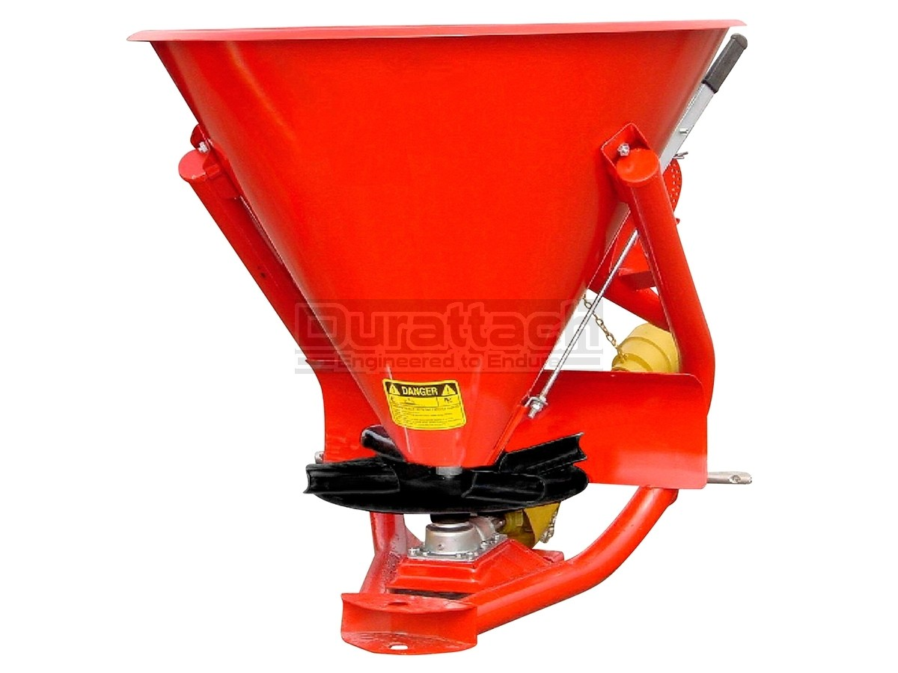
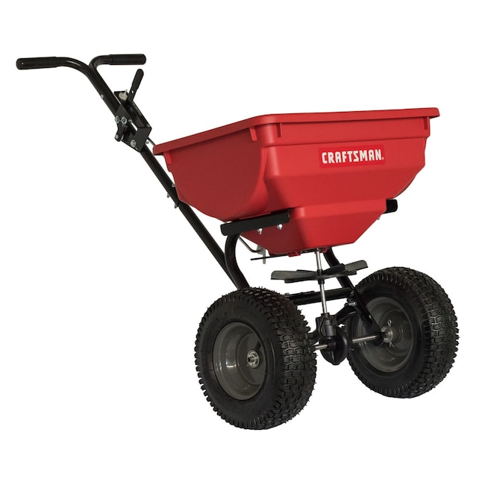
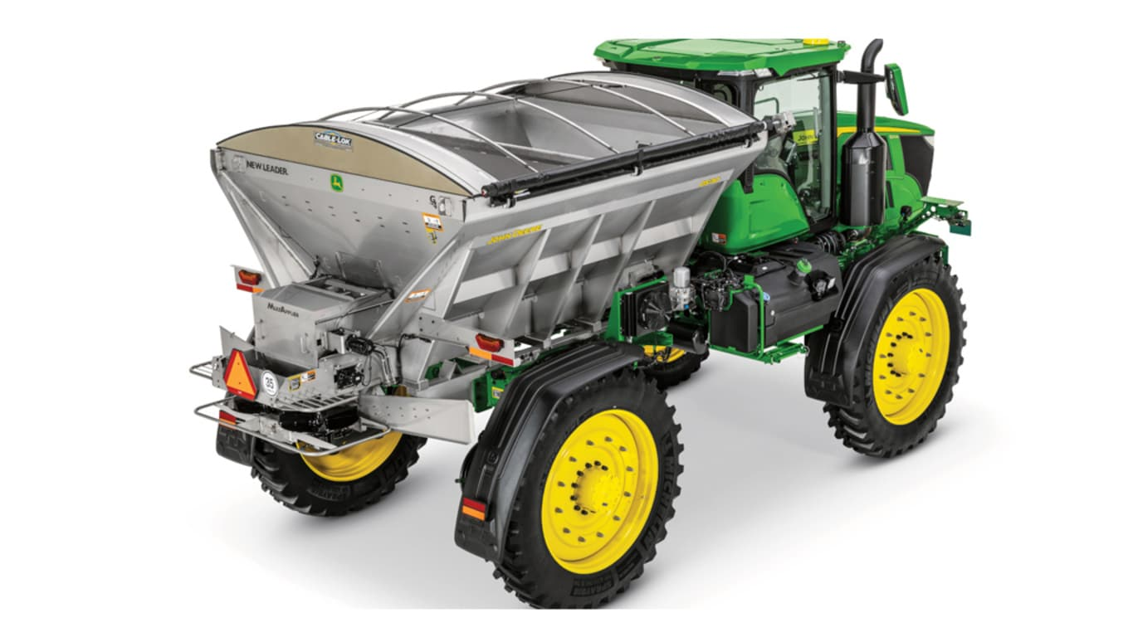
Dry Fertilizer: Spinner Spreader
Doesn’t matter the size, calibration is all the same
Fertilizer recommendation is weight/area
To calibrate, we want to weigh how much fertilizer comes out over an “area”

Slide 64
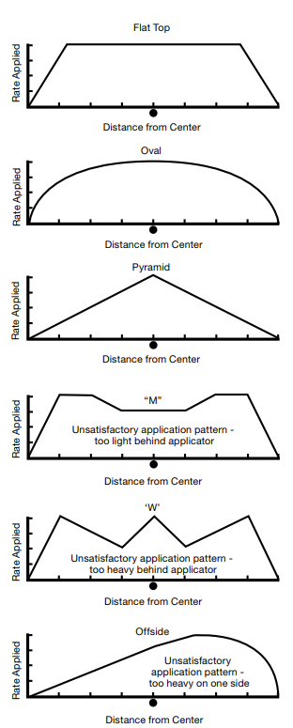
Dry Fertilizer: Spinner Spreader
Know your spread distance and distribution
Want a fairly uniform distribution across the majority of the spread pattern
Pattern will allow you to know if/how much of an overlap you need to have
Spread distance is important to know how much fertilizer is spread over the area

Slide 65
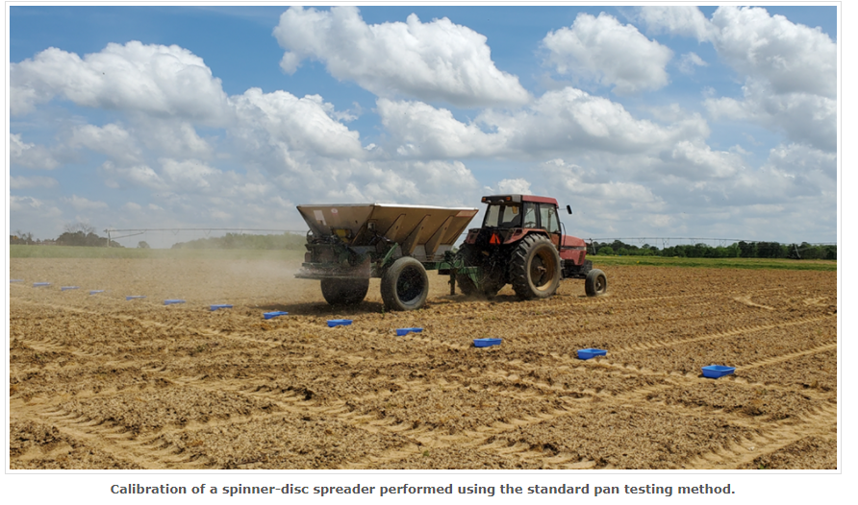
Dry Fertilizer: Spinner Spreader

